Slide 1
Outlier Detection for High-Dimensional Neuroimaging Data
Myriam Lizotte
McGill University, Dept. Mathematics & Statistics
Prof. Celia Greenwood’s Lab

Slide 2
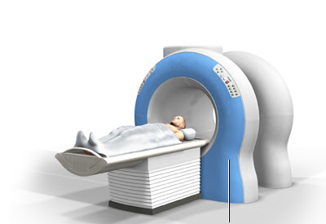
Neuroimaging Data
Magnetic Resonance Imaging (MRI) is a very common brain imaging technique
We have access to a large dataset of MRI data: ABIDE (Autism Brain Imaging Data Exchange)
This Photo by Unknown Author is licensed under CC BY-SA-NC
Notes:
The abide dataset contains brain scans from people with autism spectrum disorder and healthy controls

Slide 3
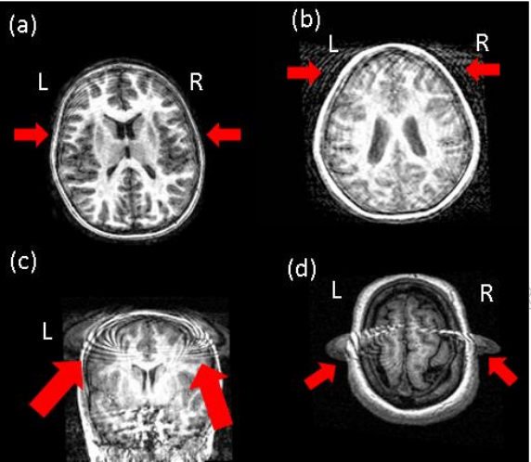
Errors in MRI Scans
In MRI scans, there can be errors in measurement or preprocessing:
Sujit, Gabr, Coronado, Robinson, Datta & Narayana. 2018
Notes:
There can be errors, for example because the head moves
Here are some examples.
These images are outliers. We would like to be able to identify them.

Slide 4
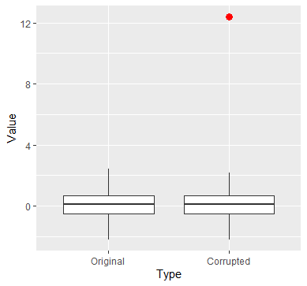
Impact of Outliers
Notes:
Let’s see a simple example that shows the impact of outliers.
100 observations from the standard normal distribution
On the right, I’ve changed 1 point to turn it into an outlier, shown in red.
Let’s see how this single point affects the mean:

Slide 5
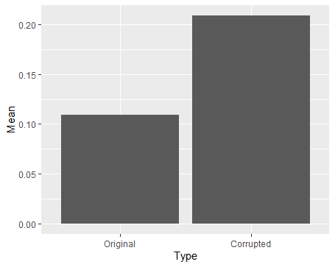
Impact of Outliers
Notes:
The mean doubles, and that’s only due to 1 outlier.
That’s why it’s important to identify them, to not let them bias our statistical analyses.

Slide 6
Challenge in High Dimension
Identifying outliers in neuroimaging data is challenging. Why?
High-dimensional: number of variables > sample size
Very hard to visualize outliers
Standard methods are computationally expensive or unusable
Notes:
Computationally expensive: take too long to run
Unusable: rely on assumptions that don’t hold anymore

Slide 7
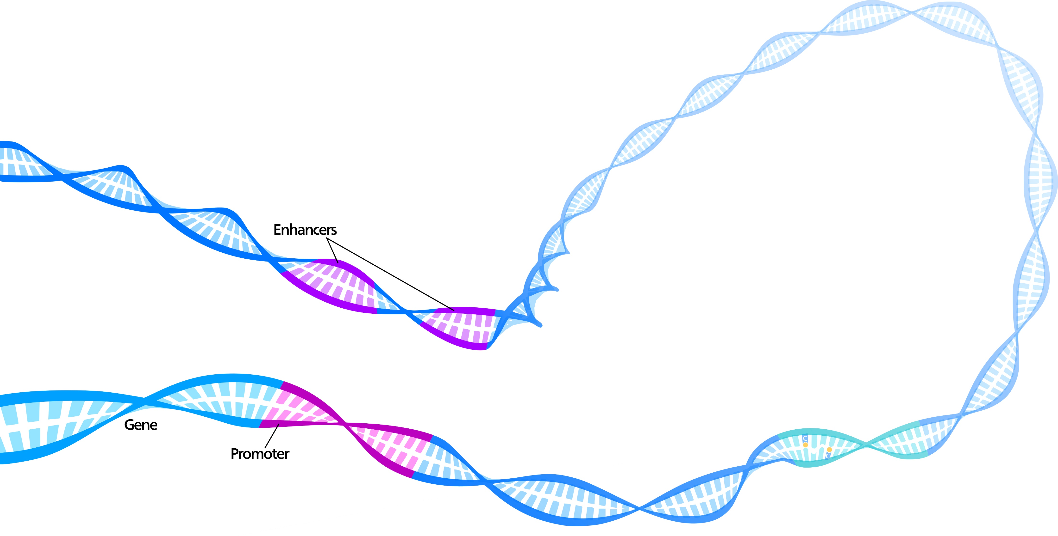
High-Dimensional Data in Other Fields
Other fields have high-dimensional data and have the same challenge:
Genetics
Medical imaging
Fraud detection
Cybersecurity
This Photo by Unknown Author is licensed under CC BY

Slide 8
Solutions
Statistical methods
Ex: Asym-HIM (Greenwood lab)
Machine-learning methods
Ex: RAMODO (Pang, Cao, Chen & Liu, 2018)
Goal: compare these two methods on the ADIBE dataset
Notes:
Thankfully there are some solutions to this problem.
The goal of my project: compare
In more details:
Learns to reduce dimensions in a way that after reducing dimension, we can apply distance-based outlier detection

Slide 9

RAMODO Intuition
Outlier
Nearest-Neighbor distance
Subset of data
Inlier
Notes:
Some inuition about what we would like to achieve after reducing the dimension?
Suppose we’ve done that, we’ve reduce our large data set into 2 dimensions, to show it on my slide.
Green is subset of our data set.
Red was an outlier in the original high-dimensional space
Yellow was not an outlier (an inlier) in the original high-dimensional space
The general idea is that we want the red point to be far away from the rest of the data,
And we want the yellow point to be close.
Far away= more rigorously, nearest neighbor distance
So this will guide the learning of the function that reduces dimension.

Slide 10
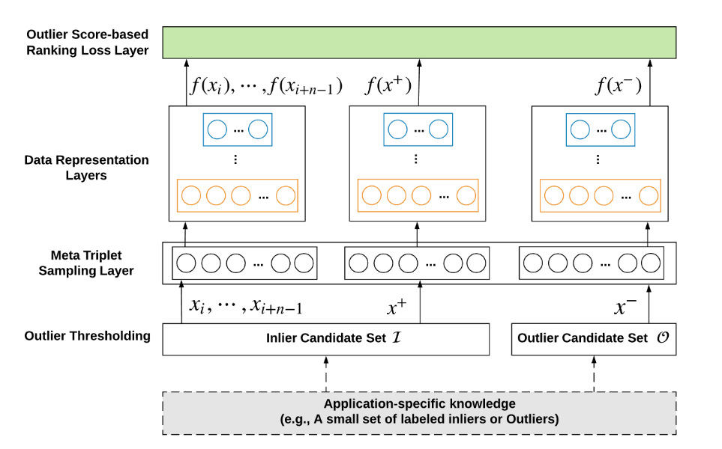
RAMODO Method
Notes:
We’re trying to learn a function f to reduce dimension
f takes long yellow vector into small blue vector
This is what happens here
One hidden layer
In the top layer, we evaluate our function f based on intuition I showed in last slide
Before that, triplet sampling + outlier thresholding, I won’t go into the details

Slide 11
Application
We applied the method (RAMODO) to two different datasets:
AID362 | Bioassay of active/inactive compounds 4279 by 114 1,4 % are outliers
ABIDE | Cortical thickness measures from MRI 542 by 149 956
Notes:
AID:
test dataset
contained labelled outliers
outliers are the active compounds (those able to bind with target)
ABIDE:
Abide data is already preprocessed
Measures of cortical thickness inferred from MRI scan
By taking only the healthy controls and the left hemisphere, here are the dimensions
Formylpeptide Receptor Ligand Binding
examples of columns: NEG_07_NEG_binarized, HBA_07_ARC_binarized (not sure)

Slide 12
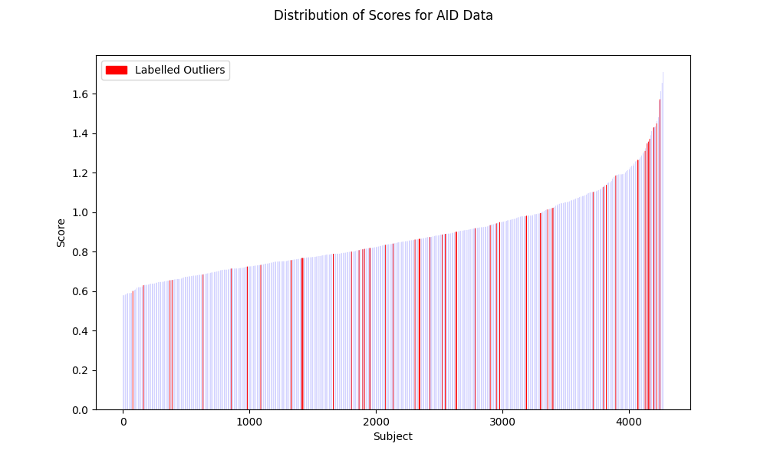
AID362
Notes:
In y, is the outlier score given by RAMODO method.
If a point has a high score, the method thinks it’s likely to be an outlier
In x, subject, in increasing order of score.
In red are the labelled outliers
Ideally we would like the red points to have high scores.
That would mean that the method identifies them as outliers too.
Some do, but there are other red points that don’t. (should be detected but aren’t)
So the method does not detect all the labelled outliers
(60 labelled outliers, out of >4000 points)

Slide 13
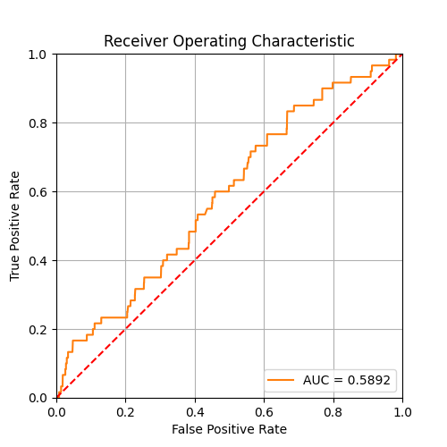
AID362
Notes:
A better way to evalutate performance:
ROC (Receiver Operating Characteristic) curve
Plotting TPR and FPR for different thresholds of classification
Performance of classification is measured by AUC (Area Under Curve)
Here it’s about 60%
TPR= TP/(TP+FN)
FPR = FP/(FP+TN)

Slide 14
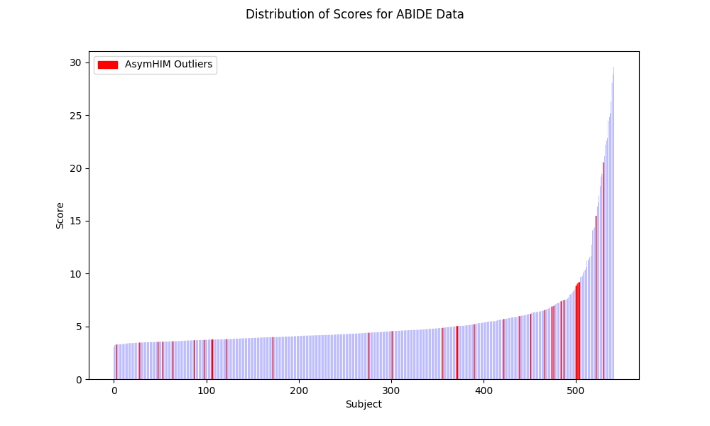
ABIDE
Notes:
Still plotting the score
In red is AsymHIM
The points with highest outlier score are not identified by asym
There are some red points that don’t have high score.
So it seems that the two methods are identifying different points as outliers.

Slide 15
Conclusions
We presented a machine learning method to detect outliers in high-dimensional data
We applied it to the ABIDE dataset
Limitations of the method
Notes:
Limitations of the method:
performs better when we have a few labelled outliers
Need to decide: hyperparameters, treshhold for classification,
Not obvious how to evaluate performance if we don’t have labelled outliers

Slide 16
Acknowledgements
Many thanks to Amadou Barry & Prof. Celia Greenwood for their supervision and helpful guidance throughout my project!

Slide 17
References
S. J. Sujit, R. E. Gabr, I. Coronado, M. Robinson, S. Datta and P. A. Narayana, "Automated Image Quality Evaluation of Structural Brain Magnetic Resonance Images using Deep Convolutional Neural Networks," 2018 9th Cairo International Biomedical Engineering Conference (CIBEC), 2018, pp. 33-36, doi: 10.1109/CIBEC.2018.8641830.
Pang, G., Cao, L., Chen, L., & Liu, H. (2018). Learning Representations of Ultrahigh-dimensional Data for Random Distance-based Outlier Detection. KDD 2018: 24th ACMSIGKDD International Conference on Knowledge Discovery & Data Mining, 2041–2050.
Sugiyama, M., & Borgwardt, K. M. (2013). Rapid distance-based outlier detection via sampling. Advances in Neural Information Processing Systems, 1–9.
Schierz, A.C. Virtual screening of bioassay data. J Cheminform 1, 21 (2009). https://doi.org/10.1186/1758-2946-1-21
Di Martino, A., C.-G. Yan, Q. Li, E. Denio, F. X. Castellanos, K. Alaerts, J. S. Anderson, M. Assaf, S. Y. Bookheimer, M. Dapretto, et al. 2014. The autism brain imaging data exchange: towards a large-scale evaluation of the intrinsic brain architecture in autism. Molecular Psychiatry 19 (6):659–67. doi:10.1038/mp.2013.78.

