Slide 1
Linear Regression for Data Science

Slide 2
Conceptual understanding
Various business applications

Slide 3
Conceptual understanding
Various business applications
We would focus on…
Applying regression to various business applications
We will cut out detailed Math and let Excel/Python do the calculations

Slide 4
What is Linear Regression?
Linear regression attempts to fit a linear relation between a variable of interest and a set of variables that may be related to the variable of interest.

Slide 5
Example
There is a Sales manager of a toys retail company which sells various kinds of toys in the local market. This sales manager needs to make some kind of projections about the number of monthly units that the retail company will be able to sell of this particular toy in the coming half year. In the past she has been making such projections based on her gut feeling and now wishes to be a little more scientific about the whole process.

Slide 6
Example
There is a Sales manager of a toys retail company which sells various kinds of toys in the local market. This sales manager needs to make some kind of projections about the number of monthly units that the retail company will be able to sell of this particular toy in the coming half year. In the past she has been making such projections based on her gut feeling and now wishes to be a little more scientific about the whole process.

Slide 7
Example
There is a Sales manager of a toys retail company which sells various kinds of toys in the local market. This sales manager needs to make some kind of projections about the number of monthly units that the retail company will be able to sell of this particular toy in the coming half year. In the past she has been making such projections based on her gut feeling and now wishes to be a little more scientific about the whole process.

Slide 8
Example
There is a Sales manager of a toys retail company which sells various kinds of toys in the local market. This sales manager needs to make some kind of projections about the number of monthly units that the retail company will be able to sell of this particular toy in the coming half year. In the past she has been making such projections based on her gut feeling and now wishes to be a little more scientific about the whole process.

Slide 9
Example
There is a Sales manager of a toys retail company which sells various kinds of toys in the local market. This sales manager needs to make some kind of projections about the number of monthly units that the retail company will be able to sell of this particular toy in the coming half year. In the past she has been making such projections based on her gut feeling and now wishes to be a little more scientific about the whole process.

Slide 10
Overview of Regression
Modeling
Estimation
Inference
Prediction
Developing a regression model
Using software to estimate the model
Interpreting the estimated regression model
Making predictions about the variable of interest

Slide 11
1. Modeling - Developing a regression model
Example (continued…)
Based on her experience, the manager figures out that the monthly unit sales depend on three important variables, the price at which the toy is sold, the monthly amount that the company spends on advertising the toy and the monthly amount spent on promotions for the toy.

Slide 12
1. Modeling - Developing a regression model
Example (continued…)
Based on her experience, the manager figures out that the monthly unit sales depend on three important variables, the price at which the toy is sold, the monthly amount that the company spends on advertising the toy and the monthly amount spent on promotions for the toy.

Slide 13
1. Modeling - Developing a regression model
Example (continued…)
Based on her experience, the manager figures out that the monthly unit sales depend on three important variables, the price at which the toy is sold, the monthly amount that the company spends on advertising the toy and the monthly amount spent on promotions for the toy.

Slide 14
1. Modeling - Developing a regression model
Example (continued…)
Based on her experience, the manager figures out that the monthly unit sales depend on three important variables, the price at which the toy is sold, the monthly amount that the company spends on advertising the toy and the monthly amount spent on promotions for the toy.

Slide 15
1. Modeling - Developing a regression model

Slide 16
1. Modeling - Developing a regression model

Slide 17
1. Modeling - Developing a regression model
Variable of interest “Y” variable “Dependent” variable “Response” variable “Regressed” variable “L.H.S.” variable

Slide 18
1. Modeling - Developing a regression model
Variable of interest “Y” variable “Dependent” variable “Response” variable “Regressed” variable “L.H.S.” variable
“Explanatory” variables “X” variables “Independent” variables “Covariate” variables “Regressor” variables “R.H.S.” variables

Slide 19
1. Modeling - Developing a regression model
Variable of interest “Y” variable “Dependent” variable “Response” variable “Regressed” variable “L.H.S.” variable
“Explanatory” variables “X” variables “Independent” variables “Covariate” variables “Regressor” variables “R.H.S.” variables
Coefficients Parameters

Slide 20
1. Modeling - Developing a regression model
Variable of interest “Y” variable “Dependent” variable “Response” variable “Regressed” variable “L.H.S.” variable
“Explanatory” variables “X” variables “Independent” variables “Covariate” variables “Regressor” variables “R.H.S.” variables
Coefficients Parameters
*** A linear relationship ***

Slide 21
Simple Regression
A regression with only one explanatory or X variable
Multiple Regression
A regression with two or more explanatory or X variables

Slide 22
The sales manager at the toys retail company wanted to make a projection of monthly unit sales of a particular toy

Slide 23
The sales manager at the toys retail company wanted to make a projection of monthly unit sales of a particular toy
“Y” variable “Dependent” variable Variable of interest

Slide 24
The sales manager at the toys retail company wanted to make a projection of monthly unit sales of a particular toy
“Y” variable “Dependent” variable Variable of interest
“X” variables “Independent” variables “Explanatory” variables

Slide 25

Overview of Regression
Modeling
Estimation
Inference
Prediction
Developing a regression model
Using software to estimate the model
Interpreting the estimated regression model
Making predictions about the variable of interest

Slide 26

Overview of Regression
Modeling
Estimation
Inference
Prediction
Developing a regression model
Using software to estimate the model
Interpreting the estimated regression model
Making predictions about the variable of interest
* Data needed for every variable in the regression model *

Slide 27
Overview of Regression
Modeling
Estimation
Inference
Prediction
Developing a regression model
Using software to estimate the model
Interpreting the estimated regression model
Making predictions about the variable of interest
* Data needed for every variable in the regression model *

Slide 28
2. Estimation - Using software to estimate the model

Slide 29
2. Estimation - Using software to estimate the model

Slide 30
2. Estimation - Using software to estimate the model

Slide 31


Overview of Regression
Modeling
Estimation
Inference
Prediction
Developing a regression model
Using software to estimate the model
Interpreting the estimated regression model
Making predictions about the variable of interest

Slide 32
Overview of Regression
Modeling
Estimation
Inference
Prediction
Developing a regression model
Using software to estimate the model
Interpreting the estimated regression model
Making predictions about the variable of interest

Slide 33
Overview of Regression
Modeling
Estimation
Inference
Prediction
Developing a regression model
Using software to estimate the model
Interpreting the estimated regression model
Making predictions about the variable of interest

Slide 34
3. Inference - Interpreting the estimated regression model

Slide 35
3. Inference - Interpreting the estimated regression model
k independent variables
k+1 beta parameters

Slide 36
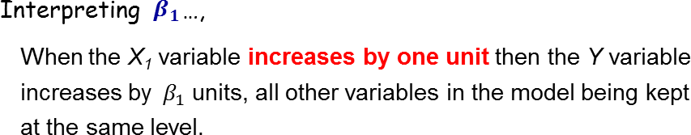
3. Inference - Interpreting the estimated regression model

Slide 37
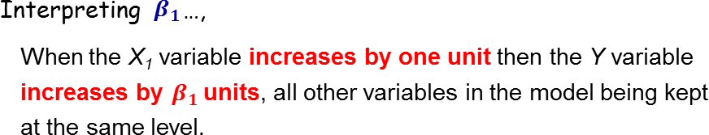
3. Inference - Interpreting the estimated regression model

Slide 38
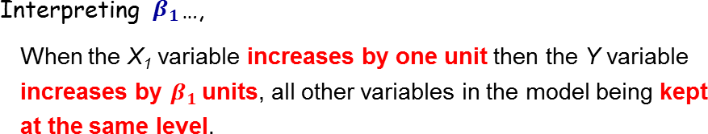
3. Inference - Interpreting the estimated regression model

Slide 39
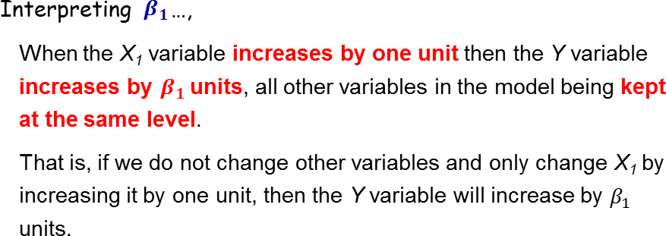
3. Inference - Interpreting the estimated regression model

Slide 40
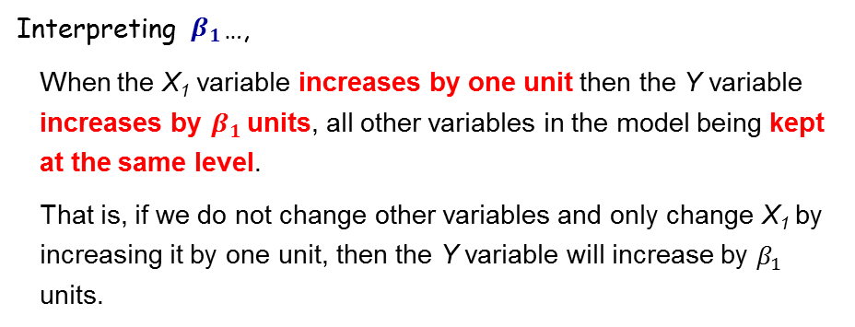
3. Inference - Interpreting the estimated regression model
1

Slide 41
3. Inference - Interpreting the estimated regression model
1
2

Slide 42
3. Inference - Interpreting the estimated regression model
1
2
3

Slide 43
3. Inference - Interpreting the estimated regression model
1
2
3

Slide 44
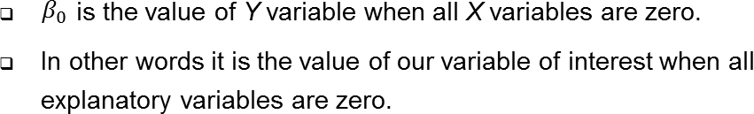
3. Inference - Interpreting the estimated regression model

Slide 45
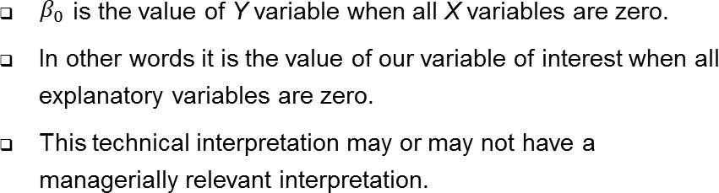
3. Inference - Interpreting the estimated regression model

Slide 46
Overview of Regression
Modeling
Estimation
Inference
Prediction
Developing a regression model
Using software to estimate the model
Interpreting the estimated regression model
Making predictions about the variable of interest

Slide 47
4. Prediction - Making predictions about the variable of interest
For the coming six months, company management is considering three alternative scenarios for selling this particular toy.
Scenario 1:
Price = 9.10$, AdExp = 52,000$, PromExp = 61,000$

Slide 48
4. Prediction - Making predictions about the variable of interest
For the coming six months, company management is considering three alternative scenarios for selling this particular toy.
Scenario 1: | Price = 9.10$, | AdExp = 52,000$, | PromExp = 61,000$
Scenario 2: | Price = 7.10$, | AdExp = 48,000$, | PromExp = 57,000$

Slide 49
4. Prediction - Making predictions about the variable of interest
For the coming six months, company management is considering three alternative scenarios for selling this particular toy.
Scenario 1: | Price = 9.10$, | AdExp = 52,000$, | PromExp = 61,000$
Scenario 2: | Price = 7.10$, | AdExp = 48,000$, | PromExp = 57,000$
Scenario 3: | Price = 8.10$, | AdExp = 50,000$, | PromExp = 60,000$

Slide 50
4. Prediction - Making predictions about the variable of interest
For the coming six months, company management is considering three alternative scenarios for selling this particular toy.
Scenario 1: | Price = 9.10$, | AdExp = 52,000$, | PromExp = 61,000$
Scenario 2: | Price = 7.10$, | AdExp = 48,000$, | PromExp = 57,000$
Scenario 3: | Price = 8.10$, | AdExp = 50,000$, | PromExp = 60,000$
Which scenario to implement to maximize unit sales?

Slide 51
4. Prediction - Making predictions about the variable of interest
Scenario 1:
Price = 9.10$, AdExp = 52,000$, PromExp = 61,000$
Predicted Sales = 72587.31
Scenario 2:
Price = 7.10$, AdExp = 48,000$, PromExp = 57,000$
Predicted Sales = 72892.96
Scenario 3:
Price = 8.10$, AdExp = 50,000$,
Predicted Sales = 74542.75 ≈
PromExp = 60,000$
74542

Slide 52
Overview of Regression
Modeling
Estimation
Inference
Prediction
Developing a regression model
Using software to estimate the model
Interpreting the estimated regression model
Making predictions about the variable of interest

Slide 53
Regression is a process that has errors

Slide 54
Regression is a process that has errors

Slide 55

Regression is a process that has errors

Slide 56
Regression is a process that has errors

Slide 57
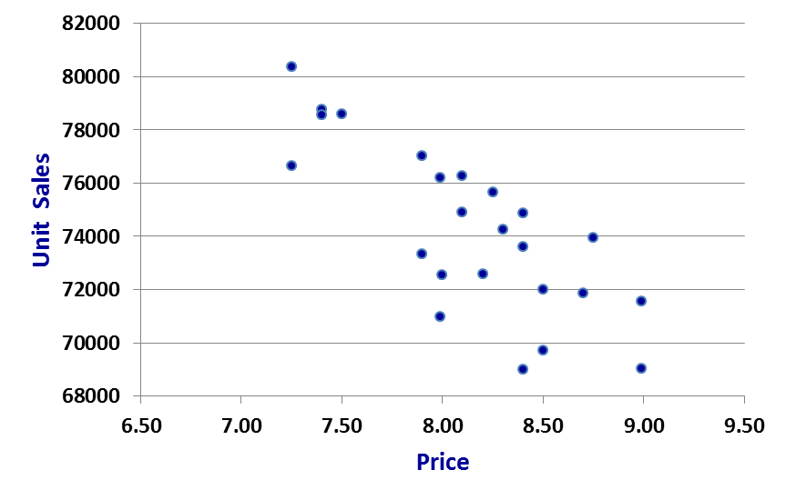
Regression is a process that has errors

Slide 58
Regression is a process that has errors

Slide 59
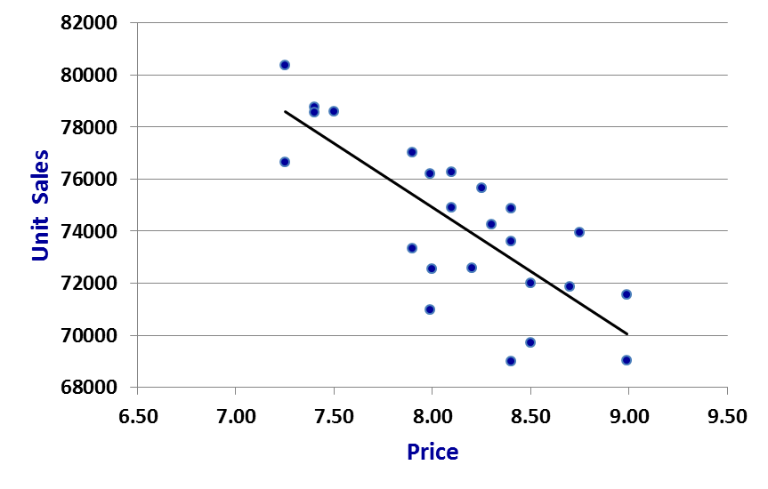
Regression is a process that has errors

Slide 60
Regression is a process that has errors

Slide 61
Regression is a process that has errors
Larger residuals ⇒ “bad” fit Smaller residuals ⇒ “good” fit

Slide 62
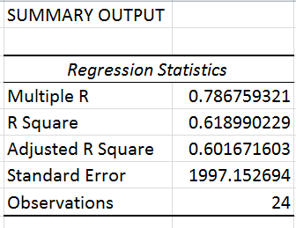
Regression is a process that has errors
R-square
[ A “goodness of fit” measure ]

Slide 63
Regression is a process that has errors
R-square
[ A “goodness of fit” measure ]
Varies from 0 through 1.
Proportion of variation in the Y variable explained by the regression model.
Values closer to 1 indicate a good fit.

Slide 64
Regression is a process that has errors
R-square
[ A “goodness of fit” measure ]
Varies from 0 through 1.
Proportion of variation in the Y variable explained by the regression model.
Values closer to 1 indicate a good fit.

Slide 65
Regression is a process that has errors
R-square
[ A “goodness of fit” measure ]
Varies from 0 through 1.
Proportion of variation in the Y variable explained by the regression model.
Values closer to 1 indicate a good fit.

Slide 66
Regression is a process that has errors
R-square
[ A “goodness of fit” measure ]
Varies from 0 through 1.
Proportion of variation in the Y variable explained by the regression model.
Values closer to 1 indicate a good fit.

Slide 67
Regression is a process that has errors
Residuals and Errors.
R-square: A “goodness of fit” measure.

Slide 68
Regression is a process that has errors
Residuals and Errors.
R-square: A “goodness of fit” measure.
Why do we have errors in the regression model ?
Omitted variables.
Functional relationship between the Y and X variables.
The theory of regression analysis is based on certain assumptions about these errors.

Slide 69
Errors and residuals in a regression model

Slide 70

Errors and residuals in a regression model

Slide 71
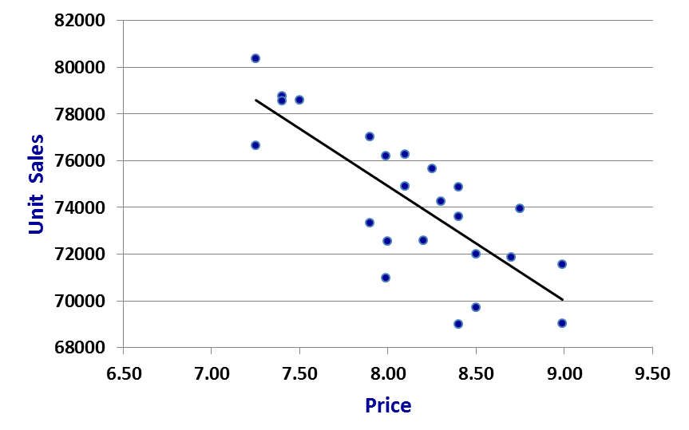
Errors and residuals in a regression model

Slide 72
Importance of the Normality assumption about errors

Slide 73
Importance of the Normality assumption about errors
Estimated Model :

Slide 74
Importance of the Normality assumption about errors
Estimated Model :
The b’s can be considered as random variables…,

Slide 75

Importance of the Normality assumption about errors
Estimated Model :
The b’s can be considered as random variables…,

Slide 76

Importance of the Normality assumption about errors
Estimated Model :
The b’s can be considered as random variables…,

Slide 77
Importance of the Normality assumption about errors
Estimated Model :
The b’s can be considered as random variables…,
…
…

Slide 78


Importance of the Normality assumption about errors
Estimated Model :
Population Mean :
Sample Mean :

Slide 79
Importance of the Normality assumption about errors
Estimated Model :
Population Mean :
Fixed but unknown
Sample Mean :

Slide 80

Importance of the Normality assumption about errors
Estimated Model :
Population Mean :
Fixed but unknown
Sample Mean :

Slide 81

Importance of the Normality assumption about errors
Estimated Model :
Population Mean :
Fixed but unknown
Sample Mean :

Slide 82
Importance of the Normality assumption about errors
Estimated Model :
Population Mean :
Fixed but unknown
Sample Mean :

Slide 83


Some important results…
n = number of observations
k = number of “X” variables
n-k-1 = residual degrees of freedom
= the standard error of b₀

Slide 84


Some important results…
n = number of observations
k = number of “X” variables
n-k-1 = residual degrees of freedom
= the standard error of b₀
= the standard error of b₀

Slide 85
Some important results…
n = number of observations
k = number of “X” variables
n-k-1 = residual degrees of freedom
= the standard error of b₀
= the standard error of b₀
…
…

Slide 86




Some important results…
n = number of observations
k = number of “X” variables
n-k-1 = residual degrees of freedom
= the standard error of b₀
= the standard error of b₀
…
…
These results enable us to…,
test stability and precision of coefficients
conduct hypothesis testing in a regression

Slide 87
A note on notations…
We have differentiated between the β’s and the b’s.
In common usage people tend to mix these notations.
However, as long as you understand the conceptual difference, you should be ok.

