Slide 1
Learning Java 8
Functional Interfaces And Lambdas

Slide 2
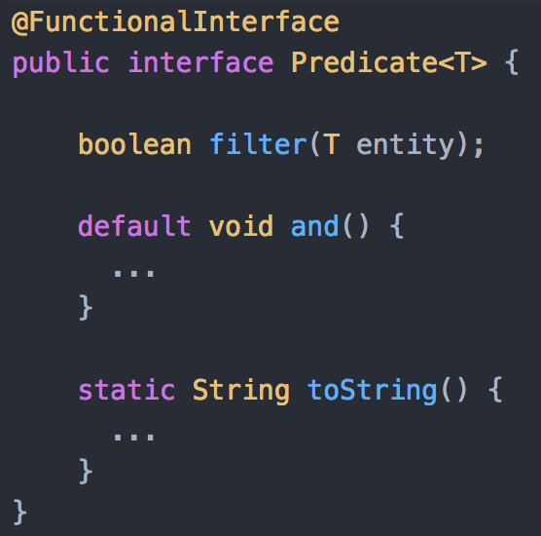
What is a Functional Interface?
Interface with ONE AND ONLY ONE abstract method
SAM (Single Abstract Method) Interfaces
May have default or static methods
Marked by @FunctionalInterface annotation

Slide 3







Slide 4
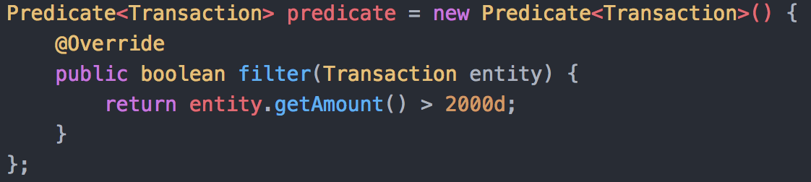
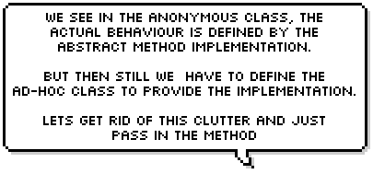

Slide 5

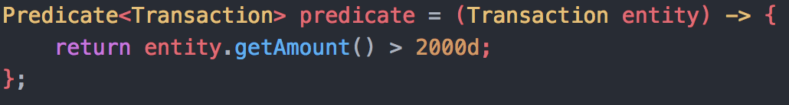



Slide 6
Lambda…
.. is Anonymous : method without a name
.. is Function : has parameters, body, and return type
.. is Passed around : can be passed as parameter or stored in variable
.. is Concise : eliminates boilerplate code unlike Anonymous classes

Slide 7
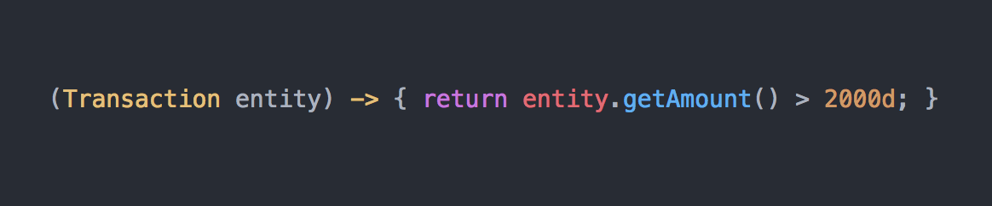
Lambda Syntax
Method Parameters
Method Body
Arrow

Slide 8



Lambda Syntax

Slide 9

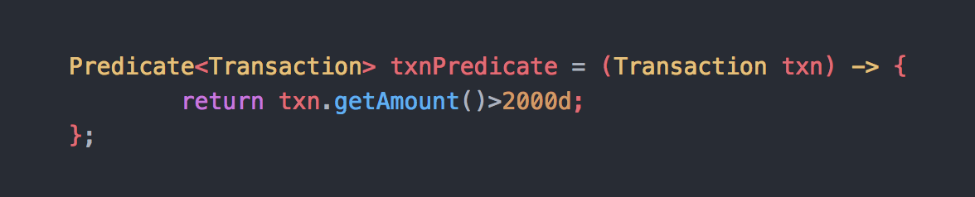

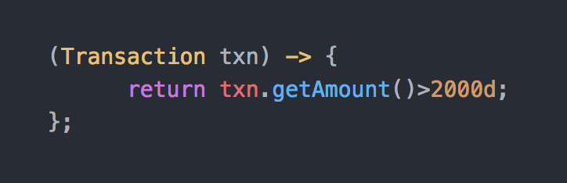

Slide 10
Type Inference
Lambda is the implementation of the abstract method defined inside a Functional Interface.
Hence, always written in context of a Functional Interface
Since Lambda is written in context of a Functional Interface, compiler infers the parameter type and return type of a Lambda expression by matching it with the SAM in the Functional Interface

Slide 11
Java 8 Functional Interfaces
Predicate<T>
Abstract method:
boolean test( T t )
Description:
Evaluates this predicate on the given argument.
Parameters:
t - the input argument
Returns:
True if the input argument matches the predicate, otherwise False

Slide 12
Java 8 Functional Interfaces
Function<T,R>
Abstract method:
R apply( T t )
Description:
Applies this function to the given argument.
Parameters:
t - the input argument
Returns:
The function result

Slide 13
Java 8 Functional Interfaces
Supplier<T>
Abstract method:
T get()
Description:
Gets result.
Returns:
The result of type T

Slide 14
Java 8 Functional Interfaces
Consumer<T>
Abstract method:
void accept( T t )
Description:
Performs this operation on the given argument.
Parameters:
t - the input argument

Slide 15

Time to Exercise

