Slide 1
Learning Java 8
Behavior Parameterization Extended

Slide 2
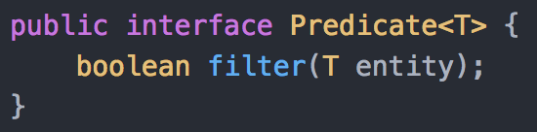
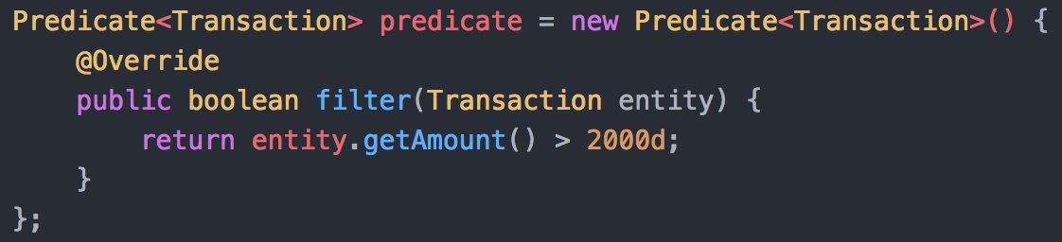
Structure of Anonymous Class
Given an Interface
Provide Inline implementation

Slide 3
Drawbacks of Anonymous classes
. . .
. . .
. . .
Although we do not write a .java file, compiler generates a .class file for you ☹

Slide 4



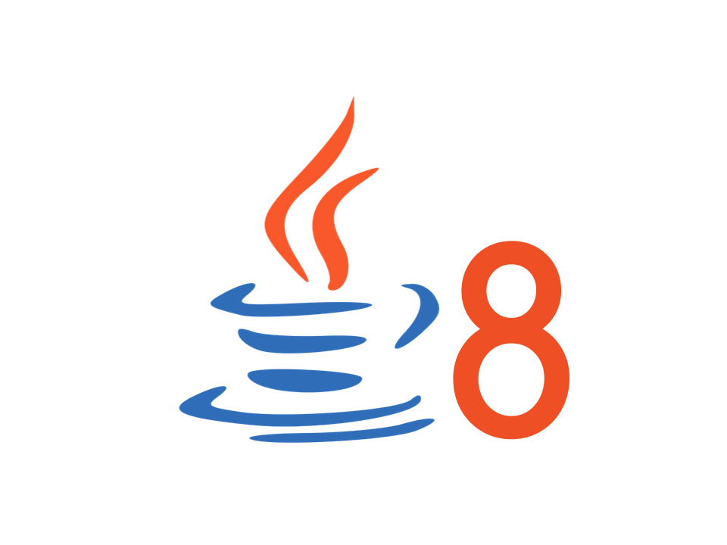
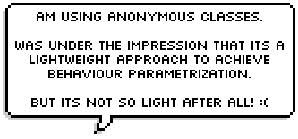


Slide 5
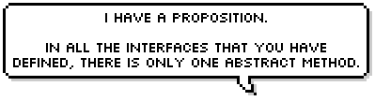






Slide 6

Time to Exercise

