Slide 1
Cinema Booking System
Myrzabek Darkhan

Slide 2
Index:
1.Introduction.
2.Purpose of the project.
3.How it works.
4.Conclusion.

Slide 3
Introduction
The following report will outline the development of an automated Ticket Reservation System. This application has been designed for customers to reserve theatre tickets for various films.

Slide 4
This project is aimed at developing a Cinema Booking System for particular Cinema Halls. The Cinema Booking System is an booking application based on javaFX .This application will automate the reservation of tickets and enquiries about availability of the tickets and seats for particular cinema’s halls. This is one of the important features of our system. First customer buy reserve seats by this application and go to the cinema where he or she booked film. Then stuff in the cinema can easily check the reservation by this application. customer has to visit cinema hall for further process. So , the customer can pay from the cinema hall. Hence both the customer and the cinema can sort out further matter .For every cinema there will be one application.

Slide 5
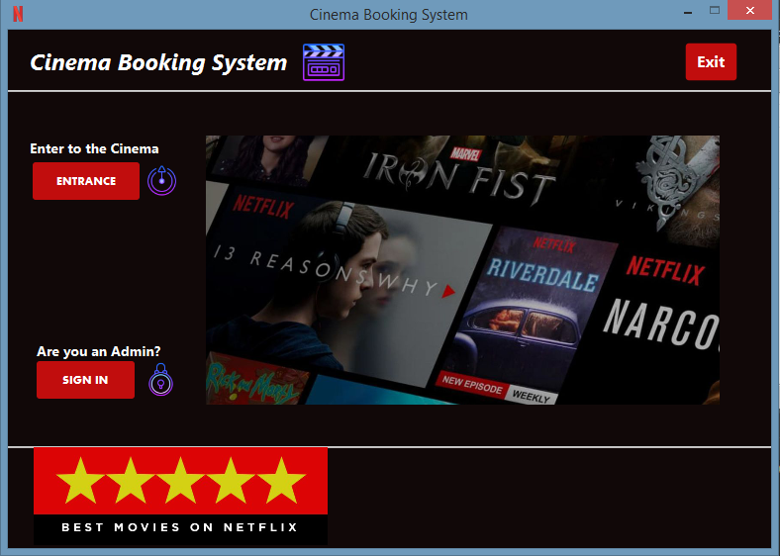
Here we have 3 directions. First direction where you entrance to the cinema and book films. Second sign in as an admin and look their reservation, third exit from the program.

Slide 6
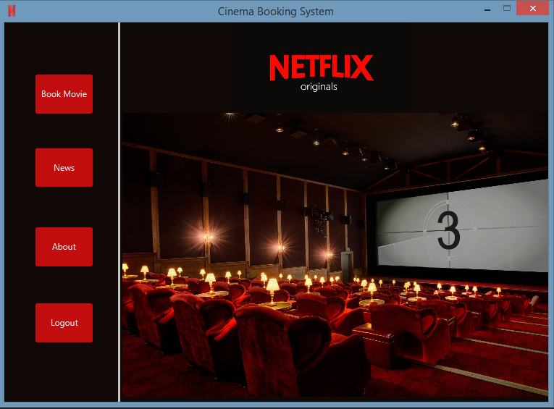
Member Dash board, where you can book , see latest news and look information about this cinema

Slide 7
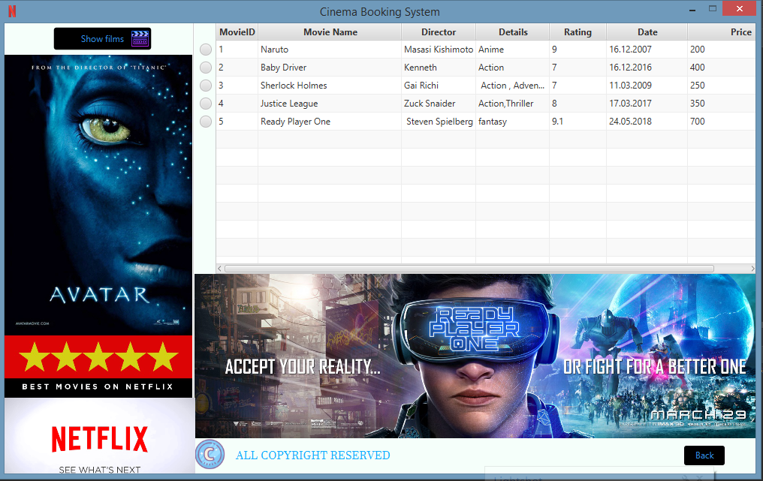
You will see 5 main halls , you can go in particular hall that you prefer.

Slide 8
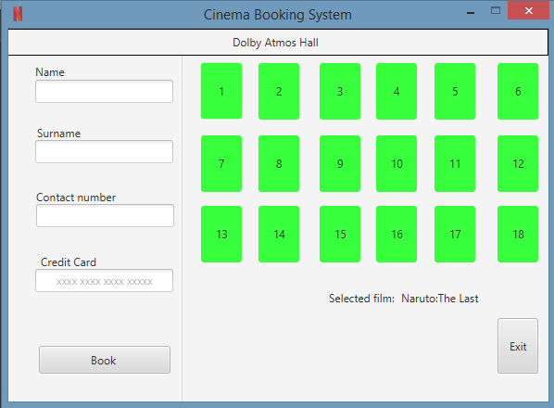
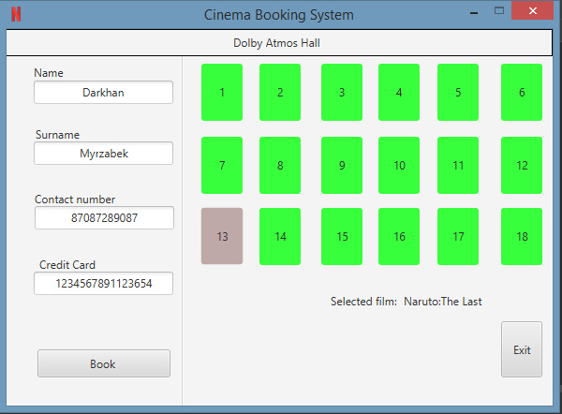
As an example you choose film Naruto and here you should fill all the field and select your seat.

Slide 9
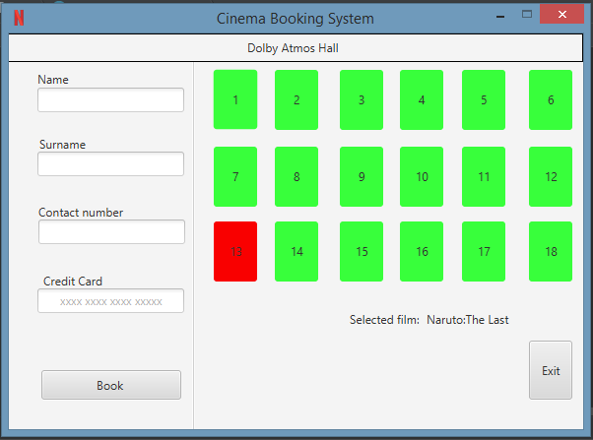
And when you successfully booked your film, you will see that your seat will be busy.

Slide 10
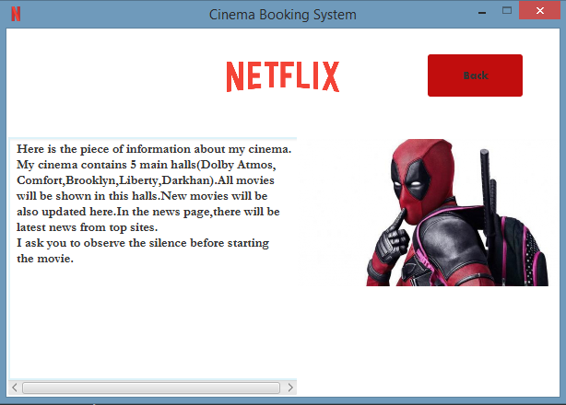
Here you will see information about this cinema.

Slide 11
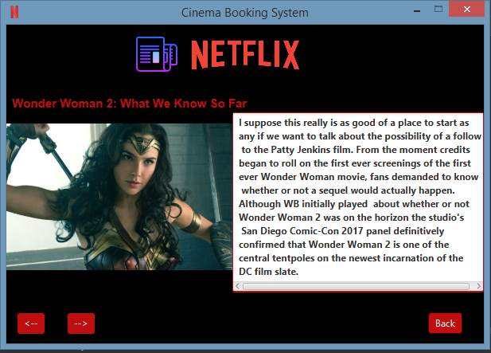
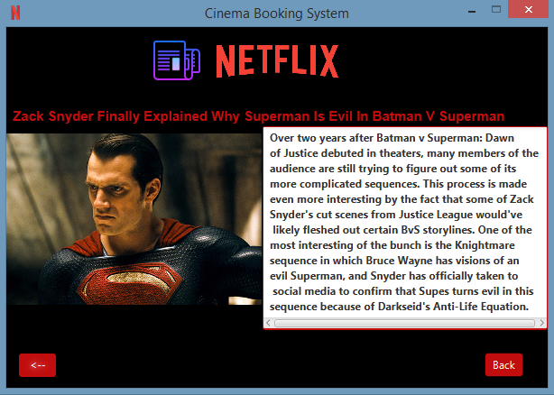
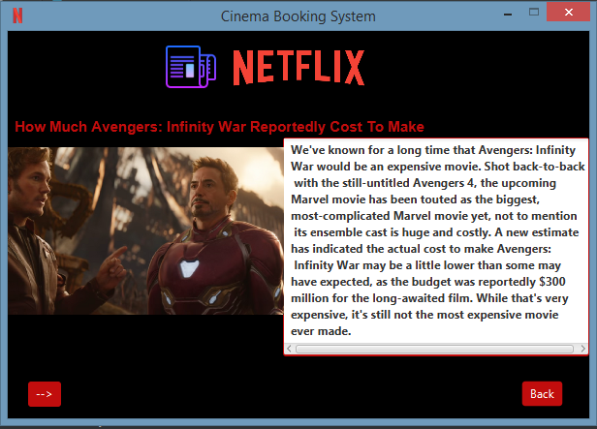
Latest news

Slide 12
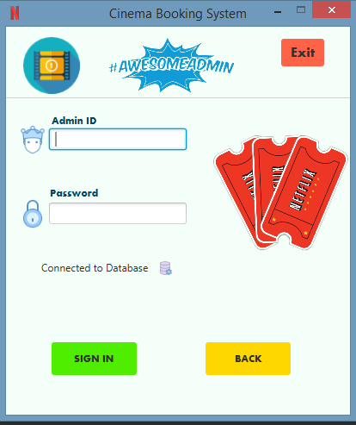
Admin entrance page

Slide 13
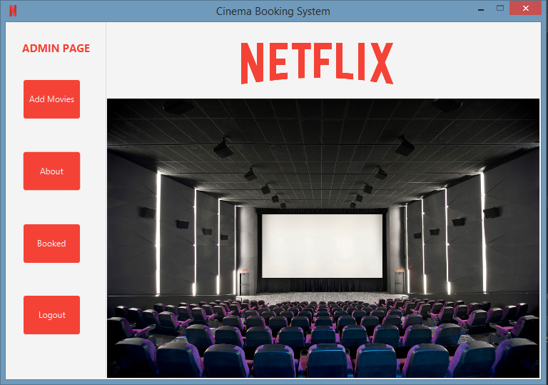
Admin dash board to add movies, see all the reservation and you can see all about admin.

Slide 14
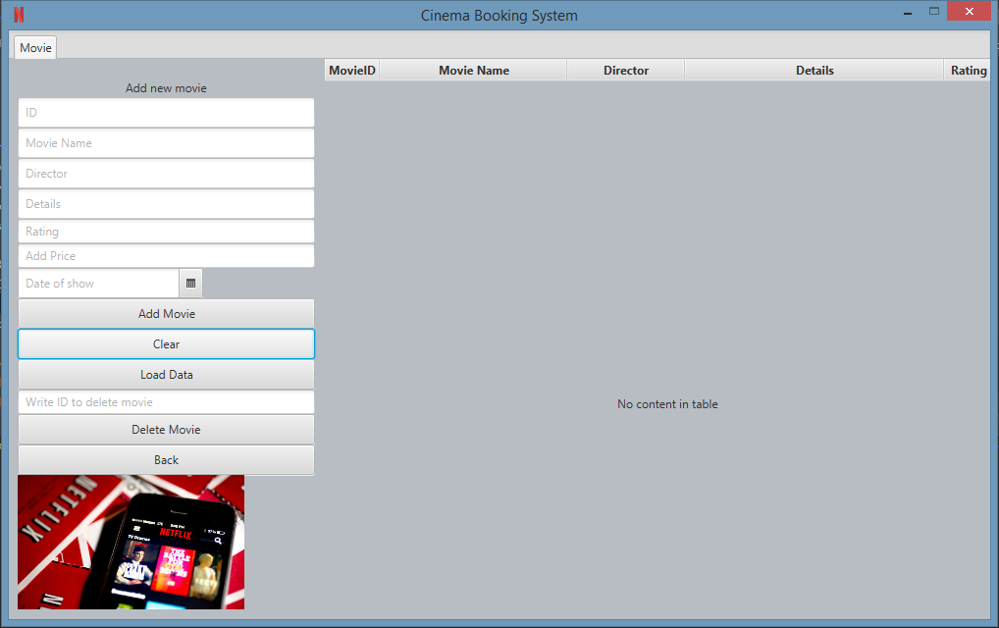
Here you can add films, delete or load all films from database.

Slide 15
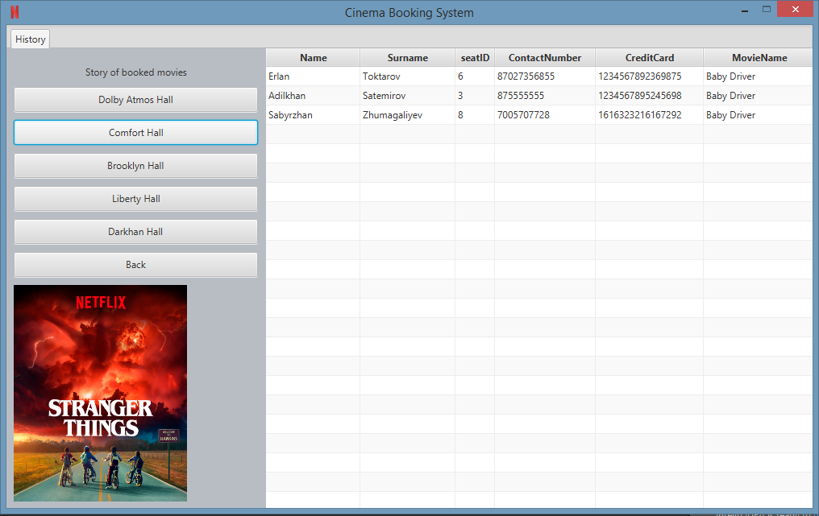
History of reservation , all booked films can be seen here

Slide 16
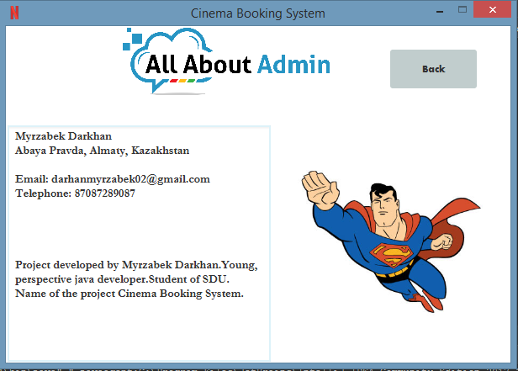
All about me!)

Slide 17
Conclusion
I do my best and I think you will appreciate it.
Here is the link to the github below
https://github.com/MyrzabekDarkhan/
CinemaBookingSystem

