Slide 1
Ansys Fluent Simulation Report

Slide 2
Header
Analyst | ShubhamR
Date | 2/8/2026 10:26 AM
Table of contents

Slide 3
Table of Contents
System Information
Geometry and Mesh
Mesh Size
Mesh Quality
Orthogonal Quality
Simulation Setup
Physics
Models
Material Properties
Cell Zone Conditions
Boundary Conditions
Reference Values
Solver Settings
Run Information
Solution Status
Named Expressions
Report Definitions
Plots
Residuals
Report Plots
Contours
Vectors
Pathlines

Slide 4
System Information
Application | Fluent
Settings | 2d, double precision, density-based explicit, laminar
Version | 25.2.0-10204
Source Revision | 5eecd5d865
Build Time | Jun 16 2025 10:44:41 EDT
CPU | AMD Ryzen 7 6800H with Radeon Graphics
OS | Windows
System Information
Table of contents

Slide 5
Geometry and Mesh
Geometry and Mesh
Table of contents

Slide 6
Mesh Size
Cells | Faces | Nodes
39 | 140 | 0
118 | 415 | 0
351 | 1192 | 0
1023 | 3254 | 0
3288 | 9800 | 0
22914 | 35063 | 12153
Geometry and Mesh / Mesh Size
Table of contents

Slide 7
Mesh Quality
Name | Type | Min Orthogonal Quality | Max Aspect Ratio
fluid | Tri Cell | 0.65988415 | 3.7977613
solid | Tri Cell | 0.65917937 | 3.7967206
Geometry and Mesh / Mesh Quality
Table of contents

Slide 8
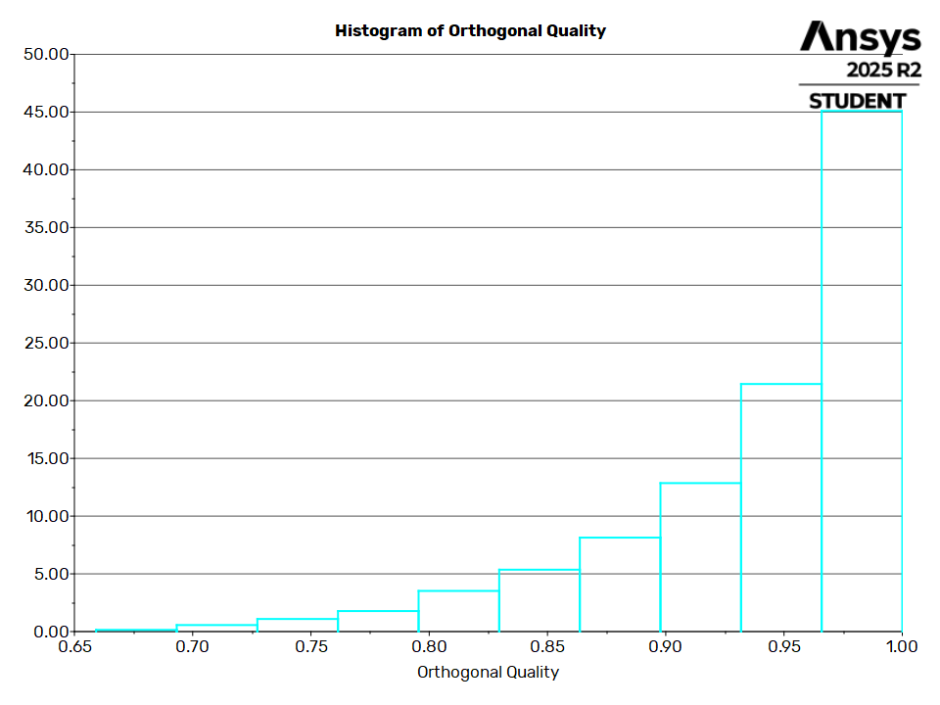
Orthogonal Quality
Geometry and Mesh / Orthogonal Quality
Table of contents

Slide 9
Simulation Setup
Simulation Setup
Table of contents

Slide 10
Physics
Simulation Setup / Physics
Table of contents

Slide 11
Models
Model | Settings
Space | 2D
Time | Steady
Viscous | Laminar
Heat Transfer | Enabled
Simulation Setup / Physics / Models
Table of contents

Slide 12
Material Properties
- Fluid
- air
Density | ideal gas
Cp (Specific Heat) | 1006.43 J/(kg K)
Thermal Conductivity | 0.0242 W/(m K)
Viscosity | 1.7894e-05 kg/(m s)
Molecular Weight | 28.966 kg/kmol
- Solid
- aluminum
Density | 2719 kg/m^3
Cp (Specific Heat) | 871 J/(kg K)
Thermal Conductivity | 202.4 W/(m K)
Simulation Setup / Physics / Material Properties
Table of contents

Slide 13
Cell Zone Conditions
- Fluid
- fluid
Material Name | air
Specify source terms? | no
Specify fixed values? | no
Frame Motion? | no
Porous zone? | no
- Solid
- solid
Material Name | aluminum
Specify source terms? | no
Frame Motion? | no
Solid Motion? | no
Simulation Setup / Physics / Cell Zone Conditions
Table of contents

Slide 14
Boundary Conditions
- Inlet
- inlet
Gauge Pressure [Pa] | 101325
Mach Number | 1.1
Temperature [K] | 300
Component of Flow Direction (x,y) | (1, 0)
- outlet
Gauge Pressure [Pa] | 101325
Mach Number | 1.1
Temperature [K] | 300
Component of Flow Direction (x,y) | (1, 0)
- Wall
- soild_wall
Simulation Setup / Physics / Boundary Conditions (1 of 3)
Table of contents

Slide 15
Boundary Conditions
Wall Thickness [m] | 0
Heat Generation Rate [W/m^3] | 0
Material Name | aluminum
Thermal BC Type | Heat Flux
Heat Flux [W/m^2] | 0
Convective Augmentation Factor | 1
- soild_wall:001
Wall Thickness [m] | 0
Heat Generation Rate [W/m^3] | 0
Material Name | aluminum
Thermal BC Type | Coupled
Wall Motion | Stationary Wall
Shear Boundary Condition | No Slip
Simulation Setup / Physics / Boundary Conditions (2 of 3)
Table of contents

Slide 16
Boundary Conditions
Convective Augmentation Factor | 1
- soild_wall:001-shadow
Wall Thickness [m] | 0
Heat Generation Rate [W/m^3] | 0
Material Name | aluminum
Thermal BC Type | Coupled
Convective Augmentation Factor | 1
Simulation Setup / Physics / Boundary Conditions (3 of 3)
Table of contents

Slide 17
Reference Values
Area | 1 m^2
Density | 1.225 kg/m^3
Depth | 1 m
Enthalpy | 0 J/kg
Length | 1 m
Pressure | 0 Pa
Temperature | 288.16 K
Velocity | 1 m/s
Viscosity | 1.7894e-05 kg/(m s)
Ratio of Specific Heats | 1.4
Yplus for Heat Tran. Coef. | 300
Reference Zone | fluid
Simulation Setup / Physics / Reference Values
Table of contents

Slide 18
Solver Settings
- Equations
Flow | True
- Numerics
Absolute Velocity Formulation | True
- Under-Relaxation Factors
Solid | 1
- Discretization Scheme
Flow | Second Order Upwind
- Time Marching
Solver | Explicit
Courant Number | 0.05
Residual Smoothing Iterations | 0 (disabled)
Residual Smoothing Factor | 0.5
Simulation Setup / Solver Settings (1 of 3)
Table of contents

Slide 19
Solver Settings
- Multigrid Solver
Coarse Grid Levels | 5
Fine Grid Iterations | 1
Final Iterations | 0
Time Step Reduction | 0.9
Correction Reduction | 0.6
Species Correction Reduction | 1
Correction Smoothing Factor | 0.5
- Multi-Stage Scheme
1 | 0.2075
2 | 0.5915
3 | 1
- Solution Limits
Simulation Setup / Solver Settings (2 of 3)
Table of contents

Slide 20
Solver Settings
Minimum Absolute Pressure [Pa] | 1
Maximum Absolute Pressure [Pa] | 5e+10
Minimum Static Temperature [K] | 1
Maximum Static Temperature [K] | 5000
Simulation Setup / Solver Settings (3 of 3)
Table of contents

Slide 21
Run Information
Number of Machines | 1
Number of Cores | 2
Case Read | 7.168 seconds
Iteration | 142.937 seconds
Virtual Current Memory | 1.07743 GB
Virtual Peak Memory | 1.13433 GB
Memory Per M Cell | 18.6047
Run Information
Table of contents

Slide 22
Solution Status
Iterations: 5473
 | Value | Absolute Criteria | Convergence Status
continuity | 0.0009993356 | 0.001 | Converged
x-velocity | 0.0001674192 | 0.001 | Converged
y-velocity | 0.0003978381 | 0.001 | Converged
energy | 0.0008814828 | 0.001 | Converged
Solution Status
Table of contents

Slide 23
Named Expressions
Expression | Definition | Value | Unit | Used In | Description
expr1 | Maximum(MachNumber, ['fluid']) | 2.0261369 | [] | report-def-0 (Report Definition)
Named Expressions
Table of contents

Slide 24
Report Definitions
report-def-0 | 2.026137
Report Definitions
Table of contents

Slide 25
Plots
Plots
Table of contents

Slide 26
Residuals
Plots / Residuals
Table of contents

Slide 27
Report Plots
Plots / Report Plots
Table of contents

Slide 28
report-def-0-rplot
Plots / Report Plots / report-def-0-rplot
Table of contents

Slide 29
Contours
Contours
Table of contents

Slide 30
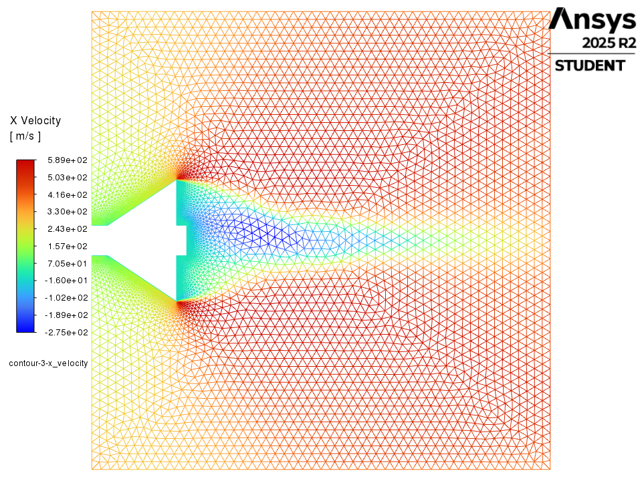
contour-3-x_velocity
Contours / contour-3-x_velocity
Table of contents

Slide 31
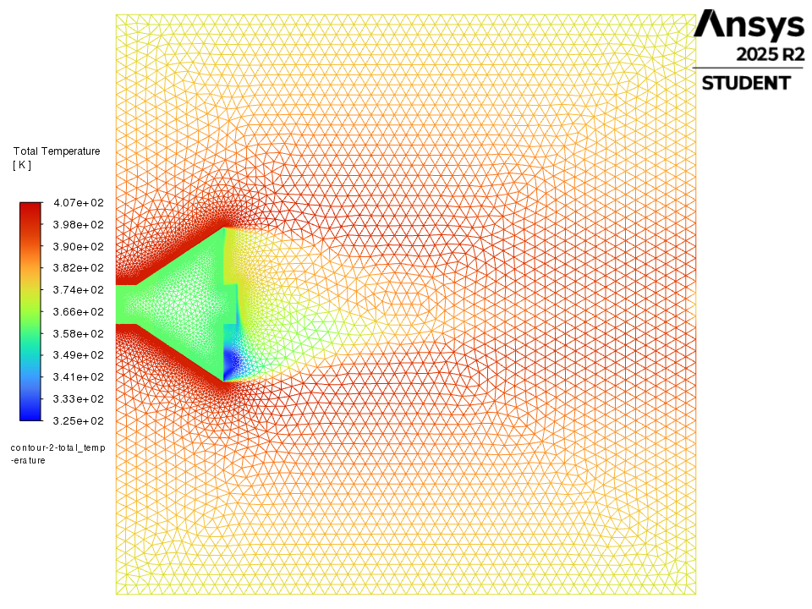
contour-2-total_temperature
Contours / contour-2-total_temperature
Table of contents

Slide 32
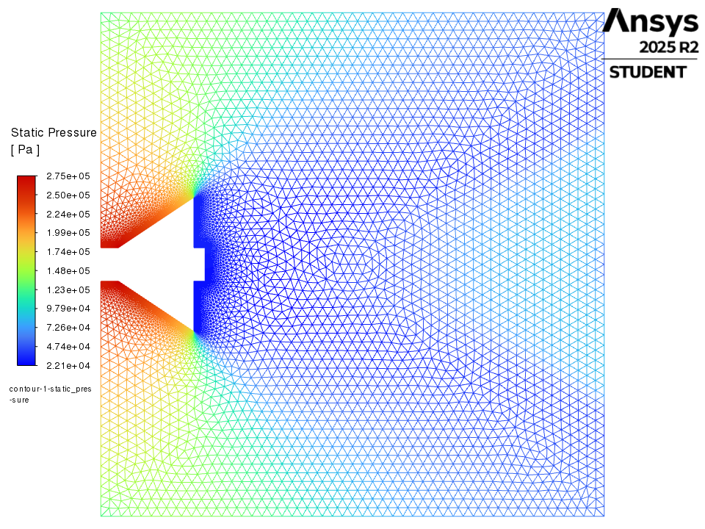
contour-1-static_pressure
Contours / contour-1-static_pressure
Table of contents

Slide 33
Vectors
Vectors
Table of contents

Slide 34
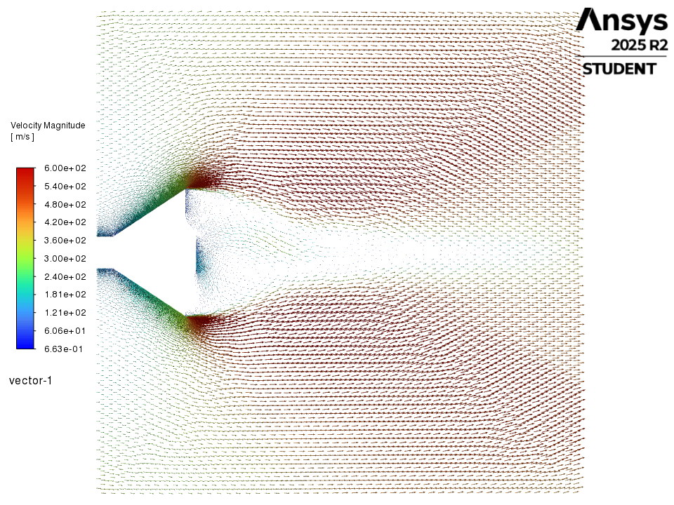
vector-1
Vectors / vector-1
Table of contents

Slide 35
Pathlines
Pathlines
Table of contents

Slide 36
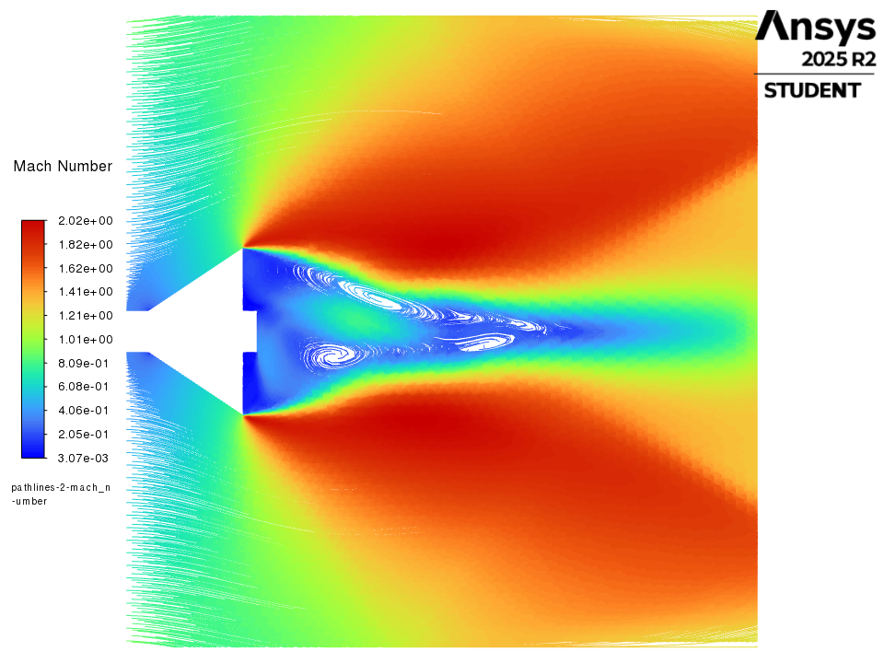
pathlines-2-mach_number
Pathlines / pathlines-2-mach_number
Table of contents

Slide 37
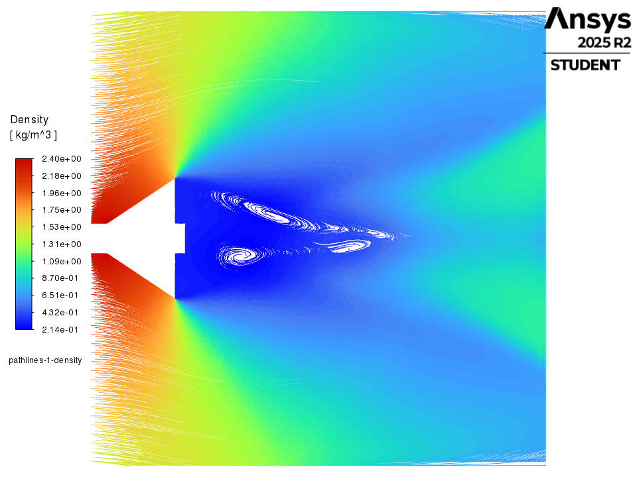
pathlines-1-density
Pathlines / pathlines-1-density
Table of contents

