Slide 1
Ansys Fluent Simulation Report

Slide 2
Header
Analyst | ShubhamR
Date | 2/8/2026 11:17 AM
Table of contents

Slide 3
Table of Contents
System Information
Geometry and Mesh
Mesh Size
Mesh Quality
Orthogonal Quality
Simulation Setup
Physics
Models
Material Properties
Cell Zone Conditions
Boundary Conditions
Reference Values
Solver Settings
Run Information
Solution Status
Named Expressions
Report Definitions
Plots
Residuals
Report Plots
Contours
Vectors
Pathlines

Slide 4
System Information
Application | Fluent
Settings | 2d, double precision, density-based explicit, Spalart-Allmaras
Version | 25.2.0-10204
Source Revision | 5eecd5d865
Build Time | Jun 16 2025 10:44:41 EDT
CPU | AMD Ryzen 7 6800H with Radeon Graphics
OS | Windows
System Information
Table of contents

Slide 5
Geometry and Mesh
Geometry and Mesh
Table of contents

Slide 6
Mesh Size
Cells | Faces | Nodes
39 | 140 | 0
118 | 415 | 0
351 | 1192 | 0
1023 | 3254 | 0
3288 | 9800 | 0
22914 | 35063 | 12153
Geometry and Mesh / Mesh Size
Table of contents

Slide 7
Mesh Quality
Name | Type | Min Orthogonal Quality | Max Aspect Ratio
fluid | Tri Cell | 0.65988415 | 3.7977613
solid | Tri Cell | 0.65917937 | 3.7967206
Geometry and Mesh / Mesh Quality
Table of contents

Slide 8
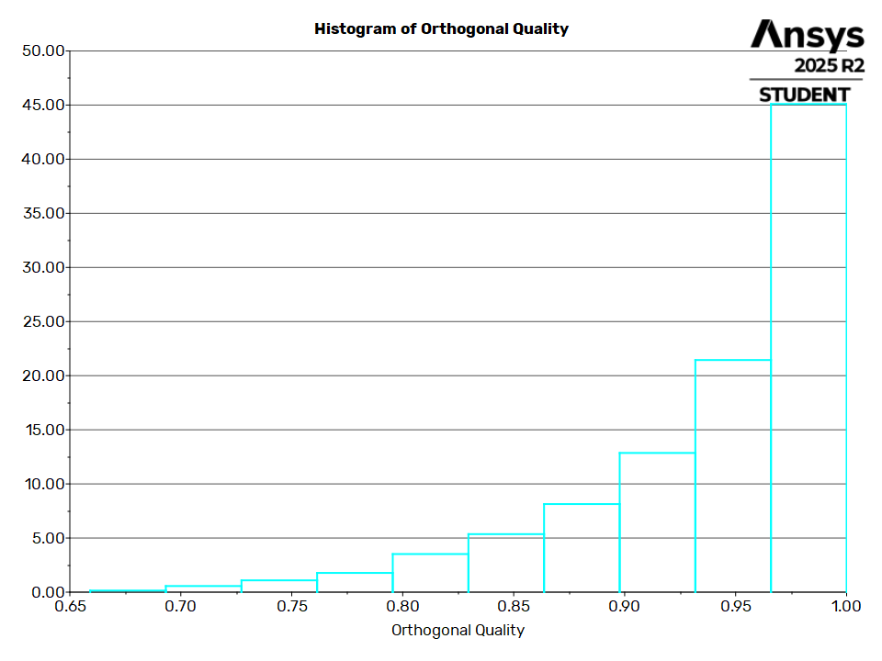
Orthogonal Quality
Geometry and Mesh / Orthogonal Quality
Table of contents

Slide 9
Simulation Setup
Simulation Setup
Table of contents

Slide 10
Physics
Simulation Setup / Physics
Table of contents

Slide 11
Models
Model | Settings
Space | 2D
Time | Steady
Viscous | Spalart-Allmaras turbulence model
Production Option | Vorticity
Heat Transfer | Enabled
Simulation Setup / Physics / Models
Table of contents

Slide 12
Material Properties
- Fluid
- air
Density | ideal gas
Cp (Specific Heat) | 1006.43 J/(kg K)
Thermal Conductivity | 0.0242 W/(m K)
Viscosity | 1.7894e-05 kg/(m s)
Molecular Weight | 28.966 kg/kmol
- Solid
- aluminum
Density | 2719 kg/m^3
Cp (Specific Heat) | 871 J/(kg K)
Thermal Conductivity | 202.4 W/(m K)
Simulation Setup / Physics / Material Properties
Table of contents

Slide 13
Cell Zone Conditions
- Fluid
- fluid
Material Name | air
Specify source terms? | no
Specify fixed values? | no
Frame Motion? | no
Laminar zone? | no
Porous zone? | no
- Solid
- solid
Material Name | aluminum
Specify source terms? | no
Frame Motion? | no
Simulation Setup / Physics / Cell Zone Conditions (1 of 2)
Table of contents

Slide 14
Cell Zone Conditions
Solid Motion? | no
Simulation Setup / Physics / Cell Zone Conditions (2 of 2)
Table of contents

Slide 15
Boundary Conditions
- Inlet
- inlet
Gauge Pressure [Pa] | 101325
Mach Number | 1.1
Temperature [K] | 300
Component of Flow Direction (x,y) | (1, 0)
Turbulence Specification Method | Turbulent Viscosity Ratio
Turbulent Viscosity Ratio | 10
- outlet
Gauge Pressure [Pa] | 101325
Mach Number | 1.1
Temperature [K] | 300
Component of Flow Direction (x,y) | (1, 0)
Simulation Setup / Physics / Boundary Conditions (1 of 4)
Table of contents

Slide 16
Boundary Conditions
Turbulence Specification Method | Turbulent Viscosity Ratio
Turbulent Viscosity Ratio | 10
- Wall
- soild_wall
Wall Thickness [m] | 0
Heat Generation Rate [W/m^3] | 0
Material Name | aluminum
Thermal BC Type | Heat Flux
Heat Flux [W/m^2] | 0
Convective Augmentation Factor | 1
- soild_wall:001
Wall Thickness [m] | 0
Heat Generation Rate [W/m^3] | 0
Simulation Setup / Physics / Boundary Conditions (2 of 4)
Table of contents

Slide 17
Boundary Conditions
Material Name | aluminum
Thermal BC Type | Coupled
Wall Motion | Stationary Wall
Shear Boundary Condition | No Slip
Wall Surface Roughness | Standard
Wall Roughness Height [m] | 0
Wall Roughness Constant | 0.5
Convective Augmentation Factor | 1
- soild_wall:001-shadow
Wall Thickness [m] | 0
Heat Generation Rate [W/m^3] | 0
Material Name | aluminum
Thermal BC Type | Coupled
Simulation Setup / Physics / Boundary Conditions (3 of 4)
Table of contents

Slide 18
Boundary Conditions
Convective Augmentation Factor | 1
Simulation Setup / Physics / Boundary Conditions (4 of 4)
Table of contents

Slide 19
Reference Values
Area | 1 m^2
Density | 1.225 kg/m^3
Depth | 1 m
Enthalpy | 0 J/kg
Length | 1 m
Pressure | 0 Pa
Temperature | 288.16 K
Velocity | 1 m/s
Viscosity | 1.7894e-05 kg/(m s)
Ratio of Specific Heats | 1.4
Yplus for Heat Tran. Coef. | 300
Reference Zone | fluid
Simulation Setup / Physics / Reference Values
Table of contents

Slide 20
Solver Settings
- Equations
Flow | True
Modified Turbulent Viscosity | True
- Numerics
Absolute Velocity Formulation | True
- Under-Relaxation Factors
Modified Turbulent Viscosity | 0.8
Turbulent Viscosity | 1
Solid | 1
- Discretization Scheme
Flow | Second Order Upwind
Modified Turbulent Viscosity | Second Order Upwind
- Time Marching
Simulation Setup / Solver Settings (1 of 3)
Table of contents

Slide 21
Solver Settings
Solver | Explicit
Courant Number | 0.05
Residual Smoothing Iterations | 0 (disabled)
Residual Smoothing Factor | 0.5
- Multigrid Solver
Coarse Grid Levels | 5
Fine Grid Iterations | 1
Final Iterations | 0
Time Step Reduction | 0.9
Correction Reduction | 0.6
Species Correction Reduction | 1
Correction Smoothing Factor | 0.5
- Multi-Stage Scheme
Simulation Setup / Solver Settings (2 of 3)
Table of contents

Slide 22
Solver Settings
1 | 0.2075
2 | 0.5915
3 | 1
- Solution Limits
Minimum Absolute Pressure [Pa] | 1
Maximum Absolute Pressure [Pa] | 5e+10
Minimum Static Temperature [K] | 1
Maximum Static Temperature [K] | 5000
Maximum Turb. Viscosity Ratio | 100000
Simulation Setup / Solver Settings (3 of 3)
Table of contents

Slide 23
Run Information
Number of Machines | 1
Number of Cores | 2
Case Read | 7.168 seconds
Iteration | 153.359 seconds
AMG | 1.133 seconds
Virtual Current Memory | 1.0861 GB
Virtual Peak Memory | 1.1983 GB
Memory Per M Cell | 19.0502
Run Information
Table of contents

Slide 24
Solution Status
Iterations: 4585
 | Value | Absolute Criteria | Convergence Status
continuity | 0.0009998756 | 0.001 | Converged
x-velocity | 0.0001775964 | 0.001 | Converged
y-velocity | 0.0005544375 | 0.001 | Converged
energy | 0.0008708995 | 0.001 | Converged
nut | 0.0002517476 | 0.001 | Converged
Solution Status
Table of contents

Slide 25
Named Expressions
Expression | Definition | Value | Unit | Used In | Description
expr1 | Maximum(MachNumber, ['fluid']) | 1.9877734 | [] | report-def-0-sa (Report Definition)
Named Expressions
Table of contents

Slide 26
Report Definitions
report-def-0-sa | 1.987773
Report Definitions
Table of contents

Slide 27
Plots
Plots
Table of contents

Slide 28
Residuals
Plots / Residuals
Table of contents

Slide 29
Report Plots
Plots / Report Plots
Table of contents

Slide 30
report-def-0-rplot
Plots / Report Plots / report-def-0-rplot
Table of contents

Slide 31
Contours
Contours
Table of contents

Slide 32
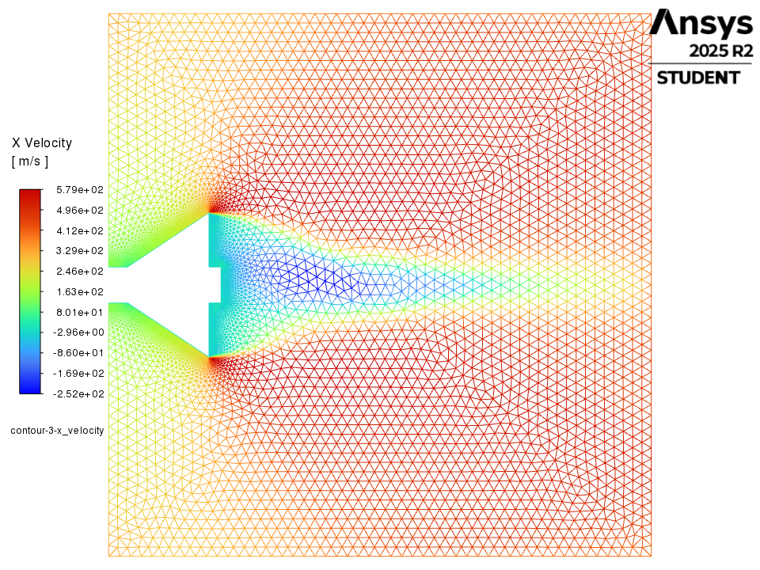
contour-3-x_velocity
Contours / contour-3-x_velocity
Table of contents

Slide 33
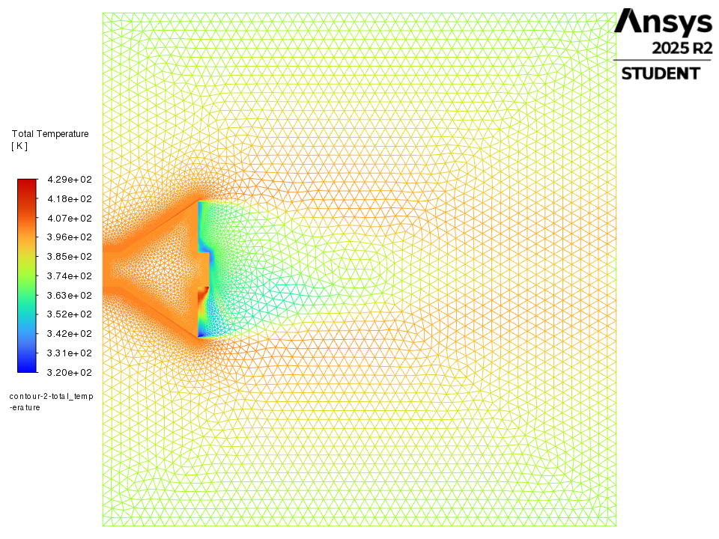
contour-2-total_temperature
Contours / contour-2-total_temperature
Table of contents

Slide 34
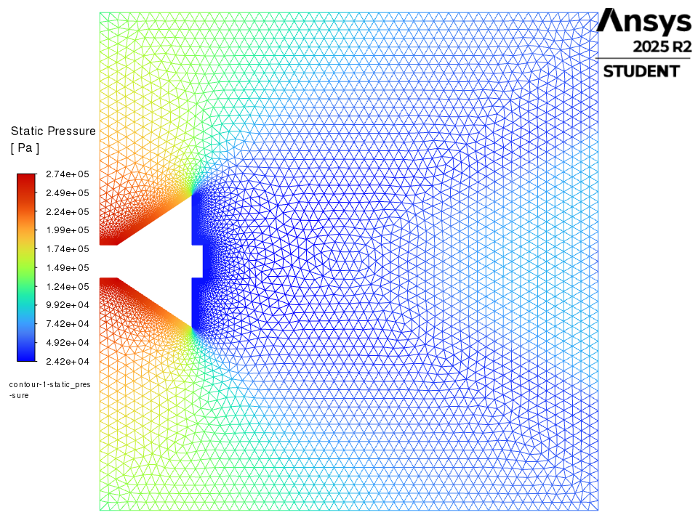
contour-1-static_pressure
Contours / contour-1-static_pressure
Table of contents

Slide 35
Vectors
Vectors
Table of contents

Slide 36
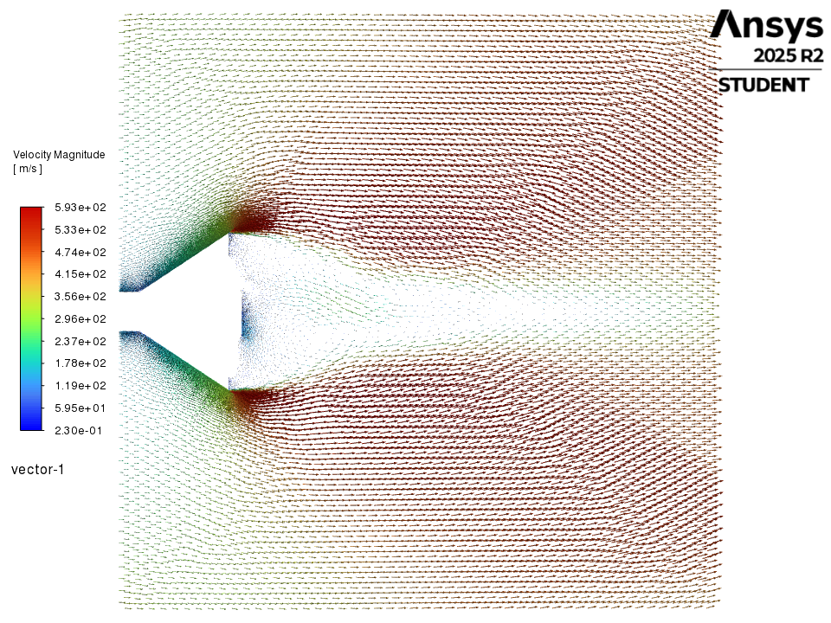
vector-1
Vectors / vector-1
Table of contents

Slide 37
Pathlines
Pathlines
Table of contents

Slide 38
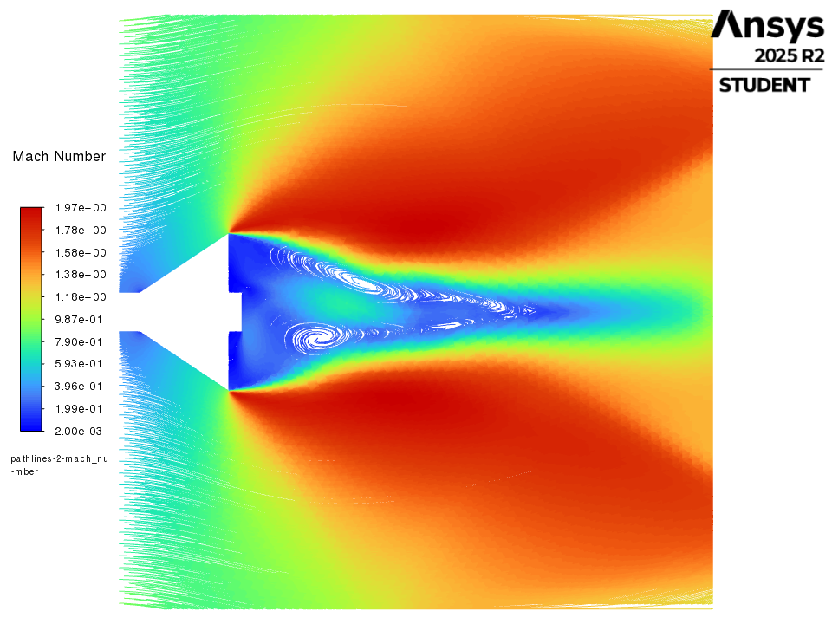
pathlines-2-mach_number
Pathlines / pathlines-2-mach_number
Table of contents

Slide 39
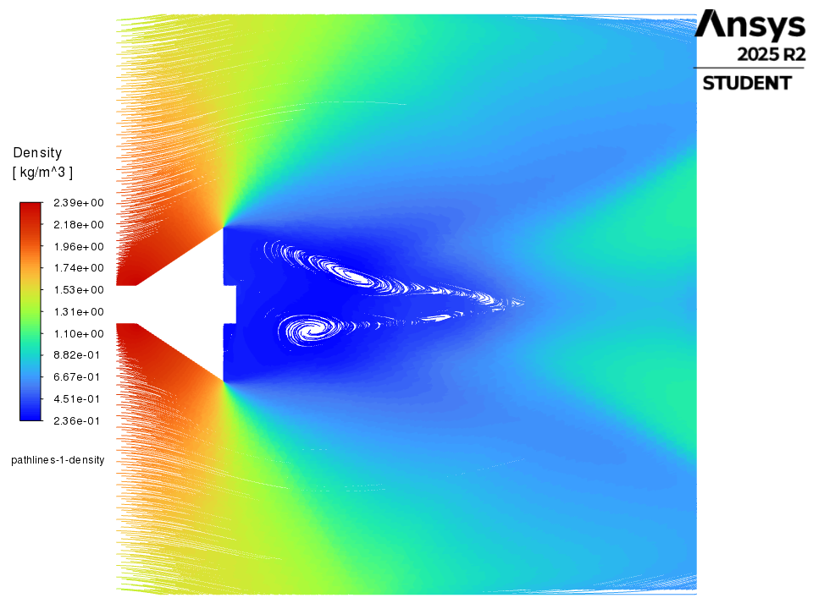
pathlines-1-density
Pathlines / pathlines-1-density
Table of contents

