Slide 1
Ansys Fluent Simulation Report

Slide 2
Header
Analyst | ShubhamR
Date | 2/14/2026 02:45 PM
Table of contents

Slide 3
Table of Contents
System Information
Geometry and Mesh
Mesh Size
Mesh Quality
Orthogonal Quality
Simulation Setup
Physics
Models
Material Properties
Cell Zone Conditions
Boundary Conditions
Reference Values
Solver Settings
Run Information
Solution Status
Named Expressions
Report Definitions
Plots
Residuals
Contours
Pathlines

Slide 4
System Information
Application | Fluent
Settings | 2d, double precision, pressure-based, laminar, transient
Version | 25.2.0-10204
Source Revision | 5eecd5d865
Build Time | Jun 16 2025 10:44:41 EDT
CPU | AMD Ryzen 7 6800H with Radeon Graphics
OS | Windows
System Information
Table of contents

Slide 5
Geometry and Mesh
Geometry and Mesh
Table of contents

Slide 6
Mesh Size
Cells | Faces | Nodes
5958 | 8997 | 3040
Geometry and Mesh / Mesh Size
Table of contents

Slide 7
Mesh Quality
Name | Type | Min Orthogonal Quality | Max Aspect Ratio
fluid | Tri Cell | 0.65433157 | 3.7971083
fluid_source | Tri Cell | 0.65707038 | 3.7953515
Geometry and Mesh / Mesh Quality
Table of contents

Slide 8
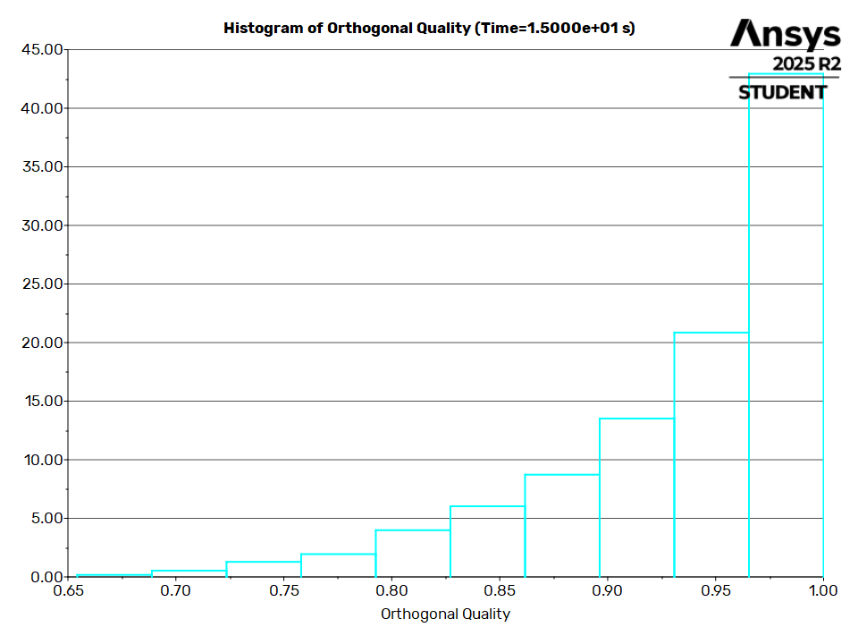
Orthogonal Quality
Geometry and Mesh / Orthogonal Quality
Table of contents

Slide 9
Simulation Setup
Simulation Setup
Table of contents

Slide 10
Physics
Simulation Setup / Physics
Table of contents

Slide 11
Models
Model | Settings
Space | 2D
Time | Unsteady, 1st-Order Implicit
Viscous | Laminar
Simulation Setup / Physics / Models
Table of contents

Slide 12
Material Properties
- Fluid
- water-liquid
Density | 998.2 kg/m^3
Viscosity | 0.001003 kg/(m s)
- air
Density | 1.225 kg/m^3
Viscosity | 1.7894e-05 kg/(m s)
- Solid
- aluminum
Density | 2719 kg/m^3
Simulation Setup / Physics / Material Properties
Table of contents

Slide 13
Cell Zone Conditions
- Fluid
- fluid
Material Name | water liquid
Specify source terms? | no
Specify fixed values? | no
Frame Motion? | no
Mesh Motion? | no
Porous zone? | no
- fluid_source
Material Name | water liquid
Specify source terms? | yes
- Source Terms
mass | mass_source::libudfInward
Simulation Setup / Physics / Cell Zone Conditions (1 of 2)
Table of contents

Slide 14
Cell Zone Conditions
x-momentum | x_mom_source::libudfInward
y-momentum | y_mom_source::libudfInward
Specify fixed values? | no
Frame Motion? | no
Mesh Motion? | no
Porous zone? | no
Simulation Setup / Physics / Cell Zone Conditions (2 of 2)
Table of contents

Slide 15
Boundary Conditions
- Inlet
- inlet
Velocity Specification Method | Magnitude, Normal to Boundary
Reference Frame | Absolute
Velocity Magnitude | Inlet_Velocity
Supersonic/Initial Gauge Pressure [Pa] | 0
- Outlet
- outlet
Backflow Reference Frame | Absolute
Gauge Pressure | Outlet_GaugePressure
Pressure Profile Multiplier | 1
Backflow Direction Specification Method | Normal to Boundary
Backflow Pressure Specification | Total Pressure
Simulation Setup / Physics / Boundary Conditions (1 of 2)
Table of contents

Slide 16
Boundary Conditions
Build artificial walls to prevent reverse flow? | no
Average Pressure Specification? | no
Specify targeted mass flow rate | no
- Wall
- walls
Wall Motion | Stationary Wall
Shear Boundary Condition | No Slip
Simulation Setup / Physics / Boundary Conditions (2 of 2)
Table of contents

Slide 17
Reference Values
Area | 1 m^2
Density | 1.225 kg/m^3
Depth | 1 m
Enthalpy | 0 J/kg
Length | 1 m
Pressure | 0 Pa
Temperature | 288.16 K
Velocity | 1 m/s
Viscosity | 1.7894e-05 kg/(m s)
Ratio of Specific Heats | 1.4
Yplus for Heat Tran. Coef. | 300
Reference Zone | fluid_source
Simulation Setup / Physics / Reference Values
Table of contents

Slide 18
Solver Settings
- Equations
Flow | True
- Numerics
Absolute Velocity Formulation | True
- Unsteady Calculation Parameters
Number of Time Steps | 150
Time Step Size [s] | 0.1
Max Iterations/Time Step | 50
- Under-Relaxation Factors
Pressure | 0.3
Density | 1
Body Forces | 1
Momentum | 0.7
Simulation Setup / Solver Settings (1 of 2)
Table of contents

Slide 19
Solver Settings
- Pressure-Velocity Coupling
Type | SIMPLE
- Discretization Scheme
Pressure | Second Order
Momentum | Second Order Upwind
- Solution Limits
Minimum Absolute Pressure [Pa] | 1
Maximum Absolute Pressure [Pa] | 5e+10
Minimum Static Temperature [K] | 1
Maximum Static Temperature [K] | 5000
Simulation Setup / Solver Settings (2 of 2)
Table of contents

Slide 20
Run Information
Number of Machines | 1
Number of Cores | 2
Case Read | 10.986 seconds
Iteration | 19.087 seconds
AMG | 6.306 seconds
Virtual Current Memory | 1.00473 GB
Virtual Peak Memory | 1.01178 GB
Memory Per M Cell | 60.3795
Run Information
Table of contents

Slide 21
Solution Status
Flow Time: 15, Time Step: 150
 | Value | Absolute Criteria | Convergence Status
continuity | 0.0009325448 | 0.001 | Converged
x-velocity | 1.962833e-06 | 0.001 | Converged
y-velocity | 3.891566e-08 | 0.001 | Converged
Solution Status
Table of contents

Slide 22
Named Expressions
Expression | Definition | Value | Unit | Used In | Description
Inlet_Velocity | 0.01 [m/s] | 0.01 | [m s^-1] | inlet (Velocity Magnitude)
Outlet_GaugePressure | 0 [Pa] | 0 | [kg m^-1 s^-2] | outlet (Gauge Pressure)
massFlow | -10 [kg/(m^3 s)] | -10 | [kg m^-3 s^-1]
xMomentum | 10 [N/m^3] | 10 | [kg m^-2 s^-2]
yMomentum | 10 [N/m^3] | 10 | [kg m^-2 s^-2]
Named Expressions
Table of contents

Slide 23
Report Definitions
delta-time | 0.1 | s
iters-per-timestep | 17
flow-time | 15 | s
Report Definitions
Table of contents

Slide 24
Plots
Plots
Table of contents

Slide 25
Residuals
Plots / Residuals
Table of contents

Slide 26
Contours
Contours
Table of contents

Slide 27
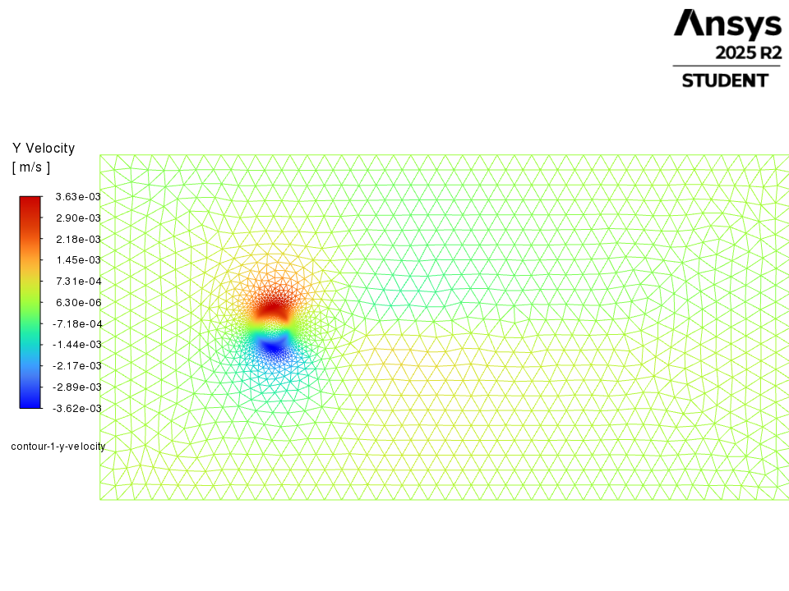
contour-1-y-velocity
Contours / contour-1-y-velocity
Table of contents

Slide 28
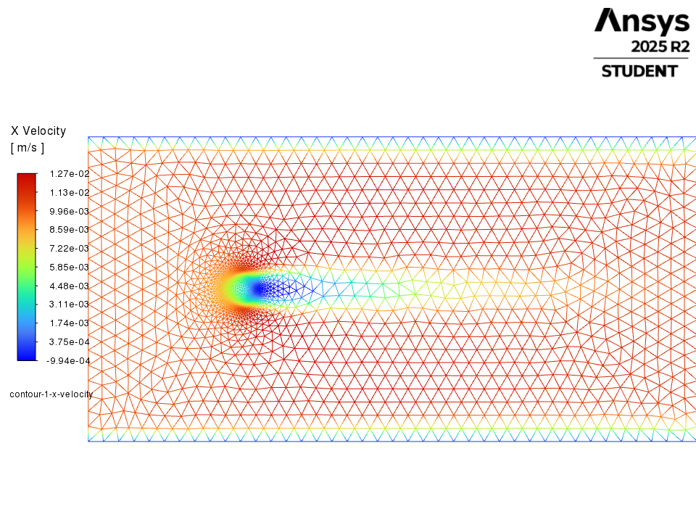
contour-1-x-velocity
Contours / contour-1-x-velocity
Table of contents

Slide 29
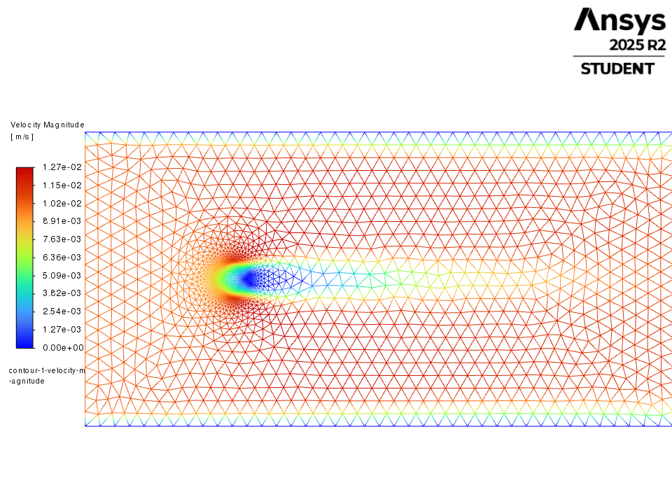
contour-1-velocity-magnitude
Contours / contour-1-velocity-magnitude
Table of contents

Slide 30
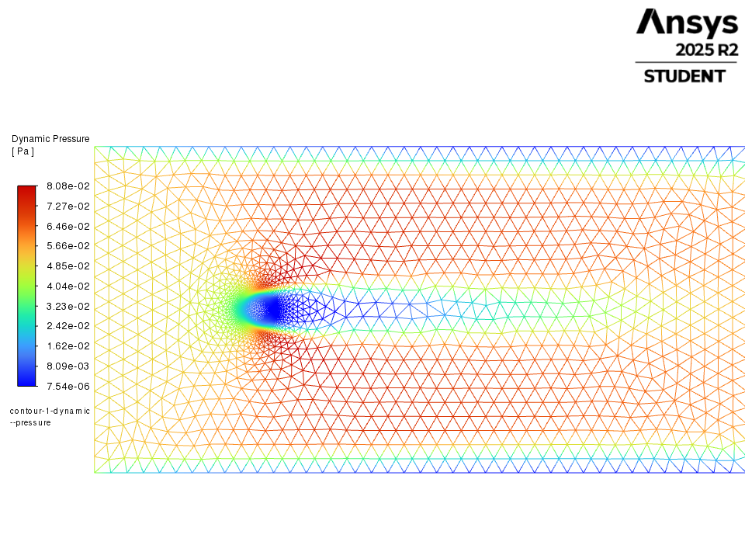
contour-1-dynamic-pressure
Contours / contour-1-dynamic-pressure
Table of contents

Slide 31
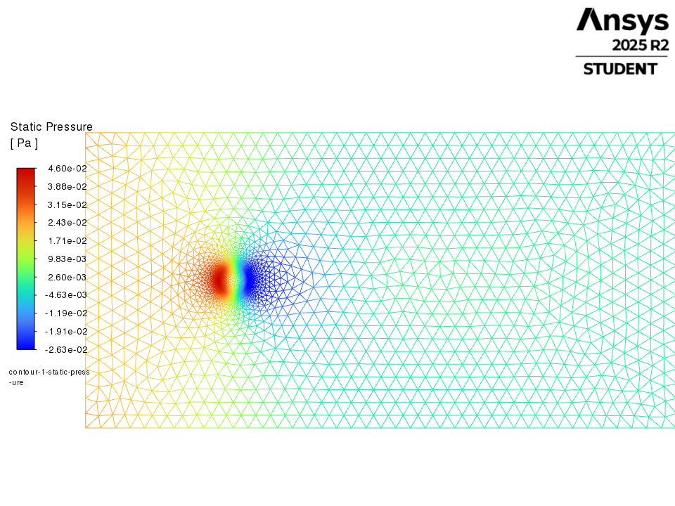
contour-1-static-pressure
Contours / contour-1-static-pressure
Table of contents

Slide 32
Pathlines
Pathlines
Table of contents

Slide 33
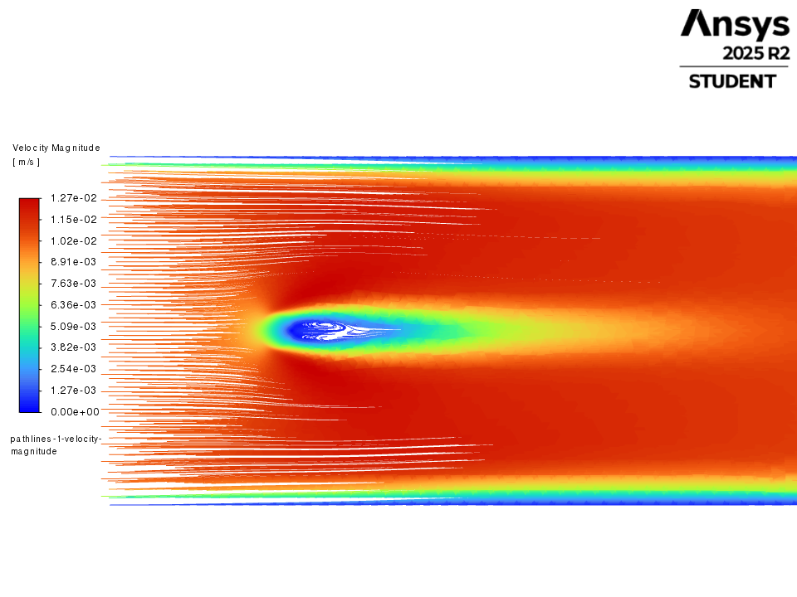
pathlines-1-velocity-magnitude
Pathlines / pathlines-1-velocity-magnitude
Table of contents

