Slide 1
Ansys Fluent Simulation Report

Slide 2
Header
Analyst | ShubhamR
Date | 8/19/2026 10:57 PM
Table of contents

Slide 3
Table of Contents
System Information
Geometry and Mesh
Mesh Size
Mesh Quality
Orthogonal Quality
Simulation Setup
Physics
Models
Material Properties
Cell Zone Conditions
Boundary Conditions
Reference Values
Solver Settings
Run Information
Solution Status
Plots
Residuals
Mesh
Contours
Pathlines
Scenes

Slide 4
System Information
Application | Fluent
Settings | 3d, double precision, pressure-based, SST k-omega
Version | 26.1.0-10262
Source Revision | b6f454dde8
Build Time | Feb 2 2026 16:34:25 EST
CPU | AMD Ryzen 7 6800H with Radeon Graphics
GPU | NVIDIA GeForce RTX 3050 Laptop GPU
OS | Windows
System Information
Table of contents

Slide 5
Geometry and Mesh
Geometry and Mesh
Table of contents

Slide 6
Mesh Size
Cells | Faces | Nodes
107676 | 241529 | 33214
Geometry and Mesh / Mesh Size
Table of contents

Slide 7
Mesh Quality
Name | Type | Min Orthogonal Quality | Max Aspect Ratio
fluid | Mixed Cell | 0.22227342 | 14.697877
solid11 | Tet Cell | 0.12993988 | 20.319746
Geometry and Mesh / Mesh Quality
Table of contents

Slide 8
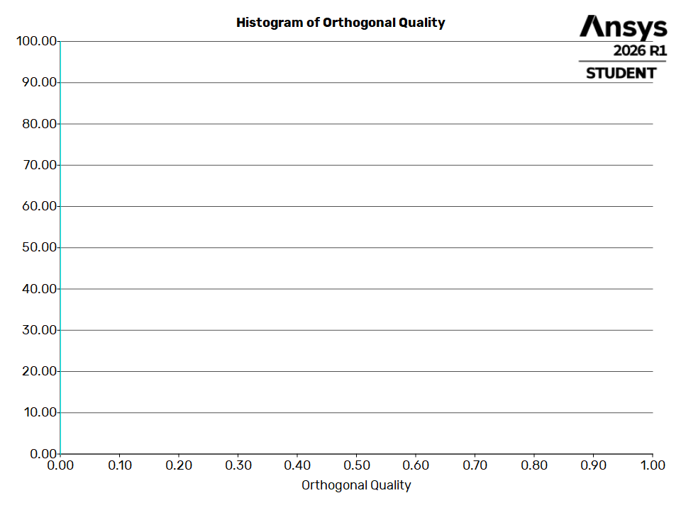
Orthogonal Quality
Geometry and Mesh / Orthogonal Quality
Table of contents

Slide 9
Simulation Setup
Simulation Setup
Table of contents

Slide 10
Physics
Simulation Setup / Physics
Table of contents

Slide 11
Models
Model | Settings
Space | 3D
Time | Steady
Viscous | SST k-omega turbulence model
Simulation Setup / Physics / Models
Table of contents

Slide 12
Material Properties
- Fluid
- water-liquid
Density | 998.2 kg/m^3
Viscosity | 0.001003 kg/(m s)
- air
Density | 1.225 kg/m^3
Viscosity | 1.7894e-05 kg/(m s)
- Solid
- steel
Density | 8030 kg/m^3
- aluminum
Density | 2719 kg/m^3
Simulation Setup / Physics / Material Properties
Table of contents

Slide 13
Cell Zone Conditions
- Fluid
- fluid
Material Name | water liquid
Specify source terms? | no
Specify fixed values? | no
Frame Motion? | no
Laminar zone? | no
Porous zone? | no
3D Fan Zone? | no
- Solid
- solid11
Material Name | steel
Frame Motion? | no
Simulation Setup / Physics / Cell Zone Conditions (1 of 2)
Table of contents

Slide 14
Cell Zone Conditions
Solid Motion? | no
Simulation Setup / Physics / Cell Zone Conditions (2 of 2)
Table of contents

Slide 15
Boundary Conditions
- Inlet
- inlet
Velocity Specification Method | Magnitude, Normal to Boundary
Reference Frame | Absolute
Velocity Magnitude [m/s] | 10
Supersonic/Initial Gauge Pressure [Pa] | 0
Turbulence Specification Method | Intensity and Viscosity Ratio
Turbulent Intensity [%] | 5
Turbulent Viscosity Ratio | 10
- Outlet
- outlet
Backflow Reference Frame | Absolute
Gauge Pressure [Pa] | 0
Simulation Setup / Physics / Boundary Conditions (1 of 3)
Table of contents

Slide 16
Boundary Conditions
Pressure Profile Multiplier | 1
Backflow Direction Specification Method | Normal to Boundary
Turbulence Specification Method | Intensity and Viscosity Ratio
Backflow Turbulent Intensity [%] | 5
Backflow Turbulent Viscosity Ratio | 10
Backflow Pressure Specification | Total Pressure
Build artificial walls to prevent reverse flow? | no
Radial Equilibrium Pressure Distribution (Unsupported) | no
Average Pressure Specification? | no
Specify targeted mass flow rate | no
- Wall
- fluid-solid11
Wall Motion | Stationary Wall
Simulation Setup / Physics / Boundary Conditions (2 of 3)
Table of contents

Slide 17
Boundary Conditions
Shear Boundary Condition | No Slip
Wall Surface Roughness | Standard
Wall Roughness Height [mm] | 0
Wall Roughness Constant | 0.5
surface:1 | wall
solid11:655 | wall
fluid-solid11-shadow | wall
Simulation Setup / Physics / Boundary Conditions (3 of 3)
Table of contents

Slide 18
Reference Values
Area | 1 m^2
Density | 998.2 kg/m^3
Enthalpy | 0 J/kg
Length | 1 mm
Pressure | 0 Pa
Temperature | 288.16 K
Velocity | 10 m/s
Viscosity | 0.001003 kg/(m s)
Ratio of Specific Heats | 1.4
Yplus for Heat Tran. Coef. | 300
Reference Zone | fluid
Simulation Setup / Physics / Reference Values
Table of contents

Slide 19
Solver Settings
- Equations
Flow | True
Turbulence | True
- Numerics
Absolute Velocity Formulation | True
- Under-Relaxation Factors
Pressure | 0.3
Density | 1
Body Forces | 1
Momentum | 0.7
Turbulent Kinetic Energy | 0.8
Specific Dissipation Rate | 0.8
Turbulent Viscosity | 1
Simulation Setup / Solver Settings (1 of 3)
Table of contents

Slide 20
Solver Settings
- Pressure-Velocity Coupling
Type | SIMPLE
- Discretization Scheme
Pressure | Second Order
Momentum | Second Order Upwind
Turbulent Kinetic Energy | Second Order Upwind
Specific Dissipation Rate | Second Order Upwind
- Solution Limits
Minimum Absolute Pressure [Pa] | 1
Maximum Absolute Pressure [Pa] | 5e+10
Minimum Static Temperature [K] | 1
Maximum Static Temperature [K] | 5000
Minimum Turb. Kinetic Energy [m^2/s^2] | 1e-14
Simulation Setup / Solver Settings (2 of 3)
Table of contents

Slide 21
Solver Settings
Minimum Spec. Dissipation Rate [s^-1] | 1e-20
Maximum Turb. Viscosity Ratio | 100000
Simulation Setup / Solver Settings (3 of 3)
Table of contents

Slide 22
Run Information
Number of Machines | 1
Number of Cores | 4
Case Read | 22.757 seconds
Data Read | 0.387 seconds
Virtual Current Memory | 8.4766 GB
Virtual Peak Memory | 8.4956 GB
Memory Per M Cell | 72.5015
Run Information
Table of contents

Slide 23
Solution Status
Iterations: 2000
 | Value | Absolute Criteria | Convergence Status
continuity | 0.0004435178 | 0.001 | Converged
x-velocity | 0.00247927 | 0.001 | Not Converged
y-velocity | 0.001759697 | 0.001 | Not Converged
z-velocity | 0.001828777 | 0.001 | Not Converged
k | 0.001399828 | 0.001 | Not Converged
omega | 0.001396939 | 0.001 | Not Converged
Solution Status
Table of contents

Slide 24
Plots
Plots
Table of contents

Slide 25
Residuals
Plots / Residuals
Table of contents

Slide 26
Mesh
Mesh
Table of contents

Slide 27
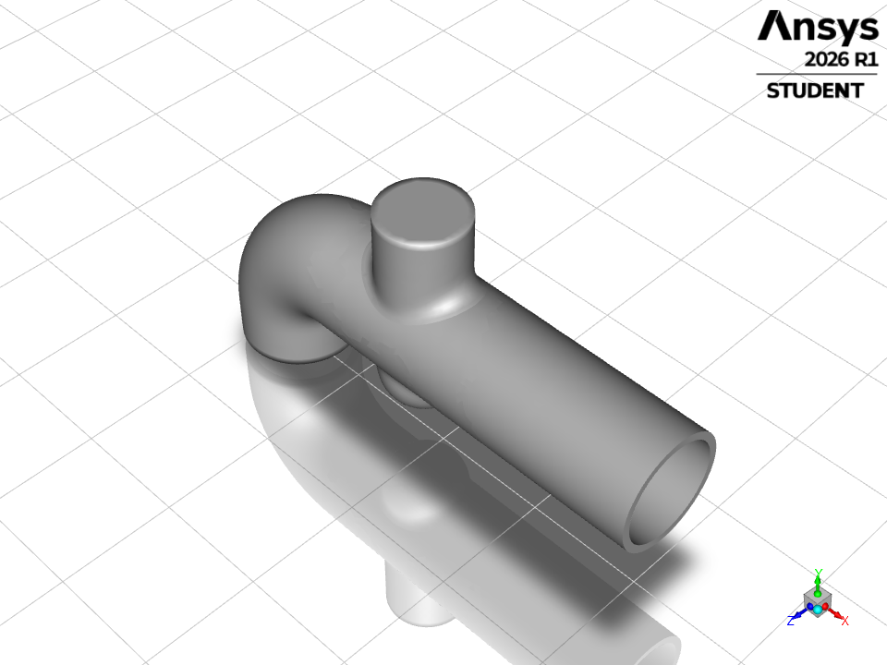
mesh-1
Mesh / mesh-1
Table of contents

Slide 28
Contours
Contours
Table of contents

Slide 29
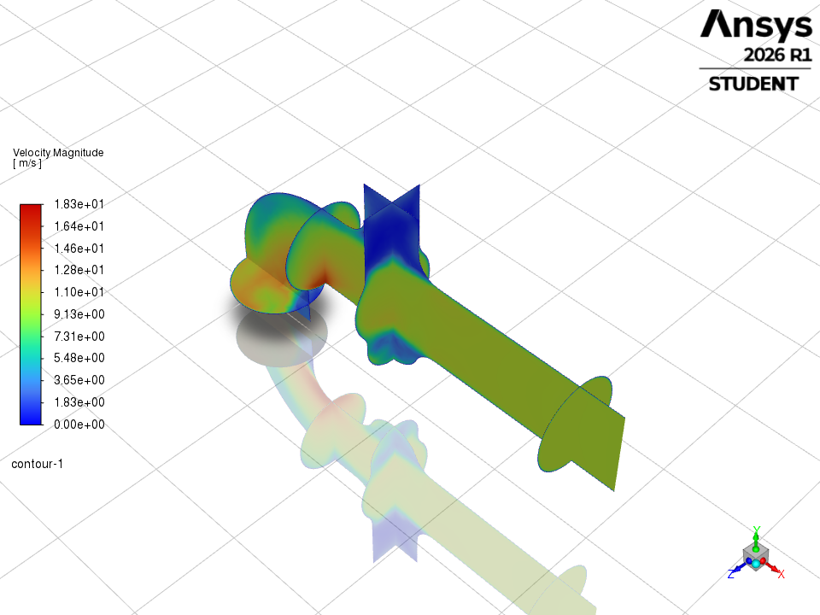
contour-1
Contours / contour-1
Table of contents

Slide 30
Pathlines
Pathlines
Table of contents

Slide 31
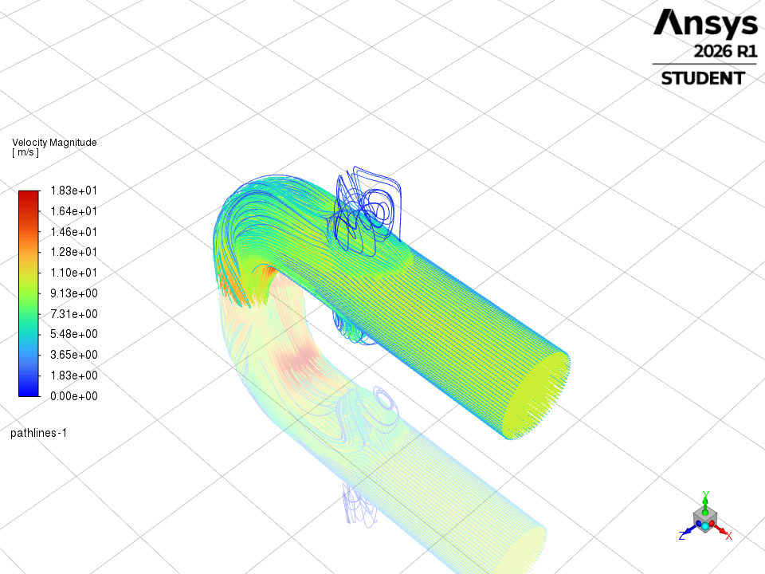
pathlines-1
Pathlines / pathlines-1
Table of contents

Slide 32
Scenes
Scenes
Table of contents

Slide 33
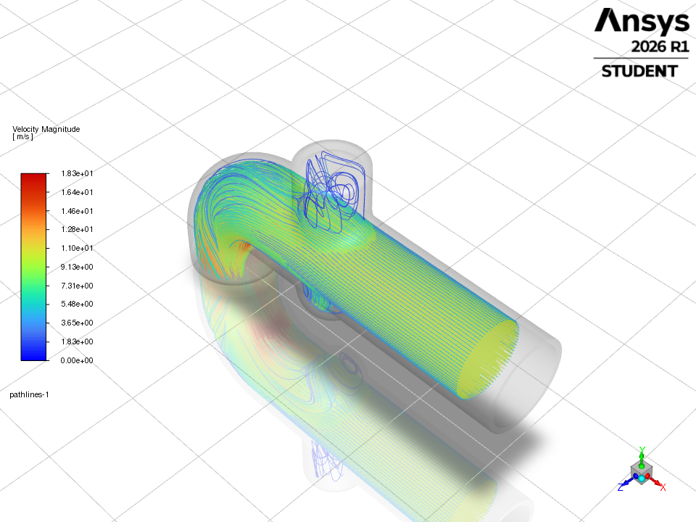
scene-1
Scenes / scene-1
Table of contents

