Slide 1
Ansys Fluent Simulation Report

Slide 2
Header
Analyst | ShubhamR
Date | 4/3/2026 10:33 PM
Table of contents

Slide 3
Table of Contents
System Information
Geometry and Mesh
Mesh Size
Mesh Quality
Orthogonal Quality
Simulation Setup
Physics
Models
Material Properties
Cell Zone Conditions
Boundary Conditions
Reference Values
Solver Settings
Run Information
Solution Status
Report Definitions
Plots
Residuals
Report Plots
Contours
Vectors

Slide 4
System Information
Application | Fluent
Settings | 2d, double precision, density-based implicit, SST k-omega
Version | 25.2.0-10204
Source Revision | 5eecd5d865
Build Time | Jun 16 2025 10:44:41 EDT
CPU | AMD Ryzen 7 6800H with Radeon Graphics
OS | Windows
System Information
Table of contents

Slide 5
Geometry and Mesh
Geometry and Mesh
Table of contents

Slide 6
Mesh Size
Cells | Faces | Nodes
38803 | 58488 | 19686
Geometry and Mesh / Mesh Size
Table of contents

Slide 7
Mesh Quality
Name | Type | Min Orthogonal Quality | Max Aspect Ratio
fluid | Tri Cell | 0.65788031 | 3.734223
Geometry and Mesh / Mesh Quality
Table of contents

Slide 8
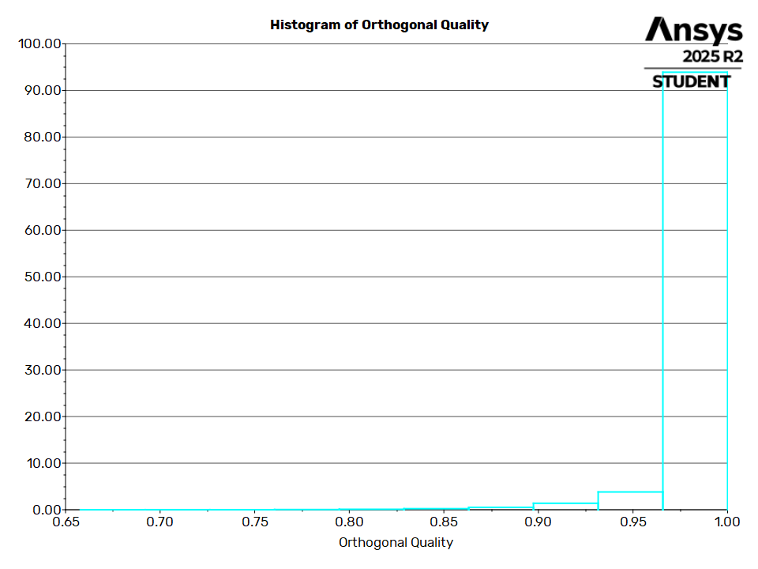
Orthogonal Quality
Geometry and Mesh / Orthogonal Quality
Table of contents

Slide 9
Simulation Setup
Simulation Setup
Table of contents

Slide 10
Physics
Simulation Setup / Physics
Table of contents

Slide 11
Models
Model | Settings
Space | 2D
Time | Steady
Viscous | SST k-omega turbulence model
Heat Transfer | Enabled
Simulation Setup / Physics / Models
Table of contents

Slide 12
Material Properties
- Fluid
- air
Density | ideal gas
Cp (Specific Heat) | 1006.43 J/(kg K)
Thermal Conductivity | 0.0242 W/(m K)
Viscosity | 1.7894e-05 kg/(m s)
Molecular Weight | 28.966 kg/kmol
- Solid
- aluminum
Density | 2719 kg/m^3
Cp (Specific Heat) | 871 J/(kg K)
Thermal Conductivity | 202.4 W/(m K)
Simulation Setup / Physics / Material Properties
Table of contents

Slide 13
Cell Zone Conditions
- Fluid
- fluid
Material Name | air
Specify source terms? | no
Specify fixed values? | no
Frame Motion? | no
Laminar zone? | no
Porous zone? | no
Simulation Setup / Physics / Cell Zone Conditions
Table of contents

Slide 14
Boundary Conditions
- Inlet
- inlet
Reference Frame | Absolute
Gauge Total Pressure [Pa] | 792840
Supersonic/Initial Gauge Pressure [Pa] | 750000
Total Temperature [K] | 300
Direction Specification Method | Normal to Boundary
Build artificial walls to prevent reverse flow? | no
Turbulence Specification Method | Intensity and Viscosity Ratio
Turbulent Intensity [%] | 5
Turbulent Viscosity Ratio | 10
- Outlet
- domain_walls:001
Simulation Setup / Physics / Boundary Conditions (1 of 7)
Table of contents

Slide 15
Boundary Conditions
Backflow Reference Frame | Absolute
Gauge Pressure [Pa] | 101325
Pressure Profile Multiplier | 1
Backflow Total Temperature [K] | 300
Backflow Direction Specification Method | Normal to Boundary
Turbulence Specification Method | Intensity and Viscosity Ratio
Backflow Turbulent Intensity [%] | 5
Backflow Turbulent Viscosity Ratio | 10
Acoustic Wave Model | Off
Backflow Pressure Specification | Total Pressure
Build artificial walls to prevent reverse flow? | no
Average Pressure Specification? | no
Specify targeted mass flow rate | no
Simulation Setup / Physics / Boundary Conditions (2 of 7)
Table of contents

Slide 16
Boundary Conditions
- domain_walls
Backflow Reference Frame | Absolute
Gauge Pressure [Pa] | 101325
Pressure Profile Multiplier | 1
Backflow Total Temperature [K] | 300
Backflow Direction Specification Method | Normal to Boundary
Turbulence Specification Method | Intensity and Viscosity Ratio
Backflow Turbulent Intensity [%] | 5
Backflow Turbulent Viscosity Ratio | 10
Acoustic Wave Model | Off
Backflow Pressure Specification | Total Pressure
Build artificial walls to prevent reverse flow? | no
Average Pressure Specification? | no
Simulation Setup / Physics / Boundary Conditions (3 of 7)
Table of contents

Slide 17
Boundary Conditions
Specify targeted mass flow rate | no
- outlet
Backflow Reference Frame | Absolute
Gauge Pressure [Pa] | 101325
Pressure Profile Multiplier | 1
Backflow Total Temperature [K] | 300
Backflow Direction Specification Method | Normal to Boundary
Turbulence Specification Method | Intensity and Viscosity Ratio
Backflow Turbulent Intensity [%] | 5
Backflow Turbulent Viscosity Ratio | 10
Acoustic Wave Model | Off
Backflow Pressure Specification | Total Pressure
Build artificial walls to prevent reverse flow? | no
Simulation Setup / Physics / Boundary Conditions (4 of 7)
Table of contents

Slide 18
Boundary Conditions
Average Pressure Specification? | no
Specify targeted mass flow rate | no
- Wall
- domain_walls:003
Wall Thickness [m] | 0
Heat Generation Rate [W/m^3] | 0
Material Name | aluminum
Thermal BC Type | Heat Flux
Heat Flux [W/m^2] | 0
Wall Motion | Stationary Wall
Shear Boundary Condition | No Slip
Wall Surface Roughness | Standard
Wall Roughness Height [m] | 0
Simulation Setup / Physics / Boundary Conditions (5 of 7)
Table of contents

Slide 19
Boundary Conditions
Wall Roughness Constant | 0.5
Convective Augmentation Factor | 1
- domain_walls:002
Wall Thickness [m] | 0
Heat Generation Rate [W/m^3] | 0
Material Name | aluminum
Thermal BC Type | Heat Flux
Heat Flux [W/m^2] | 0
Wall Motion | Stationary Wall
Shear Boundary Condition | No Slip
Wall Surface Roughness | Standard
Wall Roughness Height [m] | 0
Wall Roughness Constant | 0.5
Simulation Setup / Physics / Boundary Conditions (6 of 7)
Table of contents

Slide 20
Boundary Conditions
Convective Augmentation Factor | 1
- nozzle_walls
Wall Thickness [m] | 0
Heat Generation Rate [W/m^3] | 0
Material Name | aluminum
Thermal BC Type | Heat Flux
Heat Flux [W/m^2] | 0
Wall Motion | Stationary Wall
Shear Boundary Condition | No Slip
Wall Surface Roughness | Standard
Wall Roughness Height [m] | 0
Wall Roughness Constant | 0.5
Convective Augmentation Factor | 1
Simulation Setup / Physics / Boundary Conditions (7 of 7)
Table of contents

Slide 21
Reference Values
Area | 1 m^2
Density | 8.848594 kg/m^3
Depth | 1 m
Enthalpy | 301929 J/kg
Length | 1 m
Pressure | 101325 Pa
Temperature | 295.2846 K
Velocity | 97.424 m/s
Viscosity | 1.7894e-05 kg/(m s)
Ratio of Specific Heats | 1.4
Yplus for Heat Tran. Coef. | 300
Reference Zone | domain_walls:003
Simulation Setup / Physics / Reference Values
Table of contents

Slide 22
Solver Settings
- Equations
Flow | True
Turbulence | True
- Numerics
Absolute Velocity Formulation | True
- Under-Relaxation Factors
Turbulent Kinetic Energy | 0.8
Specific Dissipation Rate | 0.8
Turbulent Viscosity | 1
Solid | 1
- Discretization Scheme
Flow | Second Order Upwind
Turbulent Kinetic Energy | Second Order Upwind
Simulation Setup / Solver Settings (1 of 2)
Table of contents

Slide 23
Solver Settings
Specific Dissipation Rate | Second Order Upwind
- Time Marching
Solver | Implicit
Courant Number | 3
- Solution Limits
Minimum Absolute Pressure [Pa] | 1
Maximum Absolute Pressure [Pa] | 5e+10
Minimum Static Temperature [K] | 1
Maximum Static Temperature [K] | 5000
Minimum Turb. Kinetic Energy [m^2/s^2] | 1e-14
Minimum Spec. Dissipation Rate [s^-1] | 1e-20
Maximum Turb. Viscosity Ratio | 100000
Simulation Setup / Solver Settings (2 of 2)
Table of contents

Slide 24
Run Information
Number of Machines | 1
Number of Cores | 4
Case Read | 6.514 seconds
Iteration | 317.28 seconds
AMG | 109.081 seconds
Virtual Current Memory | 1.41575 GB
Virtual Peak Memory | 1.60554 GB
Memory Per M Cell | 19.9045
Run Information
Table of contents

Slide 25
Solution Status
Iterations: 6930
 | Value | Absolute Criteria | Convergence Status
continuity | 0.0008386507 | 0.001 | Converged
x-velocity | 0.0009915328 | 0.001 | Converged
y-velocity | 0.0004455444 | 0.001 | Converged
energy | 0.0008109147 | 0.001 | Converged
k | 0.0001118073 | 0.001 | Converged
omega | 0.0001546634 | 0.001 | Converged
Solution Status
Table of contents

Slide 26
Report Definitions
net-mfr | -39.71697 | kg/s
cfl-number | 3
Report Definitions
Table of contents

Slide 27
Plots
Plots
Table of contents

Slide 28
Residuals
Plots / Residuals
Table of contents

Slide 29
Report Plots
Plots / Report Plots
Table of contents

Slide 30
net-mfr-rplot
Plots / Report Plots / net-mfr-rplot
Table of contents

Slide 31
Contours
Contours
Table of contents

Slide 32
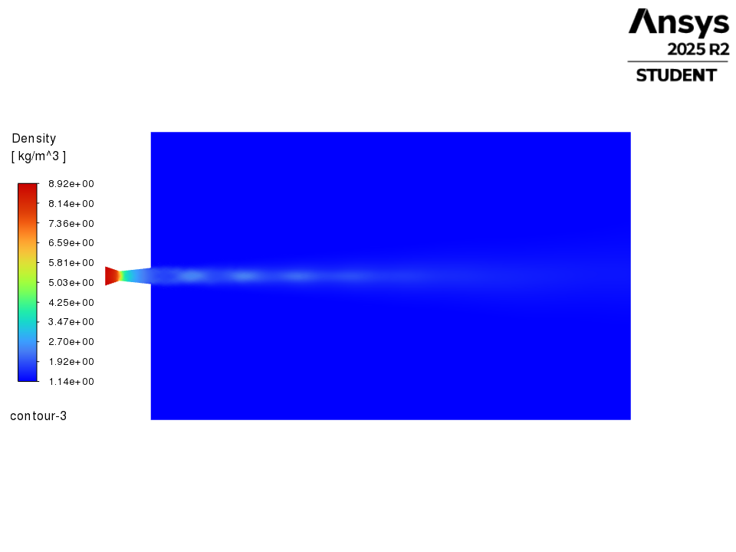
contour-3
Contours / contour-3
Table of contents

Slide 33
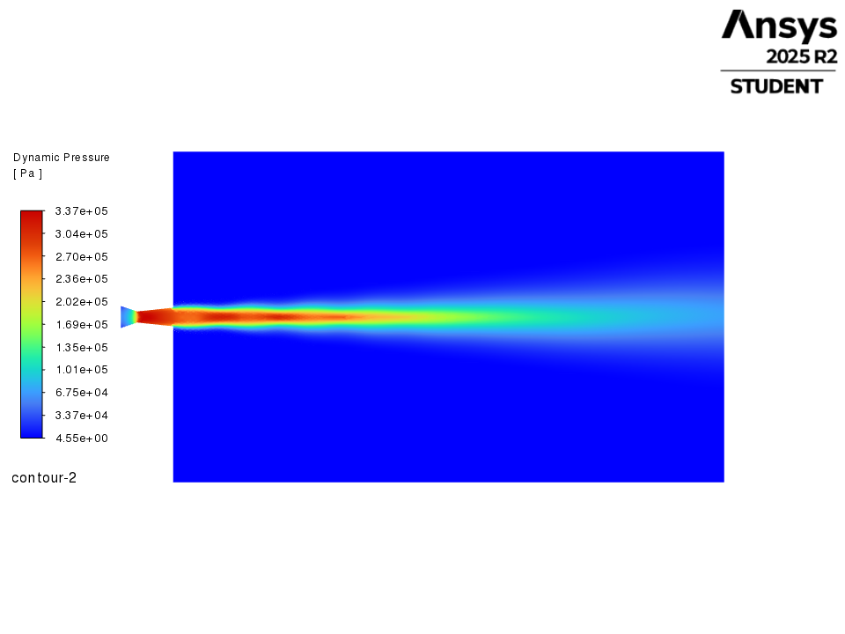
contour-2
Contours / contour-2
Table of contents

Slide 34
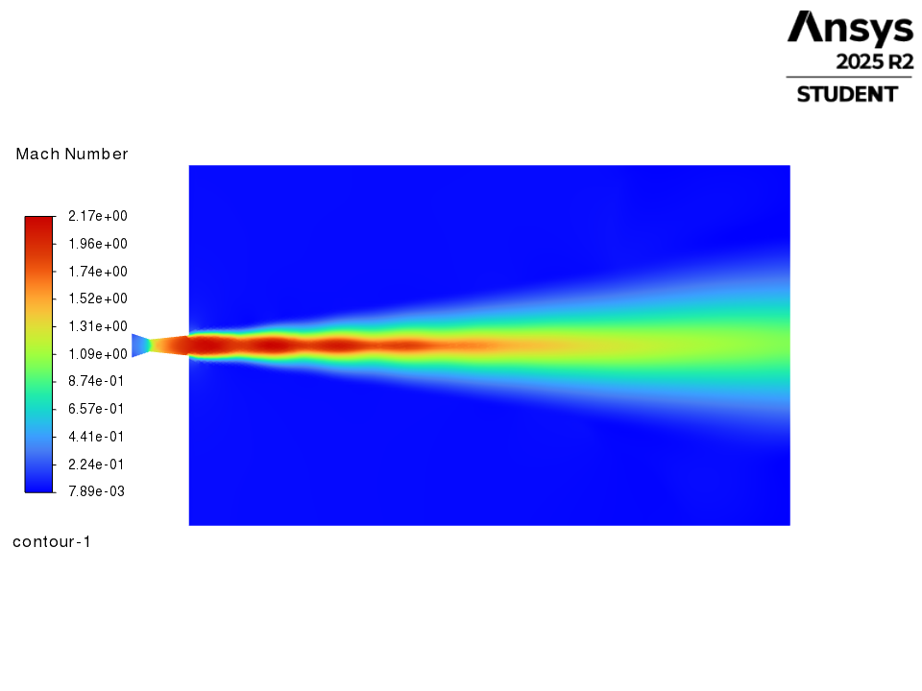
contour-1
Contours / contour-1
Table of contents

Slide 35
Vectors
Vectors
Table of contents

Slide 36
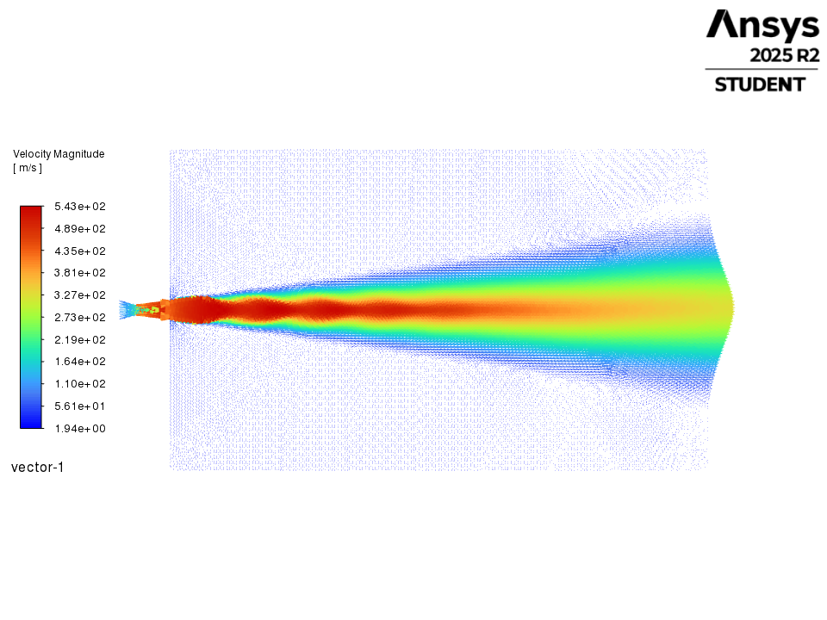
vector-1
Vectors / vector-1
Table of contents

