Slide 1
Ansys Fluent Simulation Report

Slide 2
Header
Analyst | ShubhamR
Date | 2/7/2026 08:45 PM
Table of contents

Slide 3
Table of Contents
System Information
Geometry and Mesh
Mesh Size
Mesh Quality
Orthogonal Quality
Simulation Setup
Physics
Models
Material Properties
Cell Zone Conditions
Boundary Conditions
Reference Values
Solver Settings
Run Information
Solution Status
Report Definitions
Plots
Residuals
Contours
Vectors
Pathlines

Slide 4
System Information
Application | Fluent
Settings | 2d, double precision, pressure-based, dynamic mesh, Scale Adaptive Simulation, transient
Version | 25.2.0-10204
Source Revision | 5eecd5d865
Build Time | Jun 16 2025 10:44:41 EDT
CPU | AMD Ryzen 7 6800H with Radeon Graphics
OS | Windows
System Information
Table of contents

Slide 5
Geometry and Mesh
Geometry and Mesh
Table of contents

Slide 6
Mesh Size
Cells | Faces | Nodes
5840 | 8882 | 3043
Geometry and Mesh / Mesh Size
Table of contents

Slide 7
Mesh Quality
Name | Type | Min Orthogonal Quality | Max Aspect Ratio
fluid | Tri Cell | 0.1127685 | 10.245138
solid | Tri Cell | 0.76980036 | 3.1622777
Geometry and Mesh / Mesh Quality
Table of contents

Slide 8
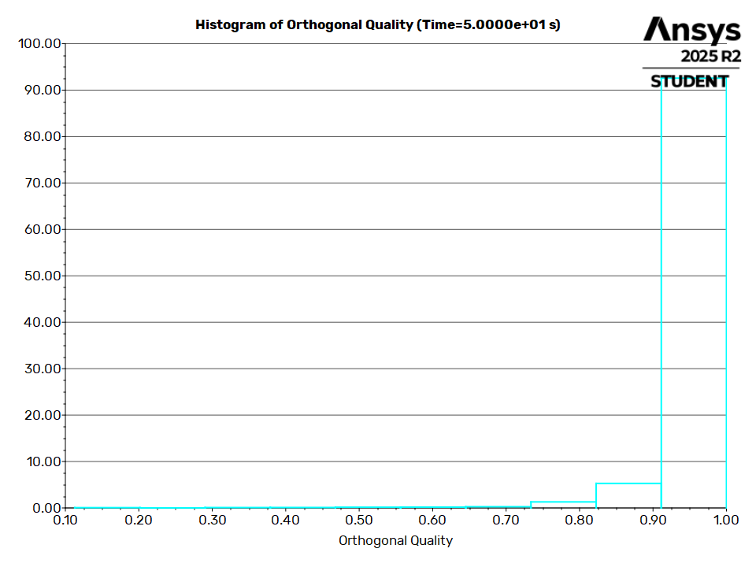
Orthogonal Quality
Geometry and Mesh / Orthogonal Quality
Table of contents

Slide 9
Simulation Setup
Simulation Setup
Table of contents

Slide 10
Physics
Simulation Setup / Physics
Table of contents

Slide 11
Models
Model | Settings
Space | 2D
Time | Unsteady, 1st-Order Implicit
Viscous | SAS model
Simulation Setup / Physics / Models
Table of contents

Slide 12
Material Properties
- Fluid
- water-liquid
Density | 998.2 kg/m^3
Viscosity | 0.001003 kg/(m s)
- air
Density | 1.225 kg/m^3
Viscosity | 1.7894e-05 kg/(m s)
- Solid
- aluminum
Density | 2719 kg/m^3
Simulation Setup / Physics / Material Properties
Table of contents

Slide 13
Cell Zone Conditions
- Fluid
- fluid
Material Name | water liquid
Specify source terms? | no
Specify fixed values? | no
Frame Motion? | no
Mesh Motion? | yes
Relative To Cell Zone | -1
Moving Mesh Rotation Speed [rad/s] | 0
Moving Mesh X-Velocity Of Zone [m/s] | 0
Moving Mesh Y-Velocity Of Zone [m/s] | 0
Moving Mesh User Defined Zone Motion Function | none
Laminar zone? | no
Simulation Setup / Physics / Cell Zone Conditions (1 of 2)
Table of contents

Slide 14
Cell Zone Conditions
Porous zone? | no
- Solid
- solid
Material Name | aluminum
Frame Motion? | no
Mesh Motion? | no
Solid Motion? | yes
Relative To Cell Zone | -1
Solid Body Rotation Speed [rad/s] | 0
Solid Motion X-Velocity Of Zone [m/s] | 0
Solid Motion Y-Velocity Of Zone [m/s] | 0
Solid Motion User Defined Solid Motion Function | none
Simulation Setup / Physics / Cell Zone Conditions (2 of 2)
Table of contents

Slide 15
Boundary Conditions
- Wall
solid_walls-shadow | wall
- solid_walls
Wall Motion | Stationary Wall
Shear Boundary Condition | No Slip
Wall Roughness Height [m] | 0
Wall Roughness Constant | 0.5
- outer_walls
Wall Motion | Stationary Wall
Shear Boundary Condition | No Slip
Wall Roughness Height [m] | 0
Wall Roughness Constant | 0.5
Simulation Setup / Physics / Boundary Conditions
Table of contents

Slide 16
Reference Values
Area | 1 m^2
Density | 1.225 kg/m^3
Depth | 1 m
Enthalpy | 0 J/kg
Length | 1 m
Pressure | 0 Pa
Temperature | 288.16 K
Velocity | 1 m/s
Viscosity | 1.7894e-05 kg/(m s)
Ratio of Specific Heats | 1.4
Yplus for Heat Tran. Coef. | 300
Reference Zone | fluid
Simulation Setup / Physics / Reference Values
Table of contents

Slide 17
Solver Settings
- Equations
Flow | True
Turbulence | True
- Numerics
Absolute Velocity Formulation | True
- Unsteady Calculation Parameters
Number of Time Steps | 100
Time Step Size [s] | 0.5
Max Iterations/Time Step | 40
- Under-Relaxation Factors
Pressure | 0.3
Density | 1
Body Forces | 1
Simulation Setup / Solver Settings (1 of 3)
Table of contents

Slide 18
Solver Settings
Momentum | 0.7
Turbulent Kinetic Energy | 0.8
Specific Dissipation Rate | 0.8
Turbulent Viscosity | 1
- Pressure-Velocity Coupling
Type | SIMPLE
- Discretization Scheme
Pressure | Second Order
Momentum | Bounded Central Differencing
Turbulent Kinetic Energy | Second Order Upwind
Specific Dissipation Rate | Second Order Upwind
- Solution Limits
Minimum Absolute Pressure [Pa] | 1
Simulation Setup / Solver Settings (2 of 3)
Table of contents

Slide 19
Solver Settings
Maximum Absolute Pressure [Pa] | 5e+10
Minimum Static Temperature [K] | 1
Maximum Static Temperature [K] | 5000
Minimum Turb. Kinetic Energy [m^2/s^2] | 1e-14
Minimum Turb. Kinetic Energy [m^2/s^2] | 1e-07
Minimum Spec. Dissipation Rate [s^-1] | 1e-12
Minimum Spec. Dissipation Rate [s^-1] | 1e-20
Maximum Turb. Viscosity Ratio | 100000
Simulation Setup / Solver Settings (3 of 3)
Table of contents

Slide 20
Run Information
Number of Machines | 1
Number of Cores | 2
Case Read | 7.157 seconds
Iteration | 39.247 seconds
AMG | 8.20299 seconds
Virtual Current Memory | 1.09753 GB
Virtual Peak Memory | 1.21539 GB
Memory Per M Cell | 77.0347
Run Information
Table of contents

Slide 21
Solution Status
Flow Time: 50, Time Step: 100
 | Value | Absolute Criteria | Convergence Status
continuity | 0.02651931 | 0.001 | Not Converged
x-velocity | 0.0002259744 | 0.001 | Converged
y-velocity | 0.0002154885 | 0.001 | Converged
k | 3.634933e-05 | 0.001 | Converged
omega | 0.0001857765 | 0.001 | Converged
Solution Status
Table of contents

Slide 22
Report Definitions
delta-time | 0.5 | s
iters-per-timestep | 40
flow-time | 50 | s
Report Definitions
Table of contents

Slide 23
Plots
Plots
Table of contents

Slide 24
Residuals
Plots / Residuals
Table of contents

Slide 25
Contours
Contours
Table of contents

Slide 26
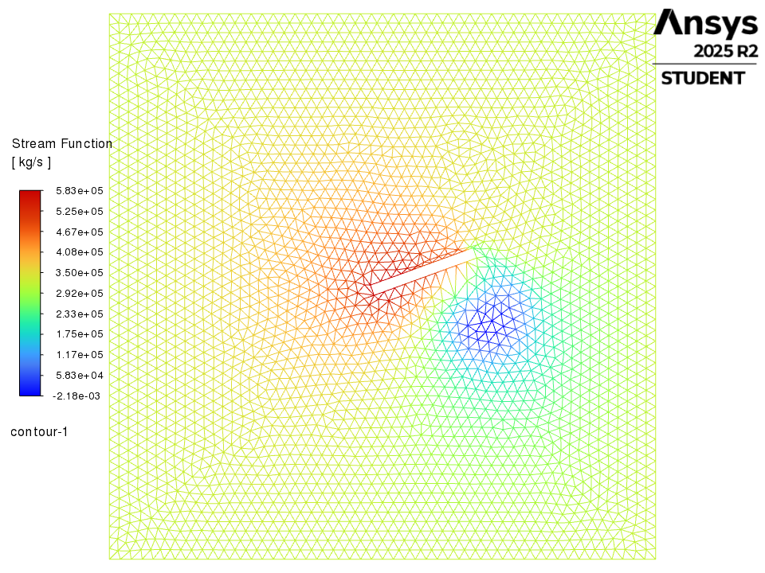
contour-1
Contours / contour-1
Table of contents

Slide 27
Vectors
Vectors
Table of contents

Slide 28
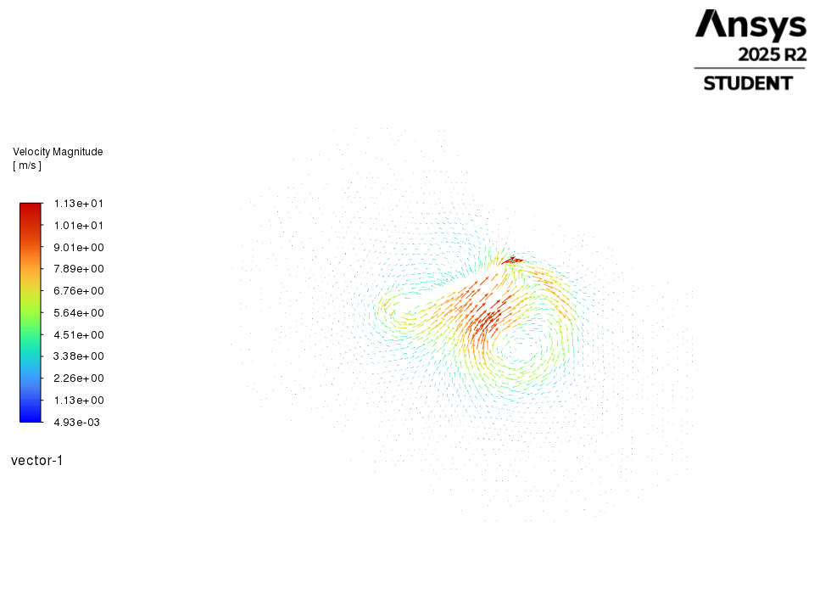
vector-1
Vectors / vector-1
Table of contents

Slide 29
Pathlines
Pathlines
Table of contents

Slide 30
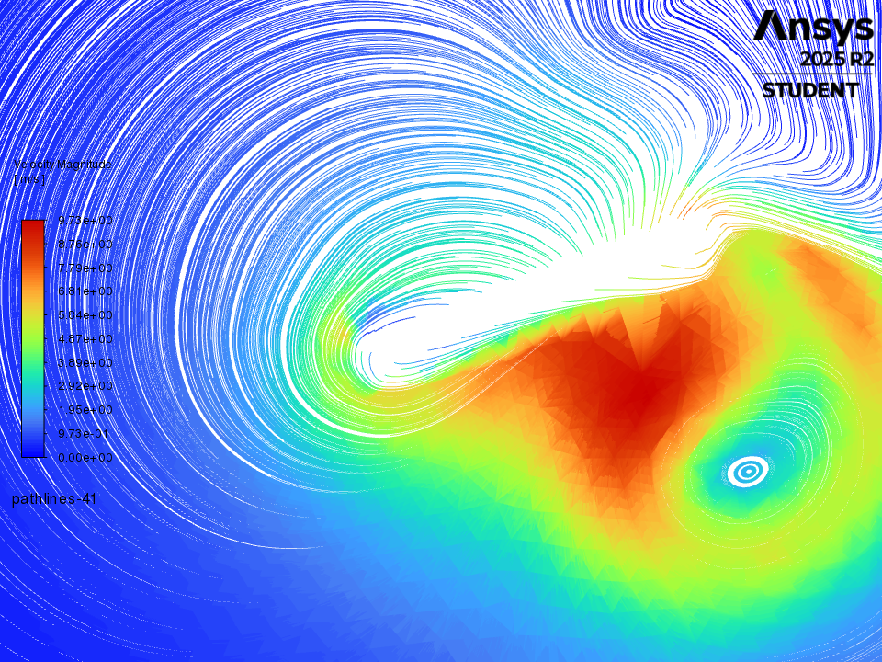
pathlines-41
Pathlines / pathlines-41
Table of contents

