Slide 1

Credit Card Fraud Detection
Machine Learning Project Summary
March 29, 2025
Chervin Daniel
BIU DS-18

Slide 2
Project Overview
Credit card fraud causes major financial losses and reduces user trust.
Goal: Build a machine learning model to detect fraud with minimal false positives.
Challenge: Only ~0.5% of transactions are fraudulent.
Approach: Use advanced techniques like feature engineering and SMOTE for better detection.

Slide 3
Data Handling
Initial dataset: 34.6 million rows; reduced to 300,000 for analysis.
Tools employed: Utilized Dask for effective data processing.
Feature engineering: Included Temporal, Geographical, Demographic, and Transactional features.
Data quality assessment: Ensured no missing values, preserved outliers, and implemented log transformations.

Slide 4
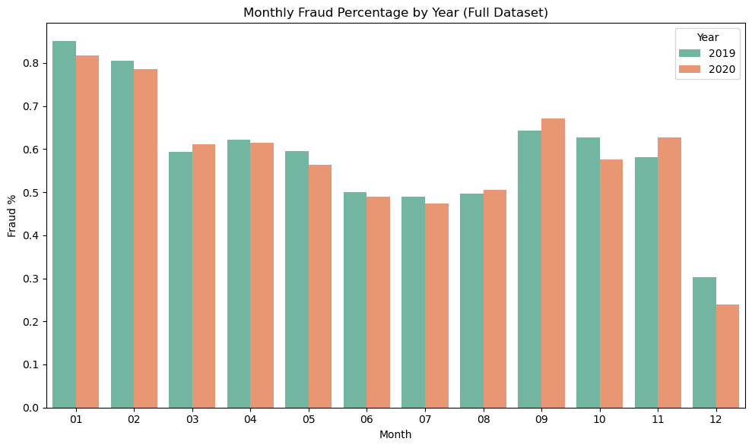
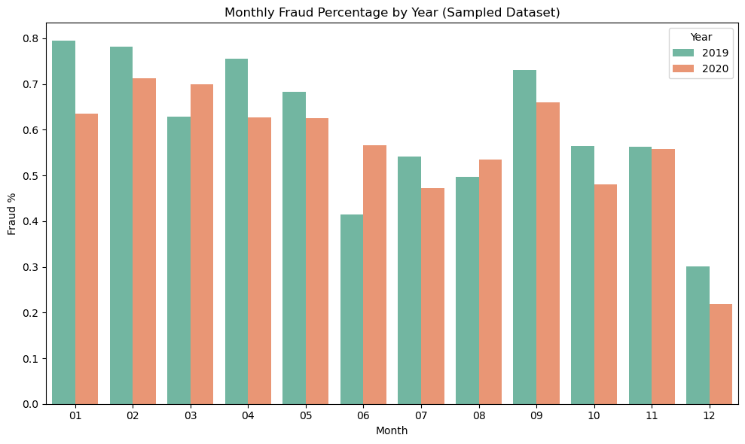
Fraud Visualization

Slide 5
Exploratory Data Analysis (EDA)
Fraud rate: approximately 0.5%.
Characteristics of fraudulent transactions often include:
Higher transaction amounts
Occurrence in categories such as entertainment and groceries
Happening during atypical hours
Major indicators: transaction category, amount (log_amt), and hour of occurrence.

Slide 6
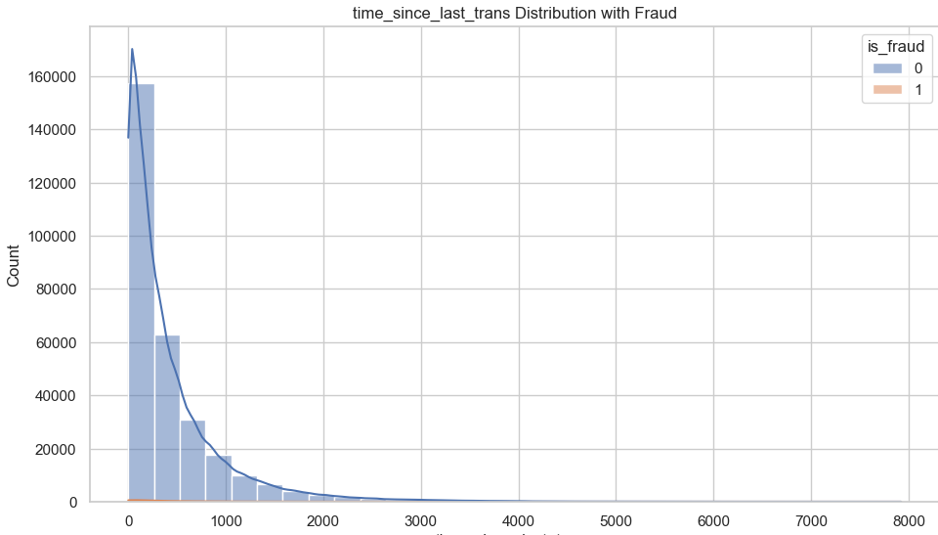
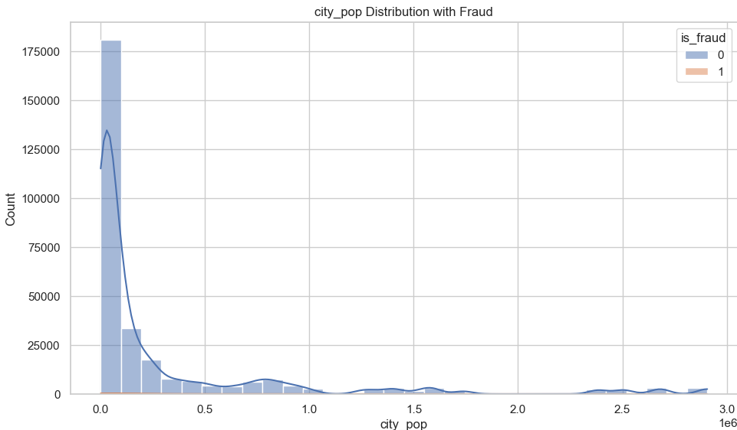
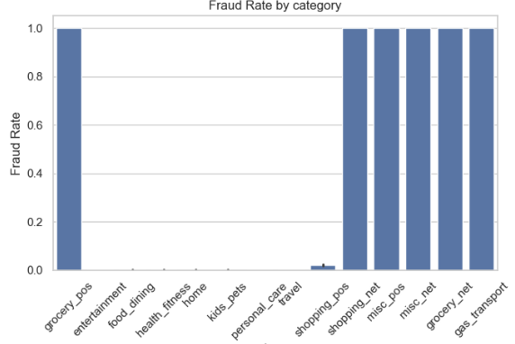
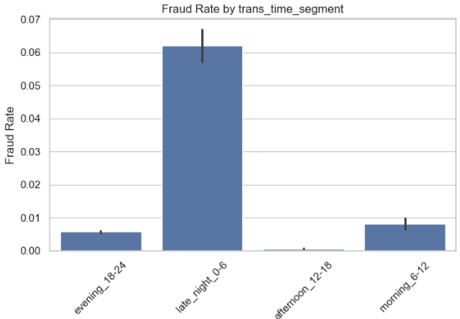

Slide 7

Feature Selection & Class Imbalance
Feature selection employed techniques including Lasso, SVC, Random Forest, and Ridge.
The resampling methods evaluated included:
No Balancing, Random Over Sampling (ROS), Random Under Sampling (RUS), SMOTE, and SMOTETomek.
Of these, SMOTE emerged as the most effective approach for achieving a balance between precision and recall.

Slide 8
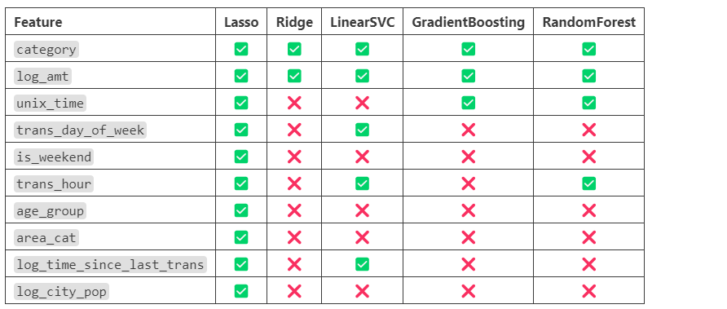
Feature Selection

Slide 9
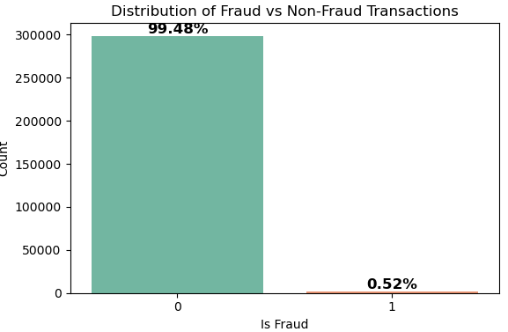
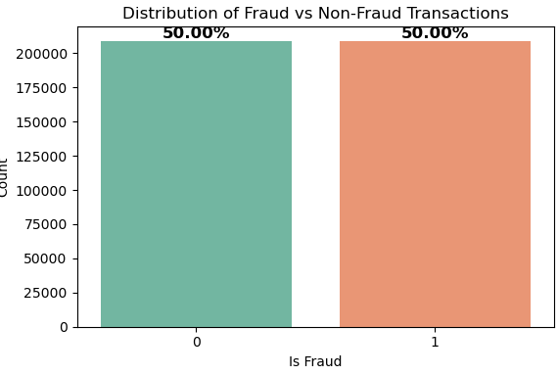
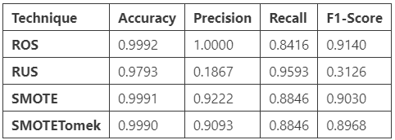
Class Imbalance

Slide 10
Model Development
Models evaluated: Linear Regression, Decision Tree, Random Forest, AdaBoost, Gradient Boosting Machine, Support Vector Machine, XGBoost.
Optimization conducted using RandomizedSearchCV.
Leading models: Random Forest and XGBoost.

Slide 11
Model Performance
Accuracy: 99.97% for both Random Forest (RF) and XGBoost.
XGBoost: Exhibits greater precision (False Positives = 3).
RF: Demonstrates superior recall (False Negatives = 7).
Recommendation: Opt for XGBoost to reduce false positives.

Slide 12
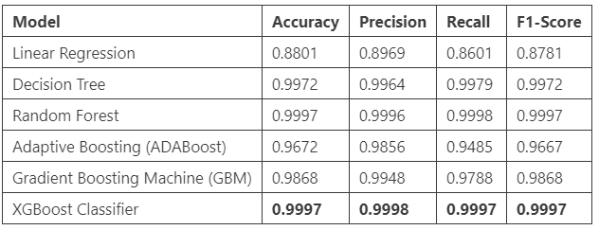
Model Selection

Slide 13
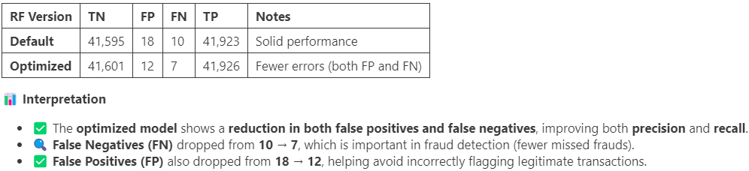
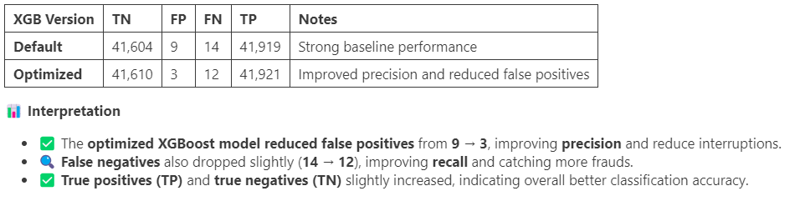
Model Optimization

Slide 14
Deployment and Key Insights
Deployed as a real-time API for fraud detection, it can accommodate two strategies:
Tailored for in-person transactions, focusing on reducing false positives (FP), minimizing interruptions, and prioritizing accuracy.
Tailored for online transactions, aiming to lower false negatives (FN) while emphasizing recall.
Key Takeaways:
Importance of class balancing
Impact of spatial and temporal factors
The application of ensemble models and resampling techniques enhances performance.

