Slide 1

SVM Diabetes Prediction Model
Will Stearns, Sharif Rakhimov, Phil Carbino, Derek Preslar

Slide 2
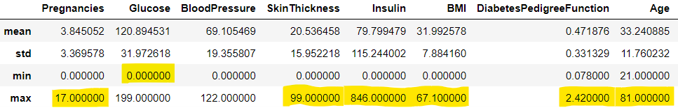
Data Set: Diabetes Data
The data gathered diagnostic measurements for diabetes by the National Institute of Diabetes and Digestive and Kidney Diseases
The data is kept in a csv format
All patients were female, at least 21 years old, and of Pima Indian heritage
Goal is to create a Support Vector Machine model to predict whether a patient has diabetes based on diagnostic criteria
Descriptive statistics and potential outliers:

Slide 3
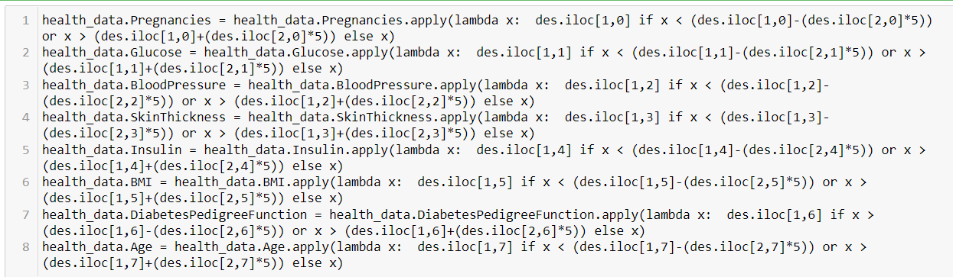
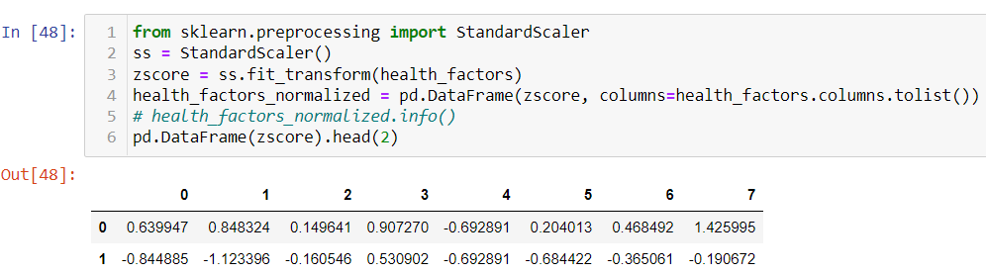
Data Normalization and Outlier mitigation codes

Slide 4
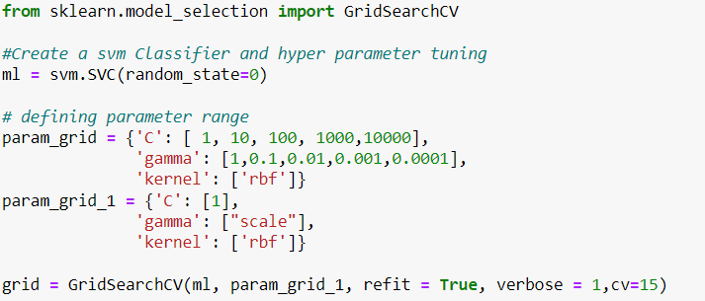
Feature Engineering and Hyperparameters
Preparing the dataset for model training:
All features were considered necessary based on descriptive statistics report analysis
Dataset was split into target (Outcome) and training (All the rest) features to feed the model
To ensure the best score, we selected 2 different sets of hyperparameter values using GridSearchCV along with 2 folds for cross validation on each set to train our model

Slide 5
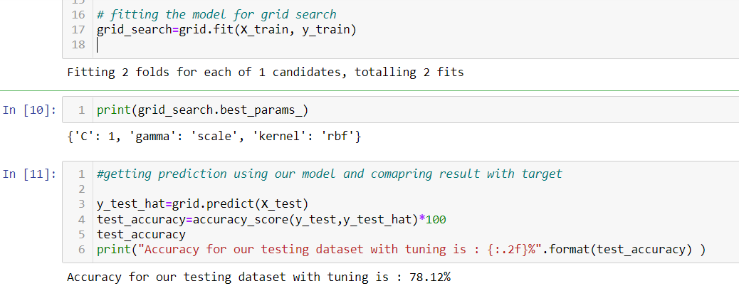
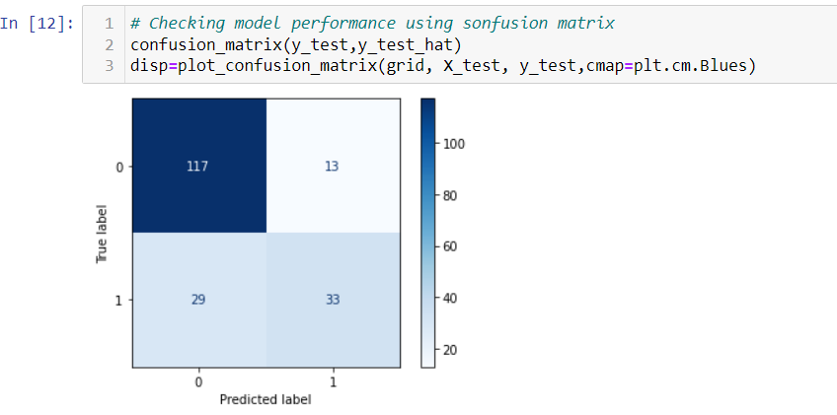
Default Hyperparameters

Slide 6
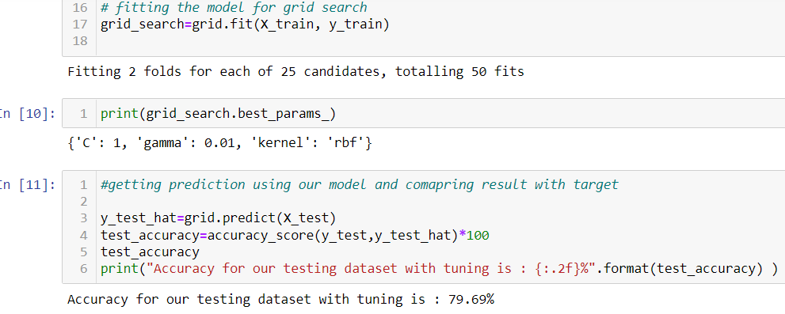
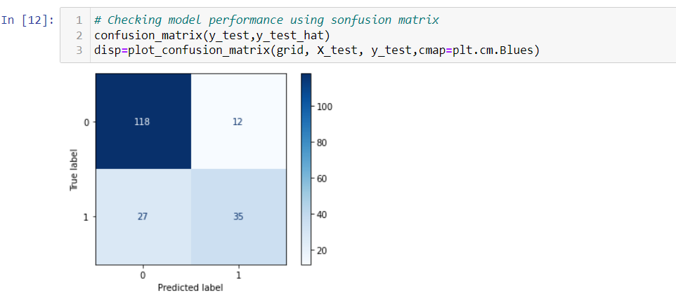
Tuning Hyperparameters

Slide 7
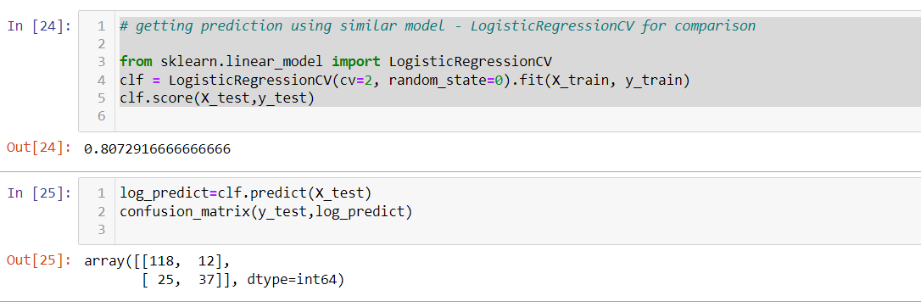
Comparing performance against a Logistic Regression Model
The SVM model achieved 78.12% accuracy on default hyperparameters and 79.69% after tuning hyperparameters
The Logistic Regression model achieved 80.7% on default hyperparameters
Performance speed differed for both models
MCC for SVM = 0.51
MCC for Logistic Regression = 0.54
Potential improvements:
Data did not differentiate between type 1 and type 2 diabetes

