Slide 1

SVM Diabetes Model
Will Stearns, Sharif Rakhimov, Phil Carbino, Derek Preslar

Slide 2
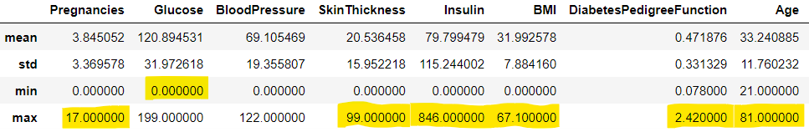
Data Set: Diabetes Data
This dataset is from the National Institute of Diabetes and Digestive and Kidney Diseases. The goal is to predict whether a patient has diabetes based on diagnostic measurements.
Basic narrative:
Dataset content
Objective
Dataset description – format, missing values, errors, outliers
Data processing steps: Outlier mitigation, Data Normalization
Below is basic descriptive statistics of dataset with potential outliers highlighted:

Slide 3
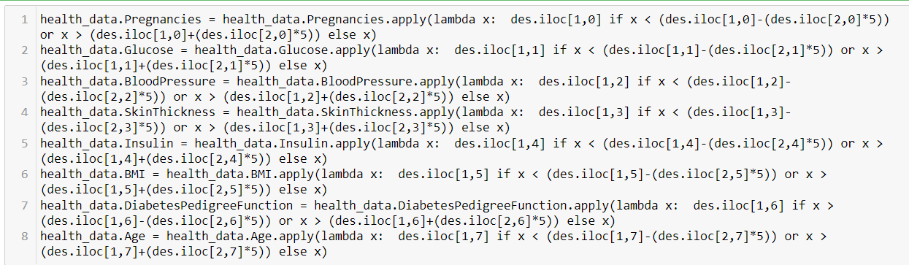
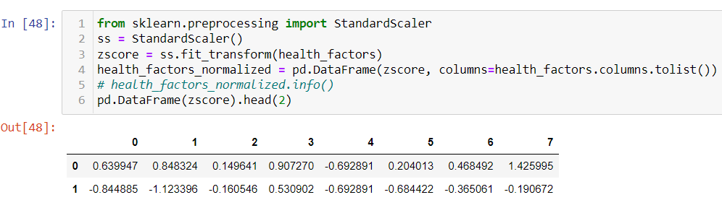
Data Normalization and Outlier mitigation codes

Slide 4
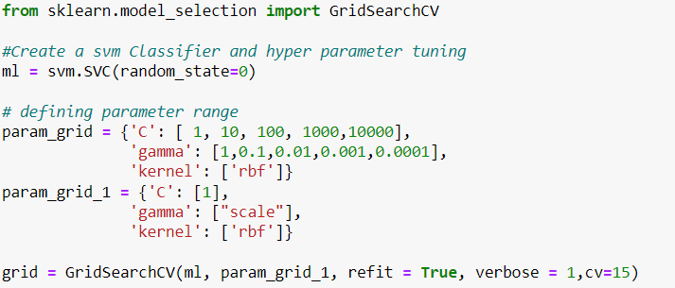
Feature Engineering and Hyperparameters
The following steps were taken to get dataset ready for model training:
All features were considered necessary based on descriptive statistics report analysis
Dataset was split into target (Outcome) and training (All the rest) features to feed the model.
To ensure best score by the model, we selected 2 different sets of hyperparameter values using GridSearchCV along with 2 folds for cross validation on each set to train our model and find best prediction score.

Slide 5
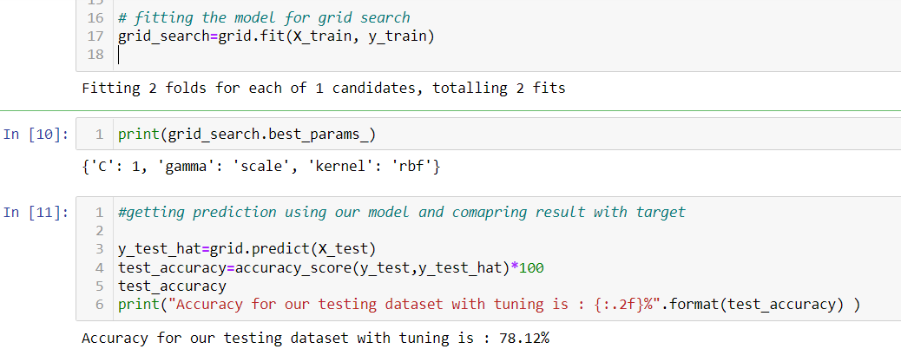
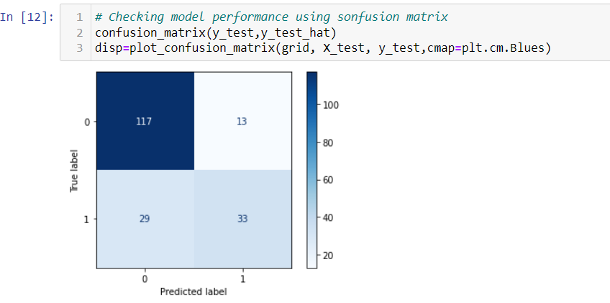
Default hyperparameter

Slide 6
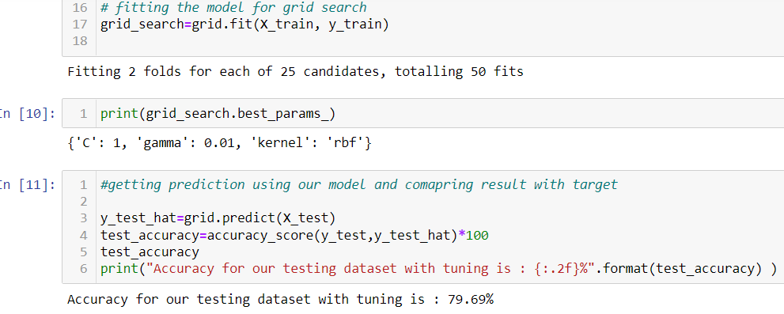
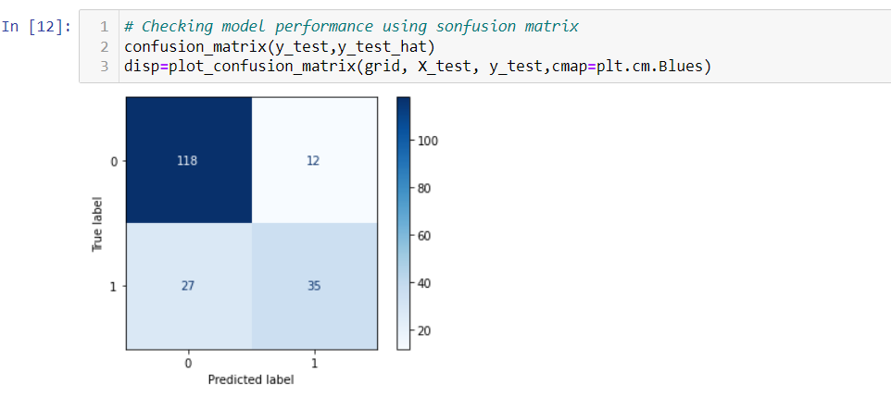
Tuning hyperparameters

Slide 7
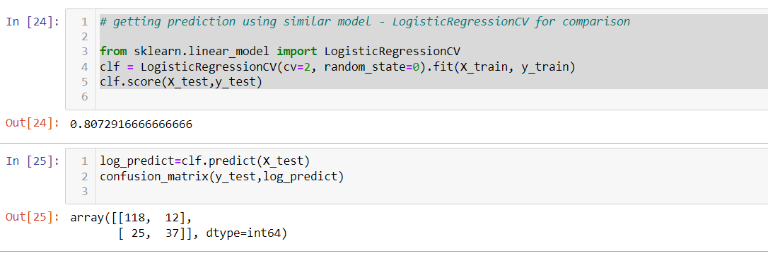
Comparing performance against LogisticRegression
SVM model achieved 78.12% accuracy on default hyperparameters and 79.69% after tuning hyperparameters
LogistirRegression achieved 80.7% on default hyperparameters
Performance speed on moth models were different
MCC for SVM = 0.51
MCC for LogisticRegression = 0.54

