Slide 1

Nothing to Wine About
Group 1:
Ethan Chase
Matthew McClure
Payton Parrish

Slide 2
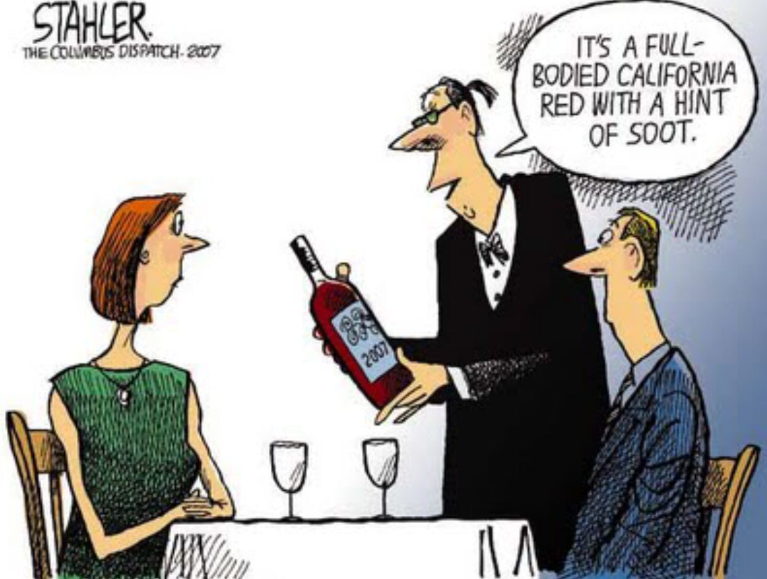
Wine Joke

Slide 3
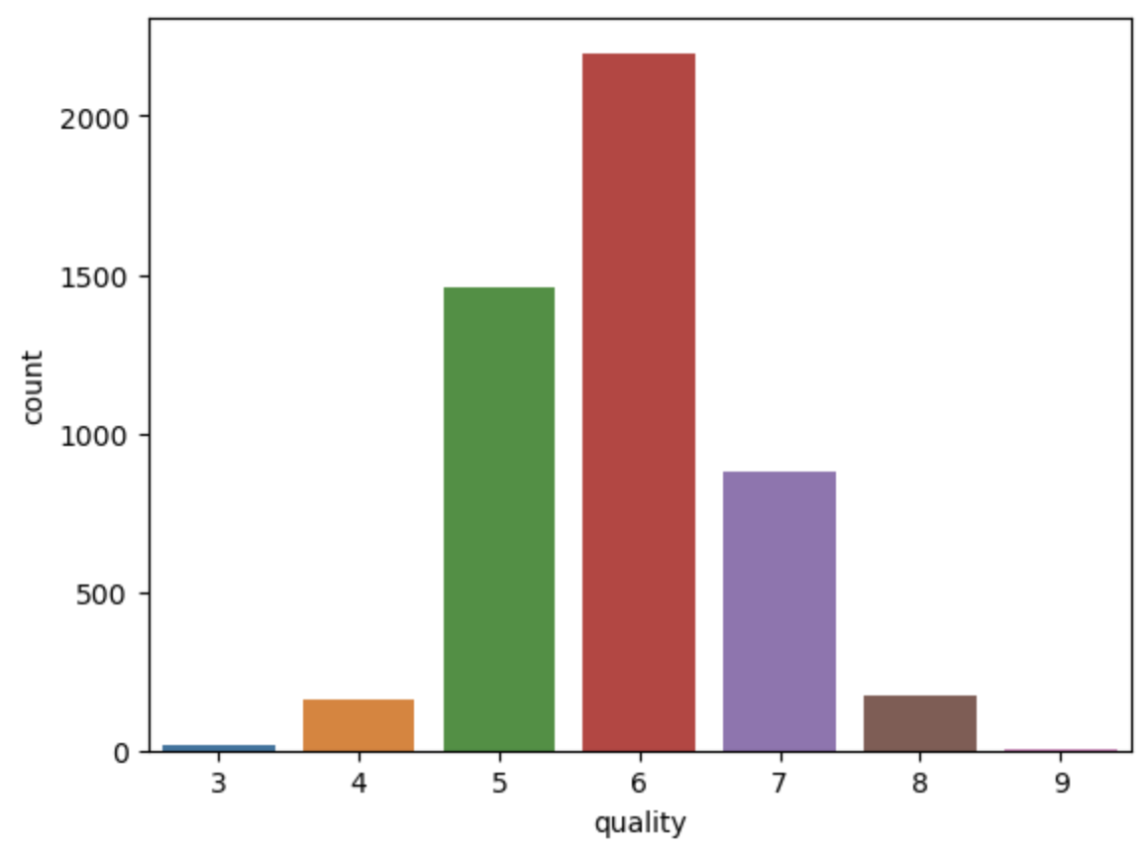
White Wine EDA
Shape: 4898 rows, 12 columns
Quality count roughly follows normal distribution
Quality values range from 3-9
Strong positive correlation between residual sugar and density
Strong negative correlation between alcohol and density

Slide 4
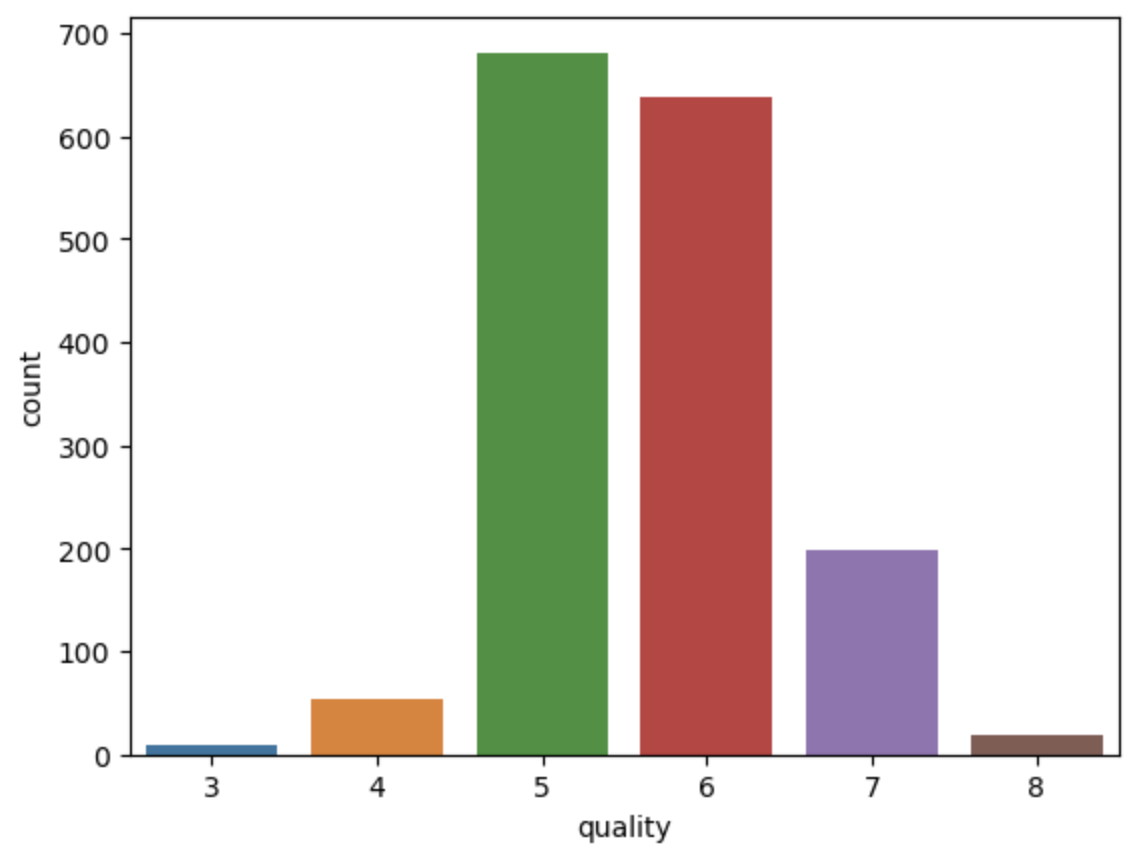
Red Wine EDA
Shape: 1599 rows, 12 columns
Quality count roughly follows normal distribution, but not as well as White Wine
Quality values range from 3-8
No strong correlations >= |0.7|

Slide 5
Regression

Slide 6
Classification

Slide 7
Comparison

Slide 8
Conclusion

