Slide 1

Nothing to Wine About
Group 1:
Ethan Chase
Matthew McClure
Payton Parrish

Slide 2
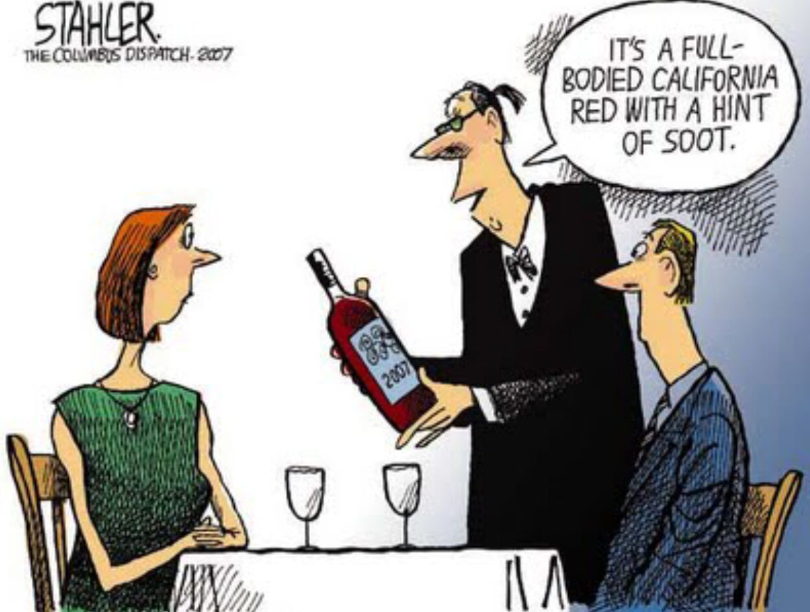
Wine Joke

Slide 3
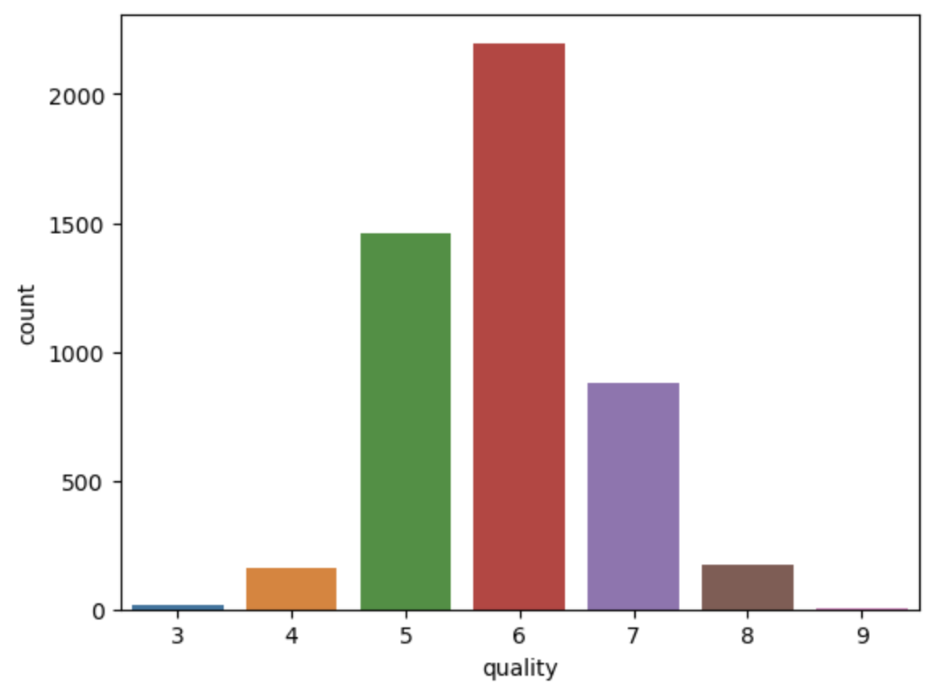
White Wine EDA
Shape: 4898 rows, 12 columns
Quality count roughly follows normal distribution
Quality values range from 3-9
Strong positive correlation between residual sugar and density
Strong negative correlation between alcohol and density

Slide 4
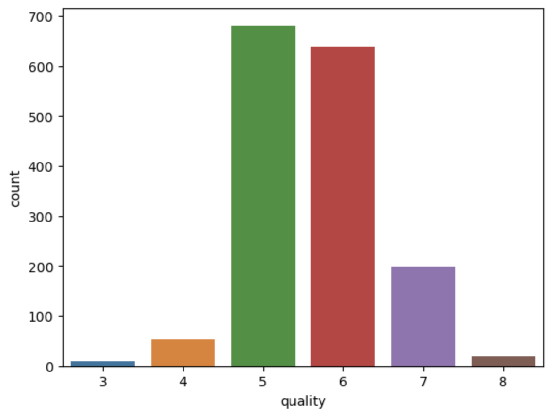
Red Wine EDA
Shape: 1599 rows, 12 columns
Quality count roughly follows normal distribution, but not as well as White Wine
Quality values range from 3-8
No strong correlations >= |0.7|

Slide 5
Goals for the Dataset
Can we predict the quality of wine based on the given variables?
What variables are most important in determining the quality of wine?
Are the important variables different for Red and White wine?

Slide 6
Variable Selection Results
Using SFS variable selection, we determined the following variables were significant in determining the quality of each type of wine:
Red Wine Only | Both Types | White Wine Only | Neither Type
Chlorides | Volatile Acidity | Fixed acidity | Citric Acid
Total Sulfur Dioxide | Free Sulfur Dioxide | Residual Sugar
 | pH | Density
 | Sulphates
 | Alcohol

Slide 7
Regression Results
1225 Test Data Points
52% Correct, 95% within ±1
402 Test Data Points
61% Correct, 97% within ±1

Slide 8
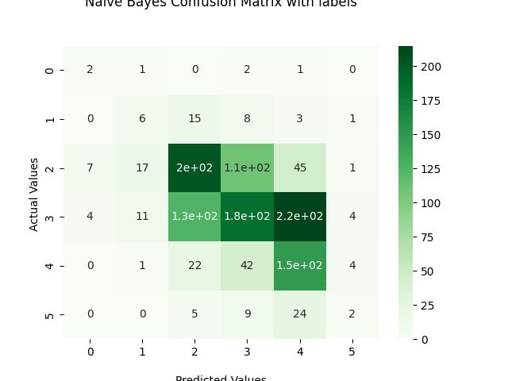
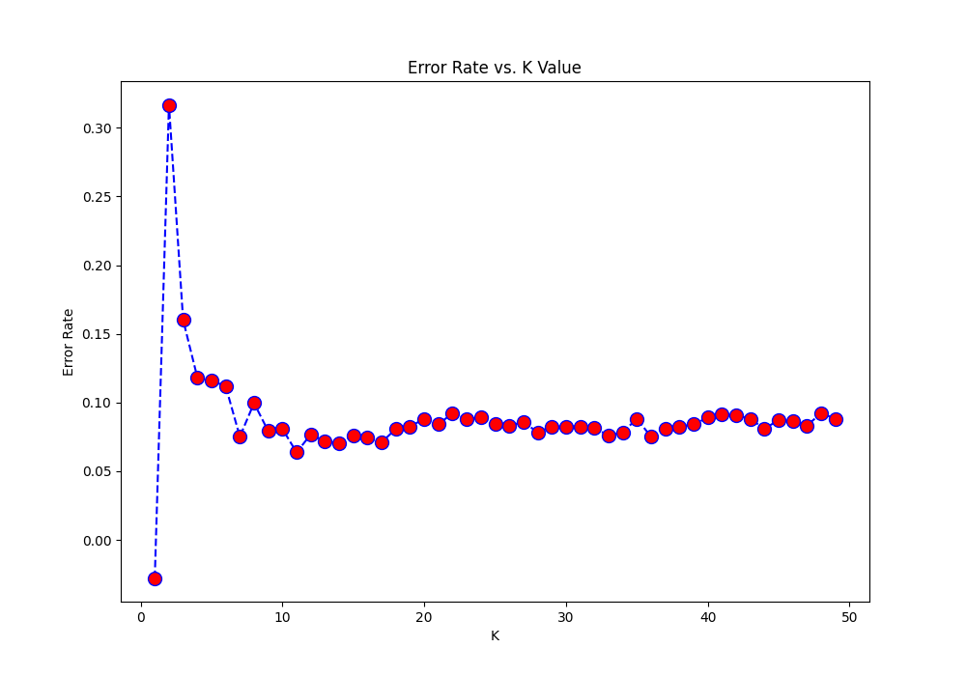
White Wine Classification
Used: Naives Bayes & KNN
Accuracy = 0.45

Slide 9
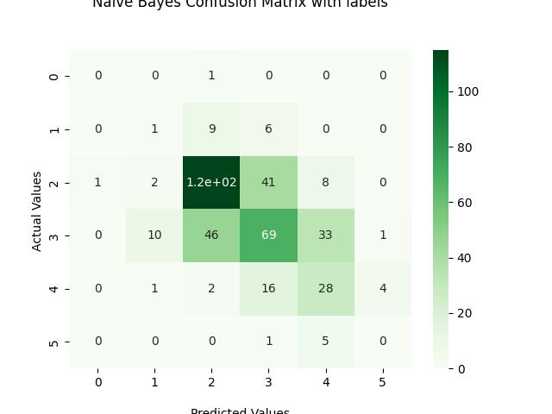
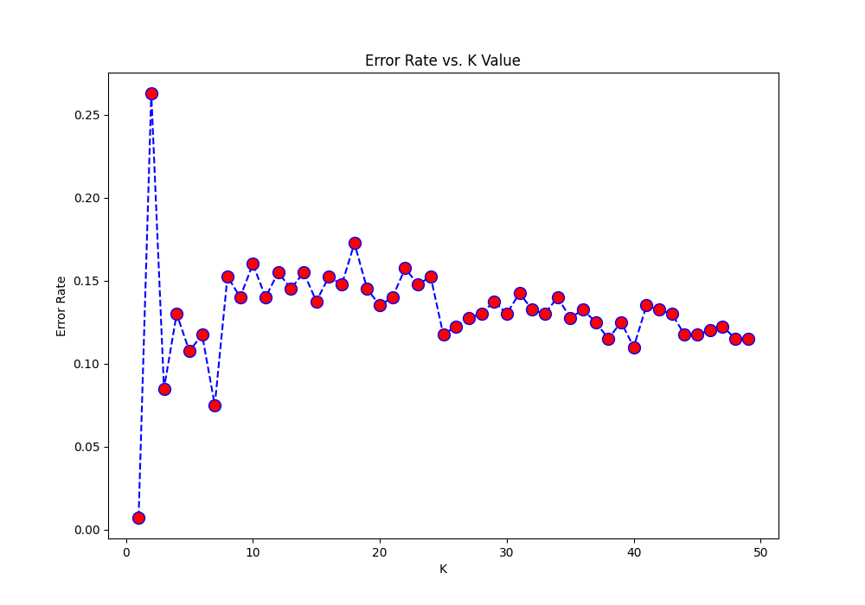
Red Wine Classification
Used: Naives Bayes & KNN
Accuracy = 0.53

Slide 10
Comparison

Slide 11
Conclusion

