Slide 1
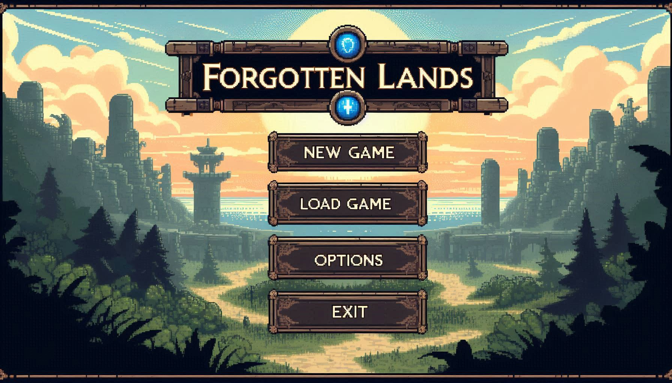

Slide 2
Contents
Realize
Assess
Plan

Slide 3
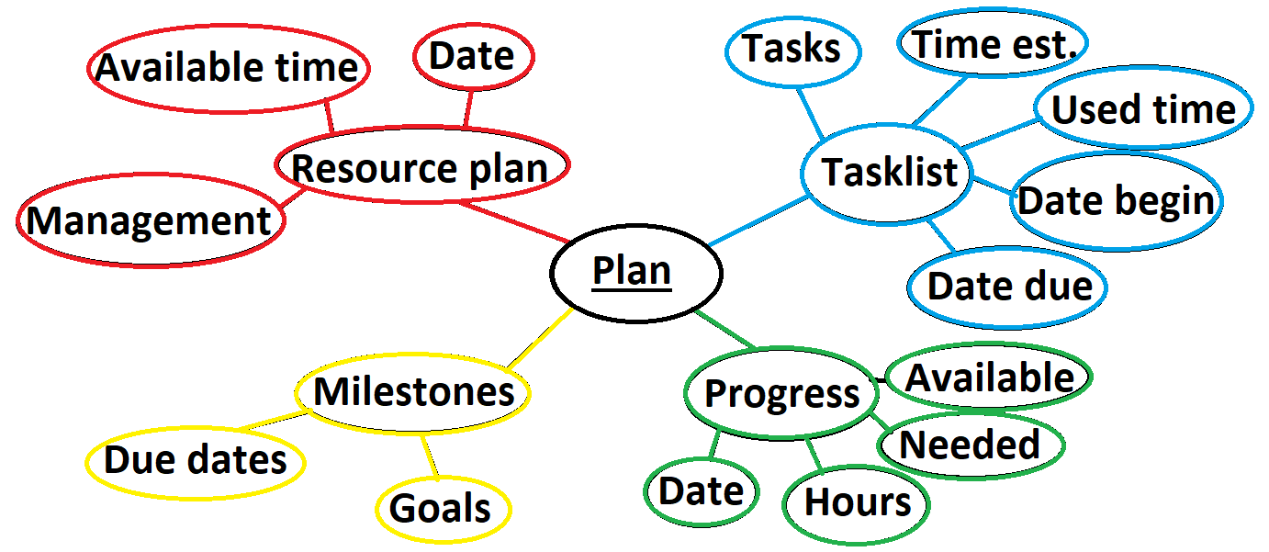

Slide 5
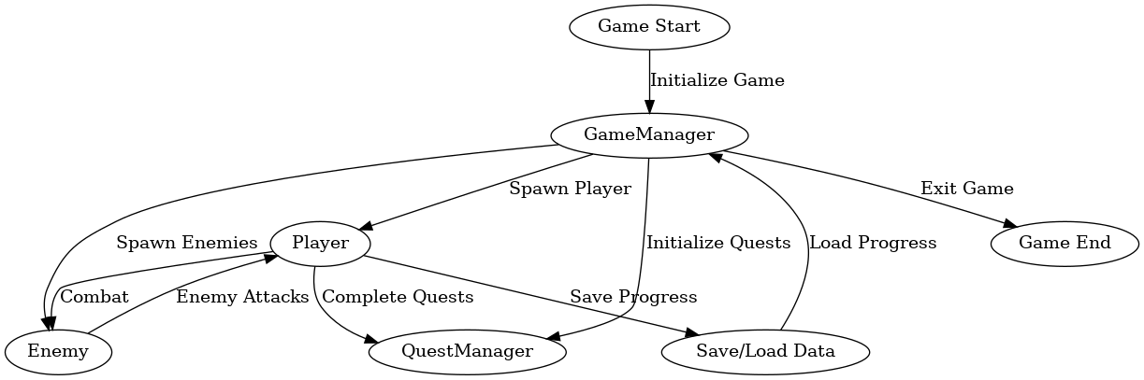
Create script
Create Object
Position
Adjust values
Add object

Slide 6
Inform
Plan
Decide
Realize
Control
Assess

Slide 7
Thanks for listening, any questions?

