Slide 1
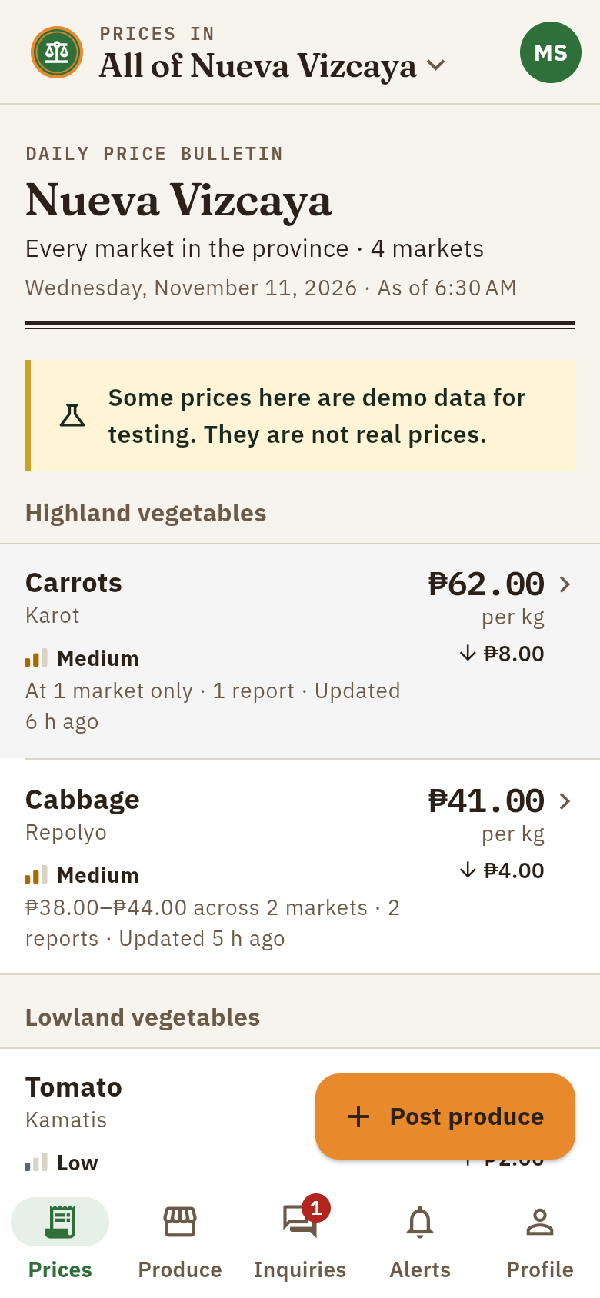
Project TIMBANG
Know the price before you sell.
A verified daily vegetable price board and produce marketplace for Nueva Vizcaya
Aaron Anthony A. Gano II
BS Computer Science · Nueva Vizcaya State University
IT ECC 6 – Application Development · CS PC 7 – Information Assurance and Technology
Notes:
Good day. I am presenting Project TIMBANG, which means "to weigh". It gives farmers in Nueva Vizcaya a verified daily vegetable price before they sell, and a direct way to reach buyers. It runs on Android, on the web, and by SMS.

Slide 2



Farmers sell without knowing today's price
Small farmers often sell without knowing the current market price, so the price is set by whoever is buying. Existing sources do not fill the gap:
DA Bantay Presyo
PSA Farm Price Survey
Facebook groups
Retail and consumer focused; reported to be Metro Manila centered
Periodic statistics, not daily prices farmers can act on
Unverified posts that are hard to search and compare
Notes:
The problem: farmers often sell without knowing the current price. DA Bantay Presyo focuses on retail prices and Metro Manila, the PSA survey is periodic, and Facebook groups are unverified. TIMBANG adds local, daily prices with a trust label, and a direct route to buyers.

Slide 3
Objectives
General objective
Develop and evaluate a secure, verified daily vegetable price board and produce marketplace for the farmers and buyers of Nueva Vizcaya.
1
Show the daily median price per vegetable and market, with its source, age and a confidence label
2
Let farmers post produce and buyers contact them directly
3
Reach every user: Android, web, offline reading, and SMS for basic phones
4
Let the agriculture office manage the lists and import official prices without code changes
5
Protect users' data in line with the Data Privacy Act of 2012
6
Evaluate the system's usability with farmers and buyers
Notes:
Adjust these to match the exact wording of the objectives in the manuscript. The general objective is to develop and evaluate the system; the specific objectives cover prices, listings, access, administration, privacy and usability.

Slide 4



One price board, three ways to reach it
Android app
Design principles
Price bulletin, listings, inquiries, alerts. Readable offline.
Timely: updated daily, always showing its age
Local: your town's markets first
Trusted: every price shows its source and confidence
Actionable: a price comes with a way to reach a buyer
Accessible: offline, SMS, low-end phones, two languages
Website
Same features in a browser, plus the admin dashboard.
SMS
Text PRESYO KAMATIS BAYOMBONG from any basic phone.
Notes:
TIMBANG reaches users three ways: the Android app, the website, and SMS for basic phones. Every feature follows five principles: timely, local, trusted, actionable and accessible. TIMBANG only reports observed prices; it never sets prices.

Slide 5




Four kinds of users
Farmer
Buyer
Price reporter
Administrator
Magsasaka
Mamimili
Tagapag-ulat
Agriculture office
Check and compare prices, post produce, answer buyers, set alerts, report prices
Check prices, browse produce, send inquiries to farmers, set alerts
Submits reports that carry more weight; approved by an admin
Manages lists, imports official prices, manages users, moderates
Notes:
Farmers and buyers sign up themselves with their phone number. Reporter and administrator roles can only be given by an administrator; the app cannot grant them.

Slide 6
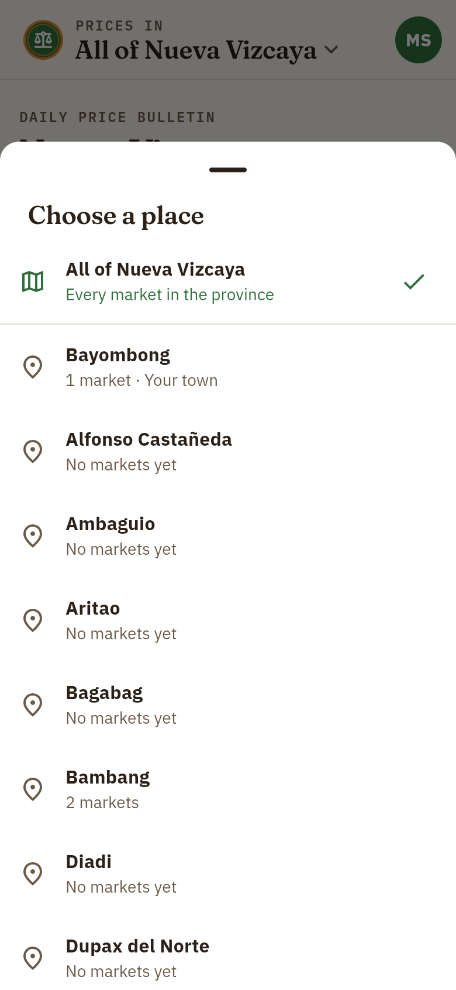
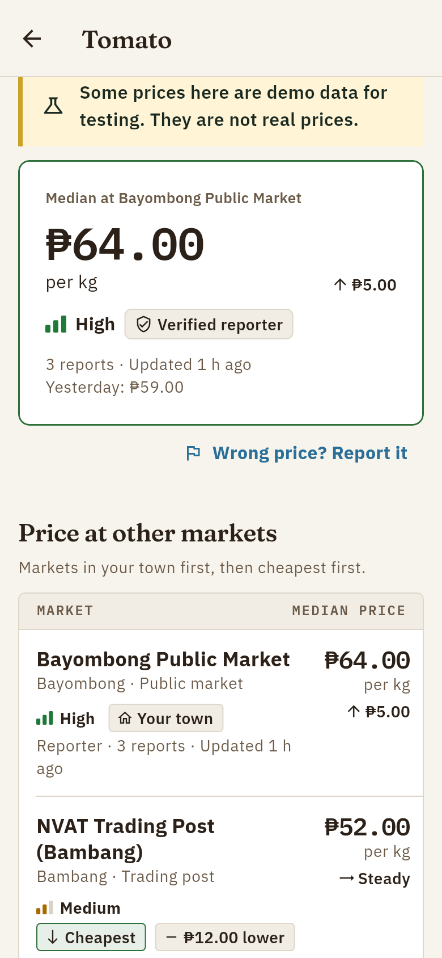
A daily price bulletin for the whole province
Province view by default
Median price, range across markets, change since yesterday
Switch to any of the 15 towns
Remembered on the phone; listings follow the same town
Compare markets
Your town first, cheapest market marked
Notes:
The home screen is the day's price bulletin for the whole province. Each vegetable shows the median price, the range across markets, the change since yesterday, and a trust meter. Users can switch to any of the 15 municipalities, and tap a vegetable to compare markets.

Slide 7
How a price earns its trust label
1
2
3
4
5
Collect
Median
Outliers
Label
Age
Reports from the last 24 hours
Never the average or the latest report
Set aside reports 30% or more away
High, Medium or Low by source
Older than 24 h: shown as stale
▮▮▮
High
An official price (DA, DAR, NVAT), or 3+ agreeing reports including a verified reporter
▮▮▯
Medium
Reports from verified price reporters
▮▯▯
Low
Community reports only, until they are confirmed
Notes:
Prices are computed by the server every time a report arrives. It takes the median of the last 24 hours, sets aside outliers more than 30% away from the median (official prices are never set aside), and labels confidence by source. A price with no new report in 24 hours stays visible but is marked stale. In the province view, the confidence shown is the lowest among the markets, so trust is never overstated.

Slide 8
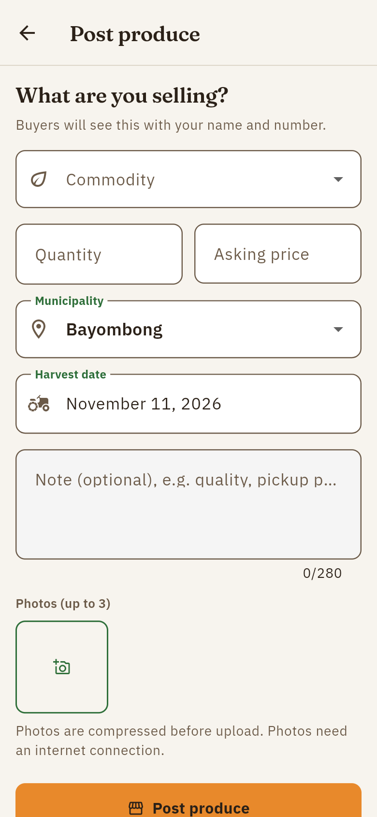
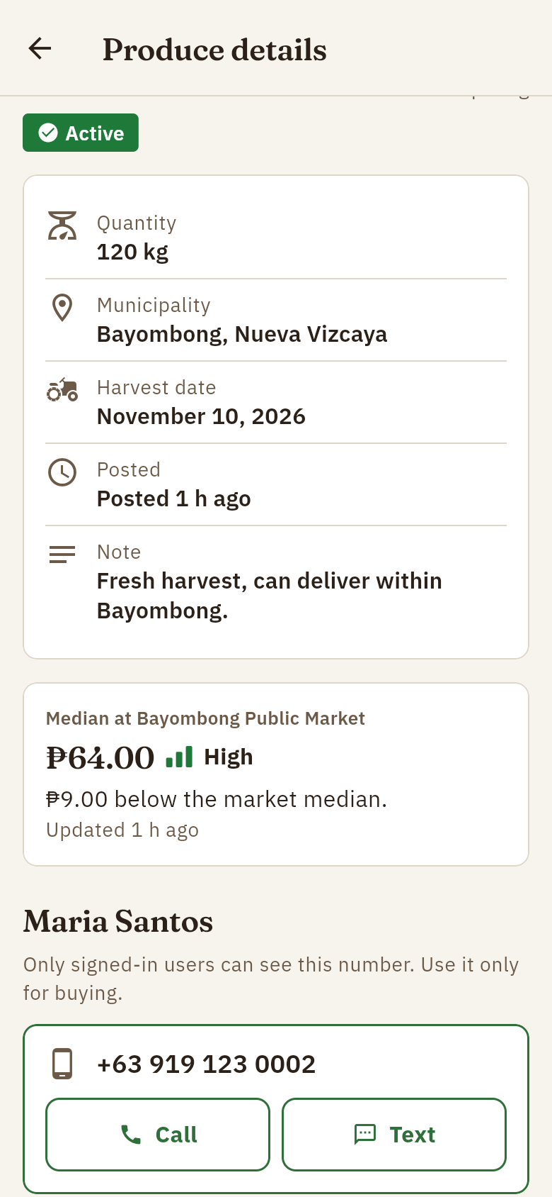
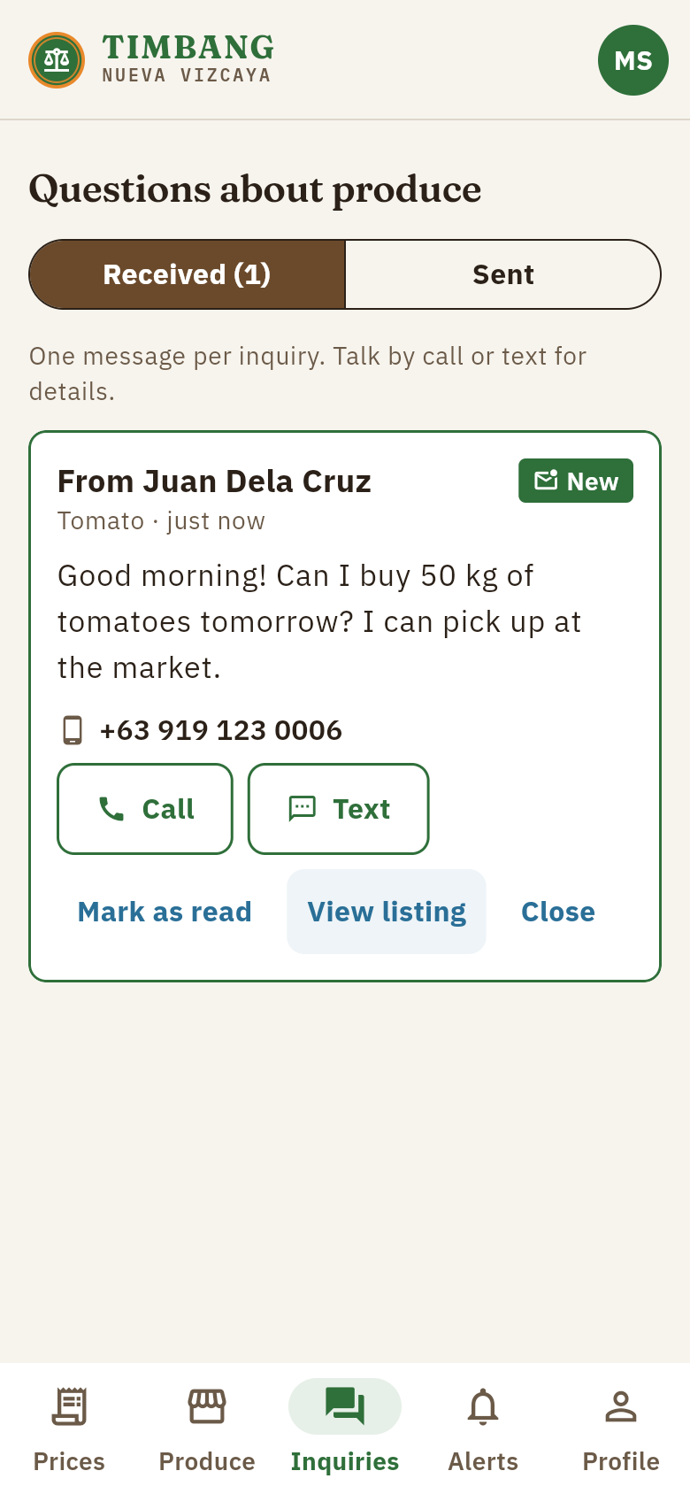
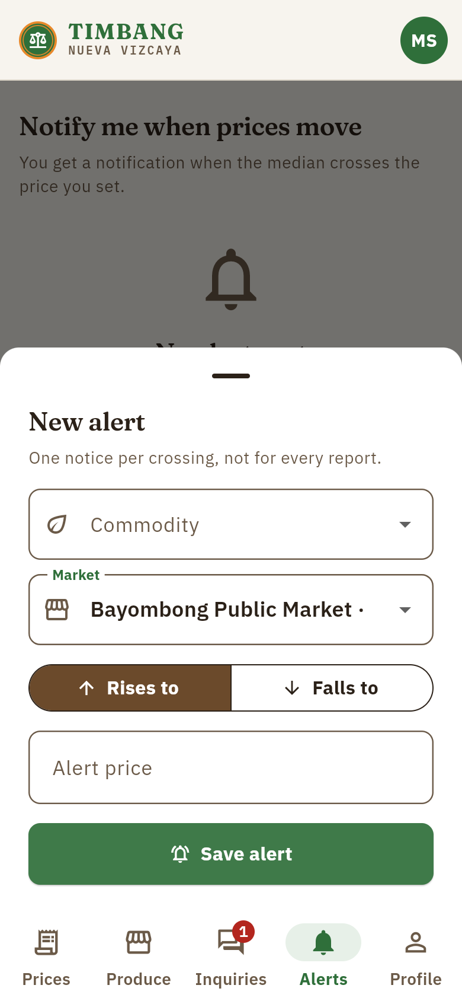
From price to buyer
Farmers post produce
Buyers see the price vs the market
Inquiries with call and text
Alerts when a price crosses a level
Notes:
Farmers post what they are harvesting; a listing lasts 14 days. Buyers see how the asking price compares with the market median, and contact the farmer by call, text, or one inquiry in the app. Anyone can set an alert that notifies them once when a price crosses their level.

Slide 9
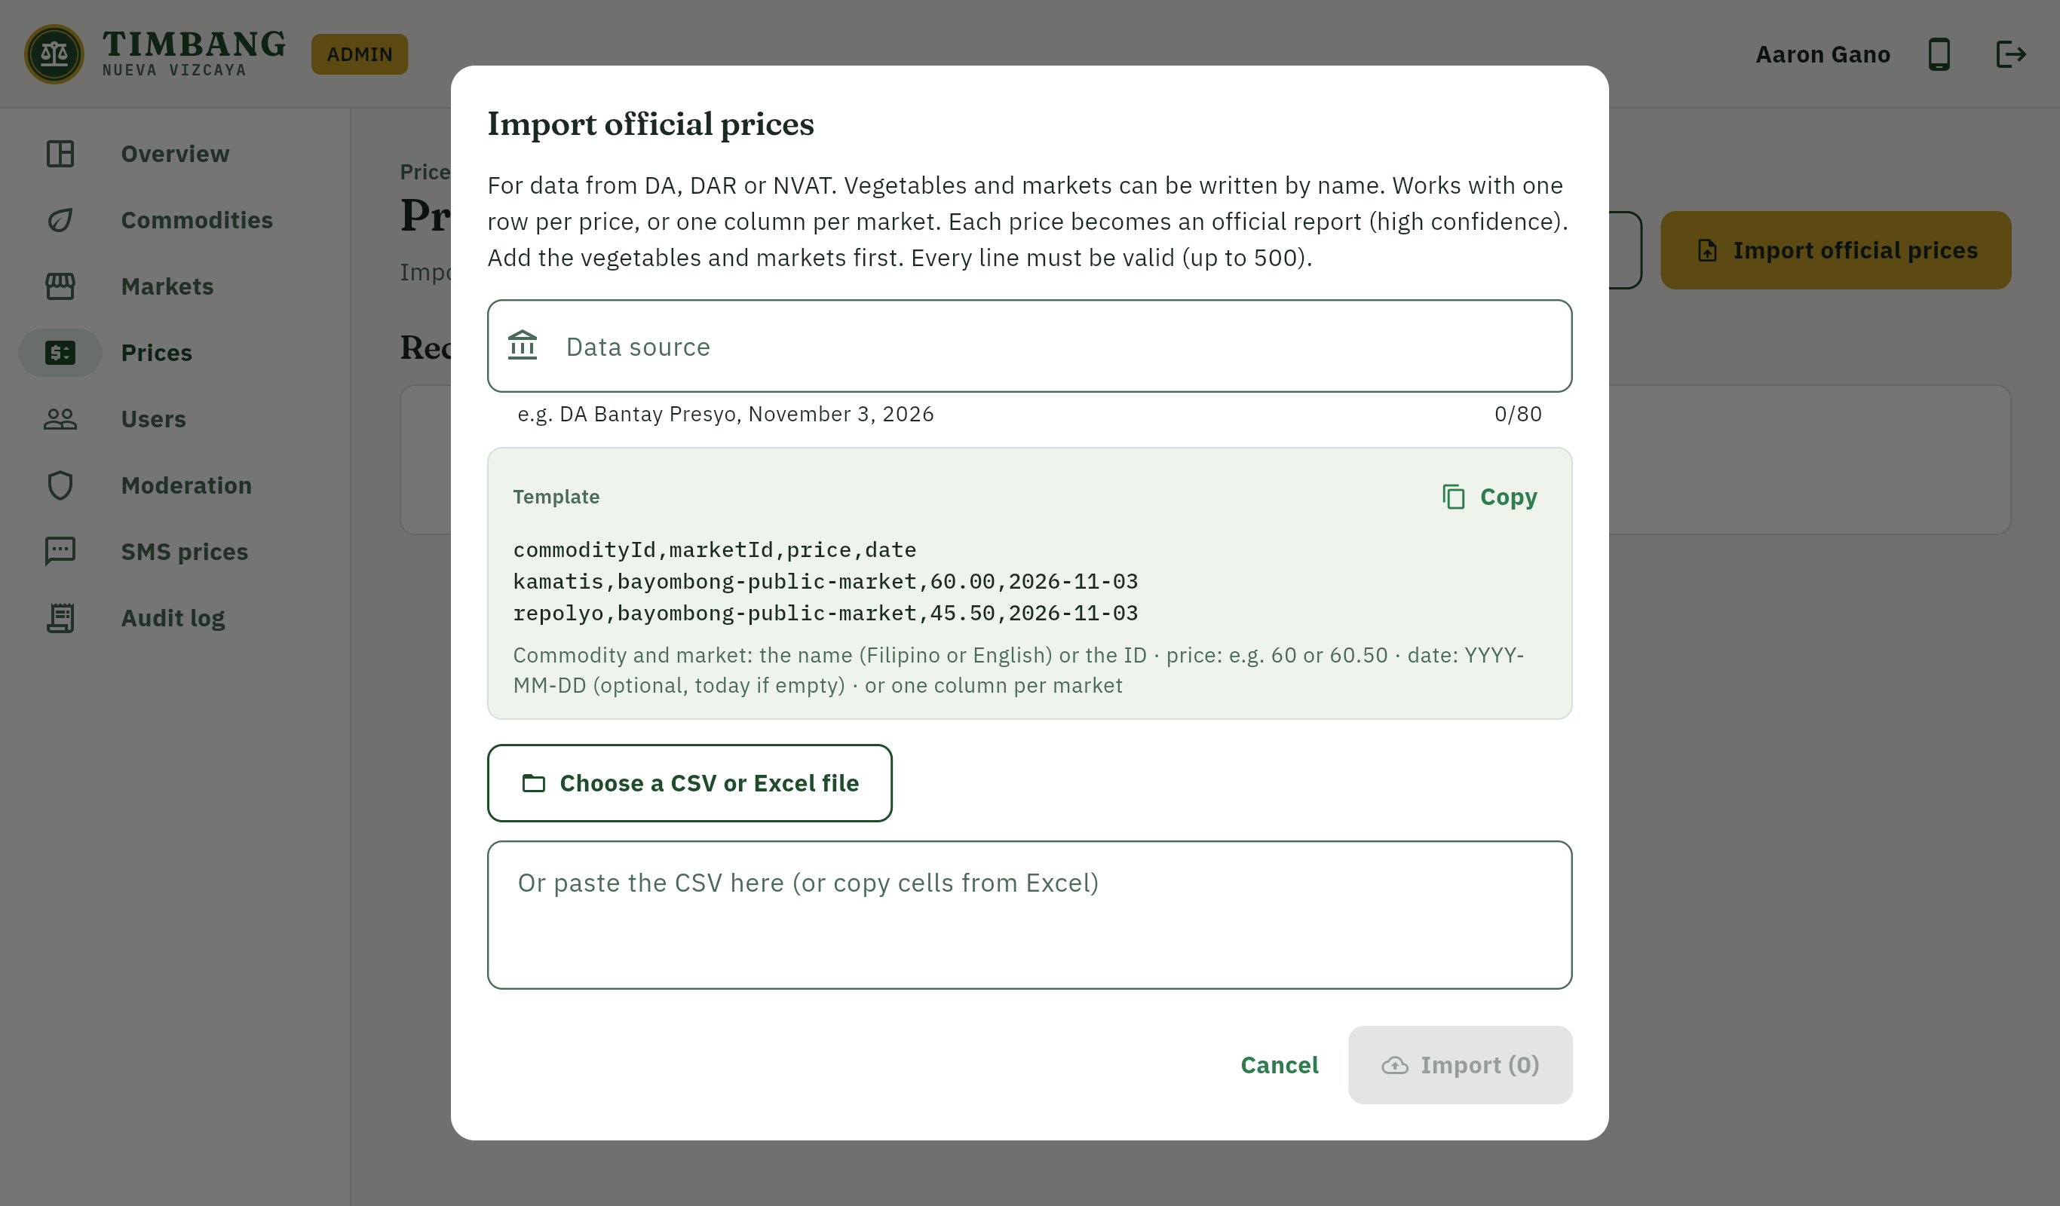
Lists are updated without changing code
Import the office's Excel file as it is
Names instead of codes, title rows and section headings skipped, one column per market
Official prices get High confidence
Every row is checked before anything is saved
Also in the dashboard
Users and roles, moderation, pilot metrics, SMS simulator, audit log
Notes:
The vegetable, market and price lists are data, not code. Administrators can import the Governor's office Excel file as it is, from a phone or the website, in the order markets, vegetables, then prices. Official prices automatically get High confidence.

Slide 10
System architecture
Android app (Flutter)
Firebase (asia-southeast1)
Authentication
Cloud Functions
Phone OTP + role claims
Prices, imports, roles, SMS
Website + admin (Flutter web)
Cloud Firestore
Cloud Storage
Rules-protected data
Listing photos
Basic phone (SMS)
Cloud Messaging
App Check + Hosting
Alerts and inquiries
Integrity, website
Notes:
One Flutter code base builds both the Android app and the website. All trusted logic runs in Cloud Functions: computing prices, imports, role changes, inquiries, alerts and SMS replies. The app can read prices and roles but can never write them. Firestore security rules deny everything by default.

Slide 11




Security and data privacy by design
Deny-by-default rules
Server-side roles
Every collection is locked unless a rule allows it; each rule is tested
Roles live in verified claims set only by an admin function
Rate limits
Audit log
20 reports per hour per user; repeated reports refused
Every sensitive admin action is recorded
Signed SMS webhook
RA 10173
HMAC-SHA256 checked in constant time; numbers masked in logs
Only name, phone and town; full notice read before consent; view and delete my data
Notes:
Security is part of CS PC 7, so it was built in from the start. The threat model follows STRIDE and the checklist follows OWASP MASVS. For the Data Privacy Act, TIMBANG collects only name, phone number and town, records consent, requires the full privacy notice to be read before agreeing, and lets users view, copy and delete their data.

Slide 12
393 automated tests, all passing
393
automated tests, all passed against the Firebase emulators
Includes accessibility checks: 4.5:1 text contrast, 48 dp touch targets, screen-reader labels
Notes:
Every part of the system is covered by automated tests: 106 app tests, 166 Cloud Functions tests, 103 security rules tests and 18 end-to-end integration tests. All 393 passed on November 11, 2026.

Slide 13
Evaluation
Method
Respondents performed six tasks, then answered the System Usability Scale (SUS) and the system evaluation form.
Respondents
Farmers, buyers and agriculture staff of Nueva Vizcaya
Target
Mean SUS score of 70 or higher (above average)
Result | Value
Number of respondents
Mean SUS score
SUS interpretation
Task completion rate
System evaluation (mean rating)
Notes:
Fill in the results table from your evaluation forms before presenting: number of respondents, mean SUS score and its interpretation, task completion rate, and the mean rating from the system evaluation form.

Slide 14
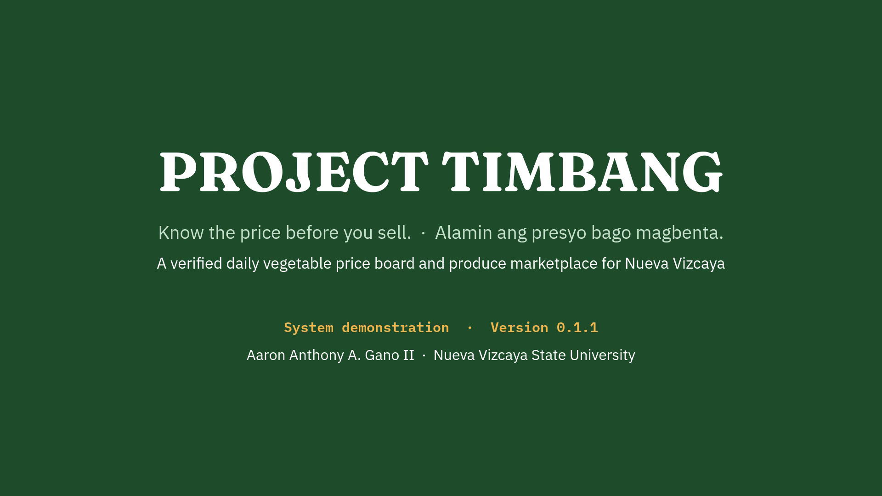
System demonstration
In the video (4.5 minutes)
A farmer signs up and posts a harvest
Inquiries, alerts and my data
Website and admin dashboard
Importing the office's Excel lists and official prices
SMS price check
Notes:
Click the video to play it, or open TIMBANG-System-Demo.mp4. The demonstration uses demo data, which the app labels as DEMO; the prices are not real.

Slide 15
Limitations and next steps
Area | Current limitation | Next step
Official lists | Demo lists until the DA, DAR and NVAT lists are imported | Import the Governor's office lists, then remove demo data
SMS gateway | Works through a mock gateway and the simulator | Connect Semaphore or Globe Labs
Release signing | APK signed with a development key | Create a release key before wider distribution
Pilot | Not yet tested in a live market | Pilot in one public market with one farmer group for about 4 weeks
Notes:
TIMBANG is a first build. The next steps are importing the official lists, connecting a real SMS gateway, creating a release signing key, and a four-week pilot in one public market with one farmer group.

Slide 16
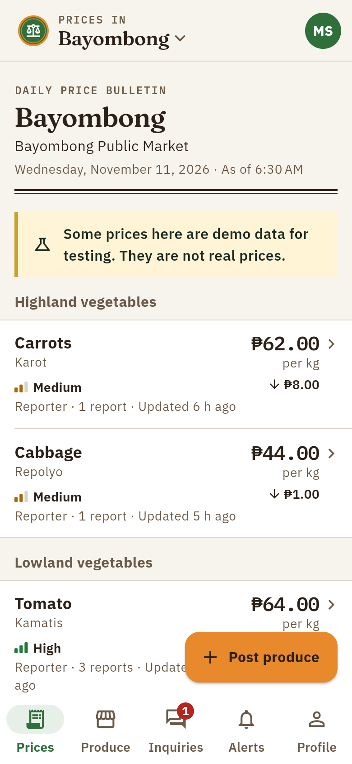
Salamat po!
TIMBANG only reports observed prices. It never sets prices.
Aaron Anthony A. Gano II
Nueva Vizcaya State University, Bayombong
github.com/MysteriousAlarm/Timbang
Notes:
Thank you. I am happy to answer questions.

