Slide 1
Debugging
urlpatterns = [ path('', include('pages.urls',namespace='pages')), path('listings/', include('listings.urls',namespace='listings')), path('contacts/', include('contacts.urls',namespace='contacts')), path('accounts/', include('accounts.urls',namespace='accounts')),

Slide 2
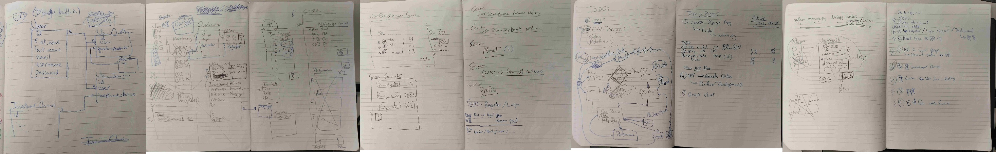
Idea's Creation

Slide 3
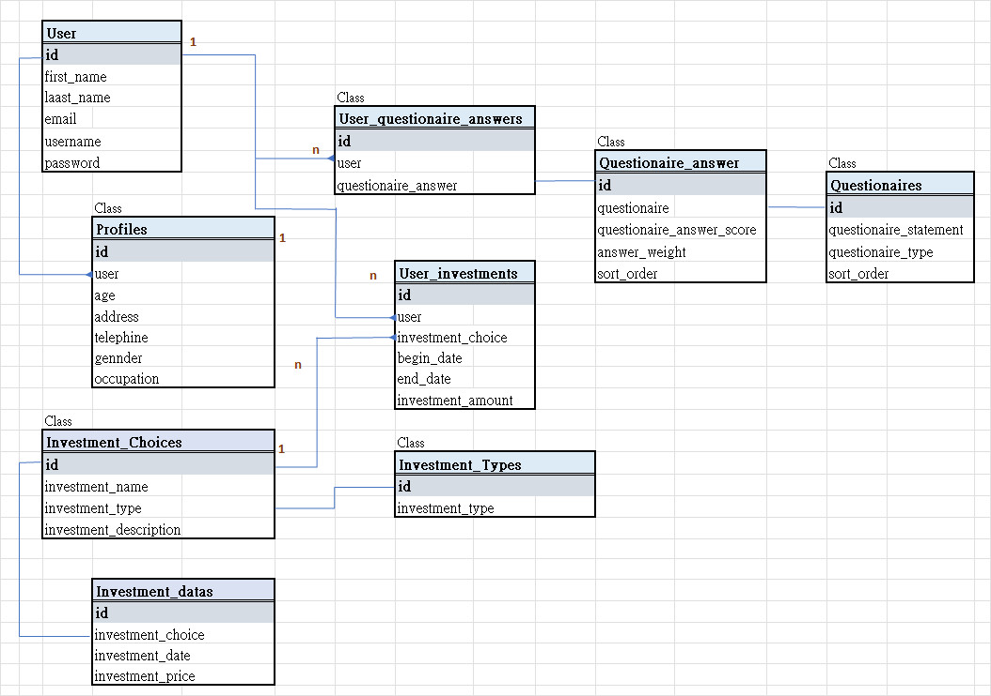
ER diagram
Accounts Questionnaires
Investment

Slide 4
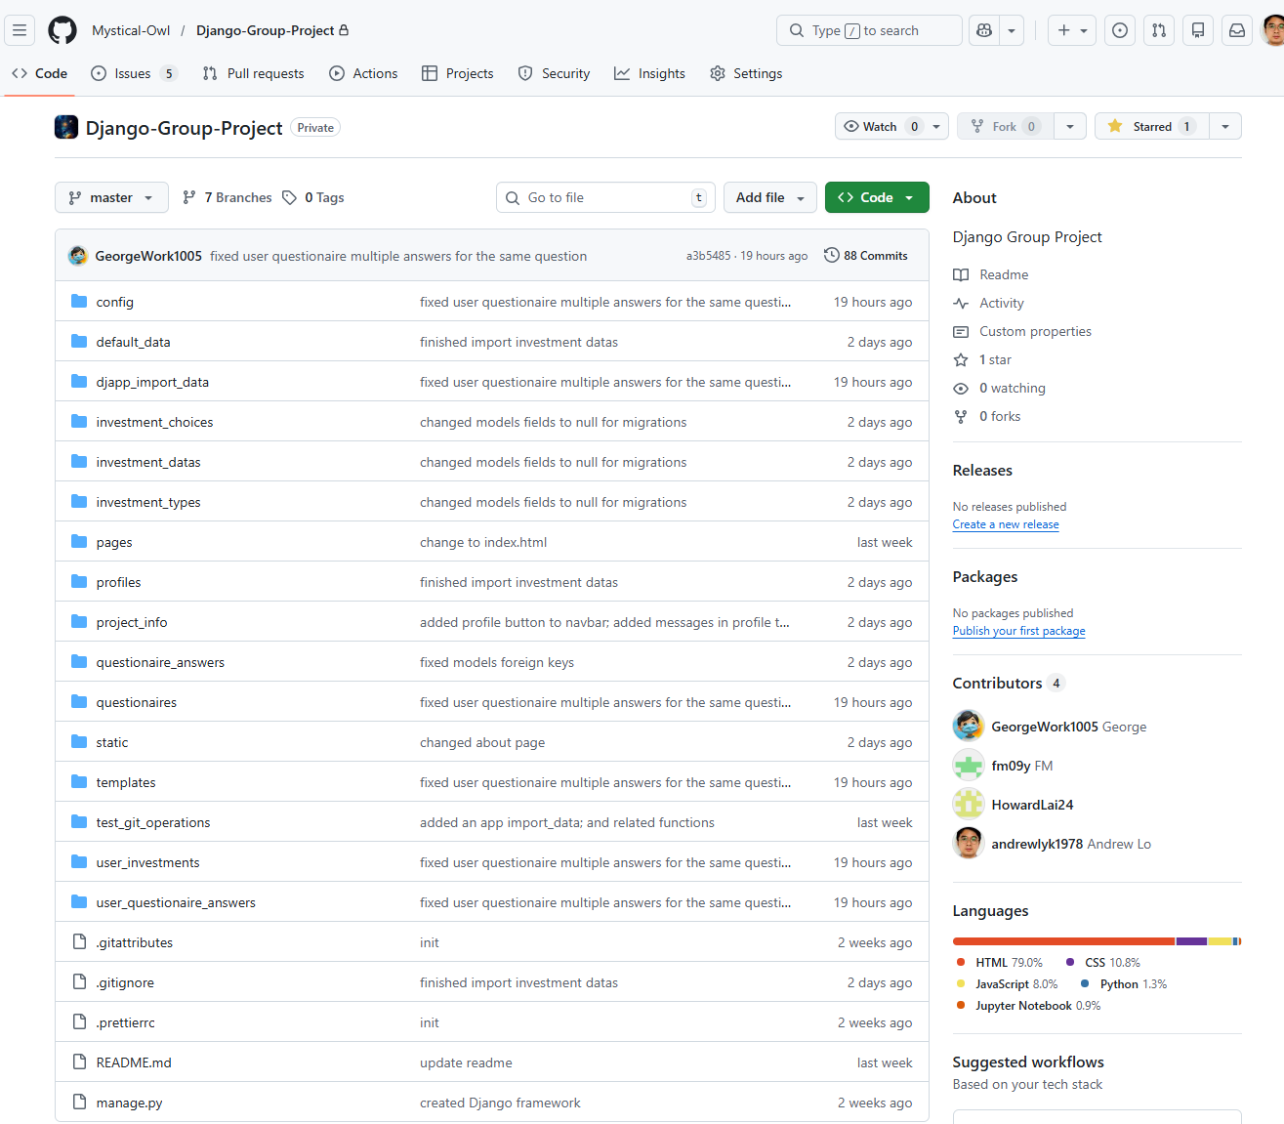



Django結構上 : Apps在 文 件 夾 按 英 文 字 排序,要特定位置收納安排 .

Slide 5
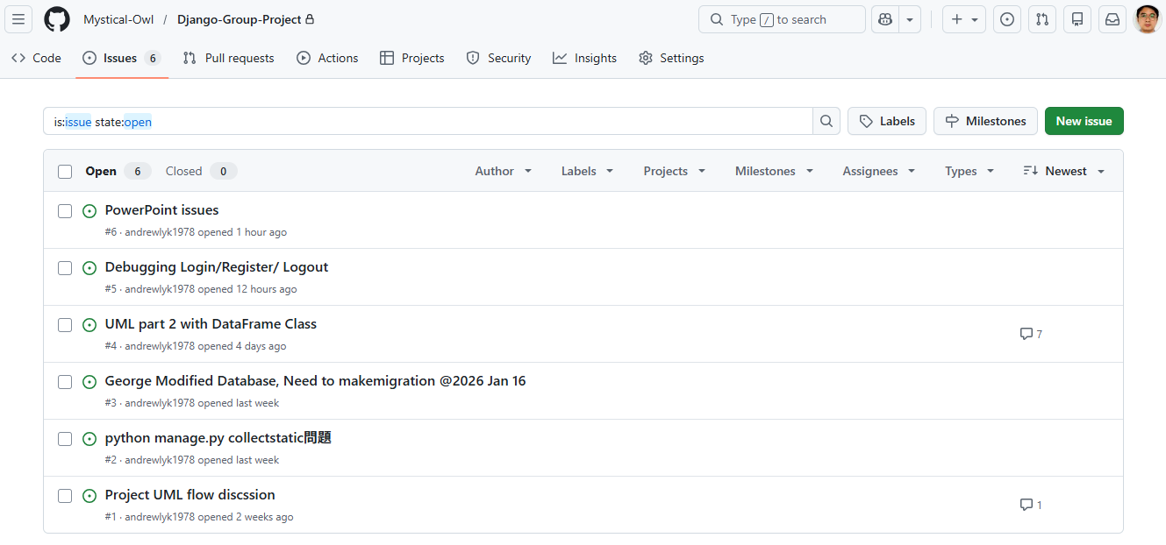
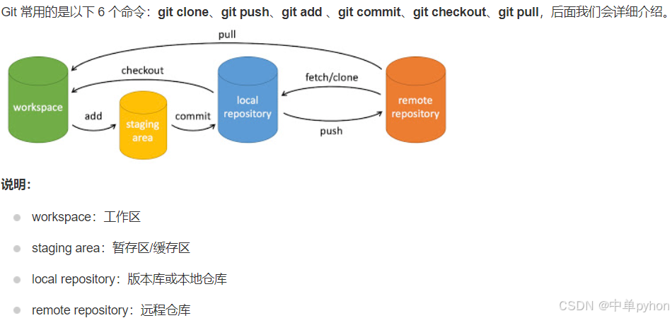
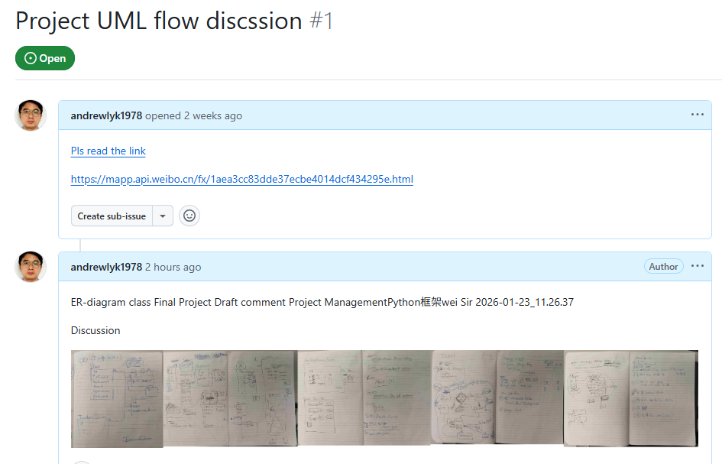

PM-項目管理:
GitHub ,Files Version management
GitHub, Create Issues, https://github.com/Mystical-Owl/Django-Group-Project/issues

Slide 6

多謝Linus Torvalds

