Slide 1
Voice Assistant for Disease Diagnosis Using Machine Learning and Natural Language Processing.
Final Review -2023
Under the Supervision of,
Dr Swati Sharma
Associate Professor
School of Computer Science & Engineering
Presidency University
Batch Number: CCE-G06

Slide 2
Team
SI NO | NAME | ROLL NO | Email/Mobile
1 | SHILPA N | 20191CCE0058 | 201910100306@presidencyuniversity.in / 7892773105
2 | SMITHA REDDY S | 20191CCE0061 | 201910100730@presidencyuniversity.in/ 8722053459
3 | SOWHARDH C K | 20191CCE0065 | 201910100737@presidencyuniversity.in / 9108054148
4 | THANUSHA M | 20191CCE0076 | 201910100204@presidencyuniversity.in / 9632398273

Slide 3
Introduction
This project presents the development of a voice assistant to predict acute diseases based on the symptoms provided by the user by making use of Artificial Intelligence (AI) and Natural Language Processing (NLP) techniques. The proposed system aims to address the lack of access to quality healthcare in remote areas by enabling early diagnosis of common acute diseases. The system uses machine learning algorithms to analyze patient symptoms and provide accurate diagnoses, while NLP techniques are employed to facilitate communication between patients and voice assistant. The system has the potential to improve healthcare outcomes in remote areas, where access to medical professionals is often limited.

Slide 4
Literature Review
SI No | Paper | Published year | Review
1 | Identification and Prediction of Chronic Diseases Using Machine Learning Approach | 2022 | The suggested system delivers disease prognosis based on patient's symptoms by employing machine learning (ML) algorithms such as convolutional neural network (CNN) for automatic feature extraction and disease prediction and K-nearest neighbor (KNN) with an accuracy of 96%.
2 | Comparing different supervised machine learning algorithms for disease prediction | 2019 | This paper offers a thorough analysis of the relative efficacy of various supervised machine learning algorithm models for disease prediction. Random Forest provided the highest accuracy.
3 | Speech to text and text to speech recognition systems-Areview | 2018 | Various text-to-speech (TTS) and speech-to-text (STT) conversion techniques are reviewed and it is concluded that Format Synthesis and Hybrid Machine Translation (HMT) works best respectively.

Slide 5
Literature Review
SI No | Paper | Published year | Review
4 | NaturalSpeech: End-to-End Text to Speech Synthesis with Human-Level Quality | 2022 | In this paper a human-level quality TTS model called NaturalSpeech is developed. It is demonstrated that the model achieves human-level quality with Comparative Mean Opinion Score (CMOS) evaluation.
5 | A Self-Diagnosis Medical Chatbot Using Artificial Intelligence | 2018 | A medical chatbot using Artificial Intelligence is proposed to diagnose and provide basic details about diseases before consulting a doctor, in order to reduce healthcare costs and improve accessibility to medical knowledge.
6 | IntelliDoctor – AI based Medical Assistant | 2019 | An AI-based personal medical assistant known as IntelliDoctor is designed to analyze symptoms, predict medical conditions, generates treatments, tracks user's health activities, and displays periodic health reports.

Slide 6
Literature Review
SI No | Paper | Published year | Review
7 | Text Messaging-Based Medical Diagnosis Using Natural Processing and Fuzzy Logic | 2020 | A chatbot service is developed using fuzzy logic rules, Telegram bot Application Programming Interface (API), knowledge base, NLP and short message service (SMS).
8 | Development of machine learning model for diagnostic disease prediction based on laboratory tests | 2021 | A disease diagnostic system using light gradient boosting machine (LightGBM) and extreme gradient boosting (XGBoost) ML models and a Deep Neural Network (DNN) model with a F1-score of 81% and prediction accuracy of 92% for the five most common diseases.

Slide 7
Proposed System
Speech-to-Text Model (STT)
Converts spoken words into text, which allows the voice assistant to understand what the user is saying.
Translate the patients symptoms into a digital format that can be processed and analyzed.
Text-to-Speech Model (TTS)
Converts written text into spoken words. This allows the voice assistant to respond to the user in a natural and human-like way.
The model communicates the predicted information or advice to patients in a way that is easy to understand and accessible.
Machine Learning Model
It is used to analyze patients data and identify patterns that may indicate the presence of particular disease.
The model is trained with the patient data. It then uses this data to predict the likelihood of a patient developing the disease based on their symptoms.

Slide 8

Proposed System - Architecture
User Input
Speech to Text Conversion
Feature Extraction and Processing
Disease Prediction with Machine Learning
Fig 1: Architecture of proposed disease prediction system.
Treatment and Diet Plan Suggestions
Results
Text to Speech Conversion
User Output

Slide 9
Proposed System – Architecture continued…
In this architecture, the user inputs their symptoms or other relevant information in the form of voice. The speech-to-text module then converts the user's voice input into text format. The text data is then preprocessed to clean and normalize the data. The trained ML model then extracts the keywords from the preprocessed data and identifies the symptoms and further predicts the likelihood of various diseases.
Finally, the output results are presented to the user using a text-to-speech module that converts the results into a voice format.

Slide 10
Methodology/Steps Involved
Following are the steps involved in creation of Voice Assistant for Disease Diagnosis,
Data Collection.
Data Preprocessing.
Disease Prediction Using Random Forest.
Speech to Text Using SpeechRecognition.
Text to Speech Using Pyttsx3.
Information Retrieval Using OpenAI.

Slide 11
Methodology/Steps involved continued…
Data Collection.
The dataset collected includes 132 common symptoms(features) mapped to 41 unique diseases(target).
Data Preprocessing.
The collected data are preprocessed to check for null values and to drop unnecessary columns and to make changes to the dataset if needed.
Disease Prediction Using Random Forest.
The processed train dataset is split into test and train data. The split data (symptoms and diseases) is then fitted onto the Random Forest Model to train. Later the model is tested on the test dataset.

Slide 12
Methodology/Steps involved continued…
Speech to Text Using SpeechRecognition.
Using the SpeechRecognition library we convert the user’s spoken words into text, which allows the voice assistant to understand what the user is saying.
Text to Speech Using Pyttsx3.
Pyttsx3 is a Python library, used for text-to-speech conversion. When integrated into the voice assistant it can be used to provide spoken responses to users about the results of their diagnosis.
Information Retrieval Using OpenAI.
This OpenAI library helps in retrieval of information from the internet on treatment plans, diet charts and so on from the GPT model.

Slide 13
Results Achieved
When tested on the test dataset an accuracy of 92.68% was achieved, which is a promising result for predicting acute diseases.
We were able to achieve desired outcomes on the system’s speech-to-text and Text-to-speech conversion, which benefitted in easier communications.
The information retrieved using the OpenAI library was a success and provided necessary treatment and diet plan.

Slide 14
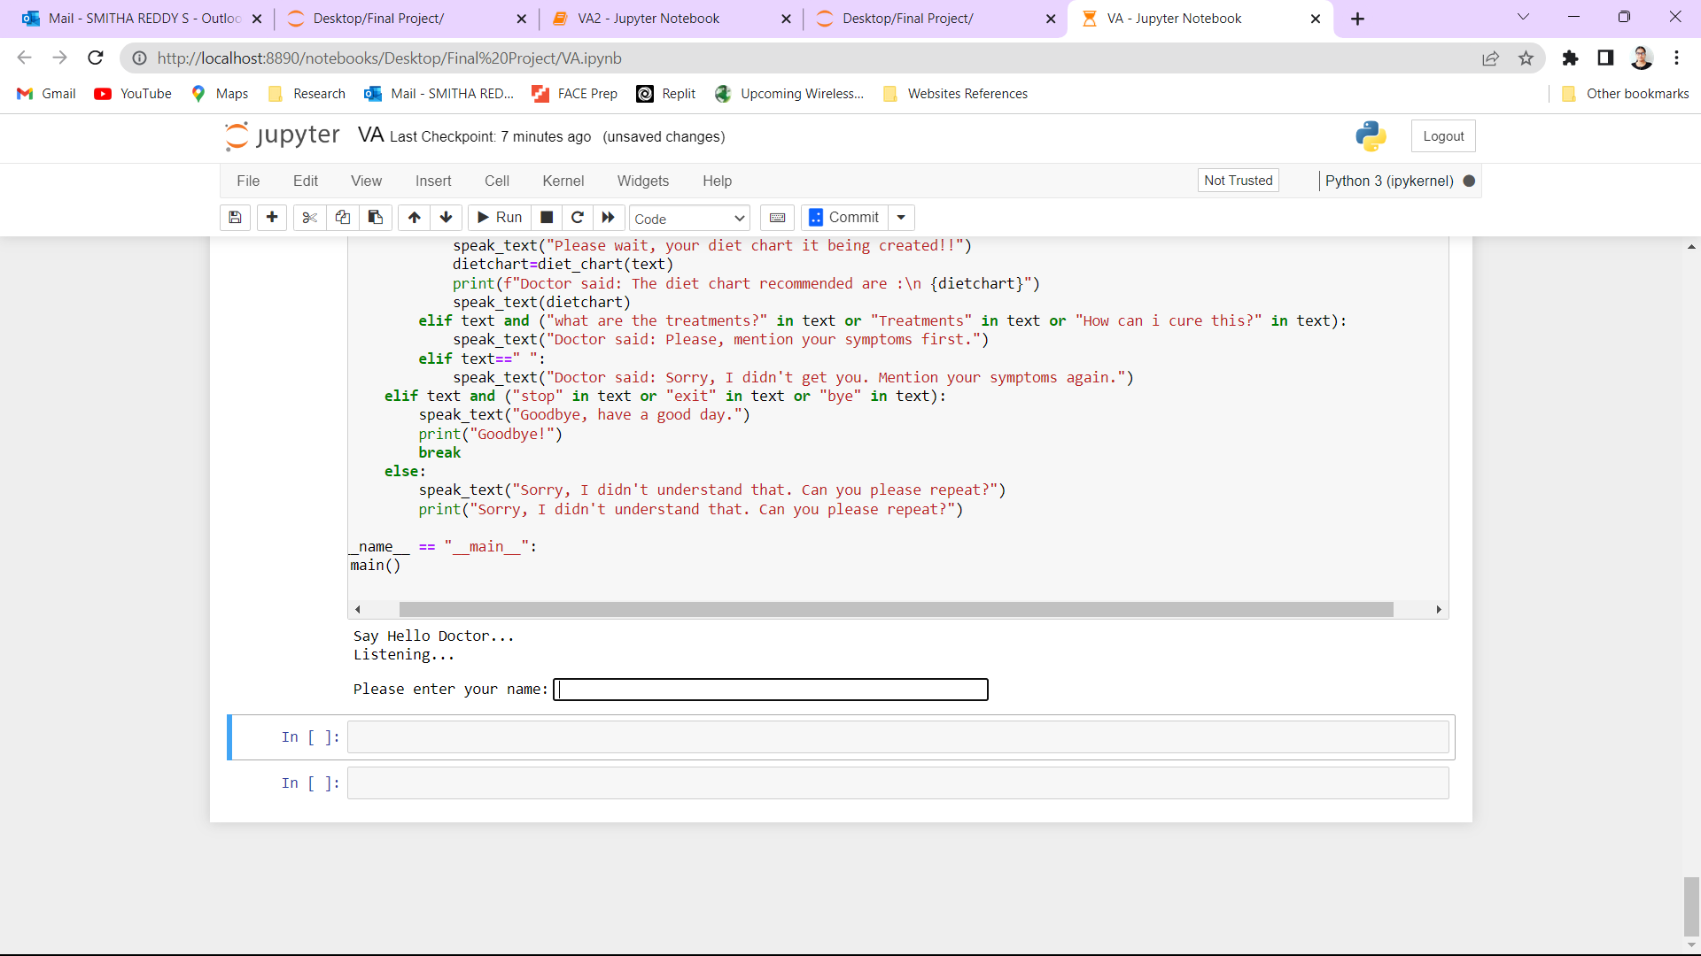
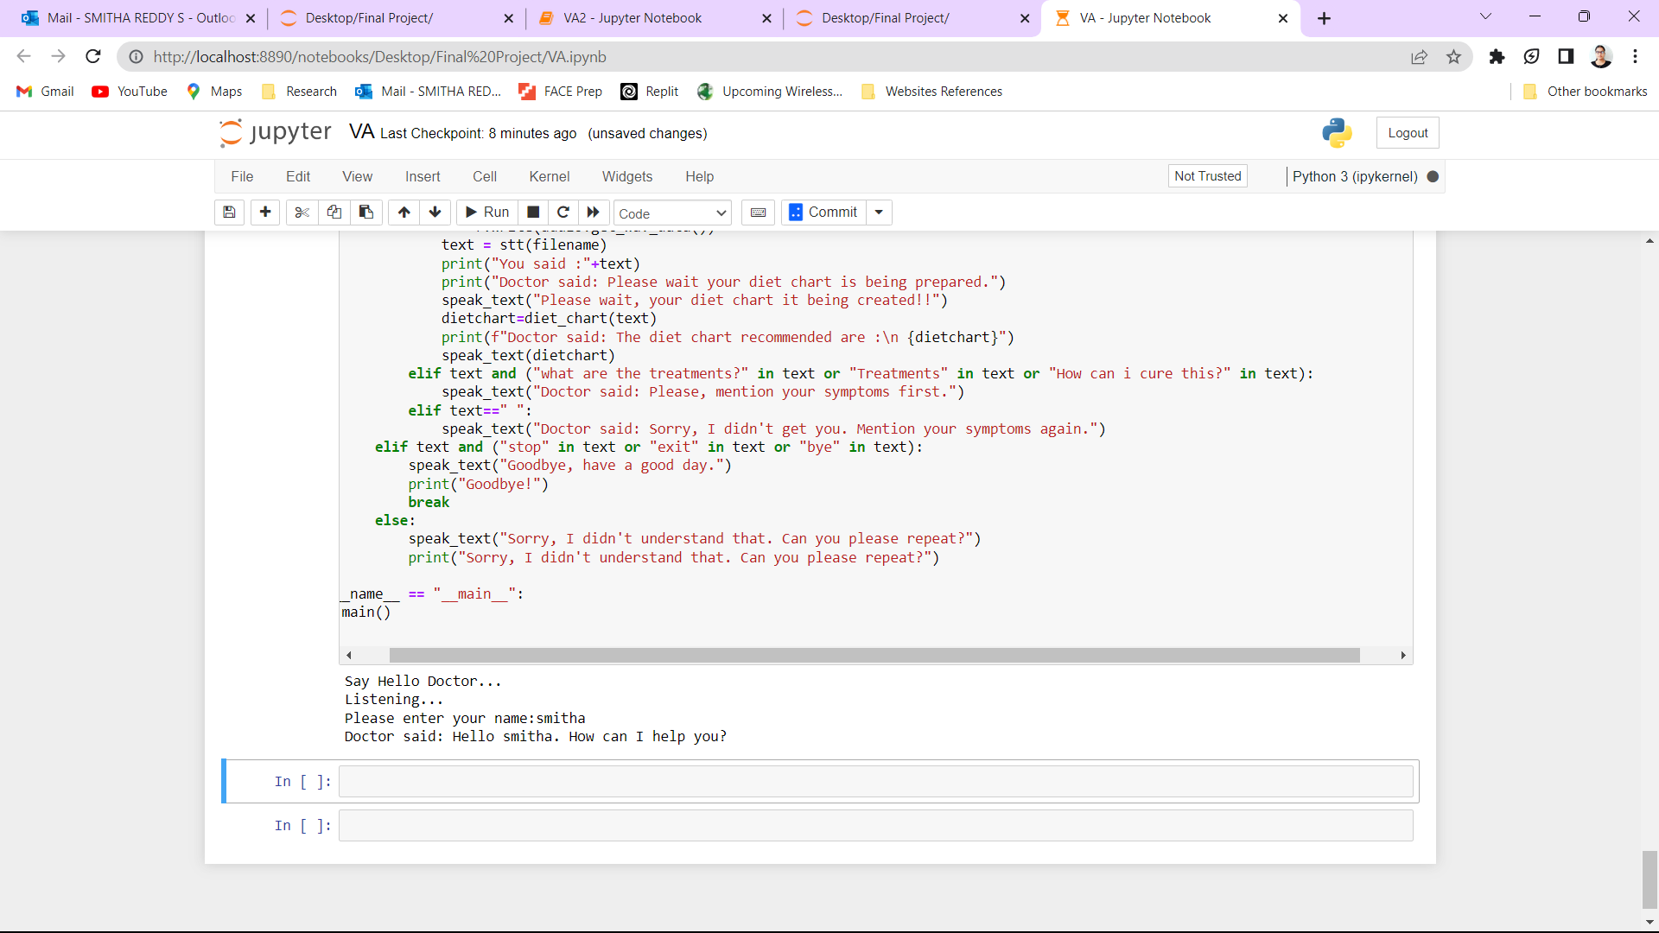
Results Achieved
Prompt: “Hello doctor”

Slide 15
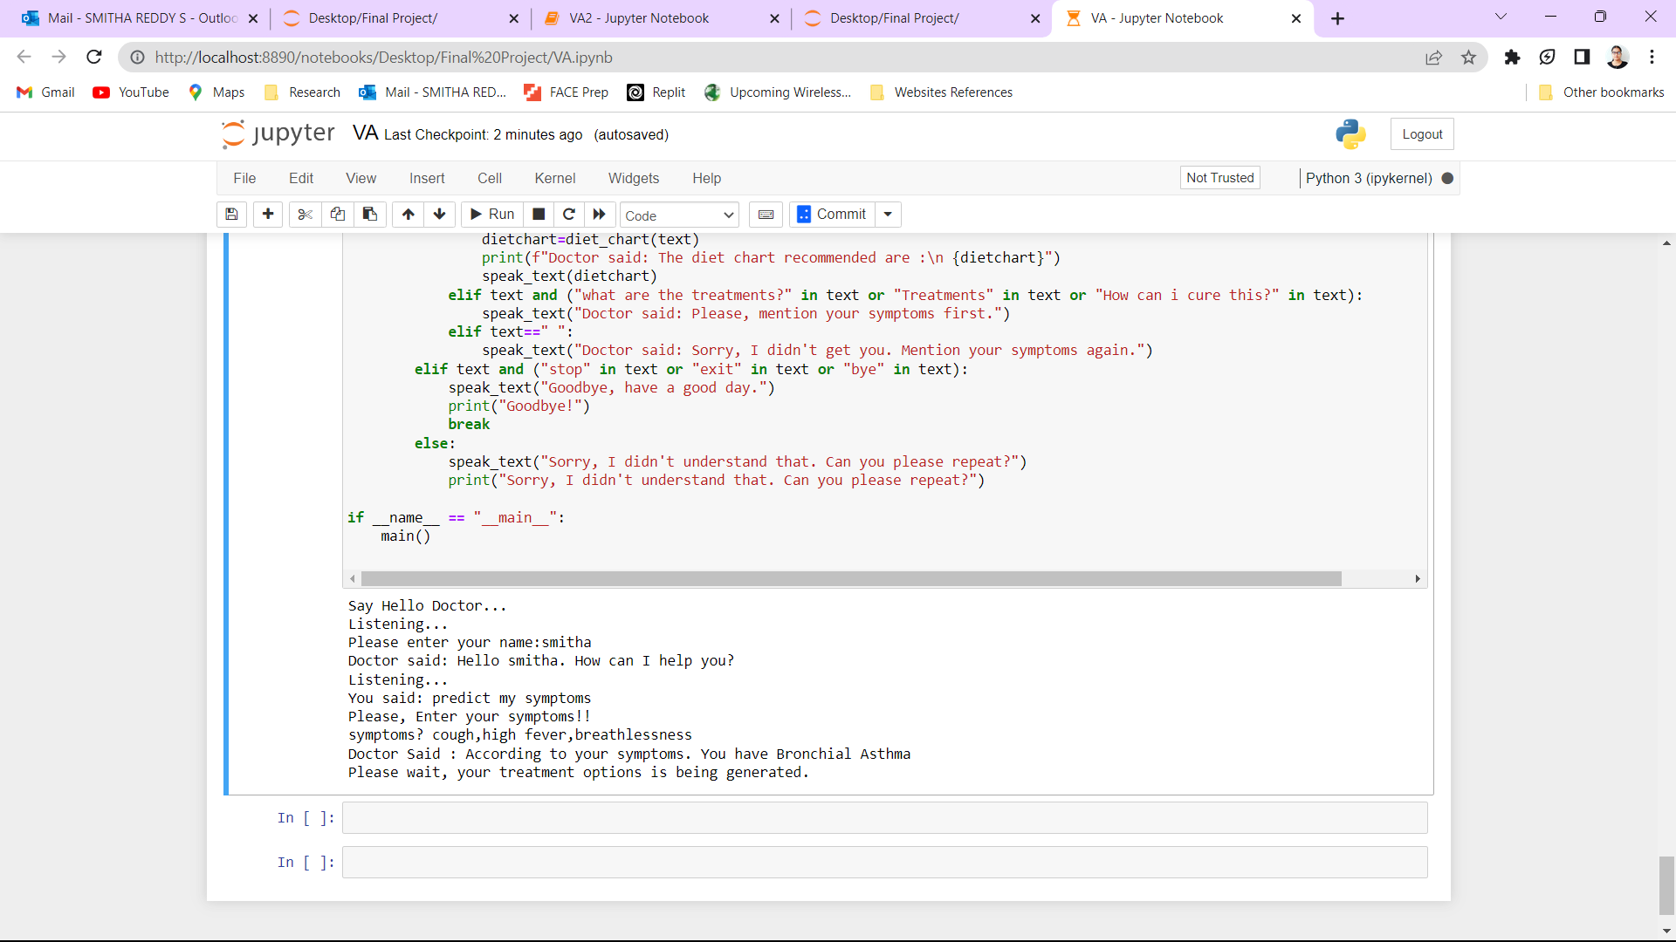
Results Achieved
Prompt: “Predict my symptoms/ predict disease/ symptoms/ predict symptoms”

Slide 16
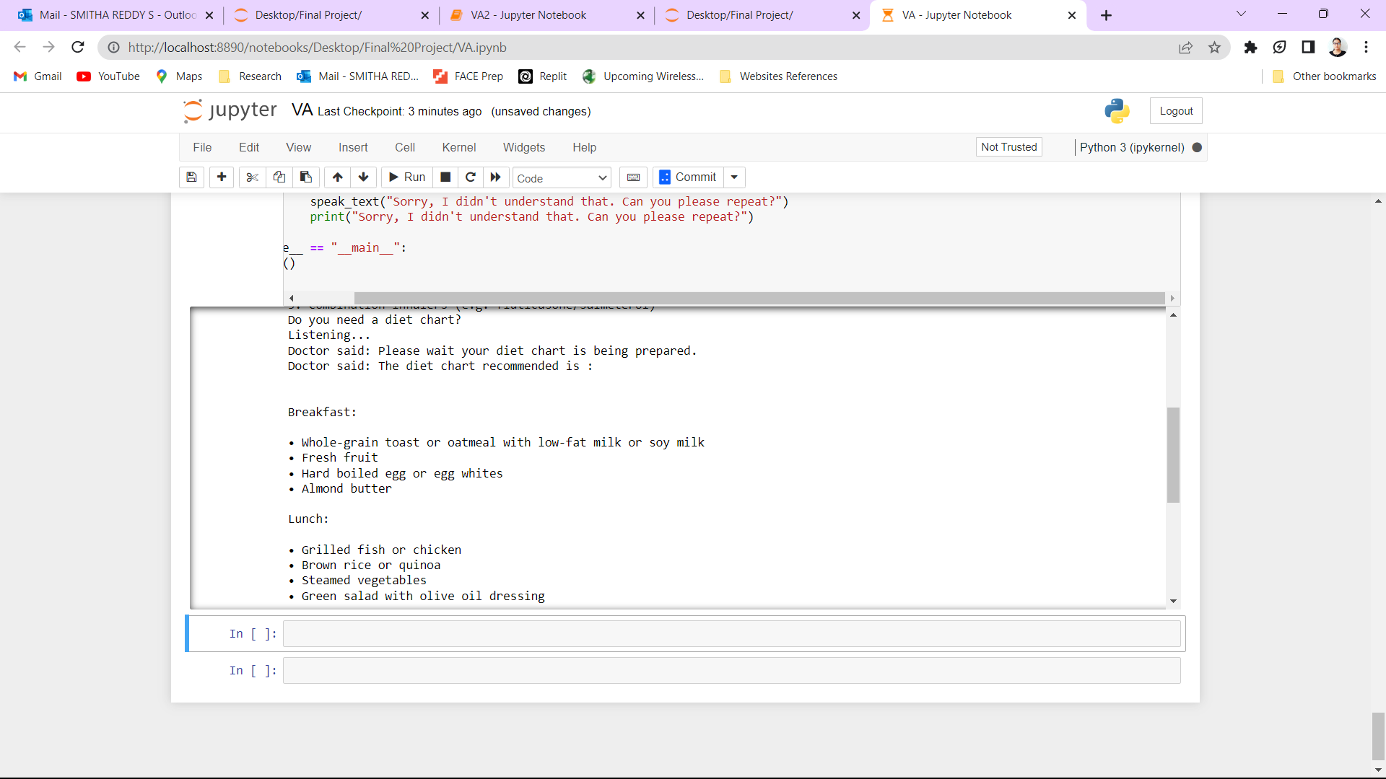
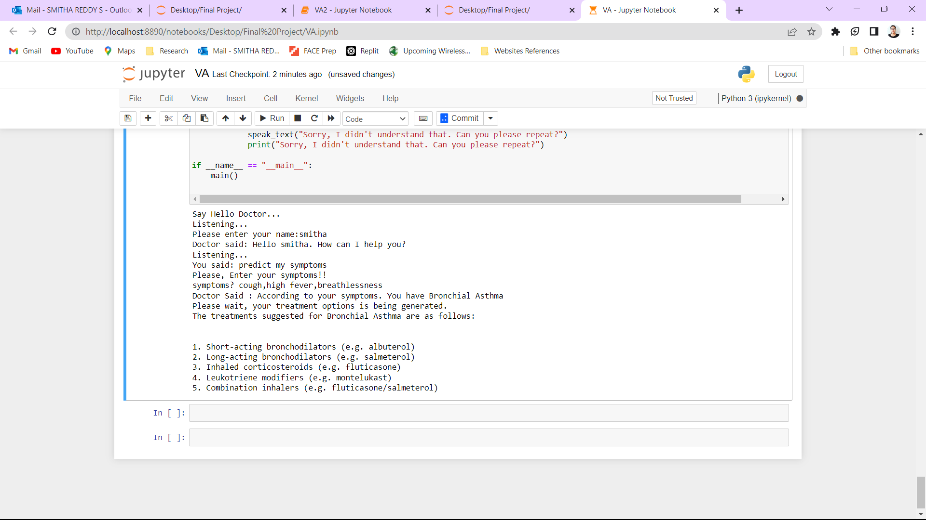
Results Achieved
Recommendation of treatments for the predicted disease.
Diet chart recommendation for the predicted disease.

Slide 17
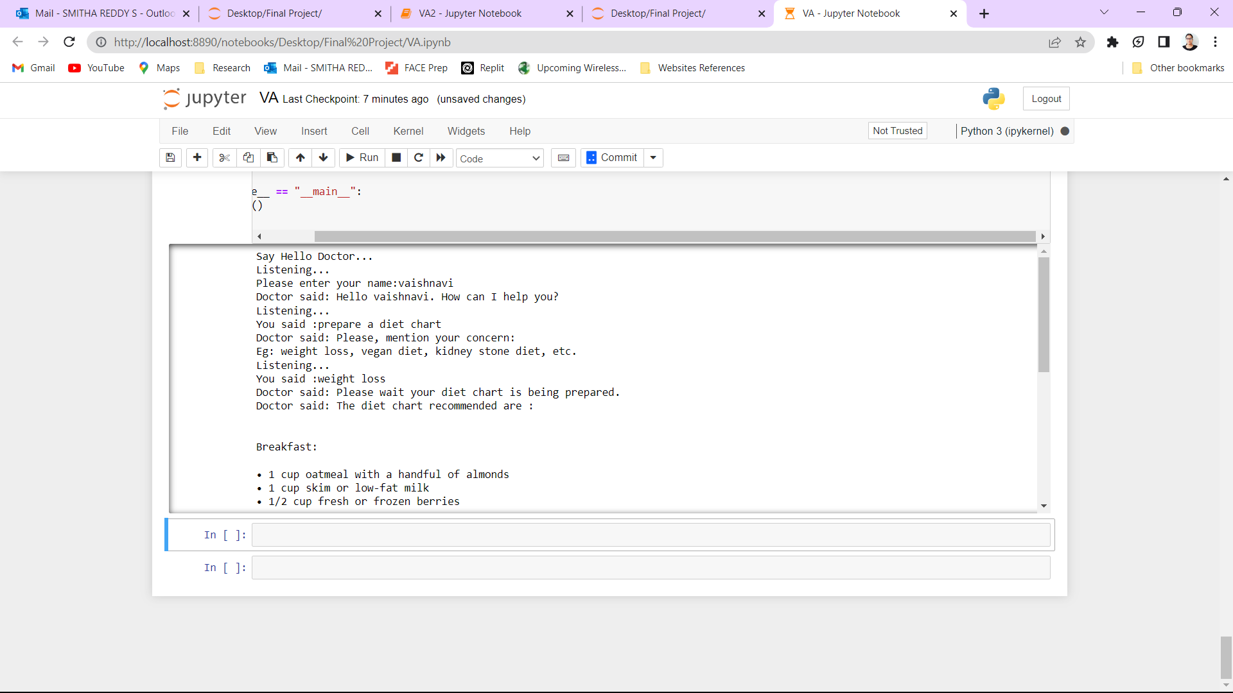
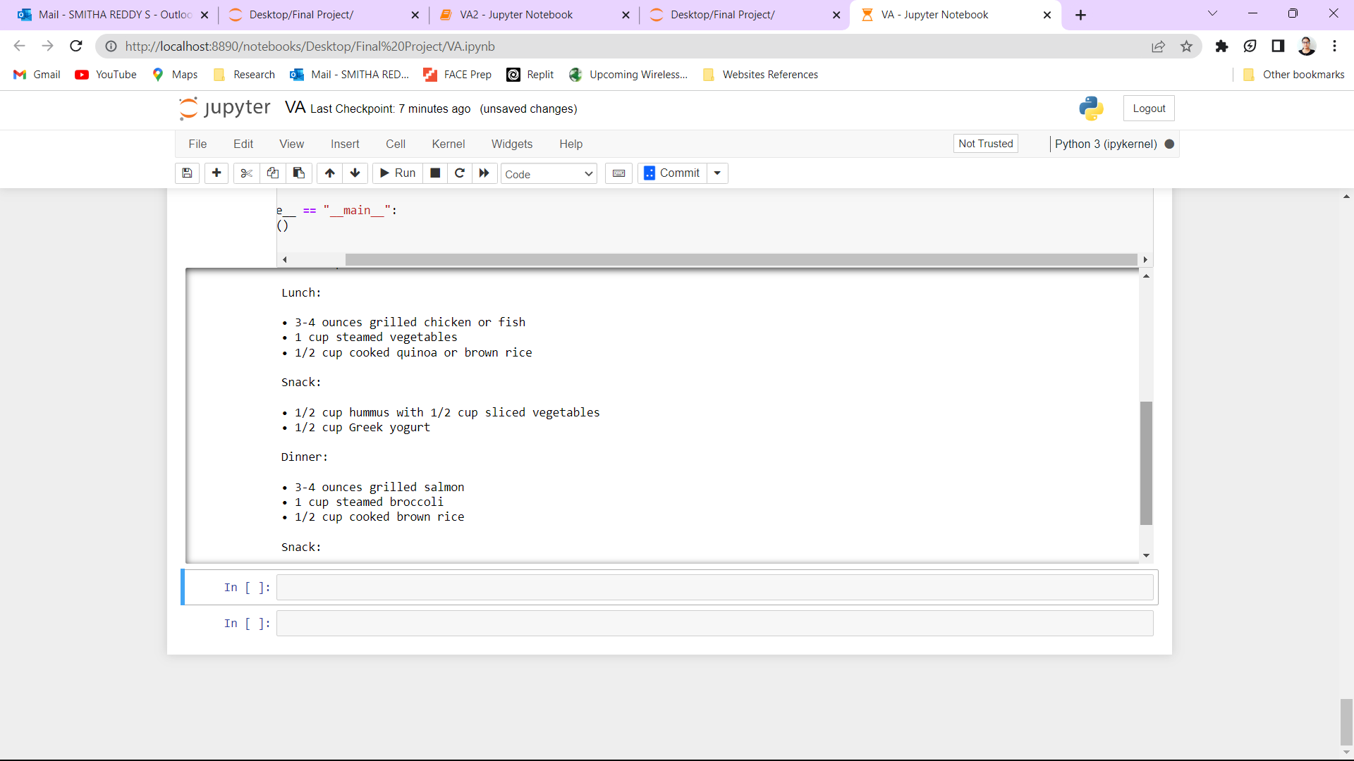
Results Achieved
Prompt: “Prepare a diet chart/ diet chart/ create a diet chart”

Slide 18
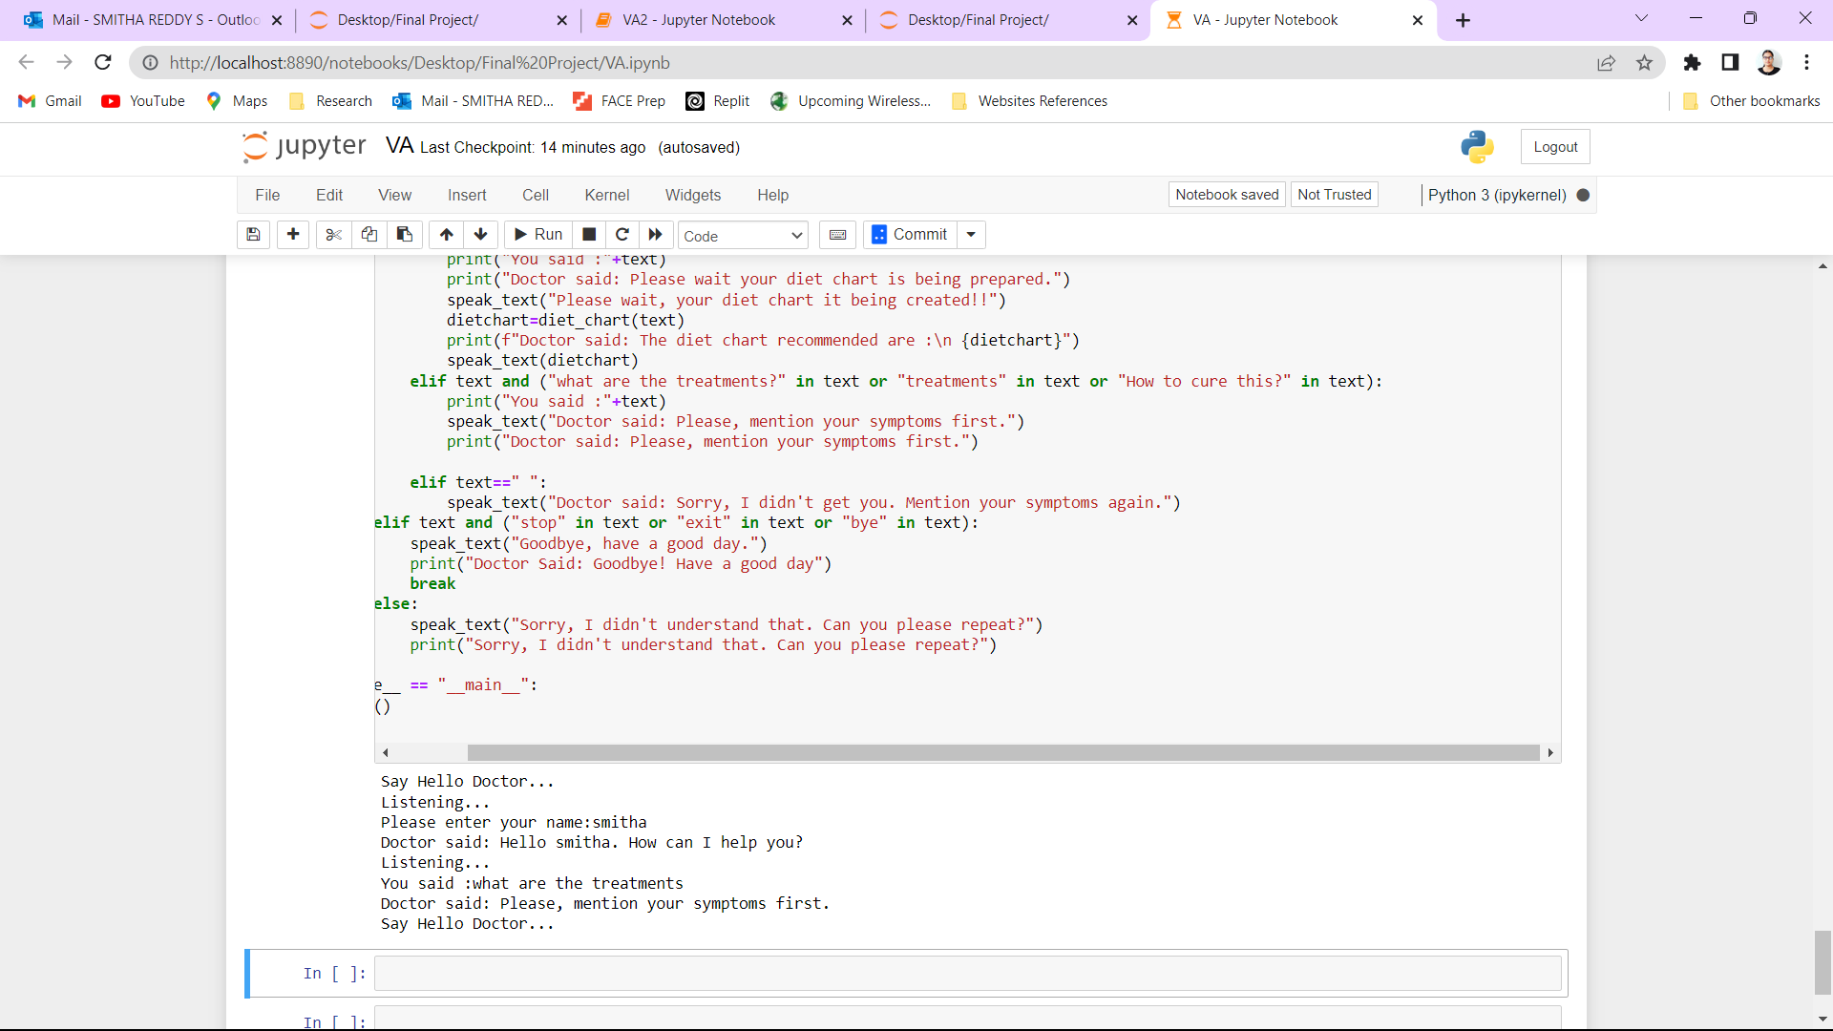
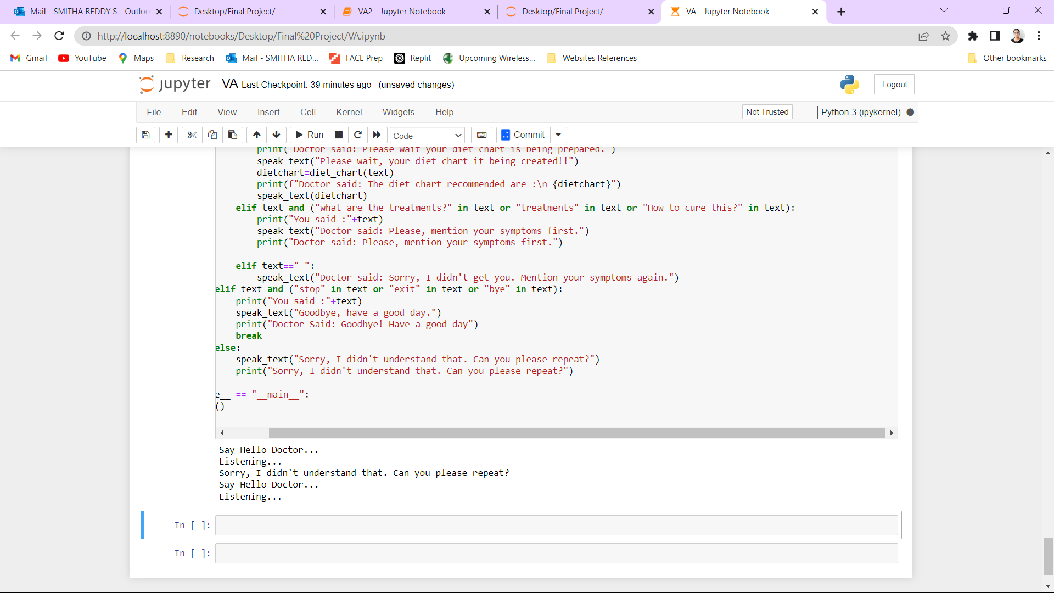
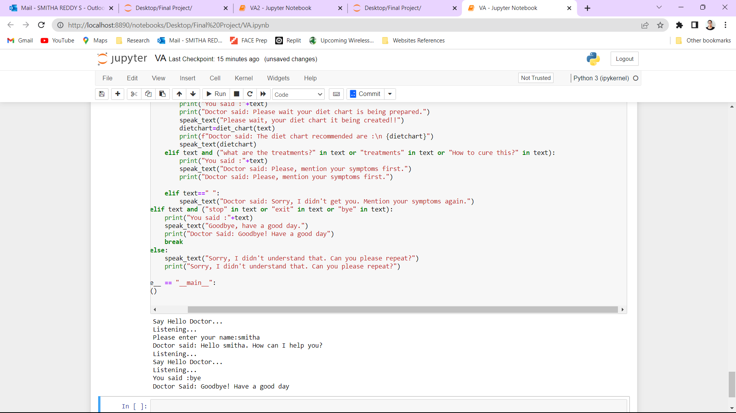
Results Achieved
Prompt: “what are the treatments/ how can I cure this/ treatments ”
Prompt: “ ”
Prompt: “stop/ exit/ bye”

Slide 19
Advantage of the Proposed System
Unlike Siri, Alexa, Google this provides accurate diagnosis based on the patient's symptoms as it is trained.
Can help healthcare professionals save time by analyzing the patient's data quickly and efficiently.
Provides necessary information on treatments and diet plans in accordance to predicted disease.
Can be used in remote areas where healthcare facilities are scarce, providing access to medical diagnosis and treatment information.

Slide 20
Future Enhancement
Future work can involve,
Expanding of dataset to include a wider range of diseases and symptoms, and incorporating other technologies such as image recognition.
Incorporation with neural networks to achieve better understanding of user’s input and generate more accurate disease diagnosis.
To include other regional and international languages.
Future systems could explore the potential use of the system in clinical settings, where it could aid healthcare professionals in making more informed diagnosis and treatment decisions.

Slide 21
Conclusion
In this paper, we proposed a voice assistant system to predict diseases and make recommendations on treatments and diets based on the user’s symptoms. It seeks to convert the input audio to machine understandable form using NLP techniques, predict symptoms using the Random Forest algorithm, and make recommendation using the OpenAI.
In conclusion, this is an innovative approach that has the potential to revolutionize the healthcare industry. By providing accurate diagnoses based on patient symptoms and medical history, voice assistants can help healthcare professionals save time, reduce costs, and provide accessible healthcare to patients. With further development and integration into healthcare systems, voice assistants have the potential to improve patient outcomes and the overall healthcare experience in urban and rural areas.

Slide 22
References
Rayan Alanazi, “Identification and Prediction of Chronic Diseases Using Machine Learning Approach”, Hindawi Journal of Healthcare Engineering, Volume 2022.
Shahadat Uddin1 , Arif Khan, Md Ekramul Hossain and Mohammad Ali Moni, “Comparing different supervised machine learning algorithms for disease prediction”, BMC Medical Informatics and Decision Making, 2019.
Ayushi Trivedi,Navya Pant, Pinal Shah,Simran Sonik, Supriya Agrawal, “Speech to text and text to speech recognition systems-Areview”, IOSR Journal of Computer Engineering, 2018.
Xu Tan∗ , Jiawei Chen∗ , Haohe Liu∗ , Jian Cong, Chen Zhang, Yanqing Liu, Xi Wang Yichong Leng, Yuanhao Yi, Lei He, Frank Soong Tao Qin, Sheng Zhao, Tie-Yan Liu, “NaturalSpeech: End-to-End Text to Speech Synthesis with Human-Level Quality”, arXiv preprint arXiv:2205.04421, 2022.
Divya S , Indumathi V , Ishwarya S , Priyasankari M , Kalpana Devi S, “A Self-Diagnosis Medical Chatbot Using Artificial Intelligence ”, Journal of Web Development and Web Designing Volume 3 Issue 1, 2018.

Slide 23
References
Dr. Meera Gandhi, Vishal Kumar Singh, Vivek Kumar, “IntelliDoctor – AI based Medical Assistant”, Fifth International Conference on Science Technology Engineering and Mathematics, 2019.
Nicholas A. I. Omoregbe, Israel O. Ndaman, Sanjay Misra, Olusola O. Abayomi-Alli, Robertas Damasevicius, “Text Messaging Based Medical Diagnosis Using Natural Processing and Fuzzy Logic”, Hindawi Journal of Healthcare Engineering, Volume 2020.
Dong Jin Park , Min Woo Park , Homin Lee , Young‑Jin Kim , Yeongsic Kim & Young Hoon Park, “Development of machine learning model for diagnostic disease prediction based on laboratory tests”, Nature Portfolio, 2021.

Slide 24
Thank You

