Slide 1
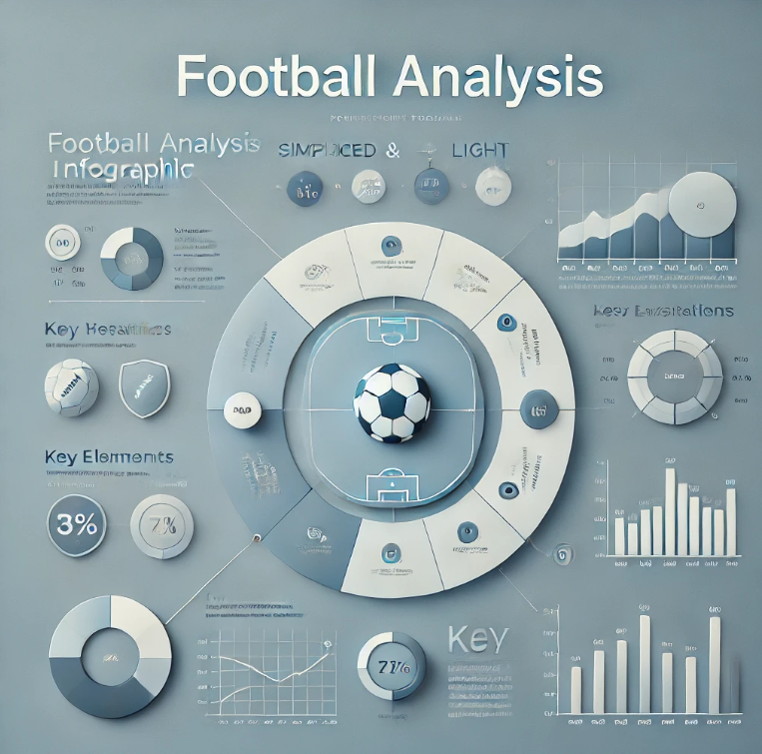
UNLEASHING INSIGHTS FROM FOOTBALL DATA
CAPSTONE PROJECT
PRESENTED BY: MAHI MISTRY
MENTORED BY: MUNNA PANDEY

Slide 2
INTRODUCTION
Football data analysis is the process of collecting, cleaning, and analyzing data to extract meaningful insights which is used to improve player performance, team tactics, fan engagement, and overall decision-making.
Various data analysis techniques, like Exploratory Data Analysis (EDA) and correlation, prediction using ML models using tools like Python, MySQL, Excel, and Tableau are employed to extract meaningful insights.
These insights aim to enhance decision-making, improve team performance, and provide a competitive edge in the sport.

Slide 3
Data Preprocessing Techniques
Import datasets
Merge datasets
Remove duplicates
Missing value treatment
Save cleaned file
Evaluate
Label encoding
Outlier & treatment
Feature reduction
Feature scaling

Slide 4
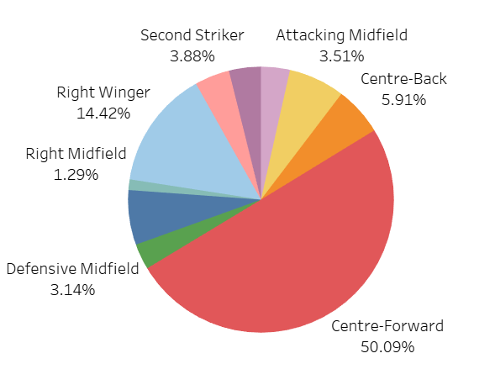
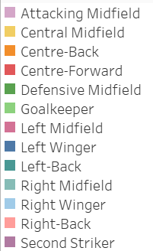
Performance Analysis
What is the overall goal-scoring performance across position of the players?
Interpretation
The chart reveals that Centre-Forwards are the most prolific goal-scorers, contributing a significant 50.09% of the total goals.
Right Wingers follow with 14.42%, while other positions like Centre-Backs and Attacking Midfielders contribute a smaller percentage of goals.
Position Wise Goals Scored

Slide 5
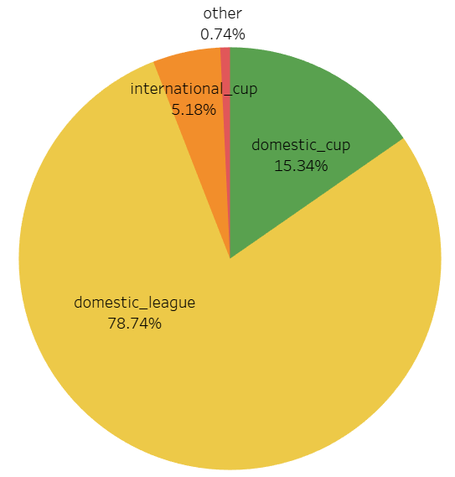
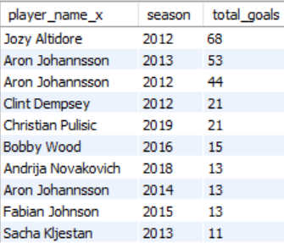
What is the overall goal-scoring performance across all competitions?
Which players scored the most goals in a season?
SELECT player_name_x, season, SUM(goals) AS total_goals
FROM football_db
GROUP BY player_name_x, season
ORDER BY total_goals DESC
LIMIT 10;
Interpretation
The pie chart shows that the vast majority of goals (78.74%) are scored in domestic league matches, followed by domestic cup matches (15.34%).
Jozy Altidore as scored highest goals in 2012. Then, followed by Aron goal scored is 53 in 2013.
Goal Distribution By Competition Types

Slide 6
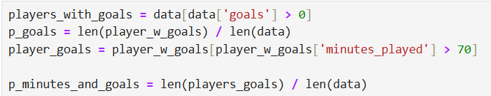
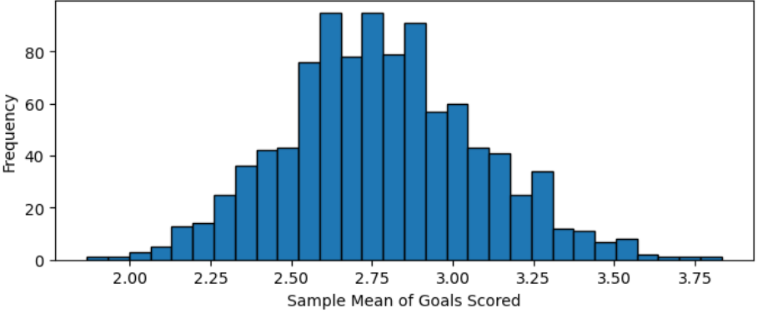
Conditional Probability
What is the probability that a player played more than 70 minutes in a game, scored at least one goal?
Probability that a player played more than 70 minutes scored at least one goal: 0.76
The plot demonstrates the CLT by showing that the sample means form a normal distribution, even if the original data is not normally distributed.
Central Limit Theorem (CLT)
How does the distribution of the sample mean of goals scored look when sampling multiple subsets of 30 matches?
import matplotlib.pyplot as plt
sample_means = [total_goals.sample(30,
random_state=i)
.mean() for i in range(1000)]
plt.figure(figsize=(8,3))
plt.hist(sample_means, bins=30, edgecolor='black’)
plt.title("Distribution of Sample Means (CLT)")
plt.xlabel("Sample Mean of Goals Scored")
plt.ylabel("Frequency")
plt.show()
Distribution of Sample Mean (CLT)

Slide 7
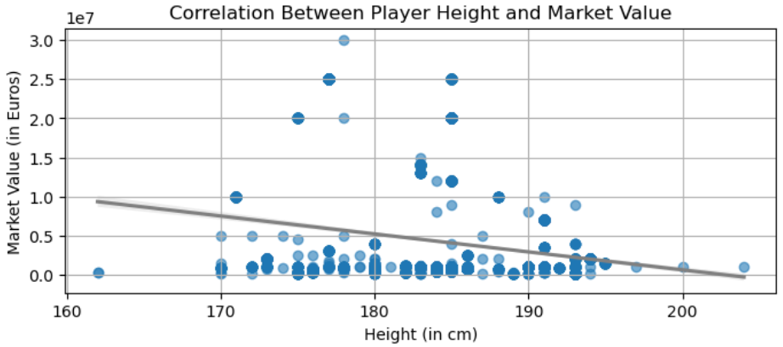
Player Profile and Market Value
Descriptive Analysis
What is the correlation between player height and market value?
# Calculate correlation
correlation = data['height_in_cm’].
corr(data['market_value_in_eur’])
print(f"Correlation between height and
market value: {correlation:.2f}")
plt.figure(figsize=(8, 3))
# Scatter plot with regression line
sns.regplot(x='height_in_cm’,
y='market_value_in_eur’,
data=data, scatter_kws={'alpha': 0.6},
line_kws={'color': 'black’})
plt.title('Correlation Player Height &
Market Value’)
plt.xlabel('Height (in cm)’)
plt.ylabel('Market Value (in Euros)’)
plt.grid(True)
plt.show()
Correlation Between Player Height & Market Value
Interpretation
As height increases, the market value of players generally decreases.
Taller players have lower market values, likely due to positional differences. Emphasizing skill over physical traits in higher-valued roles.

Slide 8
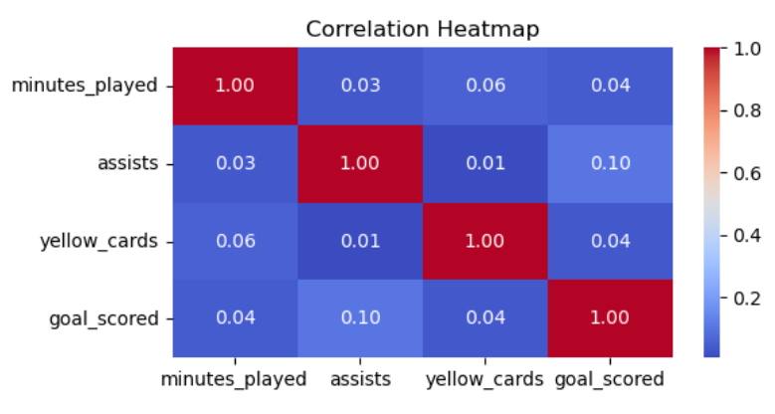
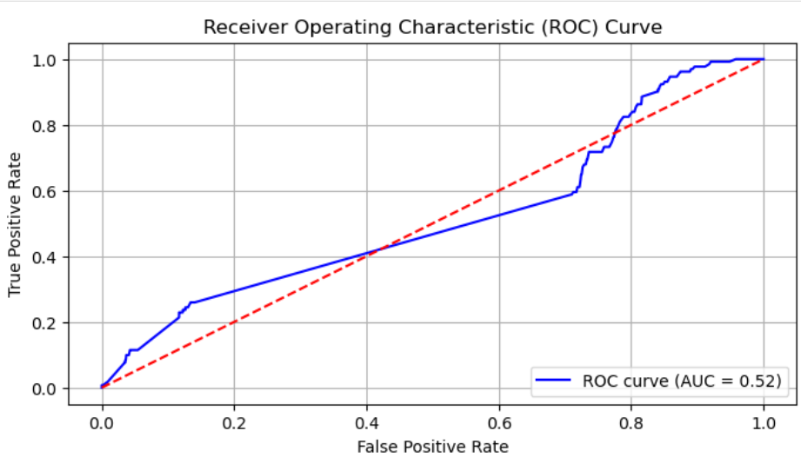

Logistic Regression for Classification
Can we classify whether a player is likely to score a goal based on their playing time, assists, and yellow cards?
The confusion matrix shows the true positives, false positives, true negatives, false negatives.
Training Accuracy: 0.91 and Testing Accuracy: 0.90
The ROC curve indicates that the model's performance (AUC = 0.52) is only slightly better than random guessing.
To improve, consider adding more predictive features or addressing potential class imbalance.

Slide 9
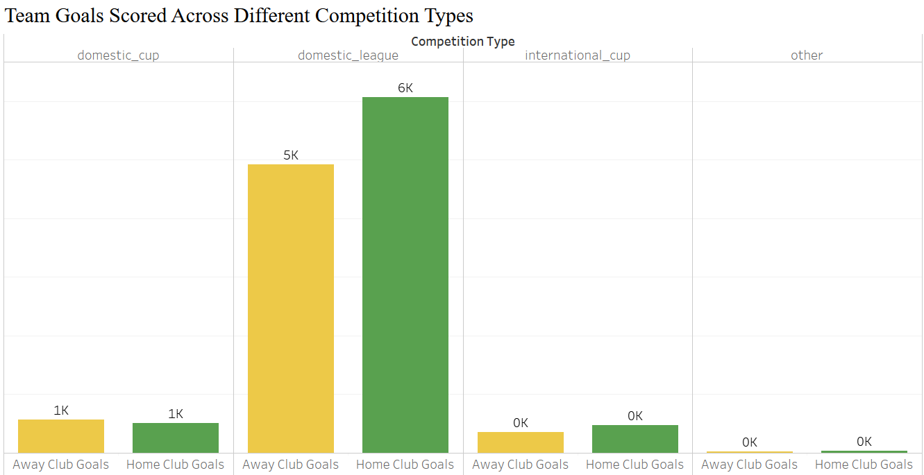
Team Comparison
Descriptive Analysis
Which team goal scored high over different competition type?
Team Goals Scored Across Different Types
Interpretation
The team scores most goals in domestic league matches, followed by domestic cup games, with significantly fewer goals scored in international cup and other competitions.
The Domestic league goal scored is high compared to other competition type.

Slide 10
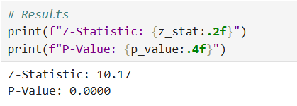
Hypothesis Testing
Is there a significant difference in the average goals scored by home and away teams?
Null Hypothesis (H0):There is no significant difference in the average goals scored by home and away teams.
Alternative Hypothesis (H1):There is a significant difference in the average goals scored by home and away teams.
from statsmodels.stats.weightstats import ztest
# Goals scored by home and away teams
home_goals = data['home_club_goals’]
away_goals = data['away_club_goals’]
# Perform z-test
z_stat,p_value = ztest(home_goals, away_goals)
# Resultsprint(f"Z-Statistic: {z_stat:.2f}")
print(f"P-Value: {p_value:.4f}")
if p_value < 0.05:
print("Reject the null hypothesis: There is a significant difference in average goals scored by home and away teams.")
else:
print("Fail to reject the null hypothesis: No significant difference in average goals scored by home and away teams.")
Interpretation
Z-Statistic: Indicates the number of standard deviations the sample means are apart.
P-Value: Determines the statistical significance of the results.
Reject the null hypothesis: There is a significant difference in average goals scored by home and away teams.

Slide 11
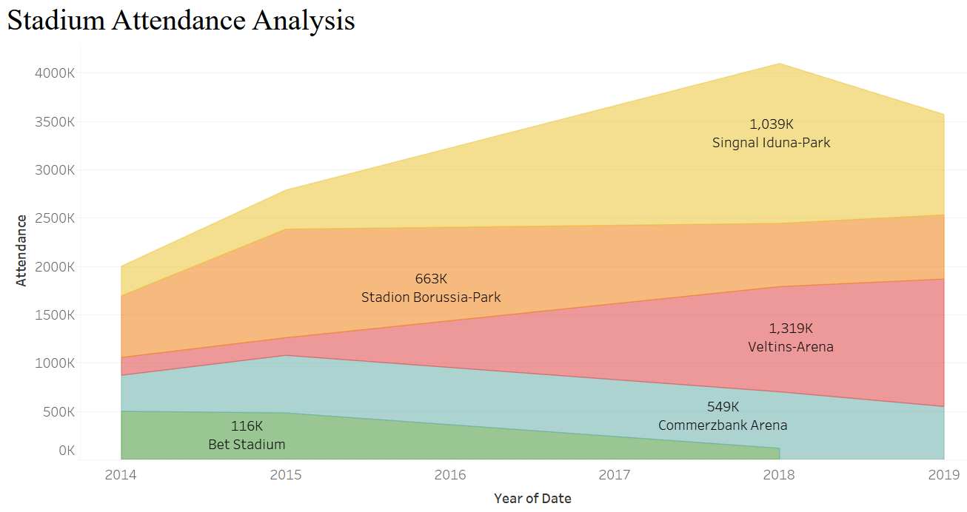
Attendance and Stadium Analysis
Which stadiums have the highest average attendance over different season?
Stadium Attendance Analysis
Interpretation
Attendance trends show steady growth from 2014 to 2019.
SIGNAL IDUNA PARK consistently attracts the highest number of fans.
Helps identify popular venues and improve crowd management strategies.

Slide 12
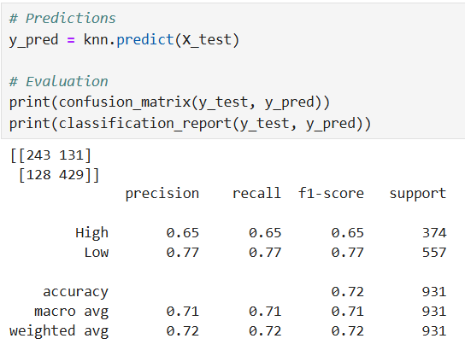

K-Nearest Neighbour (KNN) Classification
Can we classify matches as high or low attendance based on features such as stadium, competition type, and home/away team positions?
from sklearn.model_selection import train_test_split
from sklearn.preprocessing import LabelEncoder, StandardScaler
from sklearn.neighbors import KNeighborsClassifier
from sklearn.metrics import classification_report, confusion_matrix
# Encode categorical features
le_stadium = LabelEncoder()
le_competition = LabelEncoder()
data['stadium_encoded'] =le_stadium.fit_transform(data['stadium’])
data['competition_encoded'] = le_competition.fit_transform(data['competition_type’])
# Define features and target
X = data[['stadium_encoded', 'competition_encoded', 'home_club_position', 'away_club_position’]]
y = data['attendance_label’]
# Split dataX_train, X_test, y_train, y_test = train_test_split(X, y, test_size=0.2, random_state=42)
# Standardize features
scaler = StandardScaler()
X_train = scaler.fit_transform(X_train)
X_test = scaler.transform(X_test)
# Build KNN model
knn = KNeighborsClassifier(n_neighbors=5)
knn.fit(X_train, y_train)
# Prediction
sy_pred = knn.predict(X_test)
print(confusion_matrix(y_test, y_pred))
print(classification_report(y_test, y_pred))
Interpretation
Confusion Matrix: Shows the number of true positives, true negatives, false positives, and false negatives.
Classification Report: Provides precision, recall, F1-score, and accuracy, helping evaluate the model’s performance in predicting high/low attendance.

Slide 13
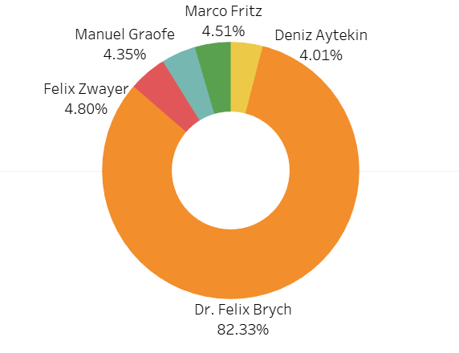
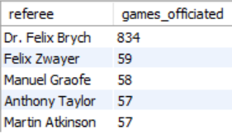
Referee Analysis
Which referees officiated the most games?
Which referee officiated the most games?
SELECT referee, COUNT(DISTINCT game_id)
AS games_officiated
FROM football_db
GROUP BY referee
ORDER BY games_officiated DESC
LIMIT 5;
Interpretation
Dr. Felix Brych referees officiate (82.33%)which is 834 matches significantly more matches than others.
Then, Followed by Felix Zwayer (4.80%) 59 matches followed by other referee.
Referee Activity Count

Slide 14
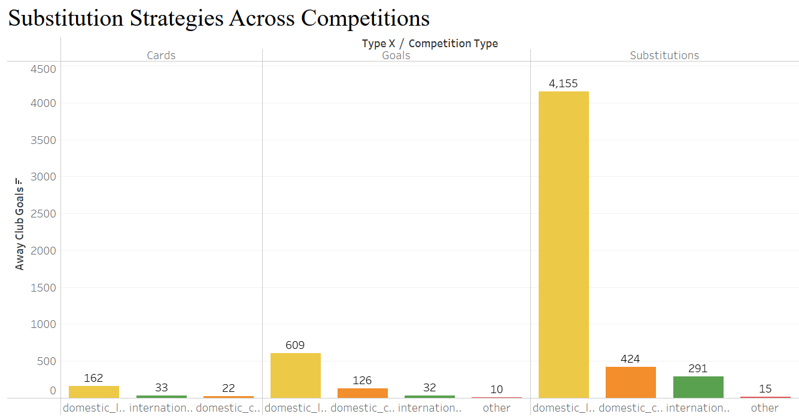
Substitution Patterns
What is the overall frequency of substitutions made by the team across all competitions
Substitution Strategies Competitions
Interpretation
It would focus on identifying trends and differences in the frequency and nature of substitutions in domestic league, domestic cup, and international cup matches.
It shows most substitution happened in domestic league as compared to thers
Then, Followed by domestic cup.

Slide 15
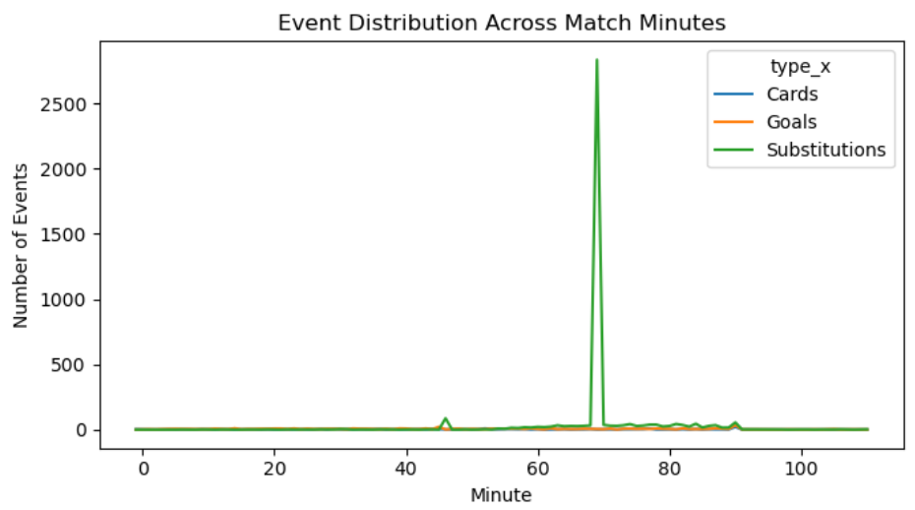
Event Analysis
Descriptive Analysis
Which match events (e.g., goals, cards) occur most frequently, and how are they distributed across minutes?
Event Distribution Across Match Minutes
# Events by minute
events_by_minute=data.groupby('minute’)
['type_x'].value_counts()
.unstack(fill_value=0)
# Events by minute
events_by_minute.plot
(kind='line', ax=plt.gca(),figsize=(10, 4))
plt.title("Event Distribution Across Match Minutes")
plt.xlabel("Minute")
plt.ylabel("Number of Events")
plt.tight_layout()
plt.show()
Interpretation
Goals, fouls, and substitutions are the most frequent match events.
Events spike around the 45th minute (halftime) and 90th minute (end of match), reflecting critical periods for tactical changes or increased intensity.

Slide 16
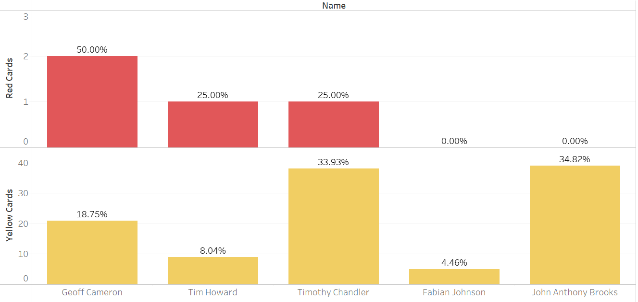
Which Player got the most card (red card, yellow card) in overall matches?
Top Players With Most Cards
Interpretation
Timothy Chandler has got 33.93% yellow cards and 25% red card in overall matches.
Geoff Cameron has got 18.75% yellow cards and 50% red cards.
Then, Followed by Tim Howard and Fabian Johnson

Slide 17
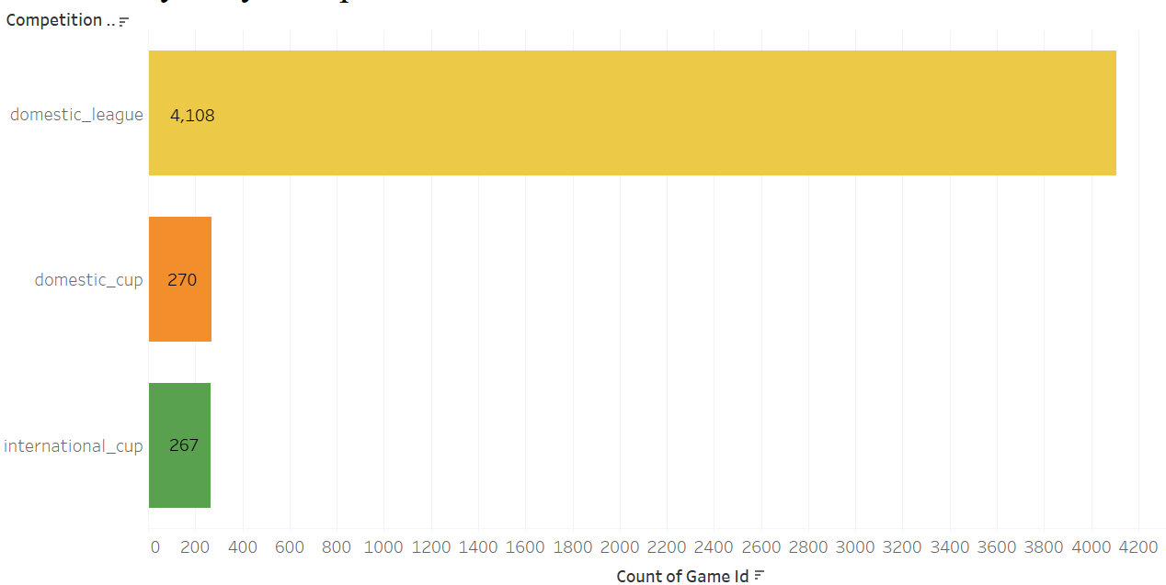
Competition Analysis
Which competition type has the highest number of games played
Games Played by Competition Type
Interpretation
The chart visually represents the distribution of games played across three different competitions: domestic_league, domestic_cup, and international_cup.
The length of each bar corresponds to the number of games played in that competition.
It is evident that the domestic_league has the highest number of games played, followed by domestic_cup, and then international_cup.

Slide 18
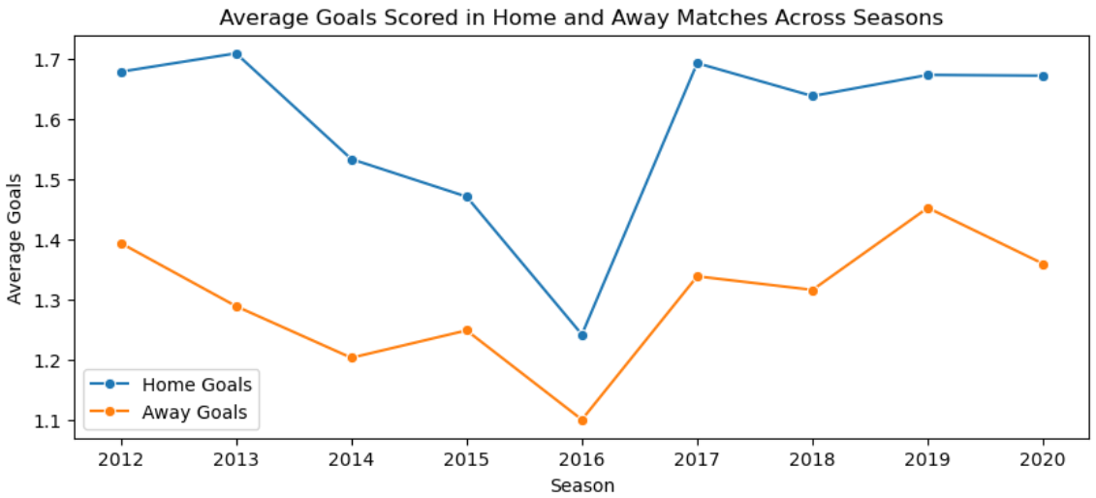
Descriptive Analysis
How do the average goals scored in home and away matches vary across different seasons?
season_goals = data.groupby('season’)
.agg({'home_club_goals’:
'mean','away_club_goals': 'mean’})
.reset_index()
sns.lineplot(data=season_goals,
x='season’, y='home_club_goals’,
marker='o', label='Home Goals’)
sns.lineplot(data=season_goals,
x='season’, y='away_club_goals’,
marker='o', label='Away Goals’)
plt.title("Average Goals Scored in
Home and Away
Matches Across Seasons")
plt.xlabel("Season")
plt.ylabel("Average Goals")
plt.legend()
plt.show()
Average Goals Scored in Home & Away Matches Across Seasons
Interpretation
Teams might perform significantly better or worse in certain seasons, which could be linked to player changes, managerial strategies, or other external factors
This shows worst game played by Away Goals Team in season 2016 and best game played by Home Goals Team in season 2017

Slide 19
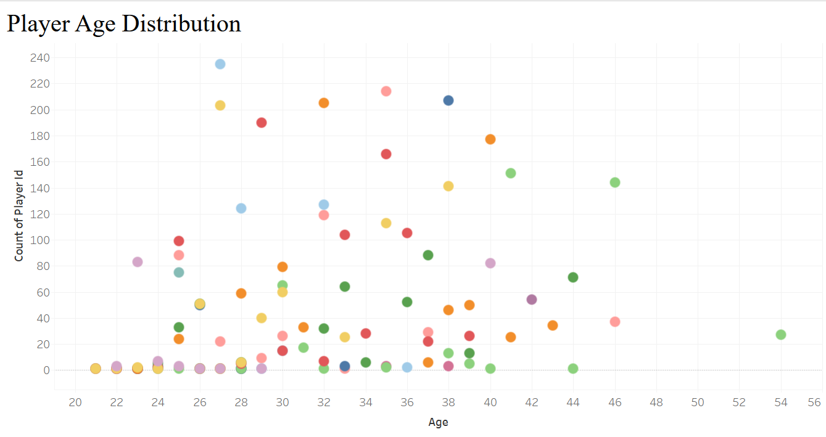
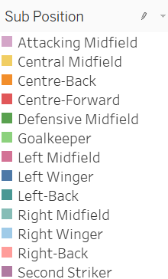
Player Attributes and Demographics
Is there any age distribution skewed towards younger or older players
Player Age Distribution
Interpretation
The age distribution of players impacts team dynamics and performance.
A diverse age range can bring a mix of experience, energy, and leadership to the team.

Slide 20
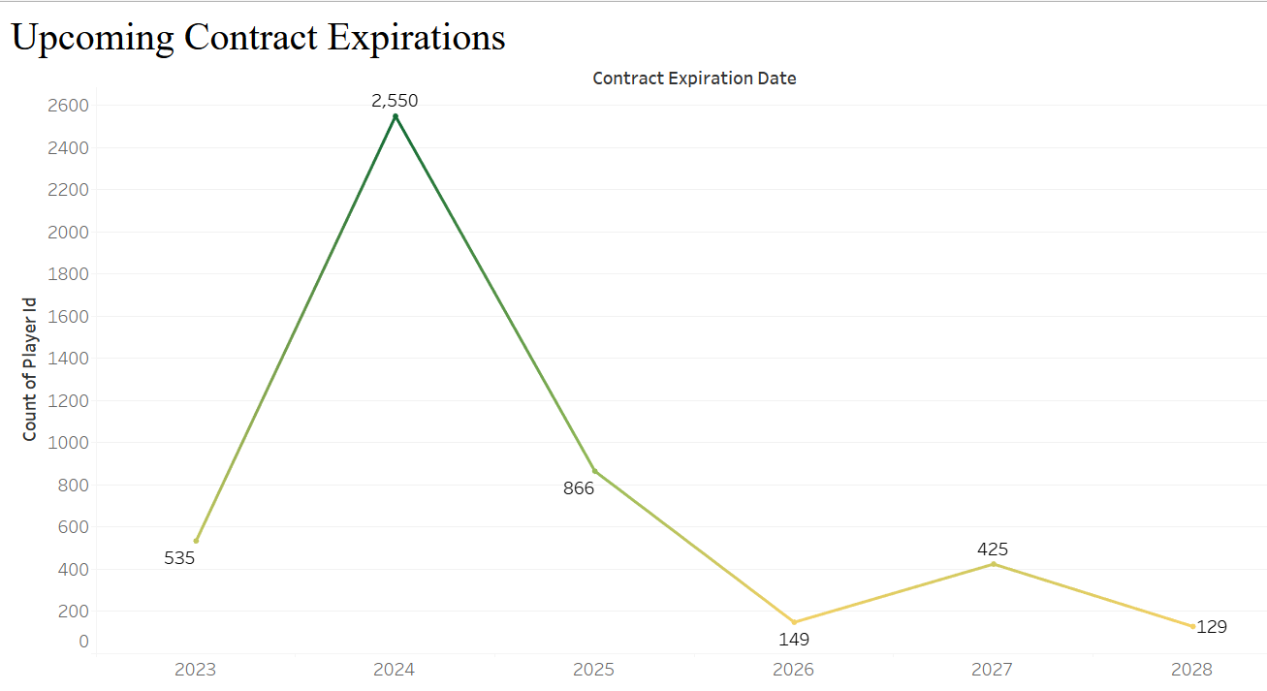

Contract Management
What is the overall trend of contract expirations over the years shown in the chart?
Which agent manages the most players?
SELECT agent_name, COUNT(DISTINCT player_id)
AS player_count FROM football_db
GROUP BY agent_name
ORDER BY player_count DESC
LIMIT 1;
Interpretation
This Shows that Wasserman manages the most players (64) contract
Upcoming Contract Expirations
Interpretation
The year with the highest number of contract expirations.
It would analyse the potential impact of this peak on the team's roster, salary cap, and overall performance.

Slide 21
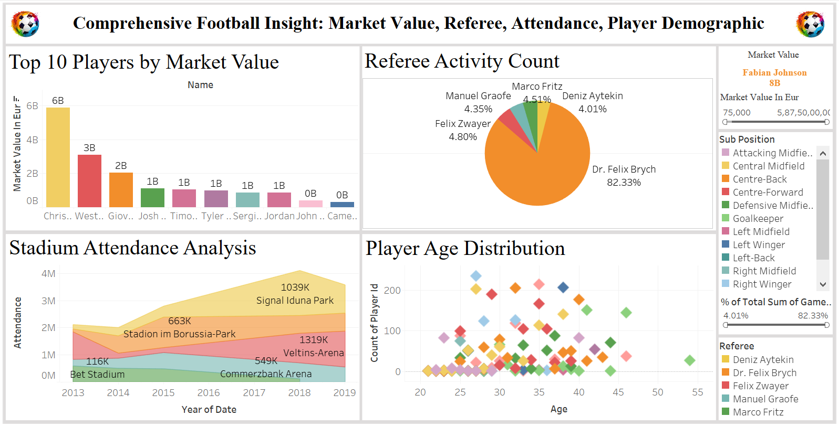
DASHBOARD

Slide 22
STORY TELLING FOR DASHBOARD
Comprehensive Football Insights: Attendance, Referees, Market Value, & Player Demographics
The "Stadium Attendance Analysis" area chart highlights trends in match attendance over the years.
Attendance trends show steady growth from 2012 to 2015.
SIGNAL IDUNA PARK consistently attracts the highest number of fans.
Peaks in attendance indicate high-profile matches or increasing fan engagement.
Helps identify popular venues and improve crowd management strategies.
The "Referee Activity Count" donut chart focuses on referee assignments across matches.
Dr. Felix Brych officiates 82% of matches, dominating referee assignments.
Referees like Felix Zwayer and Marco Fritz handle significantly fewer games.
Highlights workload imbalances, enabling better referee scheduling.
The "Top 10 Players by Market Value" bar chart illustrates players' worth in the football market.
Christian Pulisic leads with a market value of €6 billion.
Weston McKennie and Giovanni Reyna follow in the top rankings.
Clubs can focus on high-value players for strategic acquisitions.
The "Player Age Distribution" scatter plot analyzes the age demographics of players.
Most players fall within the 25-30 age group, representing peak performance years.
Outliers include young rising stars and experienced veterans

Slide 23
Summary: Transforming Football with Analytics
Player and Team Performance Metrics
Detailed breakdowns of key performance indicators such as goal-scoring probabilities, substitution impact, and player efficiency.
Insights emphasize actionable strategies for improving both individual and team dynamics.
Match Conditions and Dynamics
Analysing external factors like weather conditions, location, and match timing, demonstrating their influence on game outcomes and performance variability.
Attendance Analysis and Trends
Attendance data reveals trends in fan engagement and ticket sales across competitions. Predictive modeling demonstrates the ability to classify attendance patterns, helping clubs optimize operations and marketing efforts.
Competition and Referee Insights
Data analysis of competition types and referee decisions uncovers patterns affecting match outcomes.
These insights are valuable for game planning and understanding external match influences.
Predictive Analytics in Football
Machine learning applications like outcome prediction and attendance classification show the transformative power of predictive analytics in strategic planning.
Demonstrates accuracy and reliability in forecasting, providing a technological edge.
Visualizations and Storytelling
Visualization tools like Tableau and Python charts communicate complex insights effectively, enabling stakeholders to make informed, data-driven decisions.
Recommendations and Opportunities
The concluding recommendations outline opportunities for expanding datasets, implementing real-time analytics, and fostering collaboration with technology partners to enhance performance, engagement, and innovation.

Slide 24
By leveraging tools like Python, MySQL, Excel, and Tableau, the insights derived include:
Identifying key performance drivers for players and teams, such as the probability of scoring goals, the impact of match conditions, and strategic use of substitutions.
Revealing trends in competition types, attendance patterns, and referee activities, enabling informed decision-making for management and operations.
Employing machine learning models to predict outcomes and classify attendance, showcasing how AI-driven solutions can provide a competitive edge.
BUSINESS
CONCLUSION
Through the application of advanced data analysis techniques, this project has demonstrated the transformative potential of football data in enhancing performance, strategy, and fan engagement.

Slide 25
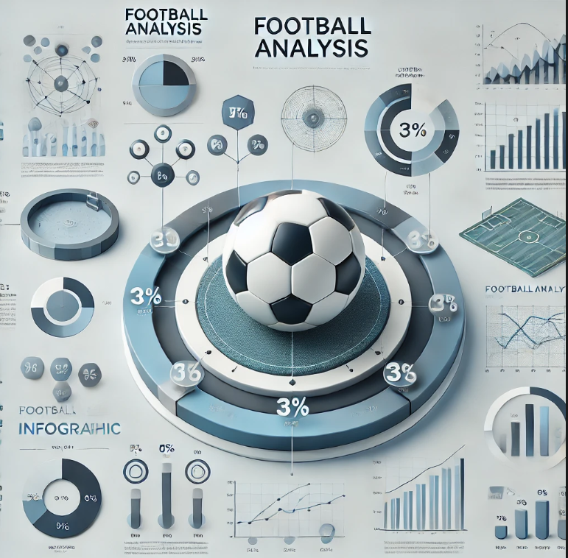
THANK YOU
MAHI MISTRY
MISTRYMAHI3@GMAIL.com

