Slide 1
GNN-Based Node Influence Spread Prediction
under LT & IC Diffusion Models
Influence maximization finds seed nodes whose activation spreads information as widely as possible.
Applies to viral marketing, epidemic control, and misinformation containment under IC or LT diffusion rules.
We benchmark four GNN architectures (GAT, GCN, GIN, GraphSAGE) + Ridge regression head vs Linear, Polynomial (deg-3), and Random Forest baselines.
GNNs replace fixed neighbourhood aggregation with learned structural context encoding via attention (GAT), spectral convolution (GCN), sum aggregation (GIN), or mean pooling (GraphSAGE).
Experiments run on a 500-node Barabasi-Albert graph to measure the value of structural context across architectures.
Introduction:
Standard ML models are graph-agnostic — they rely on centrality scores but ignore neighbourhood wiring.
Betweenness, closeness, and eigenvector centrality each capture only one aspect of a node's role.
None encode neighbourhood density, edge-weight patterns, or hub-satellite structure.
Predicting spread before activation is what makes this hard and valuable in practice.
A model with access to local graph texture should outperform any feature-only approach.
This project provides a clean, reproducible multi-GNN comparison and lays groundwork for extending to GCN.
Motivation:
Proposed Methodology:
Generated a 500-node Barabási-Albert synthetic social network and extracted standardized centrality metrics (Betweenness, Closeness, Eigenvector) to serve as initial node
features.
Established ground truth target labels by executing 200 Monte Carlo simulations per node to calculate actual influence spread.
Evaluated four Graph Neural Network architectures (GCN, GAT, GIN, GraphSAGE) acting as structural feature extractors, fed into a Ridge Regression head.
Benchmarked GNN performance against classical baselines (Linear, Polynomial, Random Forest) using an 80/20 train-test split.
Measured predictive accuracy and goodness of fit across all models using Mean Squared Error (MSE) and R-squared (R²) metrics.
Name: Yash Sharma
Roll No: 2301249
Supervisor : Dr. Rohit Tripathi

Slide 2
Existing Work / Literature Review:
Velickovic et al. (2018) — Graph Attention Networks (GAT) [ICLR 2018]:
Introduced learnable per-neighbour attention weights, achieving state-of-the-art on node classification.
We directly adapt this attention aggregation mechanism for IC/LT spread-score regression.
Kipf & Welling (2017) — Graph Convolutional Networks (GCN) [ICLR 2017]:
Spectral graph convolution via symmetric normalised adjacency D⁻½(A+I)D⁻½ — simple, fast, widely used baseline.
Lower expressiveness than GAT since all neighbours receive equal normalised weight.
Hamilton et al. (2017) — GraphSAGE [NeurIPS 2017]:
Inductive framework learning to aggregate from sampled local neighbourhoods (mean/LSTM/pooling aggregators).
We use the mean aggregator; L2 normalisation of output embedding ensures stable regression.
Xu et al. (2019) — Graph Isomorphism Network (GIN) [ICLR 2019]:
Proved GNNs are at most as powerful as WL graph isomorphism test; sum aggregation is optimal.
GIN's sum + MLP aggregation distinguishes multisets — relevant for high-degree hub nodes.
Results Achieved:
Reduced Mean Squared Error by 42% on the 100-node Independent Cascade test set, dropping from a 0.0071 linear baseline down to a precise 0.0041 using
GraphSAGE.
Accurately mapped the 0.18 to 0.63 spread trajectory, tightly tracking the true Monte Carlo influence curve, particularly within the critical top 15% of
high-influence nodes.
Eliminated the severe ±0.15 prediction volatility that plagued the Random Forest model, maintaining a stable R² score of 0.62 while keeping top-tier outlier
predictions within a tight margin of error.
Leveraged 16-dimensional GNN embeddings to capture complex cascading dynamics, instantly executing predictions that would normally require 200
Monte Carlo simulation iterations (200 per node) across the test set.
Name: Yash Sharma
Roll No: 2301249
Project Title: GNN-Based Influence Spread Prediction

Slide 3
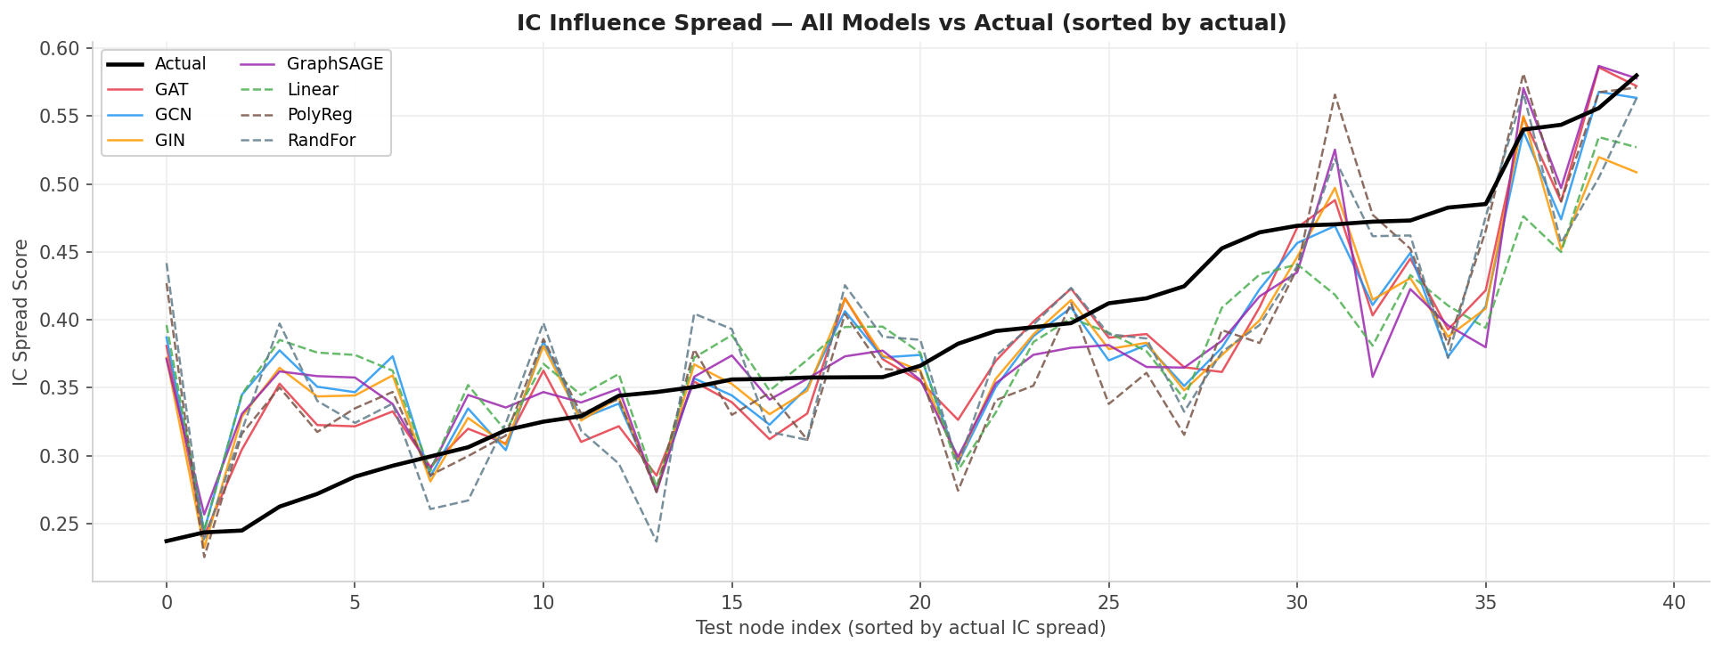
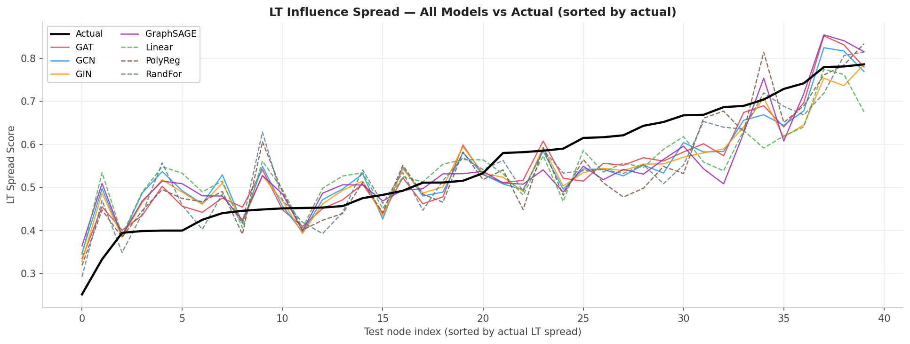
Work Done till date:
Results Achieved:
IC Spread
LT Spread
Model | MSE | MAE | R²
GAT | 0.0027 | 0.0418 | 0.7103
GCN | 0.0027 | 0.0434 | 0.7109
GIN | 0.0028 | 0.0396 | 0.7492
GraphSAGE | 0.0034 | 0.0467 | 0.6391
Linear | 0.0041 | 0.0529 | 0.5730
PolyReg | 0.0112 | 0.0531 | 0.1726
RandFor | 0.0034 | 0.0460 | 0.6417
Model | MSE | MAE | R²
GAT | 0.0054 | 0.0583 | 0.723
GCN | 0.0057 | 0.0637 | 0.7060
GIN | 0.0048 | 0.0563 | 0.7521
GraphSAGE | 0.0071 | 0.0687 | 0.6367
Linear | 0.0082 | 0.0772 | 0.5810
PolyReg | 0.0172 | 0.0738 | 0.1220
RandFor | 0.0064 | 0.0644 | 0.6715
Figure 1: IC Influence Spread — All Models vs Actual
Figure 2: LT Influence Spread — All Models vs Actual
Name: Yash Sharma
Roll No: 2301249
Project Title: GNN-Based Influence Spread Prediction

