Slide 1


Mythic 2.3 & Apollo 2.0
February 23, 2022

Slide 2


Who Are We?
Cody Thomas
@its_a_feature_
Mythic Author
Engineer
Dwight Hohnstein
@djhohnstein
Apollo Author
Senior Consultant

Slide 3


Mythic 2.3 & Apollo 2.0 Webinar Overview
What is Mythic?
What is Apollo?
What's new in Mythic 2.3?
A case study in Apollo 2.0
What's coming next?
Q&A

Slide 4
What is Mythic?
Open-Source Red Teaming Framework
https://github.com/its-a-feature/Mythic
https://docs.mythic-c2.net/
Modular Framework using Docker
Multi-Operator, Muti-Operation, Web-based
Access Controls, Spectator Mode
IoC/Artifact Tracking
Plug-n-Play architecture for Agents and C2 Profiles
https://github.com/MythicAgents
https://github.com/MythicC2Profiles
MITRE ATT&CK Mapping and Tracking

Slide 5
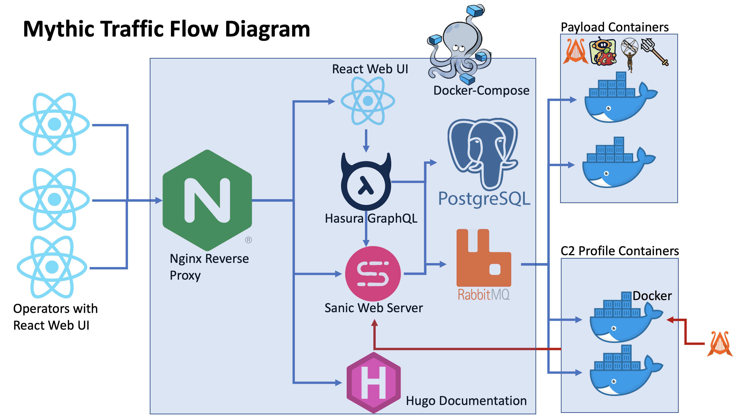

Slide 6
What is Apollo?
Open-Source C# Windows Agent for Mythic
https://github.com/MythicAgents/apollo
Supports many Mythic features:
SOCKS5, File Browser, Subtasking, Credentials, and more
Provides many OPSEC features:
PPID spoofing, customized injection, sacrificial processes, etc

Slide 7
Mythic Demo – Basic Usage
Starting Mythic
1
C2 Profiles / Payload Types
2
Creating Payloads
3
Getting a Callback
4
Issuing commands
5
https://www.youtube.com/watch?v=wprAyoQys-o&list=PLHVFedjbv6sOnsGlxslDiGFqsiY7eARJD&index=1

Slide 8
Mythic Demo Recap
Git Clone Mythic
git clone https://github.com/its-a-feature/Mythic
Edit any configurations you want in a .env file
Start Mythic
sudo ./mythic-cli start
View exposed ports and services in status output
sudo ./mythic-cli status
Create poseidon payload

Slide 9
Tasking Agents Demo – CLI and Modals
Help
1
Loaded Commands
2
Tab Complete
3
Popup Modals
4
https://www.youtube.com/watch?v=hGqIc2-XpJE&list=PLHVFedjbv6sOnsGlxslDiGFqsiY7eARJD&index=2

Slide 10
Tasking Agents Recap
Click "Interact" to start tasking an agent
Tab-complete loaded commands
Tab-complete parameters
Parsed CLI into named parameters
Tasking modal
Shift+Enter always opens the modal

Slide 11
Parameter Groups – What Are They?
Commands are multi-purpose with distinct sets of parameters
Inspired by PowerShell's Parameter Sets
Parameter Groups resolve ambiguity between desired actions
sc_create, sc_query, sc_start, etc. vs sc
Modals useful in determining required and optional parameters
Parameter Groups are inferred based on supplied arguments
Parameter Groups in the Modal popup are explicitly selected

Slide 12
Parameter Group Demo – SC
Popup Modal
1
Select Parameter Group
2
Tab Complete Arguments
3
https://www.youtube.com/watch?v=vVcJ7ApH87E&list=PLHVFedjbv6sOnsGlxslDiGFqsiY7eARJD&index=3

Slide 13
P2P Demo – PSEXEC
Create Apollo Shellcode
1
Generate a Service Executable
2
Upload Service Executable to Remote Host
3
Create and Start Service
4
Link and Issue P2P Tasking
5
https://www.youtube.com/watch?v=wewlWejnpCQ&list=PLHVFedjbv6sOnsGlxslDiGFqsiY7eARJD&index=4

Slide 14
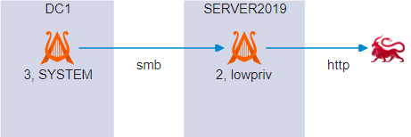
P2P Demo Recap
Generate a Payload for Lateral Movement
Use Token Manipulation to Access DC1 via "make_token"
Upload Service Executable using "upload"
Create and Start ApolloSvc via "sc"
Link to DC1 using Named Pipes

Slide 15
SOCKS5 Demo
Start SOCKS5 Proxy
1
Connect Proxychains4
2
RDP to Internal Computer
3
Proxy Tools like Impacket
4
https://youtu.be/XoSzkPYsyDE

Slide 16
MITRE ATT&CK Demo
Command Mappings
1
Task Mappings
2
Export to Navigator Layer
4
Payload Mappings
3
https://www.youtube.com/watch?v=9WxsK4zdp3g&list=PLHVFedjbv6sOnsGlxslDiGFqsiY7eARJD&index=5

Slide 17
MITRE ATT&CK Demo Recap
All commands can map to MITRE ATT&CK
We can view the "realm of the possible" by viewing all these mappings at once
We can also view this mapping by specific Payload Types
If a command is mapped to ATT&CK, then Tasks based on it are also mapped
We can view this "realm of the actual" to see what all we've done so far in an operation
We can also tag issued tasks and filter our mapping by just a single tag
All displays can be exported to ATT&CK Navigator Layers

Slide 18
Mythic – Going Forward
Mythic Scripting Updated for GraphQL
Currently hits the old REST / WebSocket interfaces
Mythic Developer Series
Blog/YouTube Series
Based on feedback from survey
https://www.surveymonkey.com/r/MythicDeveloperSeries
Updating the back-end Mythic Server
Split out RabbitMQ, Authentication, Agent Message Parsing
Move to Golang instead of Python3
Provide more language support for agent / c2 containers
Add more pages / features to the new UI
Show how people can extend the UI with their own custom React code

Slide 19
Apollo – Going Forward
Unit Testing
Ensures continuity of functionality across update cycles
C2 Profiles
DynamicHTTP
Third-Party (Slack, OWA, etc.)
Modular, Rotating, Profiles
Evasion Options
Currently Only Injection Techniques
Rearchitect Commands for Compile Time Obfuscation

Slide 20
Q&A
GitHub
https://github.com/its-a-feature/Mythic
https://github.com/MythicAgents/apollo
Documentation
https://docs.mythic-c2.net
#Mythic channel in BloodHound Slack
https://bloodhoundgang.herokuapp.com/

