Slide 1
AGNI COLLEGE OF TECHNOLOGY
DEPARTMENT OF COMPUTER SCIENCE AND ENGINEERING
CSE MINI PROJECT PRESENTATION | SUBMISSION: 07-10-2026
SMART AGRI-CROP RECOMMENDATION SYSTEM
Data-Driven Precision Decision Support System for Soil & Climate Compatibility
PROJECT TEAM MEMBERS
Lokeshwari T
Reg: 312824104089
Mythili L
Reg: 312824104102
Rahav
Reg: 312824104123
Mohamed Rafi
Reg: 312824104096

Slide 2
01. Introduction
Background & Agriculture Decision Support System Context
Agricultural Significance
The Decision Problem
Agriculture is the backbone of food security and rural livelihoods. Enhancing crop yield through scientific precision farming is essential for sustainable land management.
Farmers face complex multi-factorial choices when selecting crops. Relying solely on historical tradition leads to yield loss, soil degradation, and financial risks.
Data-Driven Approach
System Vision
By evaluating empirical soil nutrients (Nitrogen, Phosphorus, Potassium, Soil pH) and climatic attributes (Temperature, Humidity, Rainfall), farming decisions become objective.
A web-based Smart Agri-Crop Recommendation System prototype that accepts field parameters and generates ranked crop suitability scores with agronomic explanations.

Slide 3
02. Problem Statement
Key Challenges in Traditional Agricultural Crop Selection
1. Guesswork & Legacy Selection
2. Soil Nutrient Misalignment
Crop choices are predominantly based on regional habits and past seasons rather than dynamic soil chemical testing or microclimate realities.
Excessive or deficient application of Nitrogen, Phosphorus, and Potassium damages soil microbial health and lowers crop output efficiency.
3. Climate Sensitivity & Failure
4. Raw Soil Report Complexity
Unpredictable thermal changes, varying humidity, and erratic seasonal rainfall cause widespread crop failure when unmonitored.
Lab testing yields numerical soil figures (e.g. N=90 mg/kg, pH=6.5), but farmers lack automated decision tools to translate metrics into crop choices.

Slide 4
03. Project Objectives
Core Technical & Agricultural Goals of the Mini-Project
1. Ingest 7 Core Parameters
2. Multi-Crop Scoring
3. Responsive Web Prototype
4. ML Architecture Design
Accept Nitrogen (N), Phosphorus (P), Potassium (K), Soil pH, Temperature, Humidity, and Rainfall input values via intuitive UI forms.
Calculate continuous agronomic distance and weighted compatibility scores across 18 crop varieties in the dataset.
Build a modern client application (React + TypeScript + Vite) featuring real-time input sliders, test presets, and visual result cards.
Design a Python Flask API endpoint (`POST /api/predict`) to serve trained Scikit-learn Random Forest model predictions (`model.pkl`).

Slide 5
04. Existing System vs. Proposed System
Comparative Paradigm Analysis
Existing / Traditional Method
Proposed Smart Agri System
• Crop choices based on regional tradition and manual intuition.
• Limited to single-parameter check (e.g. soil type only).
• Static paper reports without interactive decision tools.
• No top alternative recommendations if primary crop fails.
• High vulnerability to changing rainfall & microclimates.
• Subjective advice with zero quantitative compatibility score.
• Empirical data-driven analytics combining 7 features.
• Simultaneous soil chemistry (N-P-K-pH) & microclimate fusion.
• Interactive React web prototype with real-time UI feedback.
• Ranks Top 3 alternative crops with compatibility percentages.
• Evaluates precipitation and thermal thresholds continuously.
• Scalable architecture connecting to Python Flask ML Backend.

Slide 6
05. Input Parameters & Feature Methodology
7 Core Agricultural Features & Compatibility Weightage
7 Core Feature Vector Inputs
Agronomic Weighting Formula
1. Nitrogen (N) [mg/kg] – Drives vegetative leaf & chlorophyll synthesis
2. Phosphorus (P) [mg/kg] – Stimulates root growth & early seed formation
3. Potassium (K) [mg/kg] – Enhances disease immunity & water stress tolerance
4. Soil pH [pH scale] – Governs soil chemical nutrient bioavailability
5. Temperature [°C] – Thermal regulator for crop respiration & growth
6. Humidity [Relative %] – Atmospheric moisture level for transpiration
7. Rainfall [mm / season] – Precipitation satisfying crop water requirements
Mathematical Compatibility Formula:
Score = 0.20(Rain) + 0.15(Temp) + 0.15(N) + 0.15(P) + 0.15(K) + 0.10(Hum) + 0.10(pH)
• Rainfall (20%): Hydrological moisture constraint
• Temperature (15%): Thermal growth window
• Nitrogen (15%): Foliage & yield volume
• Phosphorus (15%): Root & flowering vigor
• Potassium (15%): Drought & pest resilience
• Humidity (10%): Atmospheric leaf transpiration
• Soil pH (10%): Root nutrient assimilation

Slide 7
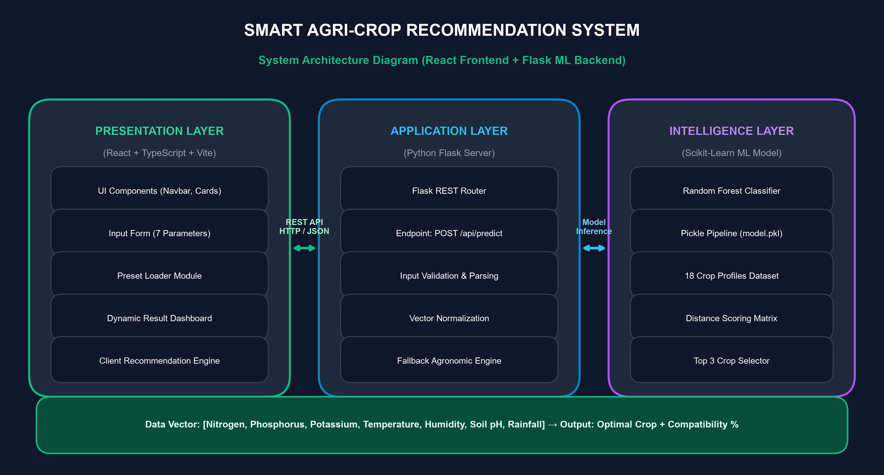
06. System Architecture
Layered System Components & Technical Integration
Architecture Highlights
Presentation Layer
React 19 + TypeScript + Vite client for fast rendering.
API Router
Flask REST API handling CORS and JSON payloads at POST /api/predict.
Intelligence Layer
Scikit-learn Random Forest model (model.pkl) trained on 18 crop varieties.
Fallback Engine
Client-side distance engine guarantees seamless offline demonstration.

Slide 8
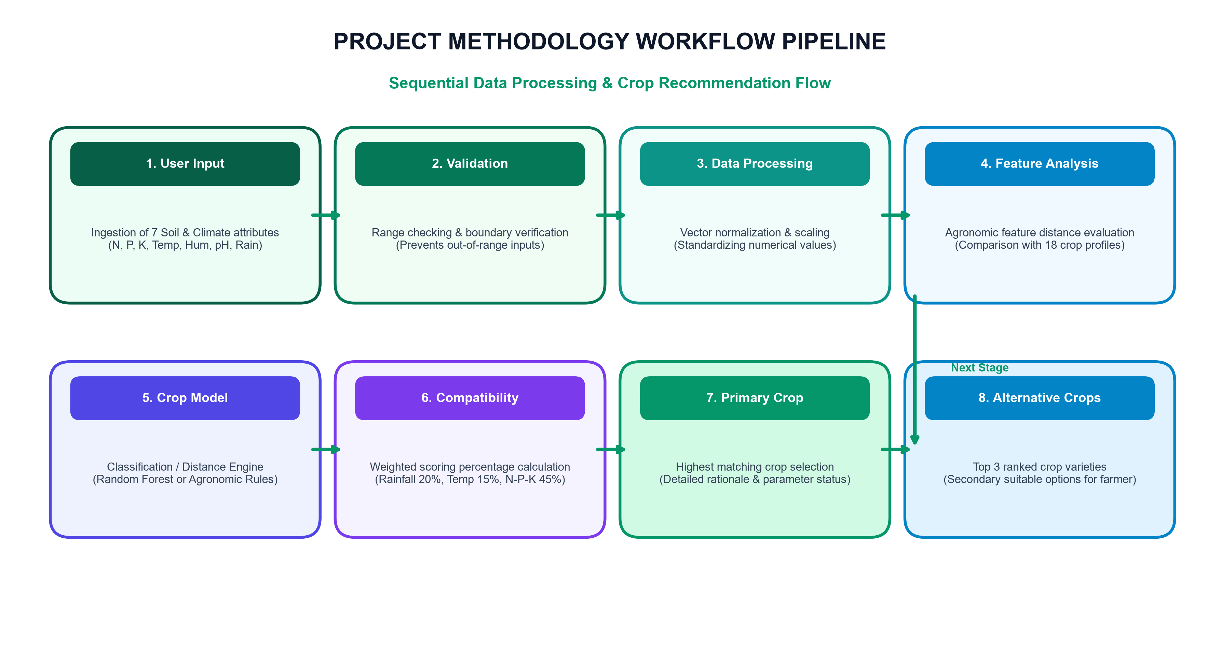
07. System Workflow & Methodology
Sequential Data Pipeline Execution
Pipeline Stages
1. Data Ingestion
Captures 7 numerical features from form inputs.
2. Validation
Ensures values fall within agricultural bounds.
3. Processing
Normalizes feature vectors for model comparison.
4. Compatibility Scoring
Calculates continuous suitability percentage.
5. Output Generation
Presents primary crop, score %, & top 3 alternatives.

Slide 9
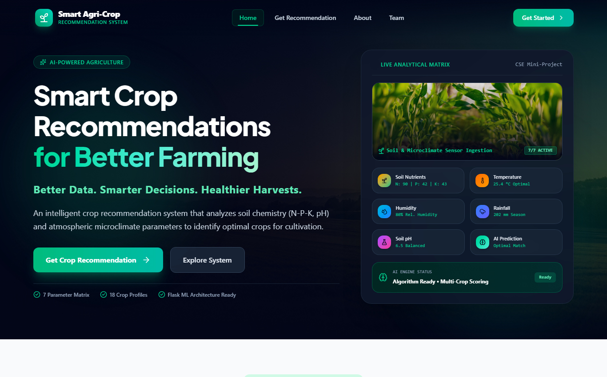
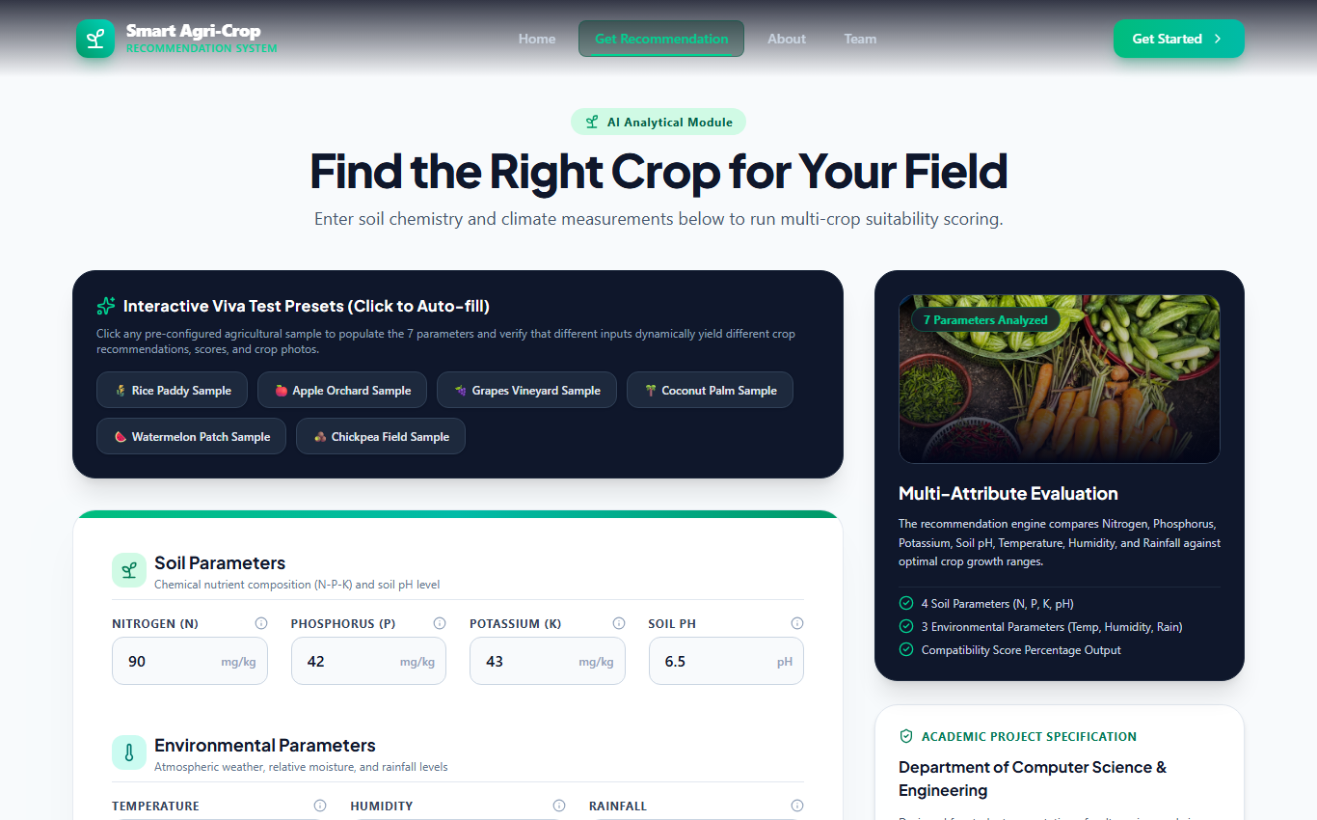
08. Website Prototype / Proposed Interface
Home Page & Crop Recommendation Input Module
Prototype / Proposed Interface
Prototype / Proposed Interface
Interface Features & Design System Highlights
• Agricultural Visual Theme: Clean emerald design system built using React, TypeScript, and Lucide React icons.
• Preset Selection Buttons: Pre-loaded soil test profiles (e.g. Clay/Rice, Black Soil/Cotton) for rapid evaluation and viva demo.
• Real-Time Slider Validation: Interactive range sliders enforce parameter boundaries (e.g. pH 0-14, Temperature 0-50°C).

Slide 10
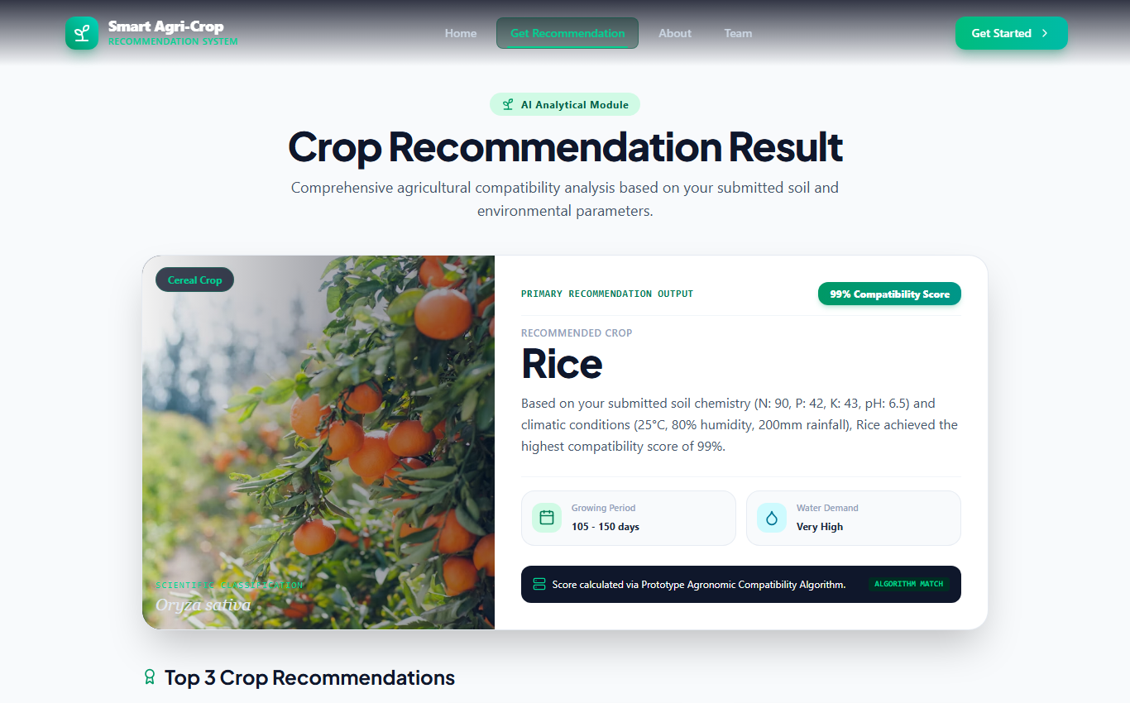
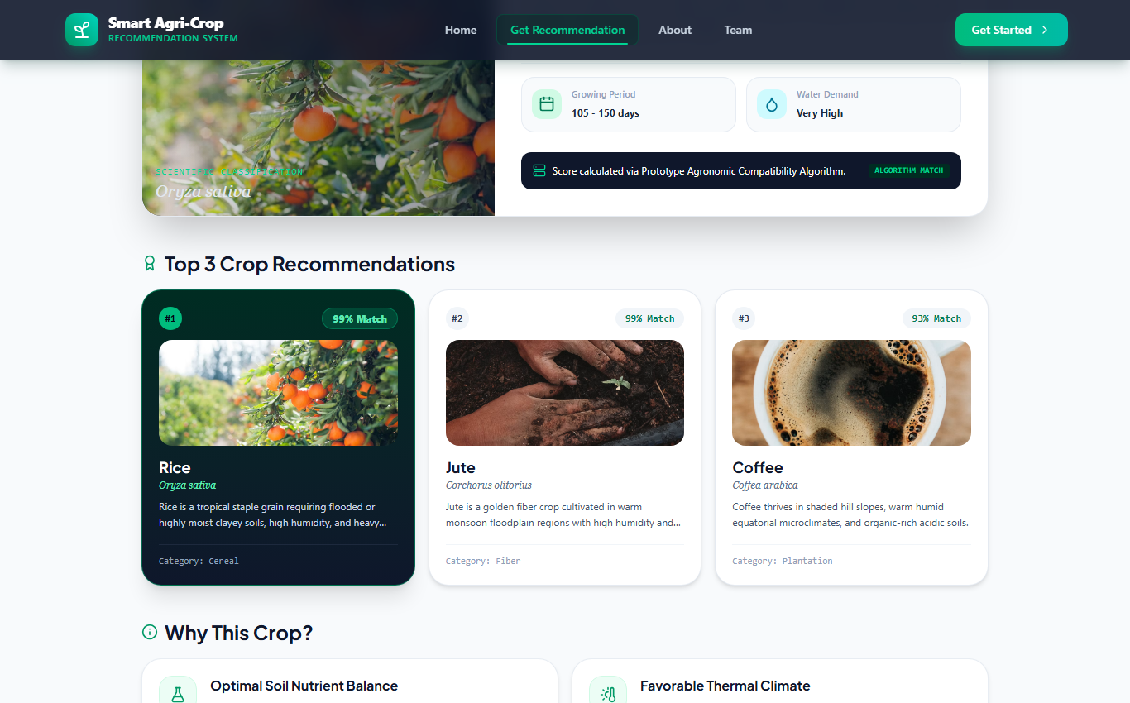
09. Website Prototype / Proposed Interface
Recommendation Results & Parameter Breakdown
Prototype / Proposed Interface
Prototype / Proposed Interface
Output Presentation & Agronomic Rationale
• Primary Crop Recommendation Card: Displays top recommended crop (e.g., Rice) with dynamic confidence compatibility %.
• Parameter Status Badges: Clear indicator tags ('Suitable', 'Near Suitable', 'Outside Range') for each of the 7 features.
• Rationale Breakdown: Explains specific agronomic reasons why the crop matches soil N-P-K and climate rainfall/temperature.

Slide 11
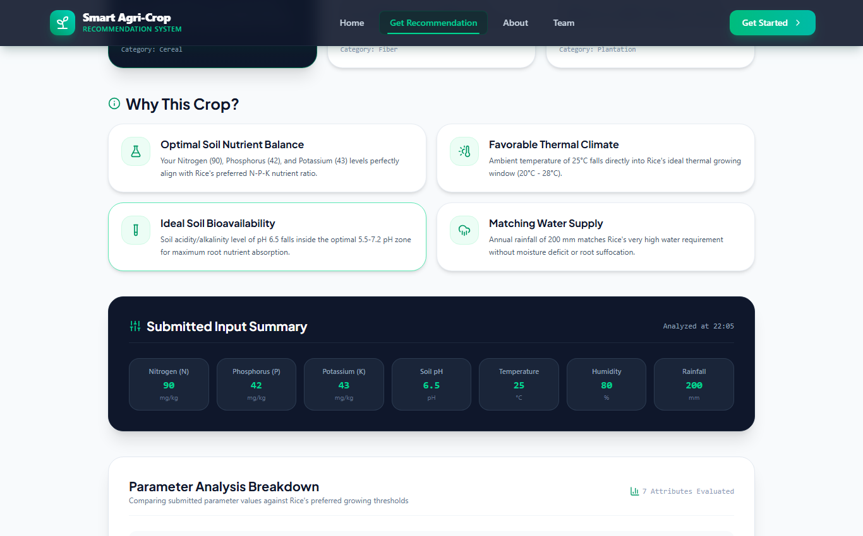
10. Top 3 Crop Recommendations & System Testing
Alternative Ranking & Quality Verification
Prototype / Proposed Interface
Testing & Verification Strategy
Form Input Boundary Testing
Verified range checks preventing negative numbers or extreme values (e.g., pH < 0 or > 14).
Preset Execution Testing
Confirmed all 4 quick-presets load accurate default feature vectors without error.
Fallback Engine Verification
Validated client distance engine activates seamlessly when Flask API server is offline.
Top 3 Ranking Consistency
Ensured secondary crops (e.g. Jute 82%, Watermelon 78%) remain sorted in strict descending order.

Slide 12
11. Advantages, Future Scope & Conclusion
Summary & Mini-Project Deliverables
Key Advantages
Future Enhancements
Conclusion
• Replaces guesswork with empirical soil analytics.
• Fuses 7 soil chemistry & climate features.
• Instant interactive web prototype response.
• Ranks Top 3 alternative crop varieties.
• Deploy trained model.pkl on Flask backend.
• Integrate live IoT soil sensors via MQTT/HTTP.
• Add live weather forecast API integration.
• Support regional language interfaces.
• Successfully designed & built CSE mini-project.
• Prototype demonstrates modular web architecture.
• Meets faculty presentation & viva standards.
• Ready for faculty evaluation & review.
THANK YOU! QUESTIONS & DISCUSSION
Agni College of Technology | Department of Computer Science and Engineering

