Slide 1

Secure Quantum Communication With Multi-Users in Quantum Networks
Secure Quantum Communication With Multi-Users in Quantum Networks
by
M. Dileep Kumar
Roll No. 224G1A3320
P. Manoj Srivastav
Roll No. 224G1A3351
Y. Mythili
Roll No. 224G1A3358
S. Mohammad Taz
Roll No. 224G1A3356
Under the guidance of
Mr. K. Venkatesh M. Tech. (Ph.D.)
Assistant Professor
Department of Computer Science and Engineering (AI & ML)
Srinivasa Ramanujan Institute of Technology
(Affiliated to JNTUA & Approved by AICTE) (Accredited by NAAC with ‘A’ Grade & Accredited by NBA (EEE, ECE & CSE)
Rotarypuram Village, B K Samudram Mandal, Ananthapuramu – 515701.
2025 - 2026
Dept. of Computer Science and Engineering (AI&ML)
Srinivasa Ramanujan Institute of Technology

Slide 2
Contents
Secure Quantum Communication With Multi-Users in Quantum Networks
Abstract
Introduction
Literature survey
Proposed Work
References
GitHub Link
Queries
Srinivasa Ramanujan Institute of Technology
2

Slide 3
Abstract
Secure Quantum Communication With Multi-Users in Quantum Networks
The rapid growth of quantum communication has enabled secure data transfer, but achieving scalable multi-user communication remains a challenge. This project proposes a secure multi-user quantum communication framework that integrates Quantum Key Distribution (QKD) with advanced encryption and post-quantum cryptographic techniques. The system uses classical-quantum multiple access methods to manage multiple users efficiently while maintaining high performance. Security is enhanced through MUQPQ and MUQQ-ESTMP GHZ-based protocols, enabling authenticated key sharing and resistance to eavesdropping. Lattice-based cryptography is incorporated to address threats from quantum computers, while real-time monitoring is performed using the RRA-BIAWGNC algorithm. Overall, the framework improves scalability, security, and reliability, offering a future-ready solution for multi-user quantum networks.
Srinivasa Ramanujan Institute of Technology
3

Slide 4
Introduction
Secure Quantum Communication With Multi-Users in Quantum Networks
Quantum communication allows secure data transfer by using principles of quantum technology.
Quantum Key Distribution (QKD) provides highly secure key sharing, but most current systems only support two users at a time, which limits their use in large networks.
As networks expand, there is a growing need for multi-user quantum communication that can support many users securely and efficiently.
Multi-user systems face challenges such as resource management, channel noise, and protection against attacks, especially from future quantum computers.
Combining multiple access methods with post-quantum cryptography can improve scalability, performance, and long-term security.
This project aims to design a secure and scalable multi-user quantum communication framework suitable for future quantum networks.
Srinivasa Ramanujan Institute of Technology

Slide 5
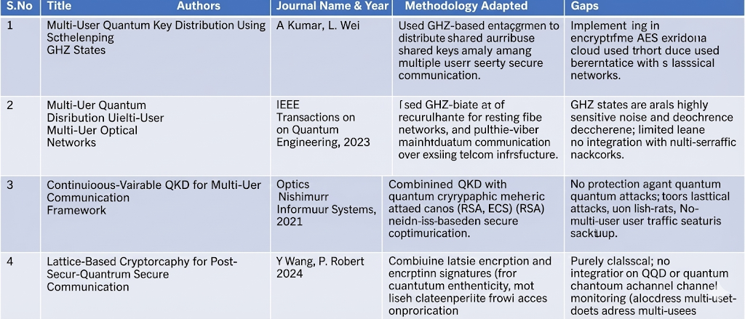
Literature Survey
Secure Quantum Communication With Multi-Users in Quantum Networks
Srinivasa Ramanujan Institute of Technology

Slide 6
Proposed Work
Secure Quantum Communication With Multi-Users in Quantum Networks
1. Multi-User Quantum Key Distribution Using MUQPQ and MUQQ-ESTMP GHZ Protocols
Implement Multi-User Quantum Protocol (MUQPQ) and MUQQ-ESTMP GHZ-based schemes to enable secure key sharing among multiple users, ensuring authenticated and coordinated communication across the network.
2. Efficient Multi-User Communication Using Classical–Quantum Multiple Access
Apply multiple access techniques to efficiently manage simultaneous communication between users, improving network performance, scalability, and resource utilization in quantum channels.
3. Post-Quantum Security Using Lattice-Based Cryptography
Integrate lattice-based cryptography to secure transmitted data against quantum computing attacks, providing long-term computational security in addition to QKD-based security.
4. Real-Time Attack Detection Using RRA-BIAWGNC Algorithm
Deploy the Reverse Reconciliation Algorithm for Binary-Input Additive White Gaussian Noise Channel (RRA-BIAWGNC) to continuously monitor channel noise, identify possible eavesdropping, and provide real-time threat detection.
Srinivasa Ramanujan Institute of Technology

Slide 7
Reference
Secure Quantum Communication With Multi-Users in Quantum Networks
[1] E. Sutcliffe and A. Beghelli, “Multi-user entanglement distribution in quantum networks using multipath routing,” IEEE Trans. Quantum Eng., vol. 4, Art. no. 4101015, Dec. 2023, doi: 10.1109/TQE.2023.3329714.
[2] M. Shaban, M. Ismail, and W. Saad, “SPARQ: Efficient entanglement distribution and routing in space-air-ground quantum networks,” IEEE Trans. Quantum Eng., vol. 4, Art. no. 4101020, Sep.2024, doi: 10.1109/TQE.2024.3464572.
[3] M. Imran, A. B. Altamimi, W. Khan, S. Hussain, and M. Alsaffar, “Quantum cryptography for future networks security: A systematic review,” IEEE Access, vol. 12, pp. 180048–180078, 2024, doi: 10.1109/ACCESS.2024.3504815.
[4] M. Mastriani, “Quantum key secure communication protocol via enhanced superdense coding,” Opt. Quant. Electron., vol. 55, no. 1, p. 10. 2023, doi: 10.1007/s11082-022-04303-5.
Srinivasa Ramanujan Institute of Technology

Slide 8
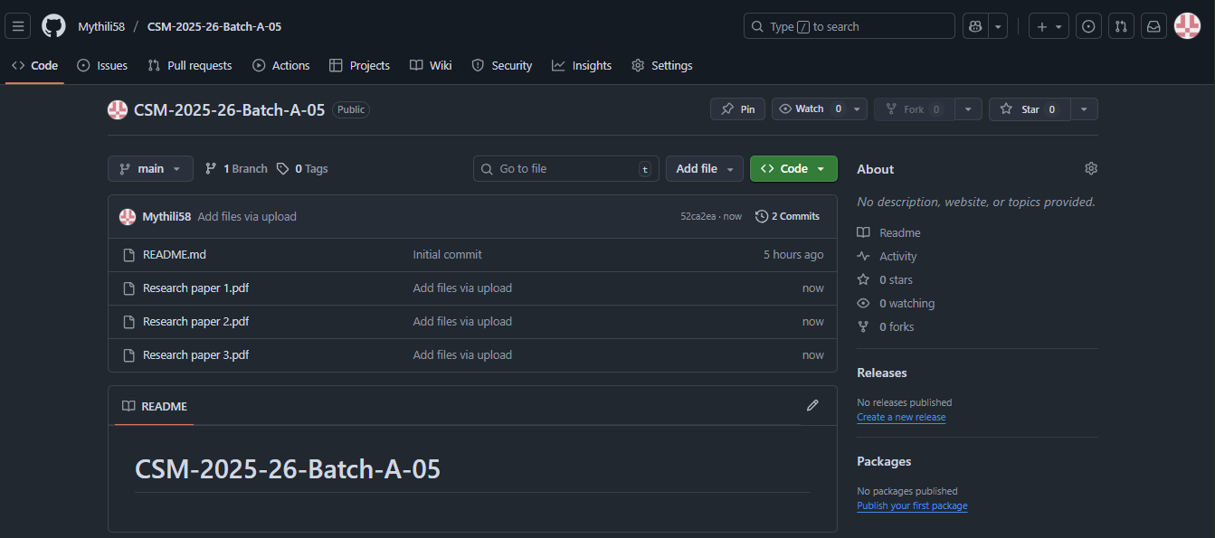
Secure Quantum Communication With Multi-Users in Quantum Networks
Git Hub Link
Srinivasa Ramanujan Institute of Technology

Slide 9
Any Queries?
Srinivasa Ramanujan Institute of Technology

Slide 10
Thank You!!!
Srinivasa Ramanujan Institute of Technology

