Slide 1
Organization Access
Spring Boot Framework
Mythili P

Slide 2
Presentation Flow
Introduction
ER Diagram
Project Setup
System requirements - Software
Conclusion

Slide 3
Introduction
A Spring Boot framework for creating REST API pertaining to CRUD operations using in-memory H2 database

Slide 4
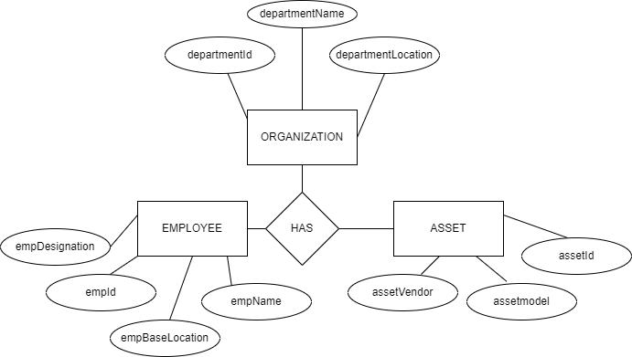
ER Diagram

Slide 5
Project Setup
Created a spring starter project in STS
Added all the required dependencies like Spring boot web, Spring boot JPA, Spring boot devtools, H2 database.
Created the entity package in which all the entities are defined with their fields and methods.

Slide 6
Project Setup – Contd.
Created the repository package to include Jparepository for seamless access to the database and inbuilt methods.
Created the controller package for REST endpoints to map their corresponding operations.

Slide 7
Project Setup – Contd.
The application is started and after the build is successful, it was ready to test.
Testing the endpoints was done using Postman Tool.

Slide 8
System requirements - Software
Operating System – Windows 8 or above
IDE – Spring Tool Suite 4 (JavaSE – 1.8)
Database – H2 database
Testing Tool - Postman
Documentation – MS Office 2007 or above

Slide 9

End

