Slide 1
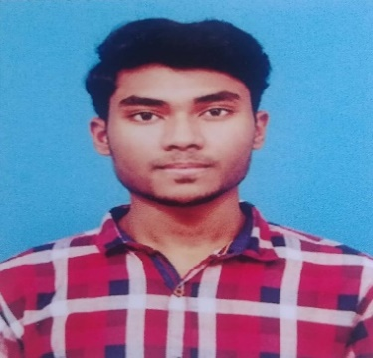






JEEVANANDHAM N
jeeva0607001@gmail.com
Kanchipuram
+91 8124310902
https://lightningnet.blogspot.com/
https://github.com/JeevaNagarajan
https://www.linkedin.com/in/jeeva-nagarajan-10800b1ba
CAREER OBJECTIVE
I Intend to be a part of the company, Where I can constantly learn and develop my technical skills and make the best use of them for the growth of the company and capable of mastering the new technologies.
EDUCATION
CERTIFICATIONS
B.Tech - Information Technology
Completed the Course (GUVI) – Python.
Completed the Course (Udemy) – Java for Beginners.
SRM Valliammai Engineering College, Kattankulathur.
2018 – 2022 CGPA – 7.975
INDUSTRIAL EXPOSURE
HSC
Industrial Visit to Regional Telecom Training Centre of BSNL.
Industrial Visit to Infoziant Pvt.Ltd.
Bharathidasan Matriculation Higher Secondary School, Kanchipuram.
2018 Percentage - 83%
INTERNSHIP AND WORKSHOP
SSLC
Internship at DLK Technologies – Cloud Computing.
Attended a Workshop on Android.
Bharathidasan Matriculation Higher Secondary School, Kanchipuram.
PROJECTS
2018 Percentage - 93.2%
Intelligent Video Streaming For Road Traffic Video Surveillance.
MANAGEMENT SKILLS
ACHIEVEMENTS
Optimistic
Adaptability
Leadership
Creativity
Participated in the AICTE - Vishwakarma Awards - 2020 and done a Mobile Application under the category of Promote value added agricultural Processes, Products and Handicrafts and gets selected in the Regional Convention Level.
AREAS OF INTEREST
OOPS Concept
Python
Cloud Computing
CURICULAR ACTIVITIES
Participated in the Guinness World Record Event conducted by GUVI.
Attended and Scored 100% in the CODE QUIZZARD V.1 conducted by Sairam Engineering College.
TECHNICAL SKILLS
Programming Language
JAVA
Python
HOBBIES
Database
Cooking
Blogging
MySQL

