Slide 1
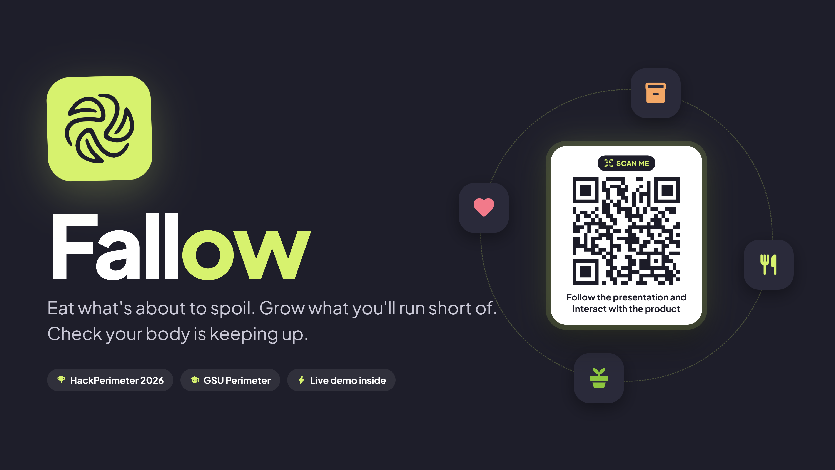
Notes:
(about 8 sec) Hi, we're Fallow. When the store is closed, the budget is tight, or a storm hits, your pantry and your backyard are the plan. Fallow runs that plan for you.

Slide 2
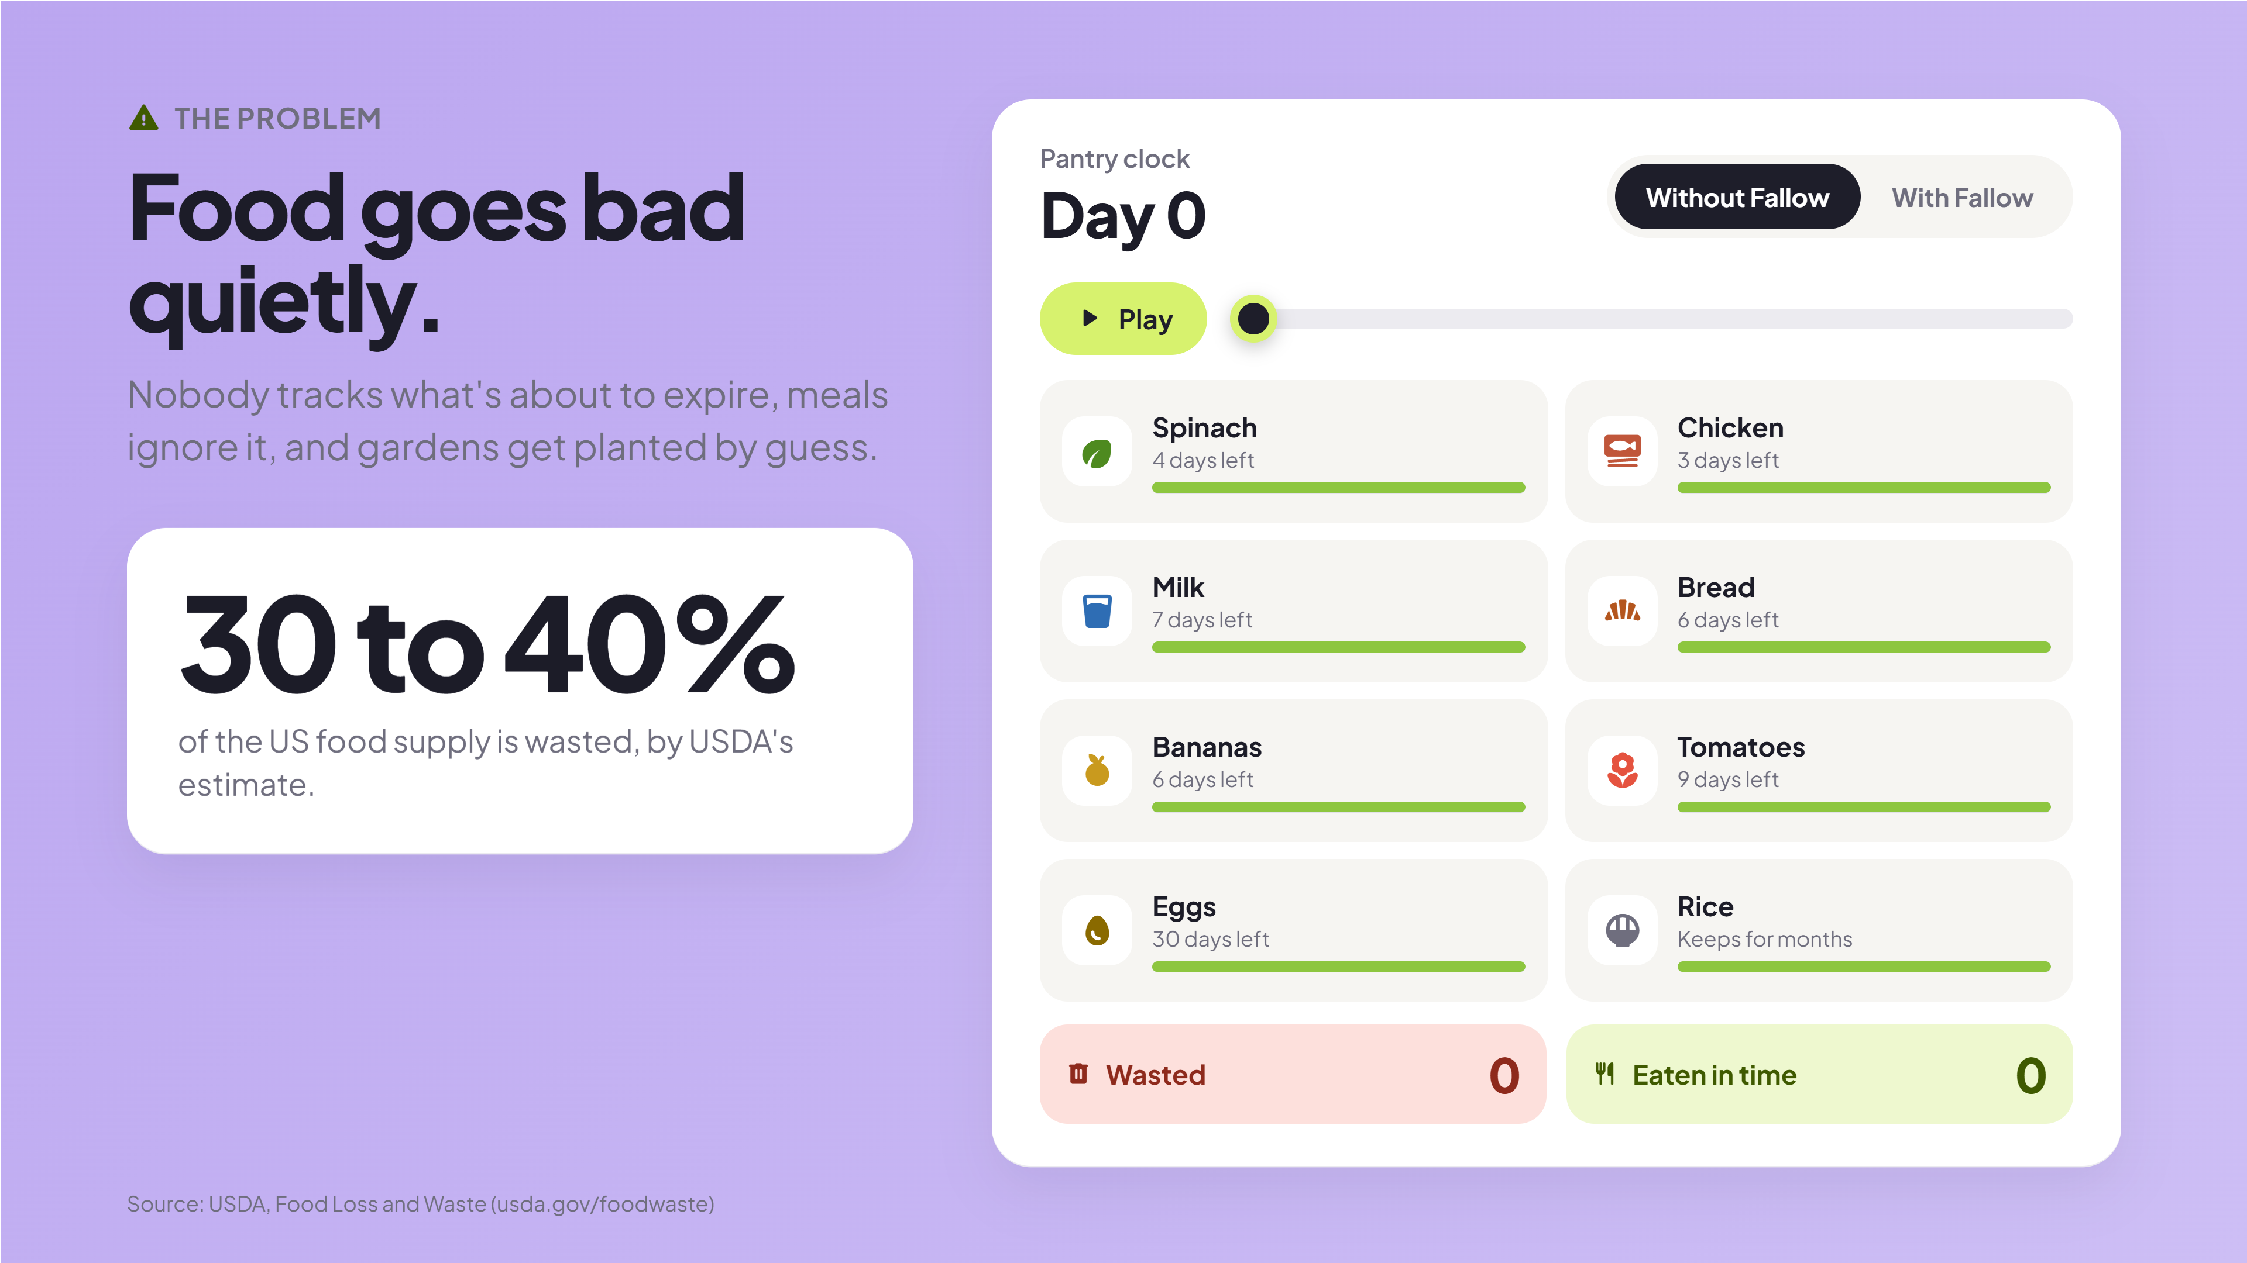
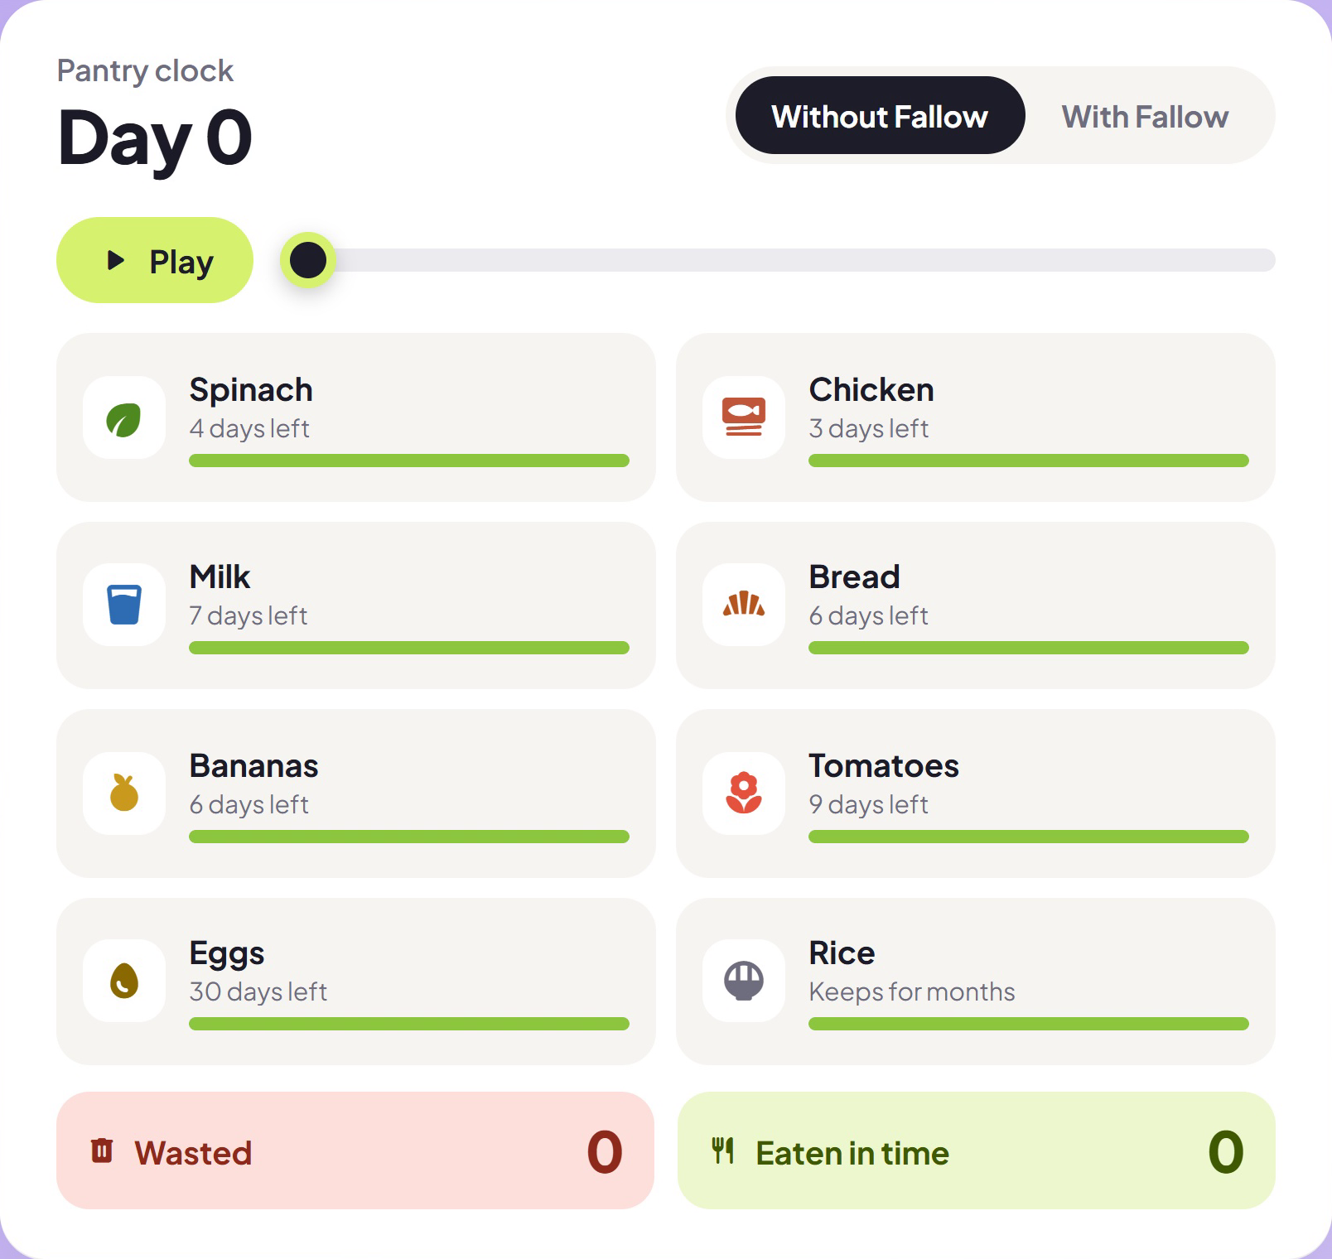
Open live ↗
Notes:
(about 15 sec) Food goes bad quietly. USDA estimates 30 to 40 percent of the US food supply is wasted. Drag the days: without Fallow, the spinach and chicken are gone by day 5. Flip Fallow on, and the same food turns into dinner before it spoils.

Slide 3
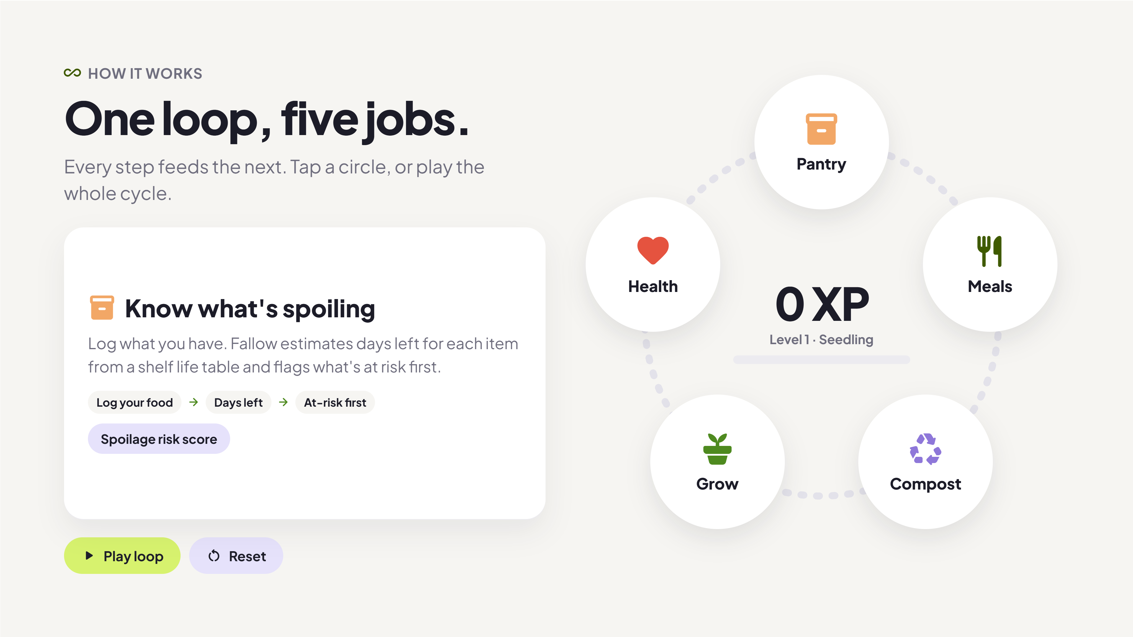
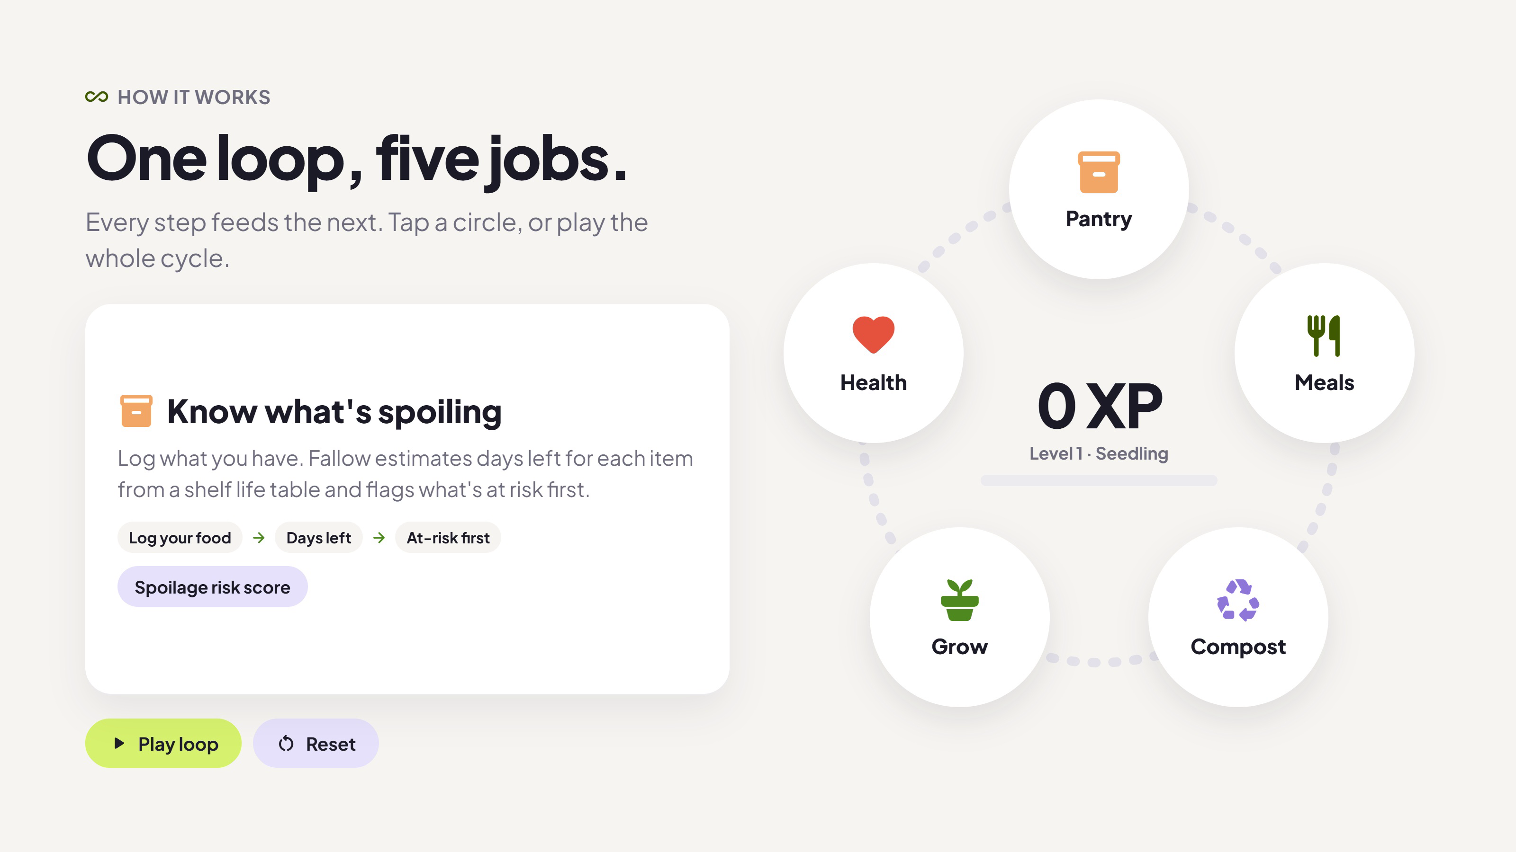
Open live ↗
Notes:
(about 15 sec) Fallow is one loop. Pantry tracks what's spoiling. Meals use it first. Scraps go to compost and back into the soil. The Fallow Stake probe in the garden bed reads the soil and air and sends it to your phone, so Grow can tell you what to plant to fill the gaps. Health checks your body is getting what it needs. Every full loop earns an achievement, so it feels like a game. Hit Play loop.

Slide 4
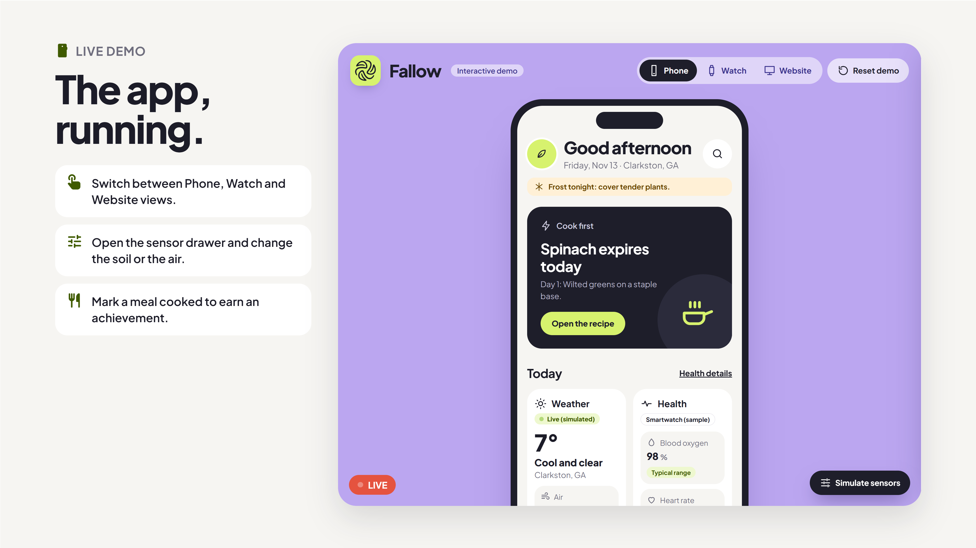
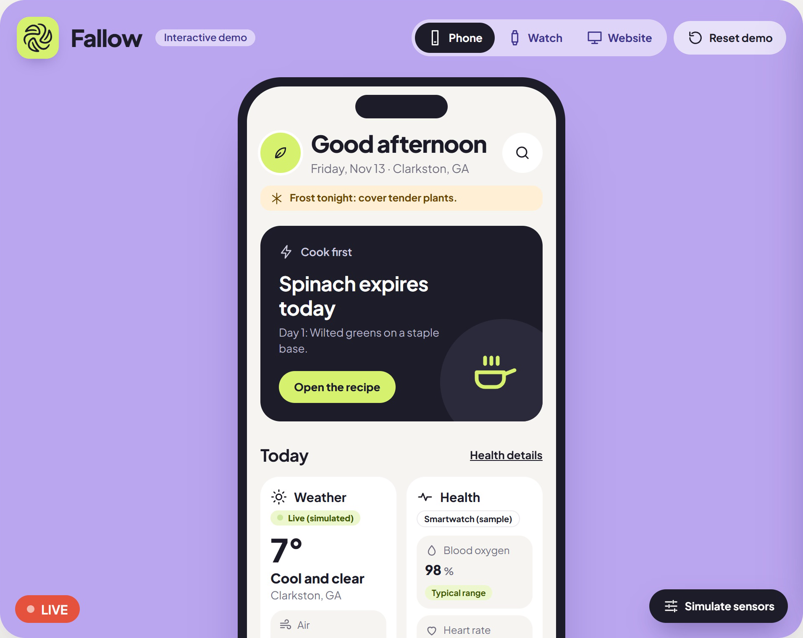
Open live ↗
Notes:
(about 20 sec) This is the app, live. Five pages: Dashboard, Pantry, Soil and farm, Health, and Food and recipes. The search button jumps to the pantry, weather and health sit side by side, and marking a meal cooked pops an achievement. Switch to the watch view to show the same data on the wrist.

Slide 5
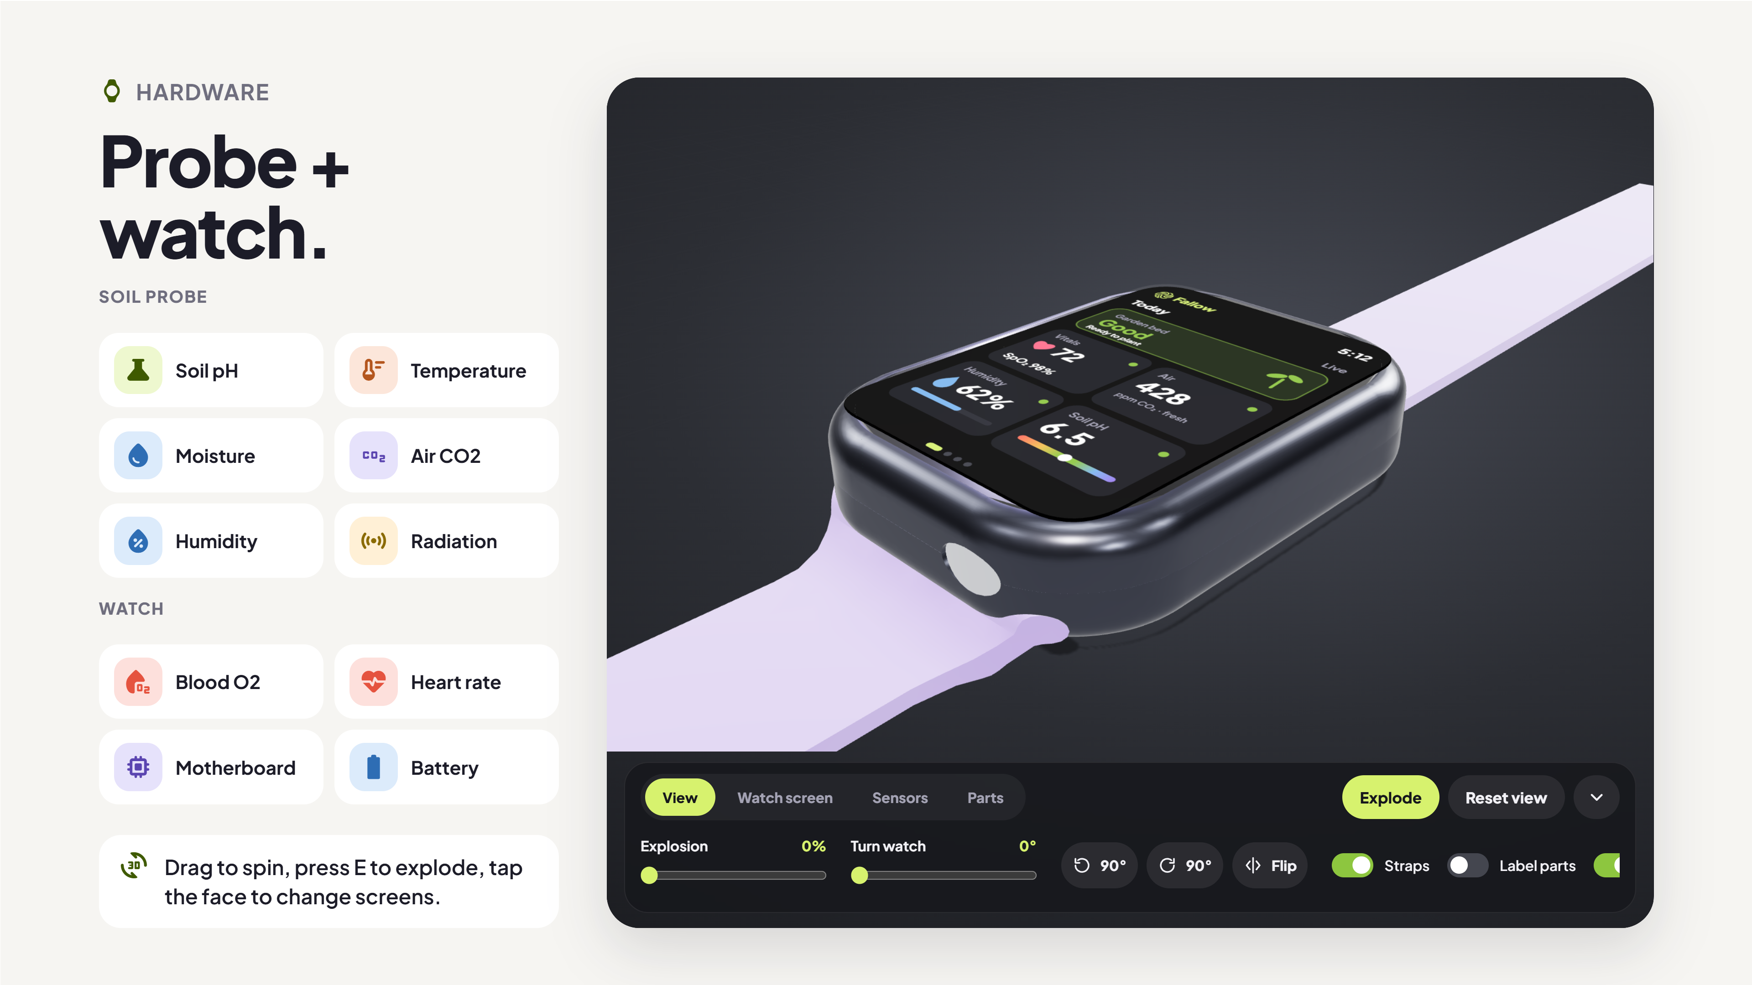
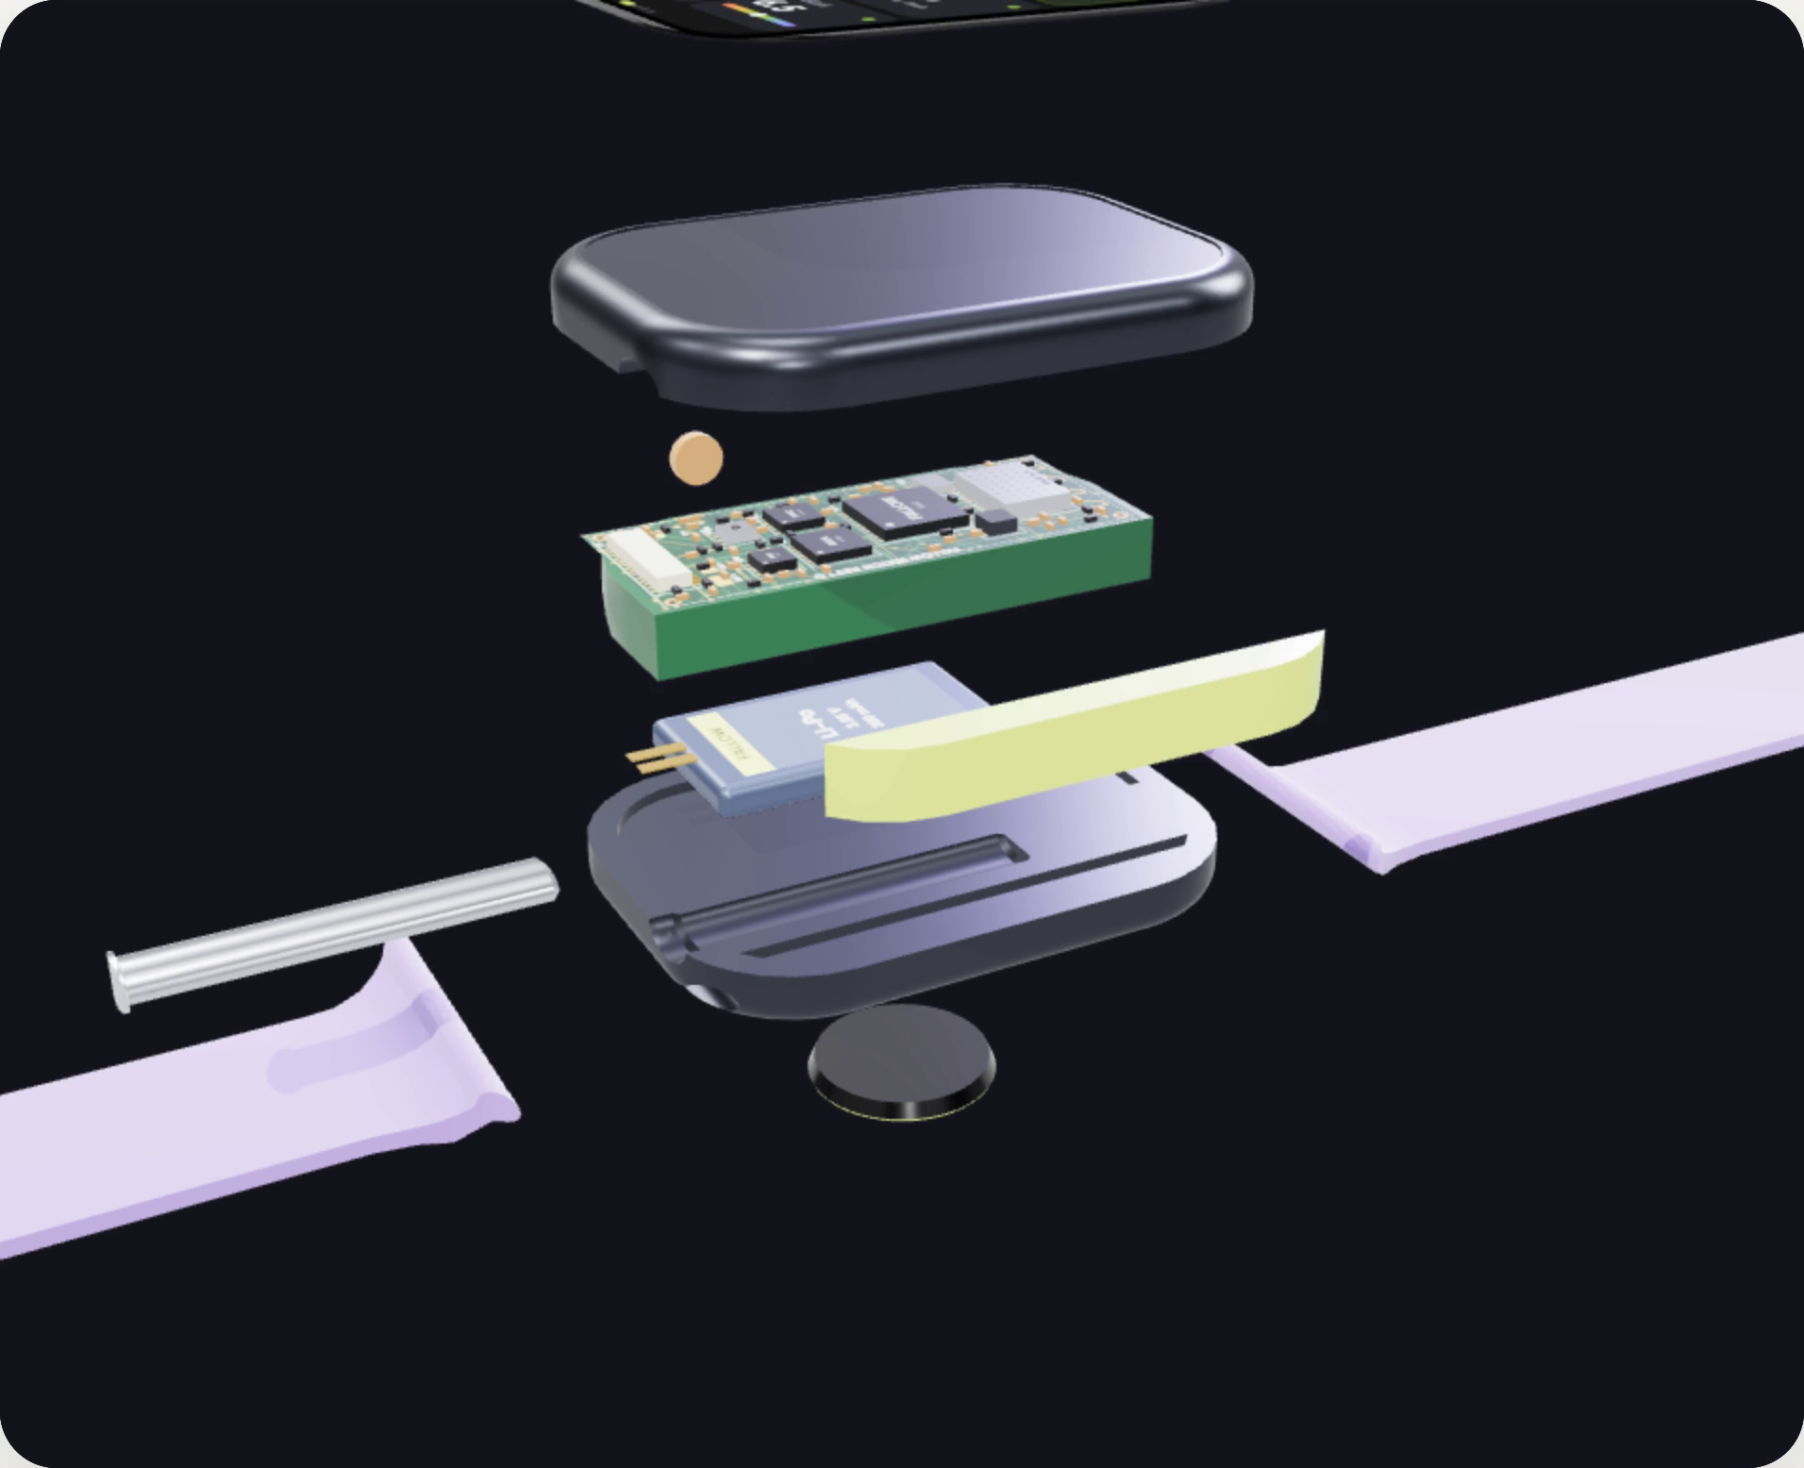
Open live ↗
Notes:
(about 15 sec) And the hardware. A soil probe plus a watch. The probe reads soil pH, temperature and moisture, and the air for CO2, humidity and radiation. The watch reads your blood oxygen and heart rate. This is our real CAD, exploded: the motherboard, battery and the optical sensor on the back. Tap the watch face to flip between your vitals, the air, and the garden bed.

Slide 6
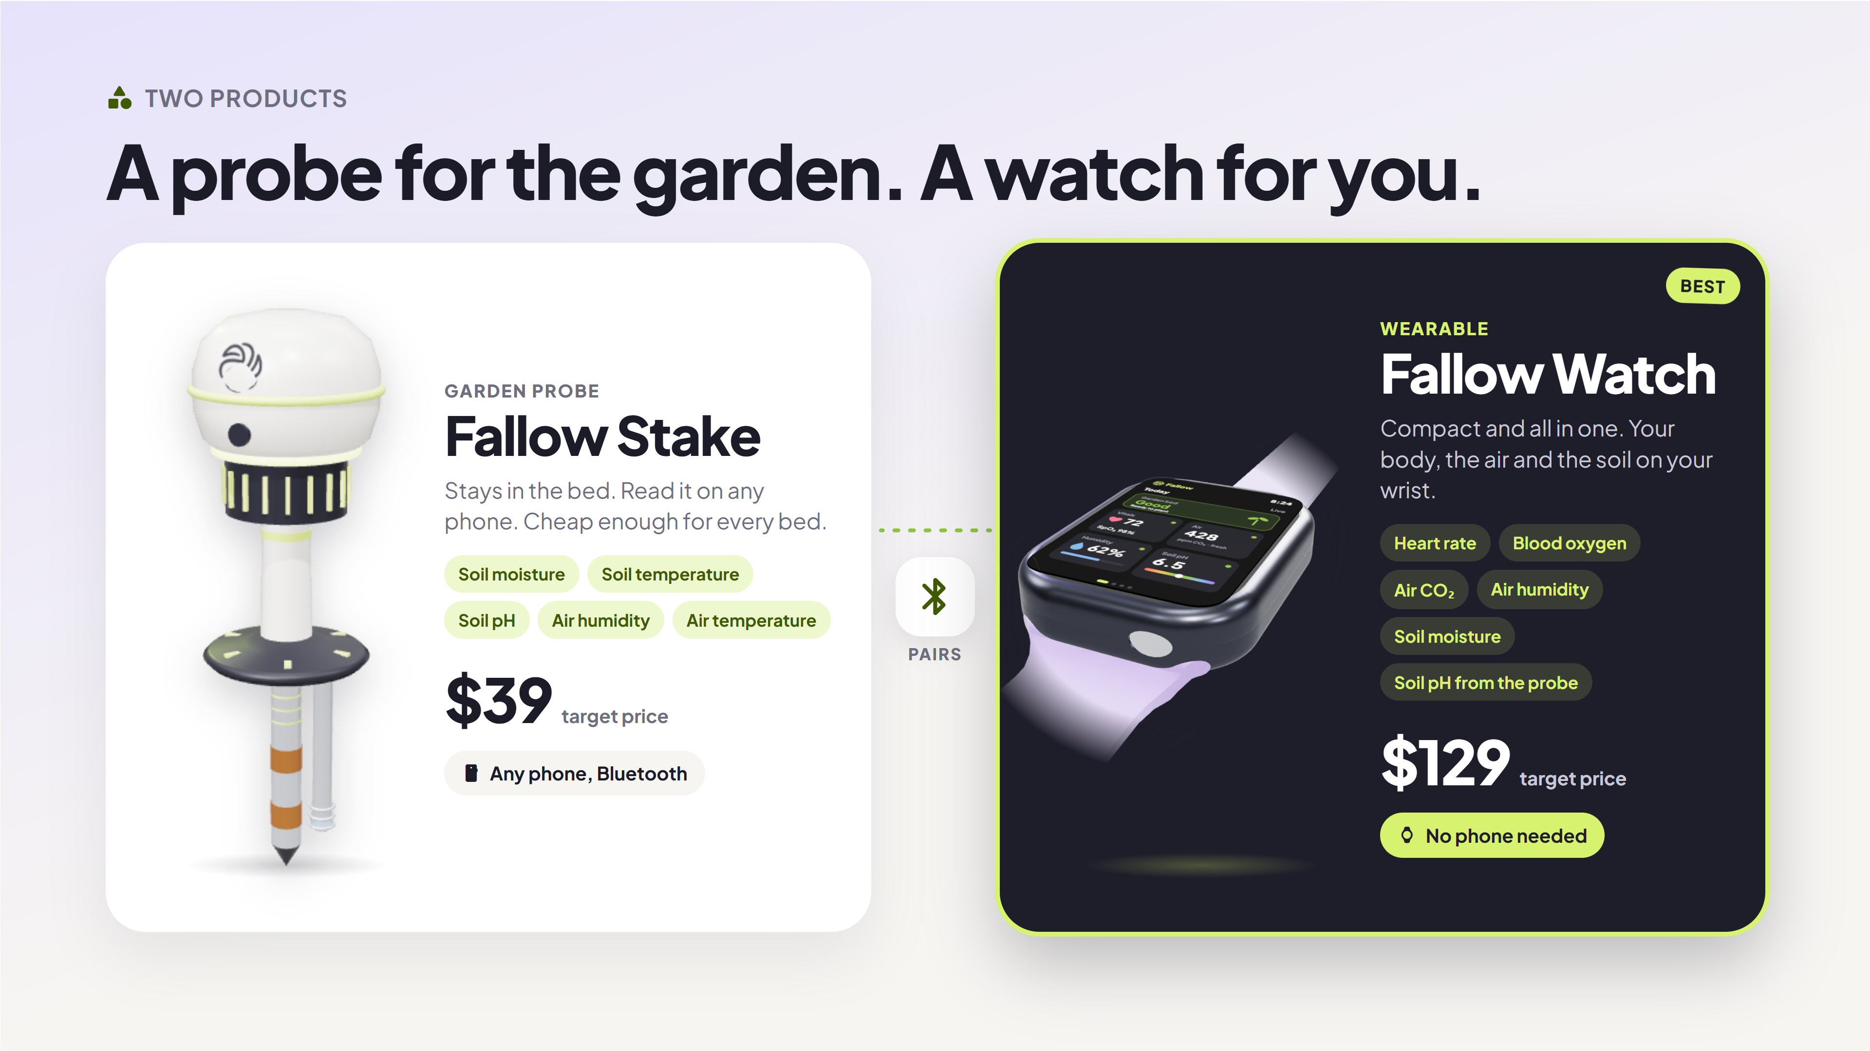
Notes:
(about 10 sec) Fallow is two products. The Fallow Stake stays in the garden bed and sends soil and air readings to any phone, for 39 dollars. The Fallow Watch is the best option: compact and all in one, with your heart rate and blood oxygen, the air, and the probe's soil data right on your wrist.

Slide 7
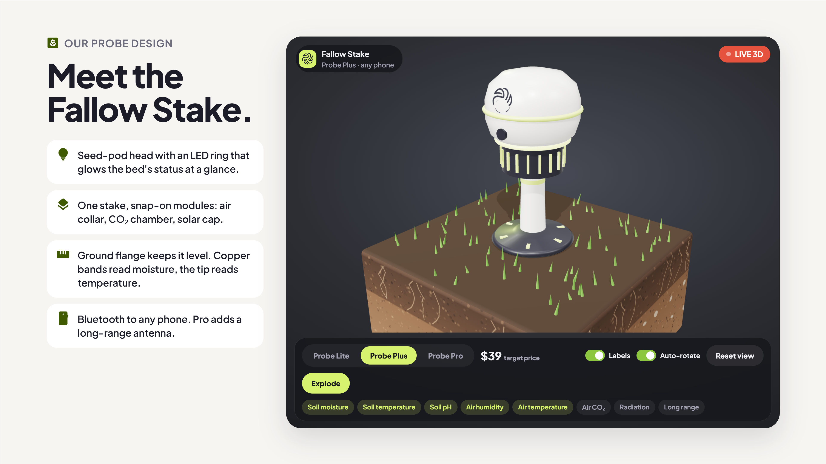
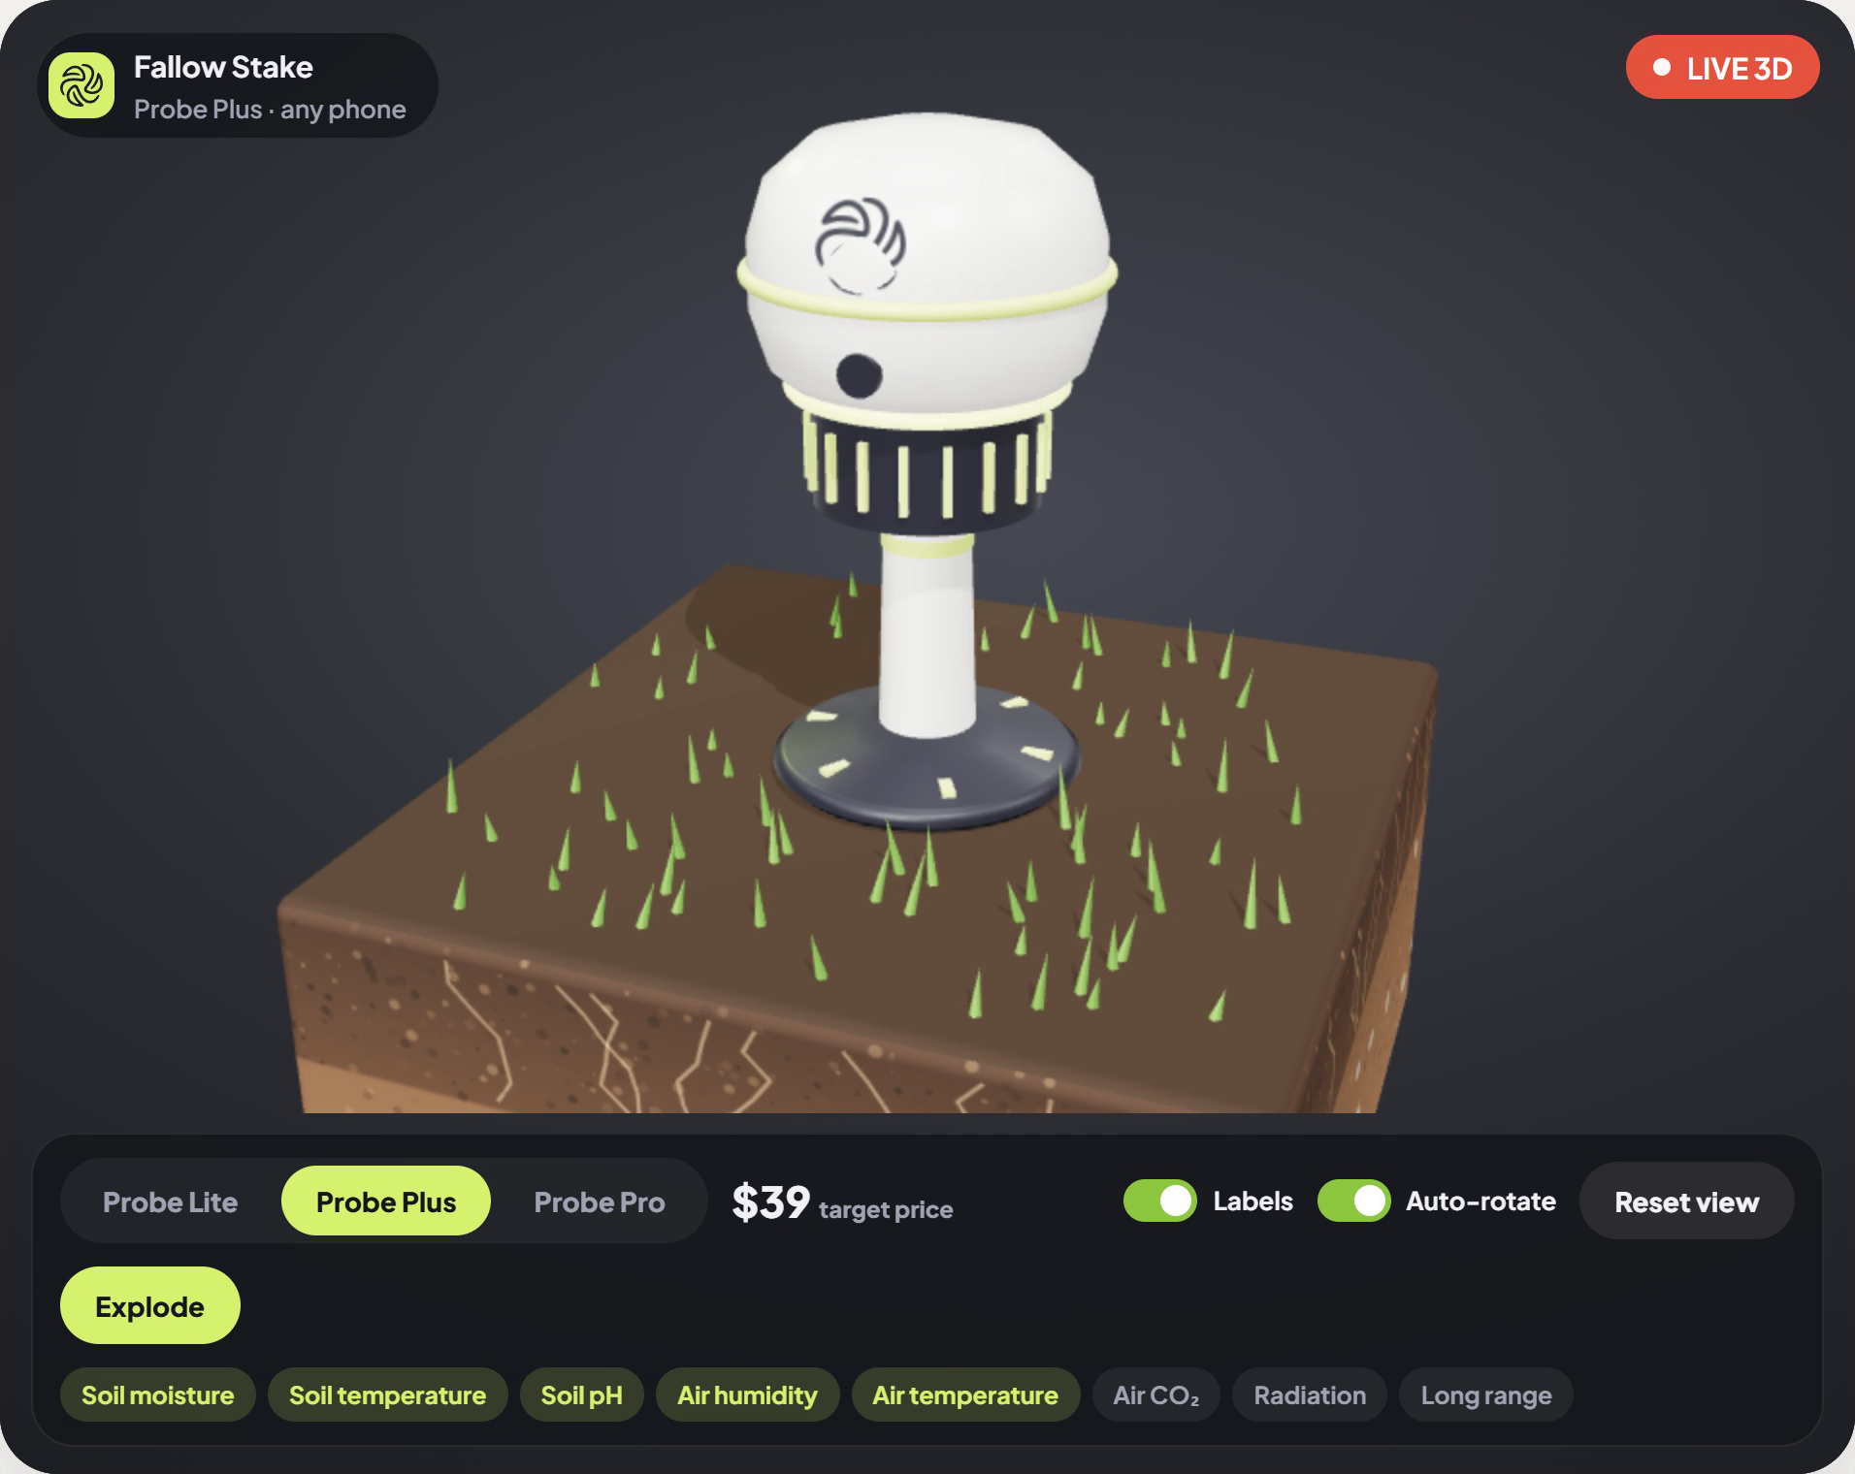
Open live ↗
Notes:
(about 10 sec) This is our own probe design, the Fallow Stake. A seed-pod head with an LED ring that glows the bed's status, and modules that snap on: the air collar, the CO2 chamber and the solar cap. Tap a tier and watch it change, then explode it.

Slide 8
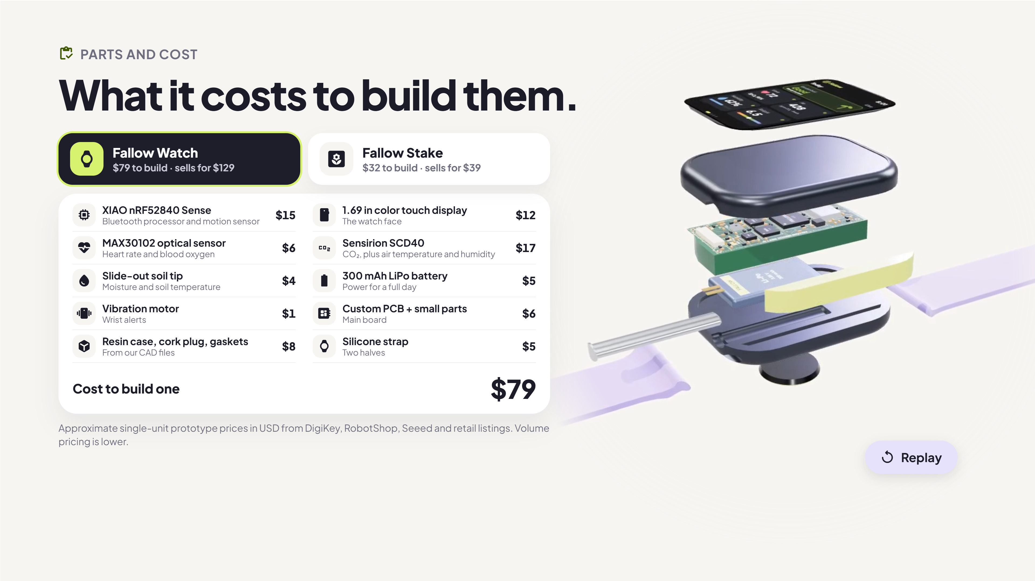
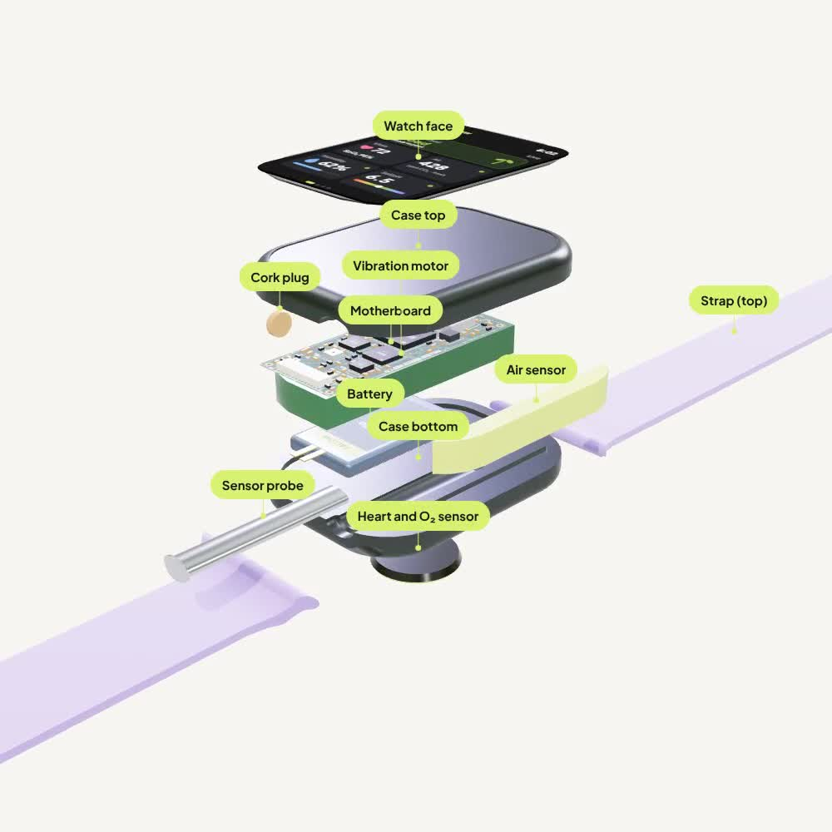
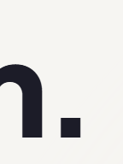
Notes:
(about 10 sec) Here is what each product costs to build, with real part prices. The watch is about 79 dollars in parts and sells for 129. The probe is about 32 dollars and sells for 39. And this is the watch coming together: every part named, then assembled into one product.

Slide 9
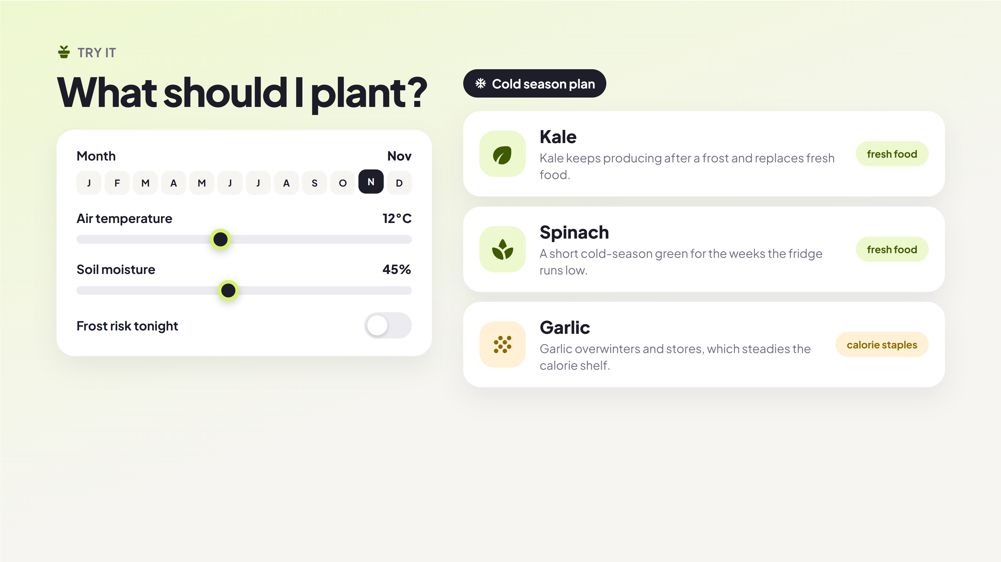
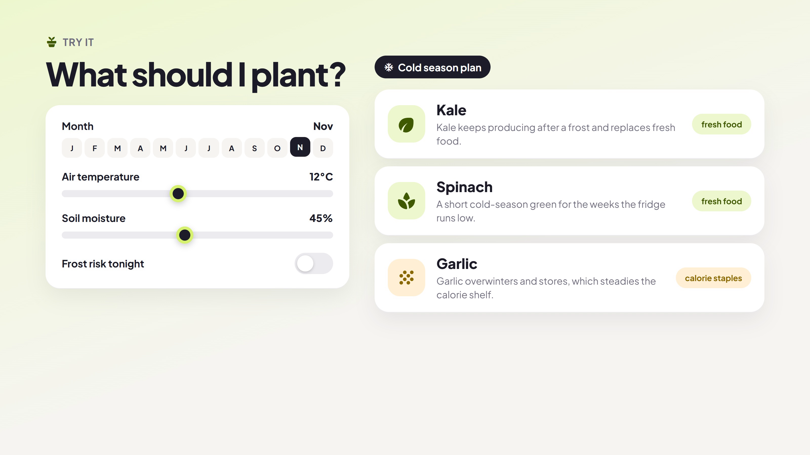
Open live ↗
Notes:
(about 10 sec) These are the same planting rules the app uses. Pick a month, flip frost, dry out the soil, and the planting plan changes on the spot.

Slide 10
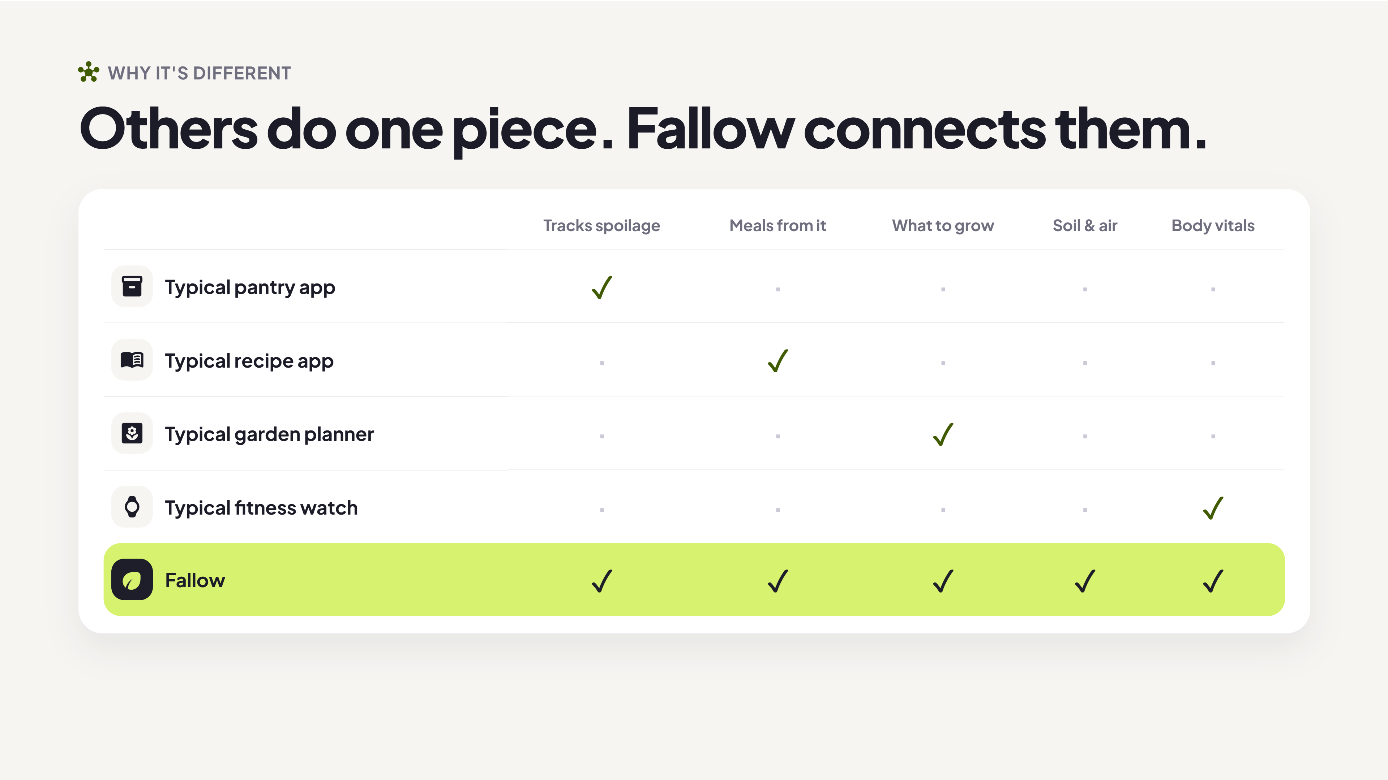
Notes:
(about 7 sec) Other apps each do one piece. A pantry app, a recipe app, a garden planner, a fitness watch. Fallow is the first we know of that connects all of them into one loop.

Slide 11
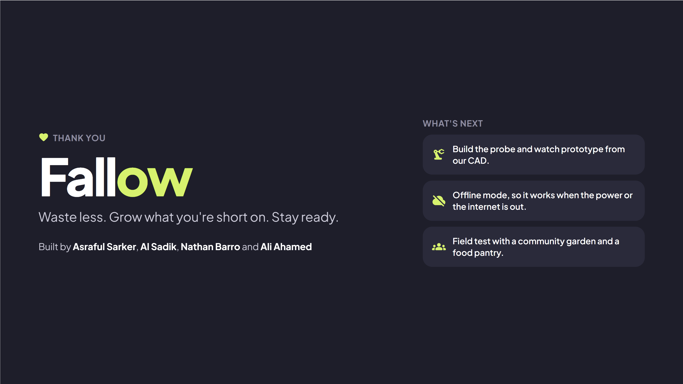
Notes:
(about 5 sec) Fallow. Waste less, grow what you're short on, and stay ready. Thank you!

