Slide 1
Panchayat Grievance Register
& Resolution Tracker
A simple way for a panchayat office to record every complaint,
see what is still waiting, and act on the oldest cases first.
NAME : MYTHREYEE.S
DEPARTMENT : BTECH AI&DS
SIH 2026 · Internal Practical Assessment

Slide 2
The Problem
Complaints about a blocked drain, a broken street light, or a damaged road are written
in a register or on loose slips at the panchayat office.
Villagers
The panchayat clerk
The panchayat secretary
Return again and again just to ask what happened to their complaint.
Cannot say how many complaints are open or which have waited longest.
Cannot show what was done, or which department is falling behind.
The information exists - it is simply not in a form anyone can act on or be held to.

Slide 3
Our Solution, in One Sentence
A single online register where every complaint is logged against the right department,
stays visible until it is closed, and is shown to the clerk with the oldest, still-waiting
complaints at the very top.
It also gives the clerk an early flag for complaints that look likely to be delayed,
so those can be prioritised before they become a repeat complaint.

Slide 4
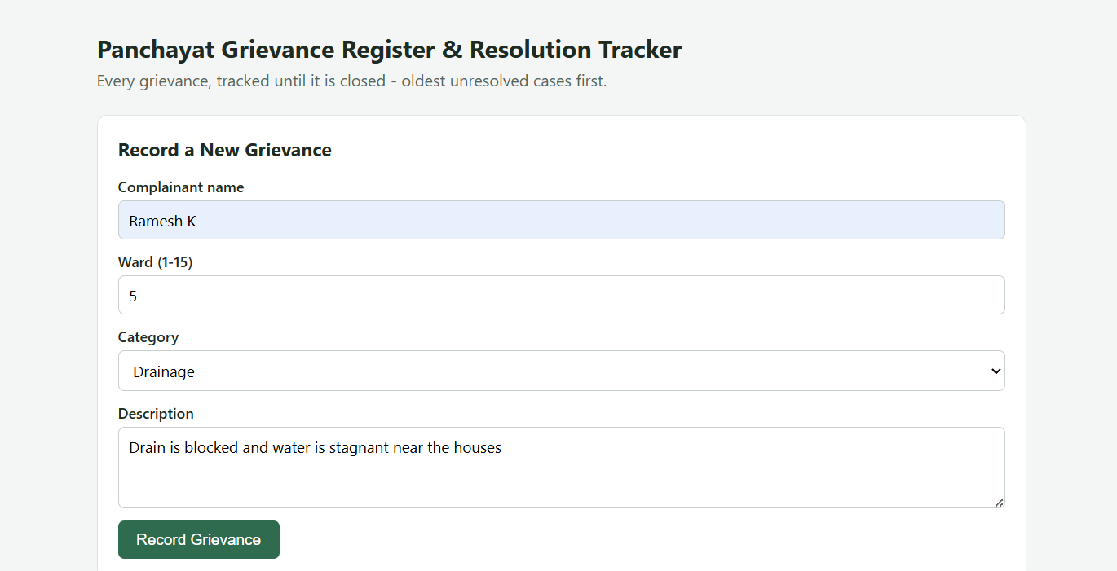
Recording a Grievance
The ward clerk fills a short form. Every field is checked on the server before it is saved.
[ Add a screenshot of your running "Record a New Grievance" form here ]

Slide 5
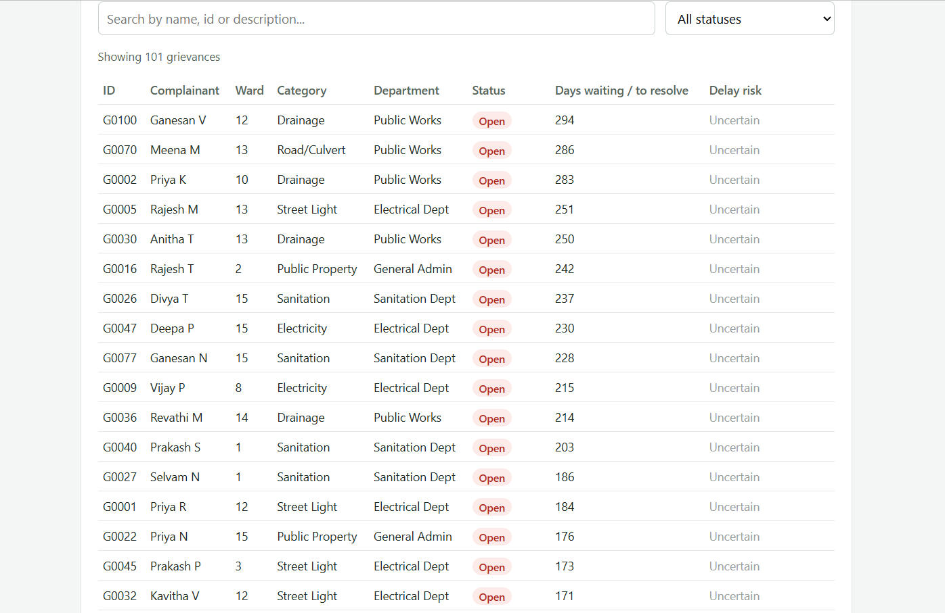
The Register: Search, Filter, Oldest First
How the waiting time is calculated
Open / In Progress cases: days waiting = today's date − date the grievance was raised.
Resolved cases: days to resolve = the date it was closed − the date it was raised.
The list is sorted so open cases come first, oldest date first - the oldest unresolved complaint is always at the top.

Slide 6
What Works Today, What Is Unfinished
Working
Not yet finished
• Recording a grievance end to end, with server-side validation
• Searching, filtering and ordering the register by urgency
• A simple risk-of-delay prediction shown at creation time
• Loading, empty and error states on every screen
- Updating a grievance's status (Open → In Progress → Resolved) has to be
done directly in the database — there is no button on the screen for the
clerk to change it themselves yet.
- Filtering by category and department is supported by the backend, but the
screen currently only has a filter dropdown for status.
- The prediction model was trained on a small seeded dataset (~26 resolved
cases), so its accuracy is limited — it is a working demo, not a production-ready model.

Slide 7
One Improvement We Would Make Next
Add a button on each grievance row so the clerk can update its status
directly from the screen (e.g. mark it "In Progress" or "Resolved"),
instead of needing direct database access. This is the most obviously
missing piece of daily-use functionality, and would make the register
usable end-to-end by a non-technical clerk.

