Slide 1
Analysis on Buy Now Pay Later
RA2211027010148: Paruchuri Geeta Chinmayee
RA2211027010191:
Mythri Gadepalli

Slide 2
Table of contents
01
02
03
04
05
06
Introduction
Dataset Overview
Objectives & KPI
Visualization
Analysis & Insights
Future Work

Slide 3
Introduction
Aim: The project aims to analyse the impact of BNPL (Buy Now, Pay Later) models on customer behaviour, merchant sales, and credit risks within the e-commerce sector. Through data-driven insights, the study seeks to understand BNPL growth over time, evaluate its economic influence, and identify potential risks associated with consumer credit and business profitability.
Objectives:
Identify primary customer loan purposes and seasonal trends.
Analyze BNPL growth over time, segmented by income levels.
Study loan default trends to evaluate long-term financial impact.

Slide 4
Dataset Overview
Source: Kaggle (Paylater loan data)
Description:
The dataset consists of BNPL (Buy Now, Pay Later) loan data, capturing a variety of customer demographics, loan details, and repayment information. It provides a comprehensive view of factors influencing customer behavior and default patterns within BNPL models, making it suitable for studying growth, risk assessment, and impact on the financial ecosystem.

Slide 5
Objectives and Key Performance Index
General Goal:
To enhance understanding of the impact of BNPL models on customer behavior and financial performance in e-commerce, enabling stakeholders to make informed decisions regarding credit offerings and risk management.
Key Performance Indicators (KPIs):
Loan Default Rate: Percentage of loans that default.
Customer Adoption Rate: Increase in customers using BNPL.
Average Loan Size: Mean value of loans issued.
Repayment Rate: Percentage of loans repaid on time.

Slide 6
Visualizations

Slide 7

Key Visualizations
Customer Behaviour Analysis
Identifies common loan purposes, seasonal approval trends, and riskier loan categories based on default patterns.
BNPL Growth and Adoption Over Time
Reveals the growth of BNPL, adoption rates by income levels, and shifts in loan purpose preferences, illustrating BNPL’s inclusivity and consumer priorities.
Financial Impact and Risk Analysis
Provides a view of BNPL’s financial sustainability, potential default risks, and how loan terms and customer income affect loan decisions.

Slide 8
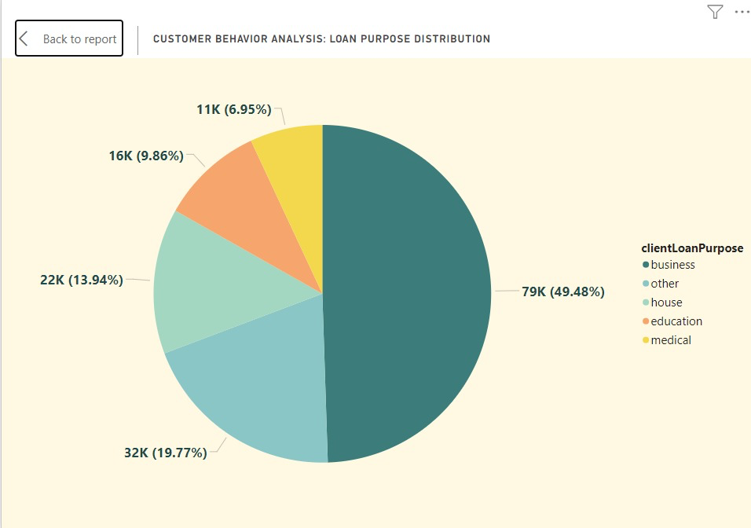
Loan Purpose Distribution
Description: This pie chart shows the distribution of different loan purposes among customers. Each segment represents a loan purpose category, with labels displaying the percentage and total count for each purpose.
Implications: The data suggests a high focus on business-related loans, which could inform targeted financial products or marketing strategies. It might also point to economic trends where more individuals are seeking business funding.

Slide 9
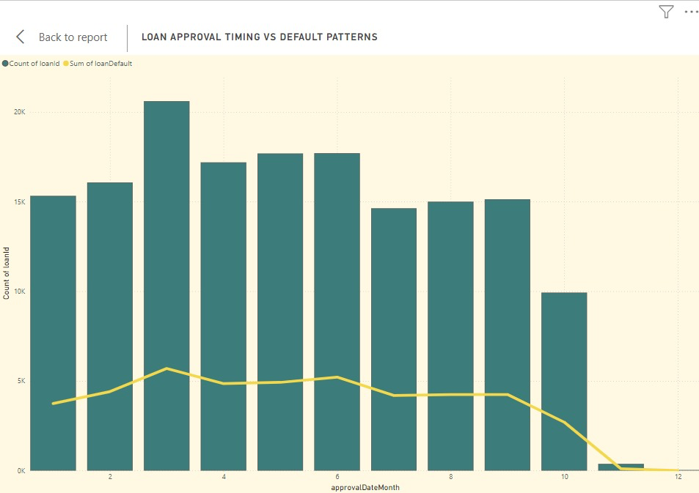
Loan Approval Timing vs. Default Patterns
Description: This chart combines columns showing the count of approved loans each month (approvalDateMonth) with a line chart representing the sum of loan defaults.
Implications: This data can help in understanding the seasonal risk of defaults, allowing lenders to prepare for higher-risk periods. It also provides insight into the relationship between approval times and default tendencies, useful for refining risk assessment criteria.

Slide 10
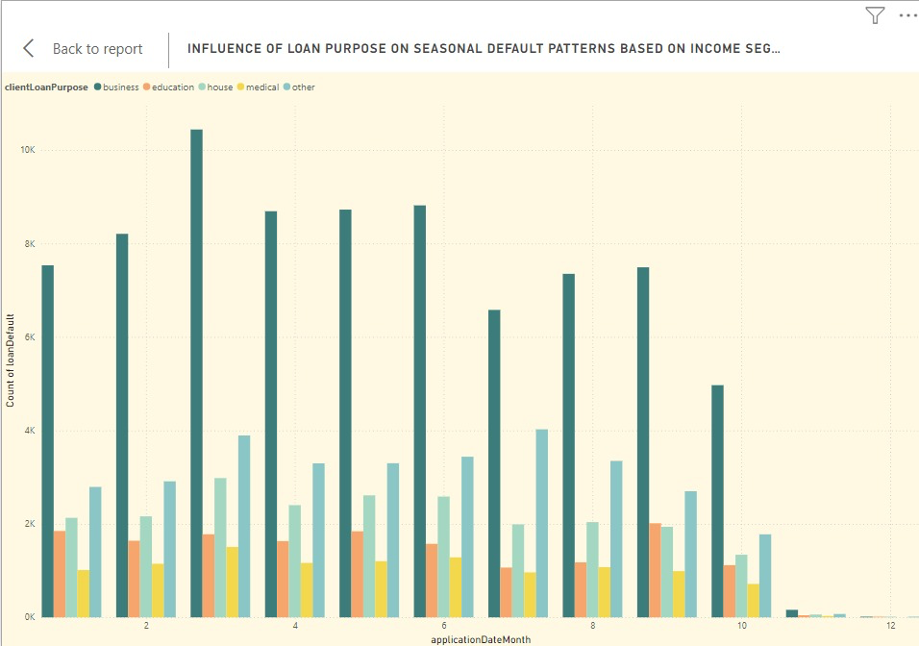
Influence of Loan Purpose on Seasonal Default Patterns
Description: This chart shows the distribution of defaults by loan purpose over time (application date month). Each color-coded column represents a loan purpose category, enabling a visual comparison across months.
Implications: This insight helps in identifying high-risk loan purposes and periods, allowing for better loan structuring and possibly tighter credit requirements for certain categories during specific months.

Slide 11
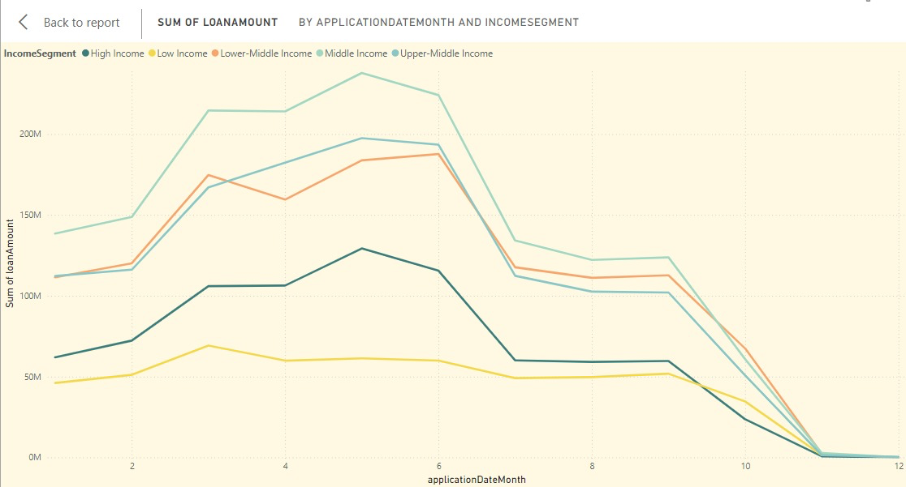
Sum of Loan Amount by Income Segment and Application Date Month
Description: This line chart displays the total loan amounts taken by different income segments (high, upper-middle, middle, lower-middle, and low) for each month.
Implications: This breakdown helps identify which income groups contribute the most to loan demand and can inform targeted financial products. The seasonal peaks suggest periods of opportunity for loan promotions to upper-middle and middle-income segments.

Slide 12
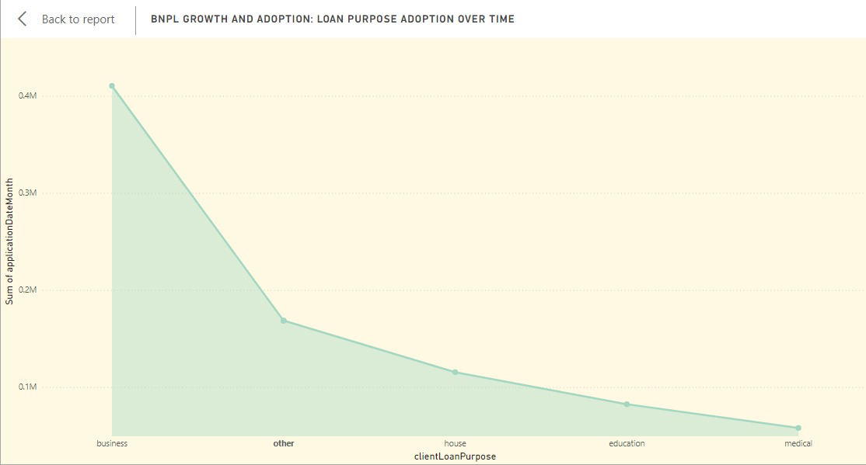
Loan Purpose Adoption Over Time
Description: This area chart demonstrates the adoption of various loan purposes over time, such as business, house, education, medical, and other purposes.
Implications: Understanding the dominance of business loans helps in designing customized financial products and understanding market demand. Lower demand for medical and education loans could indicate an area to explore for new offerings or community-based funding options.

Slide 13
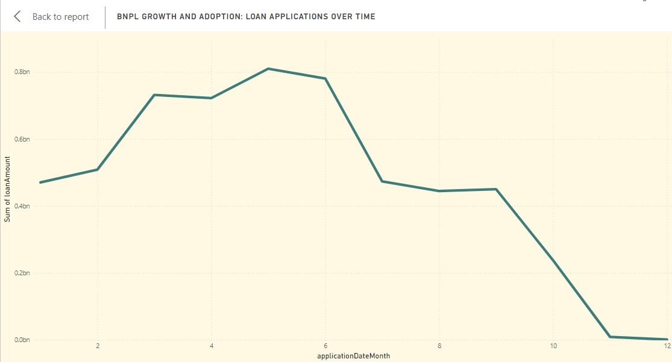
Loan Applications Over Time
Description: This line chart tracks the total amount of loan applications across each month.
Implications: This chart provides valuable insight into the timing of BNPL demand, allowing financial institutions to prepare for higher demand periods. It also highlights potential opportunities for promotions or loan products that align with peak borrowing times.

Slide 14
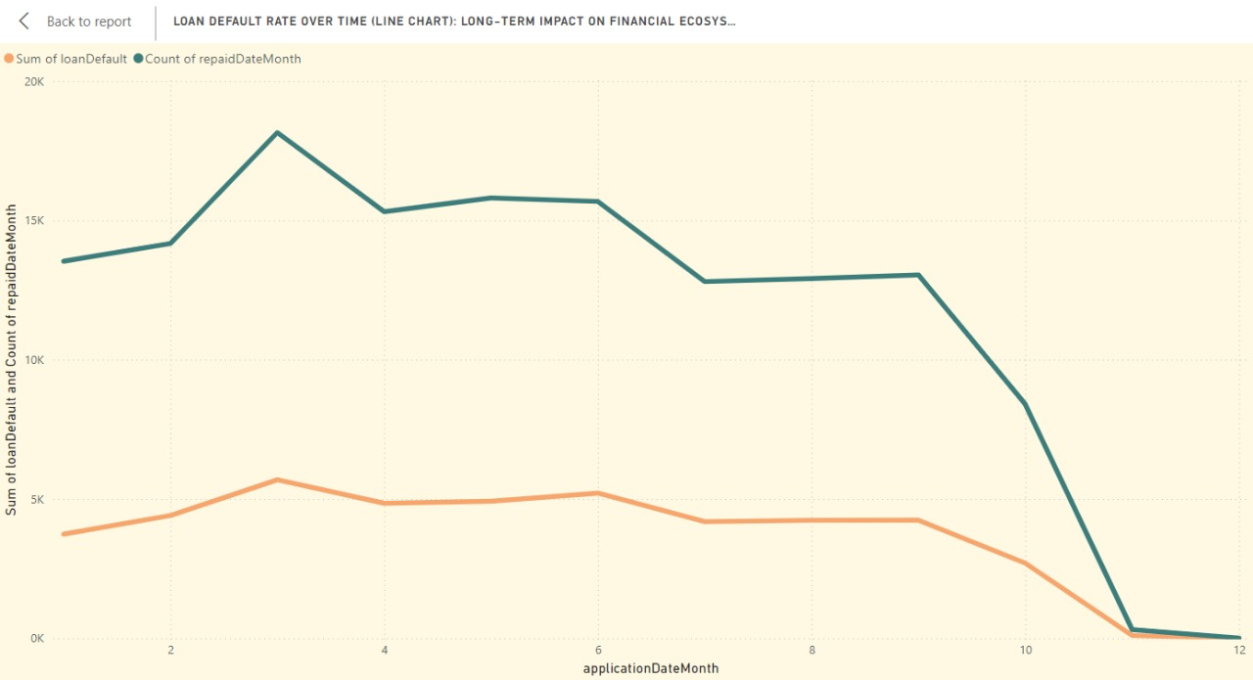
Loan Default Rate Over Time
Explanation:The line chart displays two metrics over time. Count of ⁠ repaidDateMonth ⁠ (in green) Represents the number of loans repaid each month. Sum of ⁠ loanDefault ⁠ (in orange) shows the number of loan defaults each month.
Implications: Financial institutions could leverage these patterns to adjust loan offerings or introduce repayment assistance programs based on seasonal trends.

Slide 15
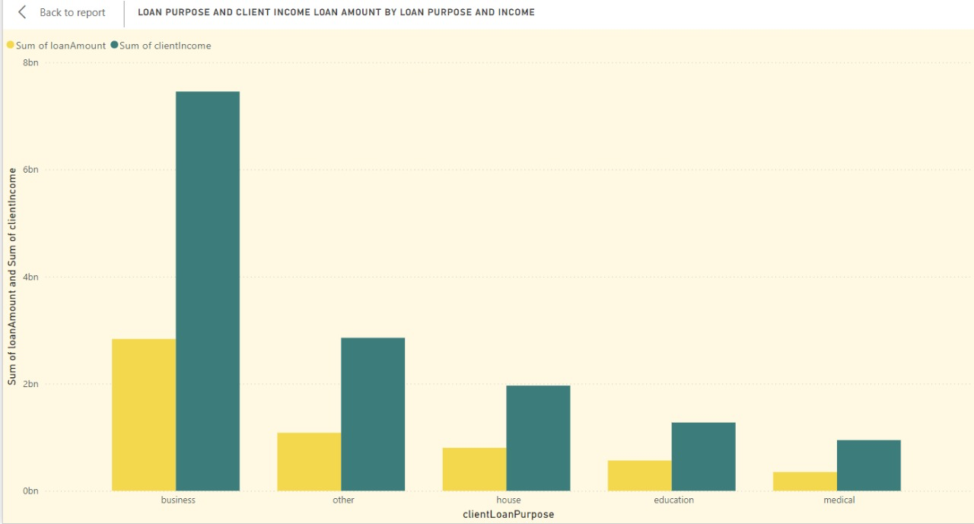
Loan Purpose and Client Income – Loan Amount by Purpose and Income
Explanation: This bar chart compares the sum of ⁠ loanAmount ⁠ (in yellow) with the sum of ⁠ clientIncome ⁠ (in green) across different loan purposes (e.g., business, house, education, medical, other).
Implications: Tailoring interest rates or repayment structures based on loan purposes could improve client satisfaction and repayment success, catering to different financial needs across categories.

Slide 16
Analysis and Insights
Customer Segmentation and Loan Purpose
Business Loans Dominate: Nearly 50% of loans are for business purposes, indicating strong demand in this area.
Implication: Opportunity to develop targeted financial products, especially for business and housing loans.
Seasonal and Income-Based Loan Trends
Seasonal Borrowing Peaks Mid-Year: High demand in mid-year, declining towards year-end, possibly due to economic cycles.
Implication: Prepare for peak borrowing periods with promotional products, focusing on mid-year demand and targeting middle-income segments.

Slide 17
Loan Approval, Default Patterns, and Risk Management
Approval and Default Trends: Loan approvals drop in Q4; defaults peak in specific months, possibly due to post-holiday financial strain.
Implication: Tighten credit policies and adjust repayment plans for high-risk loan types and high-default months.
Loan Repayment and Income Correlation
Repayment Peaks Mid-Year: Possibly due to seasonal income cycles or bonuses.
Implication: Introduce tailored repayment plans for high-income borrowers, especially in high-risk business loans.

Slide 18
Future Work and Improvement
1.⁠ ⁠Targeted Financial Products for Business Loans: Introduce enhanced credit risk assessment tools to handle the higher volumes and potential risks associated with business loans, ensuring sustainability while meeting demand.
2.⁠ ⁠Seasonal Adjustment of Loan Offerings: Analyze loan demand and repayment patterns over multiple years to strengthen seasonal insights. This could include tracking loan approvals and defaults across seasonal or economic cycles.
3.⁠ ⁠Customized Lending for Lower-Income Segments: Investigate the low demand and limited uptake of loans in education and medical sectors to understand the barriers. Consider strategies to make loans more accessible for lower-income clients.
4.⁠ ⁠Enhanced Risk Management for High-Default Periods: Deepen analysis of default trends by integrating external economic indicators (e.g., inflation rates, employment data) to understand broader factors affecting defaults.

Slide 19
Thank You

