Slide 1
FGT (FEEL GOOD TOGETHER)

Slide 2
INTRODUCTION
A music playlist website allows users to create , manage , and share playlists of their favorite songs .
Users can browse a catalog of music , add songs to their playlists , and enjoy a personalized listening experience.
Users can create accounts or log in using existing accounts .Users can manage their profile details .
Users can browse and search for songs , albums , and artists . Categorized music by genres and personalized recommendations based on users preferences .
Users can share their playlists with others via links or social media.

Slide 3

DESIGN AND FORMAT:-
Users can personalize there profiles and playlist covers.
Options for public or private playlists and profile visibility.
There will be smooth performance , fast loading times and seamless transition.
Efficient search capabilities for finding songs , artists , album and playlist.
Visually appealing layout with consistent color schemes , fonts , and high-quality images.
Personalized suggestions based on user references and listening history.

Slide 4
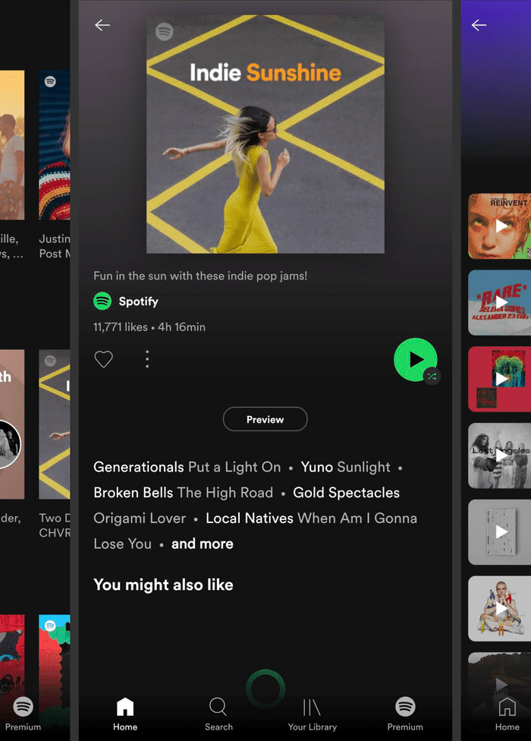
Purpose:-
The purpose of a music webpage can vary depending on its target audience, features, and goals.
Helps users o discover new songs, artists, genres they might not encountered otherwise.
Ensure a high-quality audio experience with options for different bitrates.
Helps users to manage their music library, including creating, editing, and organizing playlists.
Provide detailed information about songs, artists, album, and genres.

Slide 5

TAGS USED:-
Structural tags are: <html>, <head>, <body>, <header>, <nav>, <main>, <footer>.
Content tags are: <h1><h2><h3>.., <p>, <div>, <span>.
Media and interactive tags are: <audio>, <source>, <img>, <button>, <input>.
Metadata tags are: <meta>, <title>, <link>, <script>.
Data tags are: <data>, <time>.
Semantic and accessibility tags are: <aside>, <figure>, <details>, <summary>, <table>, <tr>, <td>, <th>.

Slide 6

REQUIRMENTS:-
Creating a music playlist website involves several technical and design considerations to ensure it is user-friendly, visually appealing, and functional.
Visible and easily accessible play, pause, skip , and volume controls.
Easy and intuitive navigation with clear menus and buttons.
Allow users to search for specific songs, artists, or genres.
Features for creating, editing, and deleting playlists.
Enable users to filter and sort playlists by various criteria.

Slide 7

CONCLUSION:-
Our music playlist webpage offers a carefully curated selections of songs to suit every mood and occasion. Whether you’re looking to relax, energize, or discover new artists , our diverse playlists provide a seamless and enjoyable listening experience. We continuously update our selections to ensure fresh and exciting content, making your musical journey both dynamic and engaging. Thankyou for choosing our platform as you go-to source for music discovery and enjoyment.
HAPPY LISTENING!

