Slide 1
DATA ANALYTICS
Data Analytics — Executive Readout
Player Health, Monetization, Acquisition & Churn | Jan 1 – Apr 30, 2026
ARPDAU
D30 RETENTION
OBSERVED CHURN
CHURN MODEL
$0.351 → $0.293
~13–15%
18.91%
0.744
−16.5% overall
Mature weekly cohorts
Test-period base rate
Test ROC-AUC
KEY FINDINGS
01 — ARPDAU decline is primarily a mix effect
02 — Channel quality needs adjustment
03 — Churn can support targeting
All country tiers were stable or improving,
while Tier 4's active-player mix increased substantially.
Paid Video shows stronger engagement, while the raw
Organic revenue gap largely disappears after adjustment.
The model identifies higher-risk player-date
observations, but offer economics still need testing.
Bottom line: focus on acquisition mix, measure channel economics correctly, and use churn prediction as a targeting layer.

Slide 2
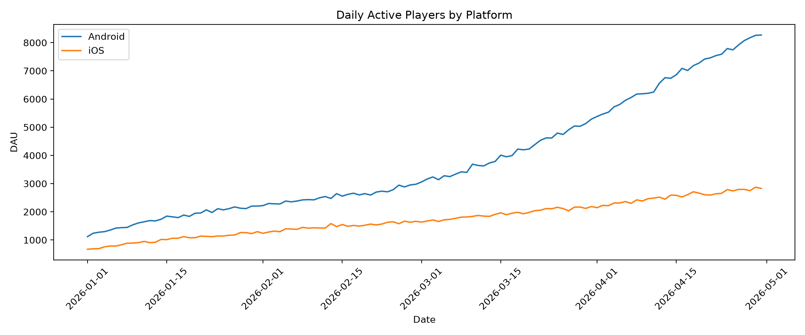
1. Game Health — Activity & Retention
Use this slide to show the product baseline before moving into monetization.
ACTIVITY
RETENTION
Milestone | Mature cohort range
D1 | ~46–50%
D7 | ~24–27%
D14 | ~19–21%
D30 | ~12.7–15.0%
ACTUAL GRAPH: Daily Active Players by Platform
Android vs iOS, Jan–Apr 2026
Insert the actual daily DAU chart from Task 1. Do not use a fabricated time series.
Key message
D1 retention is consistently around 46–50%, while mature
D30 cohorts remain around 13–15%.
Recent cohorts are not eligible for later milestones because the observation window ends on Apr 30.

Slide 3
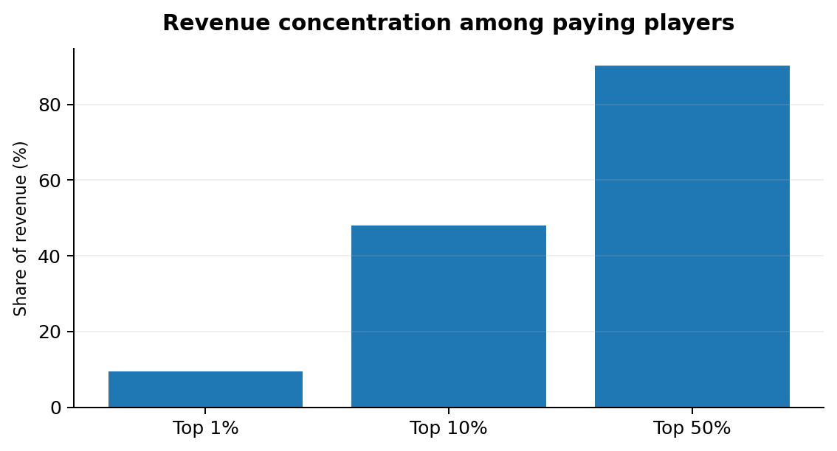
2. Monetization — Concentration & Rewarded Ads
Revenue means real-money in-app purchases; rewarded-ad activity is engagement, not ad revenue.
REWARDED-AD ENGAGEMENT
Ad cap | Ad-watching player-days | Cap-hit rate
5 | 294,776 | 1.0265%
8 | 102,049 | 0.0127%
Anomaly to investigate
Mar 6, 2026 recorded zero ad events. Validate telemetry before treating this as player behavior.
Key message: 48.08% of revenue comes from the top 10% of paying players; cap hits are rare.

Slide 4
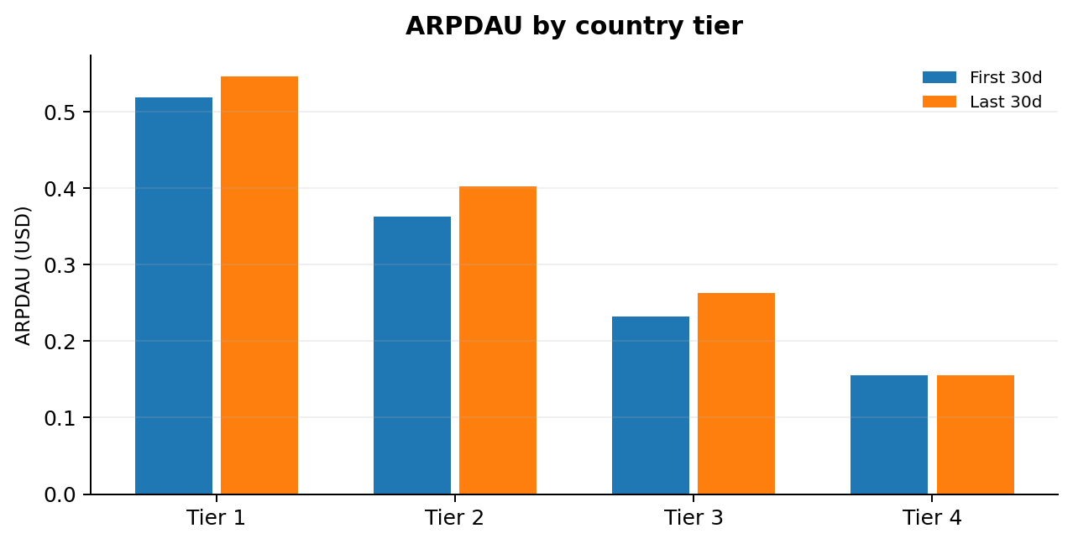
3. ARPDAU Is Falling — But the Decline Is Mostly Mix-Driven
First 30 days vs last 30 days of the analysis window.
FIRST 30 DAYS
LAST 30 DAYS
CHANGE
TIER 4 MIX
$0.3511
$0.2933
−16.49%
17.65% → 45.99%
ARPDAU
ARPDAU
Overall ARPDAU
+28.33 percentage points
DECOMPOSITION
MIX EFFECT
−$0.0758
WITHIN-TIER EFFECT
+$0.0179
TOTAL CHANGE
−$0.0579
Recommendation: investigate the acquisition/mix shift toward Tier 4; do not apply a blanket monetization fix.

Slide 5
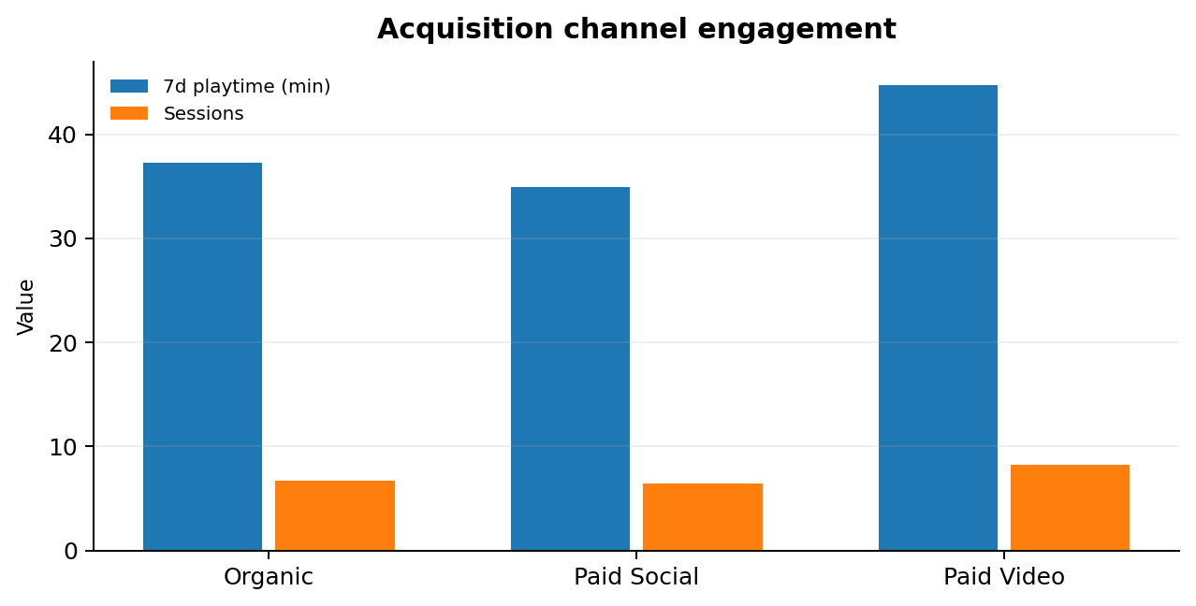
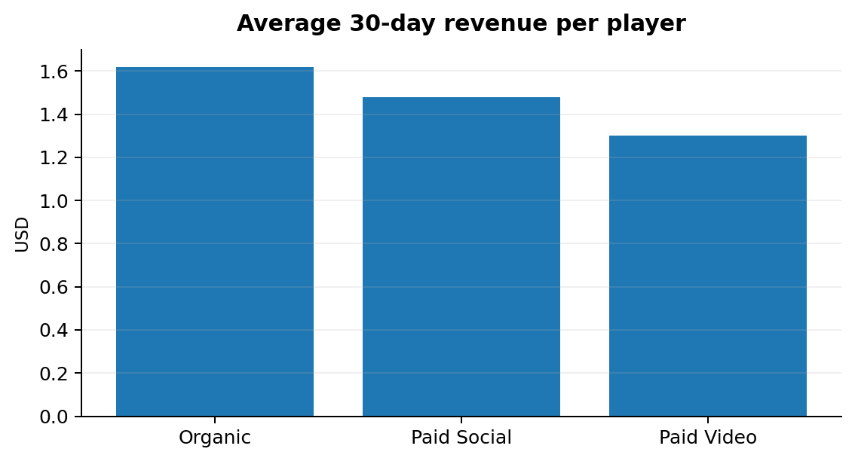
4. Acquisition Quality — Engagement Differs, Revenue Needs Adjustment
Channels: Organic, Paid Social, Paid Video.
KEY NUMBERS
STATISTICAL EVIDENCE
Metric | Organic | Paid Social | Paid Video
Avg 7d playtime | 37.29 min | 34.95 min | 44.75 min
Avg 30d revenue | $1.6185 | $1.4793 | $1.2995
Payer conversion | 8.74% | 8.68% | 7.49%
Raw Organic − Paid Video revenue: +$0.9125
95% CI: +$0.6643 to +$1.1795 | p = 0.0003
Adjusted difference: +$0.0917
95% CI: −$0.2337 to +$0.4098 | p = 0.5751

Slide 6
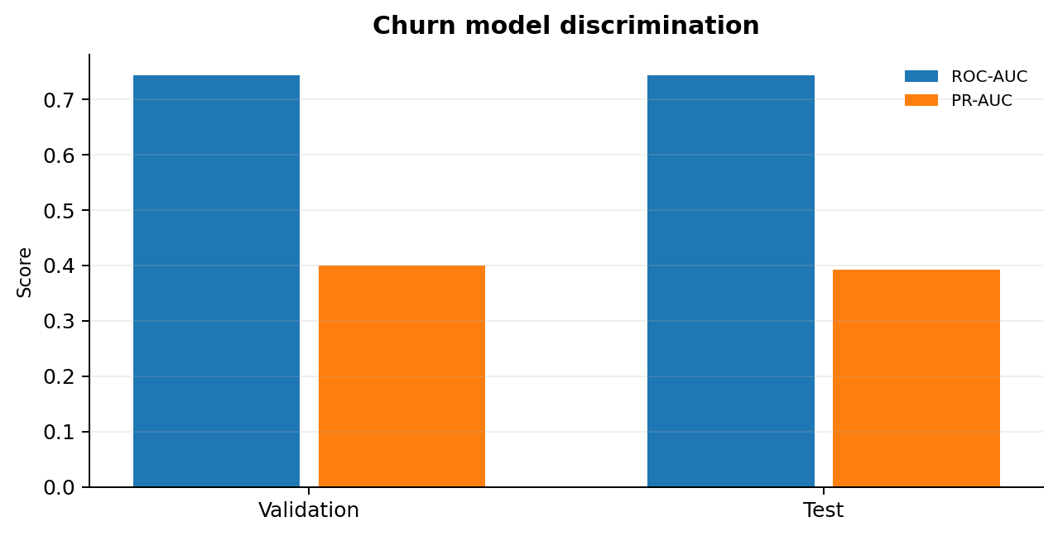
5. Churn Prediction — Identify Players at Risk Before They Leave
Target: currently active players who stop playing in the next 14 days.
CHURN DEFINITION
MODEL PIPELINE
Active at T
Player telemetry
≥1 activity record during T−6 to T
Churn = 1
Feature engineering
No activity during T+1 to T+14
Time split
Prediction period: Feb 1 – Apr 16, 2026
Logistic regression
14-day churn probability
Metric | Test
ROC-AUC | 0.7439
PR-AUC | 0.3925
Accuracy | 0.7713
F1-Score | 0.4309
TEST OBSERVATIONS
PREDICTED CHURN
ACTUAL CHURN
553,691
117,730
18.91%
21.26% of test observations
Test base rate
Threshold = 0.30: use only if offer cost and incremental retained-player value justify the targeting volume.

Slide 7
6. What Should the Business Do?
Recommendations are deliberately tied to evidence and known data gaps.
1 — Monitor acquisition mix
3 — Use churn selectively
2 — Measure channel economics
4 — Improve telemetry
Tier 4 active-player mix rose 17.65% → 45.99%.
Predicted churn does not prove an offer will work.
Raw revenue differences are composition-sensitive.
Purchase and rewarded-ad anomalies remain.
ACTION Track volume and economics by country tier.
ACTION Predict → Target → Experiment → Measure.
ACTION Add CPI/CPA → Retention → LTV → ROAS.
ACTION Validate duplicate IDs, pre-install purchases and Mar 6.
Decision principle: optimize for incremental economics, not descriptive metrics alone.

Slide 8
7. What We Know — and What We Still Need
The final readout should be explicit about uncertainty.
WE KNOW
WE DON'T KNOW
• ARPDAU fell 16.5% overall.
• Country-tier ARPDAU did not deteriorate.
• Tier 4's active-player mix increased sharply.
• Paid Video has the highest engagement among the three channels.
• Adjusted Organic–Paid Video revenue difference is not statistically established.
• Churn model reaches 0.7439 ROC-AUC on test.
• Why the acquisition mix shifted toward Tier 4.
• Channel profitability without CPI/CPA/marketing spend.
• Incremental value of a retention offer.
• Whether predicted churners are actually persuadable.
• Whether the Mar 6 ad anomaly is telemetry failure or genuine behavior.
Next: add marketing economics, run a retention-offer experiment, validate uplift, and investigate telemetry anomalies.

Slide 9
APPENDIX
Detailed evidence, outputs, methodology, judgement calls & limitations
Slides 9 onward are not part of the 8-slide Product Director readout.
Appendix

Slide 10
A1. Dataset Overview
Detailed supporting evidence
Table | Rows | Grain
player_profile | 80,295 | one row per player
player_day | 667,435 | one row per player per active day
purchase | 15,426 | one row per real-money transaction
currency_spend | 489,892 | one row per in-game currency spend
ad_view | 647,623 | one row per rewarded-ad interaction
Window
Jan 1 – Apr 30, 2026
Important context
• Install volume is not flat across the window.
• Revenue in this assignment means in-app purchase revenue.
• No marketing cost or ad revenue is present.
Appendix

Slide 11
A2. Data Quality Checks & Treatment
Detailed supporting evidence
Check | Count | Treatment / interpretation
Duplicate player IDs | 0 | No issue found
Duplicate player-day keys | 0 | No issue found
Duplicate purchase IDs | 122 | Investigated; not blindly deduplicated
Purchases before install | 114 | Excluded from lifecycle timing
Ad events outside window | 7,732 | Excluded from windowed metrics
Zero-ad-event days | 1 | Mar 6; investigate telemetry
Negative purchase amounts | 228 | Flagged for data-quality review
Ad count above cap | 0 | No cap violation found
Zero purchase amounts | 0 | No issue found
Invalid currency values | 0 | No issue found
Assignment principle
Thoughtful handling of a smaller number of real issues is
preferable to mechanically listing every anomaly.
Appendix

Slide 12
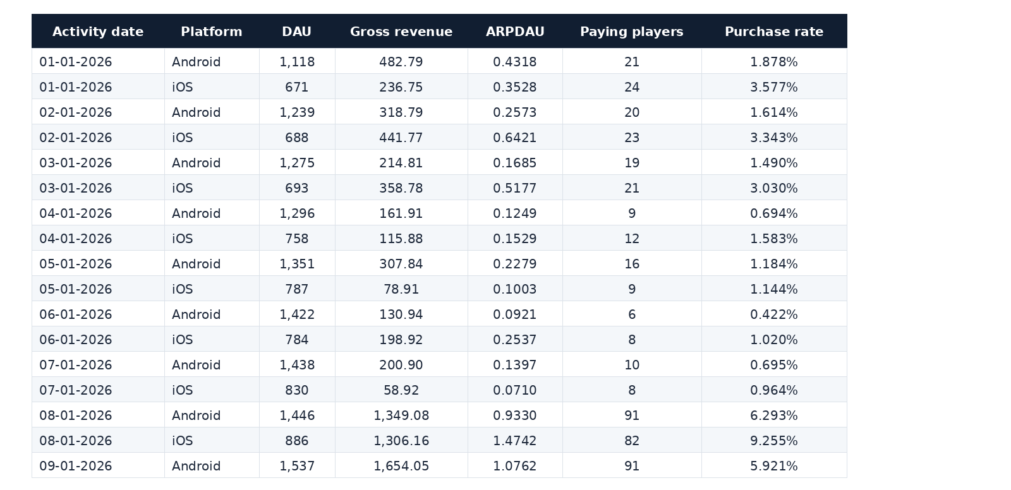
A3. Daily Health — Selected Output Rows
Detailed supporting evidence
Appendix

Slide 13
A4. Retention Cohort Grid
Detailed supporting evidence
Cohort week | Players | D1 | D7 | D14 | D30
2025-12-29 | 1229 | 45.97% | 24.25% | 18.88% | 12.77%
2026-01-05 | 2199 | 46.48% | 26.78% | 19.15% | 13.69%
2026-01-12 | 2266 | 47.75% | 26.21% | 19.86% | 14.96%
2026-01-19 | 2234 | 47.72% | 24.53% | 18.62% | 12.67%
2026-01-26 | 2193 | 47.51% | 25.95% | 21.43% | 14.77%
2026-02-02 | 2335 | 48.05% | 26.85% | 20.77% | 14.60%
2026-02-09 | 2262 | 50.44% | 25.24% | 19.72% | 14.59%
2026-02-16 | 2269 | 47.25% | 23.89% | 19.48% | 14.50%
2026-02-23 | 2744 | 46.90% | 26.75% | 18.99% | 14.10%
2026-03-02 | 3241 | 47.58% | 24.22% | 19.56% | 13.33%
2026-03-09 | 3734 | 47.27% | 26.62% | 19.28% | 13.20%
2026-03-16 | 4337 | 47.43% | 25.27% | 19.18% | 13.72%
2026-03-23 | 4943 | 48.80% | 24.80% | 20.07% | 14.06%
2026-03-30 | 5365 | 46.15% | 26.37% | 19.24% | 13.17%
2026-04-06 | 6065 | 48.34% | 25.90% | 19.03% | Not eligible
2026-04-13 | 6551 | 47.63% | 24.29% | 19.84% | Not eligible
2026-04-20 | 6543 | 48.08% | 24.28% | Not eligible | Not eligible
2026-04-27 | 3785 | 46.85% | Not eligible | Not eligible | Not eligible
Recent cohorts are marked not eligible where the observation window is too short.
Appendix

Slide 14
A5. Revenue Concentration
Detailed supporting evidence
Ranked payer segment | Revenue share
Top 1% | 9.4409%
Top 10% | 48.0806%
Top 50% | 90.2277%
Population ranked: paying players only.
Interpretation: revenue is highly concentrated among the payer base;
this makes payer behavior an important monetization lever.
Appendix

Slide 15
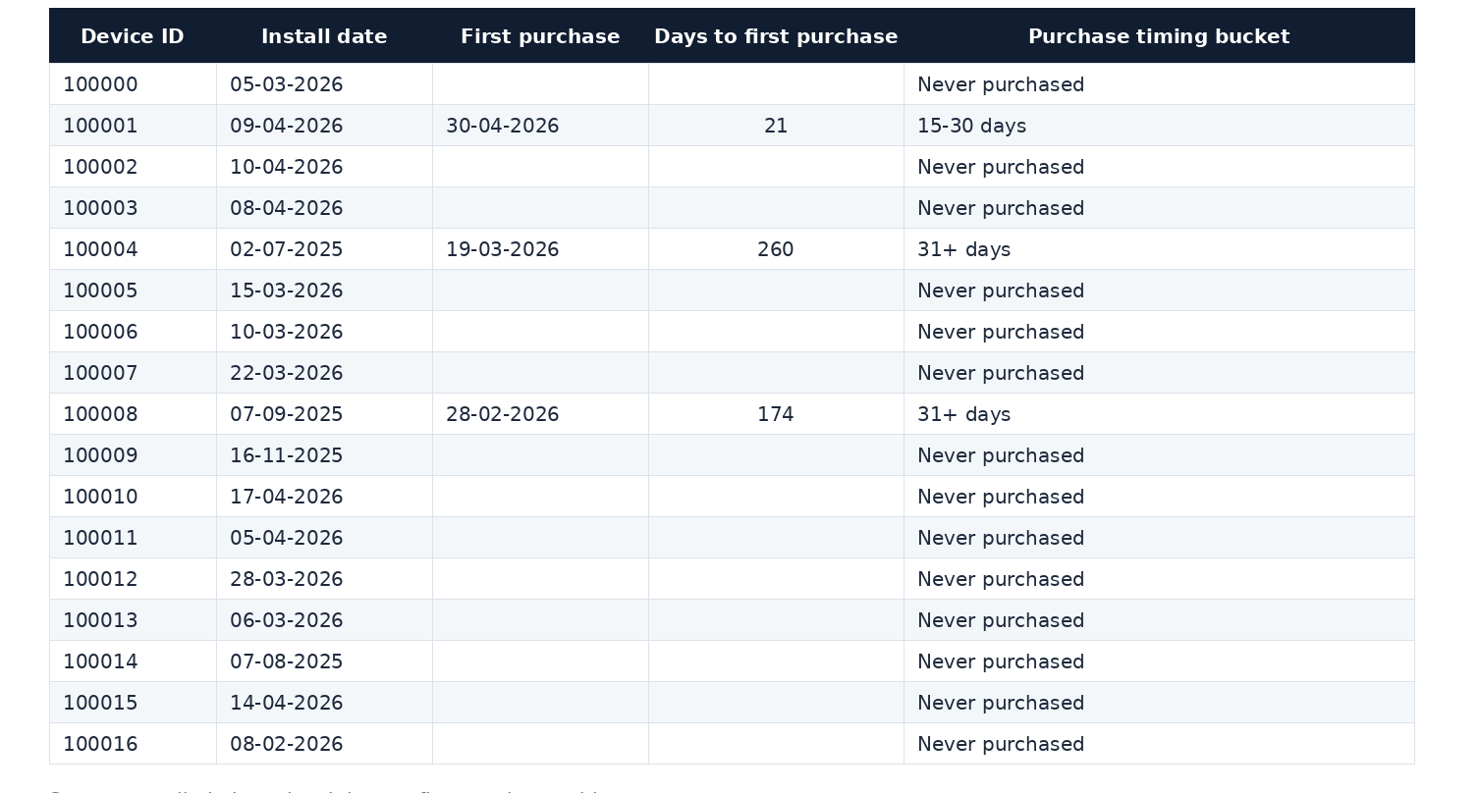
A6. Time to First Purchase – Selected Player Rows
Detailed supporting evidence
Required interpretation
• Define the time origin as install.
• Show distribution/buckets.
• Report never-purchase share.
• Mention any censoring/window limitation.
Appendix

Slide 16
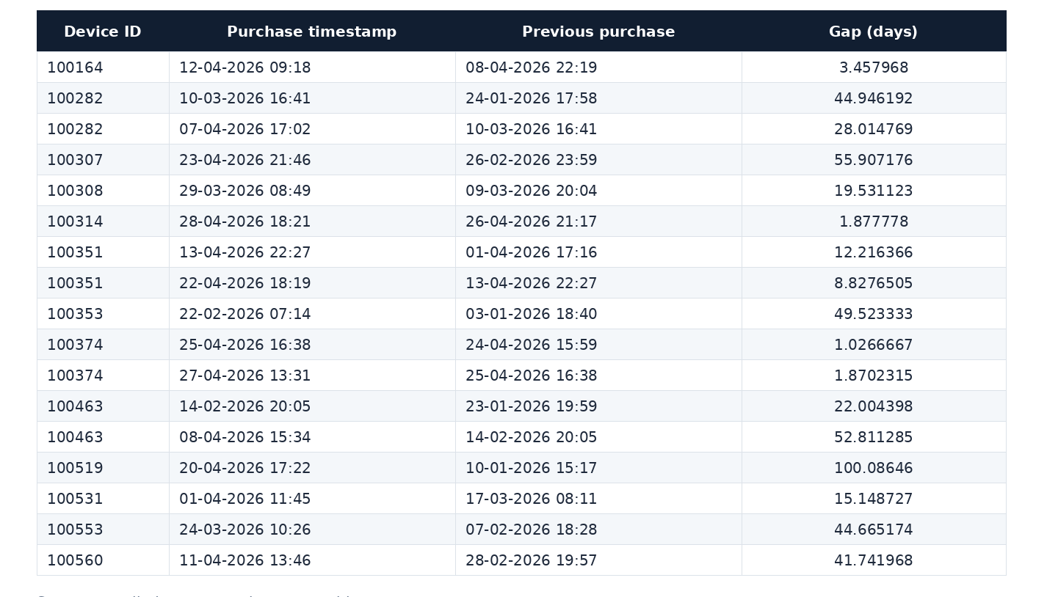
A7. Repeat Purchase Gap – Selected Player Rows
Detailed supporting evidence
Method
Use a window function such as LAG(event_ts) to
calculate consecutive purchase gaps.
Business use
Use the distribution to understand purchase cadence and timing
of repeat monetization opportunities.
Appendix

Slide 17
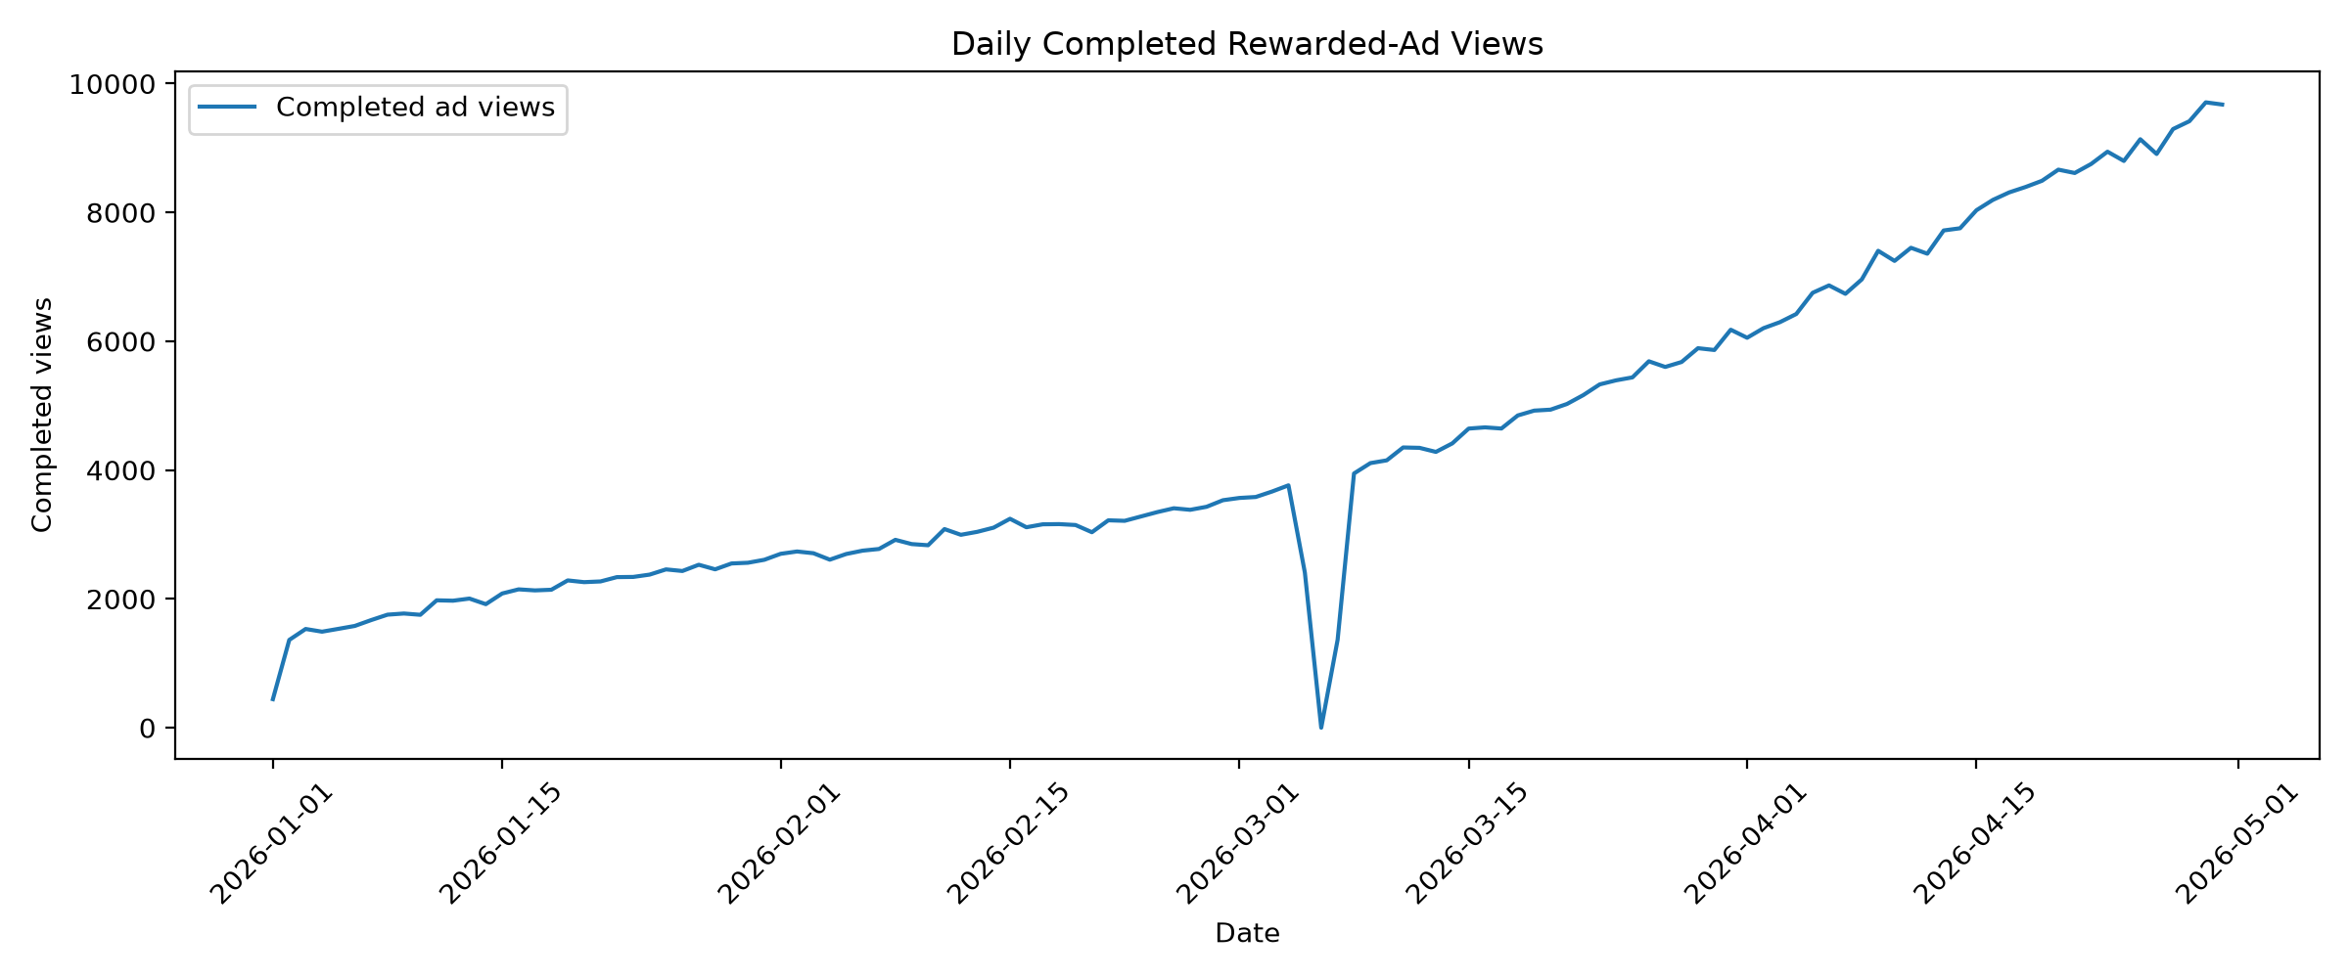
A8. Rewarded Ads — Cap Hits & Daily Views
Detailed supporting evidence
Cap | Ad-watching player-days | Cap hits | Hit rate
5 | 294,776 | 3,026 | 1.0265%
8 | 102,049 | 13 | 0.0127%
Product implication
Cap hits are rare. If a future dataset shows routine cap hits, this becomes
a product-capacity question as well as a data question.
Known anomaly: Mar 6, 2026 has zero recorded ad events.
Appendix

Slide 18
A9. ARPDAU Decomposition
Detailed supporting evidence
Component | Change
Overall ARPDAU | −$0.057886
Mix effect | −$0.075772
Within-tier effect | +$0.017886
Share of total change from mix | 130.90%
Sensitivity excluding purchases before install
Metric | Recorded | Post-install
First 30d ARPDAU | $0.351136 | $0.349754
Last 30d ARPDAU | $0.293250 | $0.290935
Interpretation: the mix shift is the dominant aggregate explanation; within-tier performance improved.
Appendix

Slide 19
A10. Acquisition — Raw Comparison
Detailed supporting evidence
Metric | Organic | Paid Social | Paid Video
Population | 20,159 | 17,857 | 15,473
Avg 7d playtime | 37.288 min | 34.946 min | 44.752 min
Median 7d playtime | 20.4 min | 19.9 min | 33.5 min
Avg sessions | 6.676 | 6.411 | 8.269
Avg active days | 1.803 | 1.777 | 2.295
Avg 30d revenue | $1.6185 | $1.4793 | $1.2995
Median 30d revenue | $0 | $0 | $0
Payer conversion | 8.74% | 8.68% | 7.49%
Country-tier mix and install-month mix differ across channels; raw comparisons therefore require adjustment.
Observed channel engagement: Paid Video has the highest average playtime, sessions and active days.
Appendix

Slide 20
A11. Acquisition — Statistical Evidence
Detailed supporting evidence
Comparison | Difference | 95% CI | p
Organic − Paid Video playtime | +4.6316 min | +3.5021 to +5.8096 | 0.0003
Organic − Paid Video raw revenue | +$0.9125 | +$0.6643 to +$1.1795 | 0.0003
Adjusted revenue | + $0.0917 | −$0.2337 to +$0.4098 | 0.5751
Adjustment controls
Country tier + install month
Interpretation
The raw revenue gap is statistically significant, but the adjusted difference
is not statistically established (p = 0.5751).
Business significance also requires CPI/CPA, LTV and ROAS — none are in the extract.
Appendix

Slide 21
A12. Churn — Setup & Feature Design
Detailed supporting evidence
Item | Definition / value
Prediction target | Currently active player at T
Active at T | Activity on ≥1 day in T−6…T
Churn = 1 | No activity T+1…T+14
Prediction dates | Feb 1 – Apr 16, 2026
Observations | 1,787,831
Churn rate | 19.63%
Feature groups
• Profile & acquisition
• 7/14/30-day activity and engagement
• Progression and level movement
• Purchases and time since purchase
• Currency spend
• Rewarded-ad starts/completions and completion rate
38 original features → 63 processed features after encoding.
Appendix

Slide 22
A13. Churn — Time-Based Train / Validation / Test Split
Detailed supporting evidence
Split | Dates | Observations | Churn rate
Train | Feb 1 – Mar 15 | 799,292 | 20.10%
Validation | Mar 16 – Mar 31 | 434,848 | 19.69%
Test | Apr 1 – Apr 16 | 553,691 | 18.91%
Why time-based?
The model is intended for future churn prediction. A chronological split better reflects deployment than a random split and reduces leakage from future behavior.
Appendix

Slide 23
A14. Churn — Model Evaluation
Detailed supporting evidence
Metric | Validation | Test
Accuracy @ 0.30 | 0.7693 | 0.7713
Precision @ 0.30 | 0.4175 | 0.4070
Recall @ 0.30 | 0.4345 | 0.4576
F1 @ 0.30 | 0.4258 | 0.4309
ROC-AUC | 0.7430 | 0.7439
PR-AUC | 0.3999 | 0.3925
Where it works badly: precision for churn is ~41%, meaning many targeted observations would not actually churn.
This is why threshold selection and offer economics matter more than accuracy alone.
Appendix

Slide 24
A15. Churn — Threshold & Confusion Matrix
Detailed supporting evidence
Metric | Threshold 0.30
Precision | 40.70%
Recall | 45.76%
F1 | 43.09%
Predicted churn | 117,730 (21.26%)
Actual churn | 104,714 (18.91%)
Test confusion matrix
 | Pred. non-churn | Pred. churn
Actual non-churn | 379,168 | 69,809
Actual churn | 56,793 | 47,921
Threshold principle
Choose the threshold where the expected incremental value of retained players exceeds the cost of offers and wasted targeting.
Appendix

Slide 25
A16. Limitations, Dead Ends & What I Would Do With Another Week
Detailed supporting evidence
Known limitations
Next week
• No marketing spend, CPI or CPA.
• No ad revenue in player telemetry.
• No support tickets or survey responses.
• No causal acquisition experiment.
• No retention-offer experiment.
• Optional Task 4b (90-day install revenue) not pursued.
• Add marketing economics and LTV/ROAS.
• Run retention-offer A/B testing.
• Measure incremental retention by churn-risk segment.
• Consider uplift modeling for treatment targeting.
• Investigate rewarded-ad and purchase telemetry anomalies.
• Stress-test acquisition conclusions across additional cohorts.
Depth was prioritized over optional breadth, consistent with the assignment's guidance.
Appendix

Slide 26
A17. Technical Stack & Analysis Workflow
Tools and technologies actually used across the assignment analysis
Programming & Querying
Python Libraries
• Python — analysis, feature engineering and ML
• SQL — analytical queries and data preparation
• DuckDB — local analytical database / SQL execution
• Pandas — tabular data manipulation
• NumPy — numerical operations
• Matplotlib — charts and visualizations
• scikit-learn — preprocessing, logistic regression and evaluation
Analysis Workflow
Development Environment
• Source CSVs → DuckDB / SQL
• Tasks 1–3 → descriptive + statistical analysis
• Task 4 → feature engineering → time split → ML
• Outputs → business interpretation and recommendations
• Jupyter Notebook — exploratory analysis and outputs
• VS Code — code editor / development environment
• Python scripts — repeatable Task 4 pipeline
• CSV / TXT / PPTX outputs — evidence and final readout
| Appendix

