Slide 1
Multimedia
An Overview of Components, Advantages and Disadvantages

Slide 2
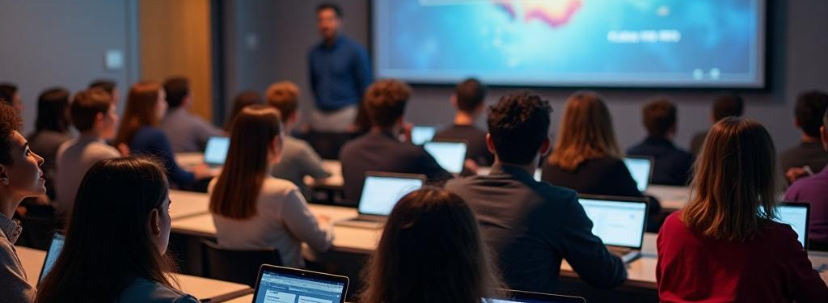
Introduction
Multimedia means using a mix of different types of content like text, pictures, sound, video, and animation to share information or tell a story. Instead of just reading words, you can see, hear, and even interact with it. Multimedia makes learning, entertainment, and communication more fun and interesting.

Slide 3
01
Components

Slide 4
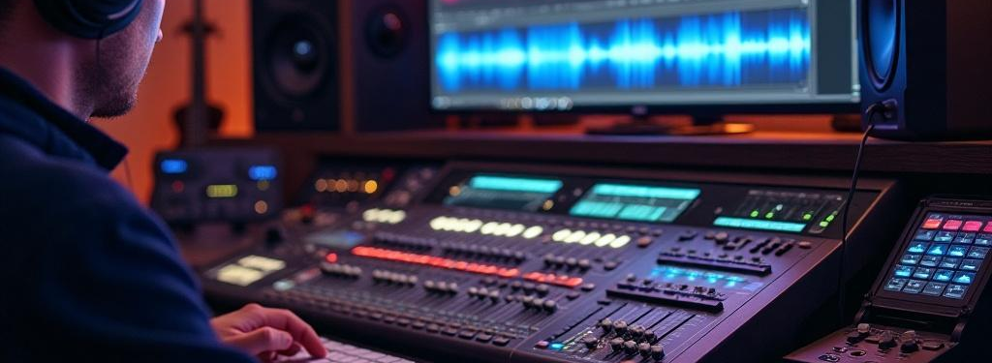
Audio Elements
Audio in multimedia includes things like talking, music, and sound effects. It helps make the experience more fun and real. Good quality sound can help people enjoy it more and remember things better.

Slide 5
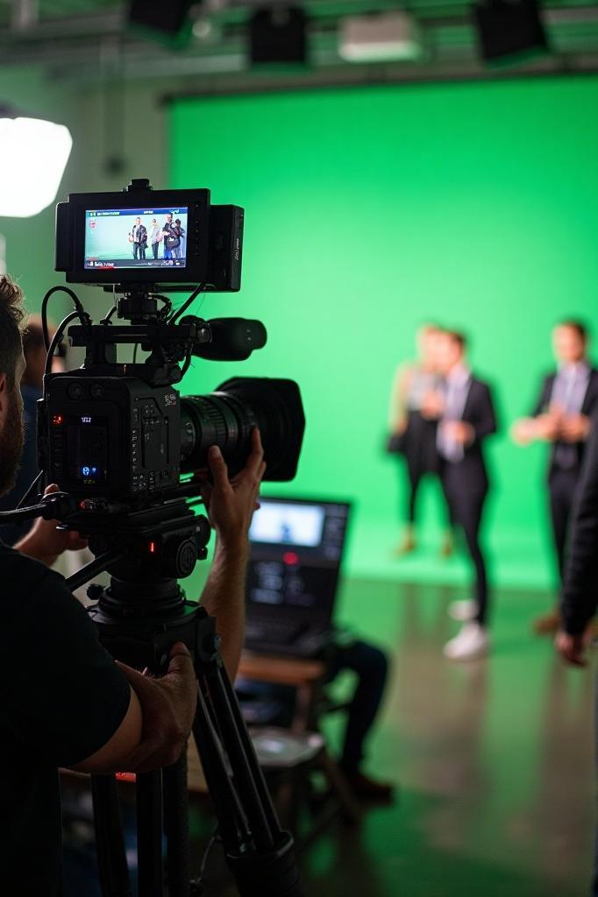
Video Elements
Videos in multimedia are a mix of pictures and sounds, like animations, real-life recordings, or slideshows. They are great for grabbing attention and making hard ideas easier to understand.

Slide 6

Graphic Elements
Graphics in multimedia include things like pictures, diagrams, and infographics. They help tell a story and make tricky ideas easier to get. Good visuals also help people stay interested and remember information better.

Slide 7
Text Elements
Text in multimedia includes words, sentences, and written information. It helps explain ideas clearly and gives important details. Good text makes it easier for people to understand and follow along with the content.

Slide 8
02
Advantages

Slide 9

More Engagement
Multimedia captures the audience's attention more effectively than traditional presentations. By incorporating various formats such as audio, video, and interactive content, it keeps users engaged and encourages active participation, leading to a more dynamic learning experience.

Slide 10
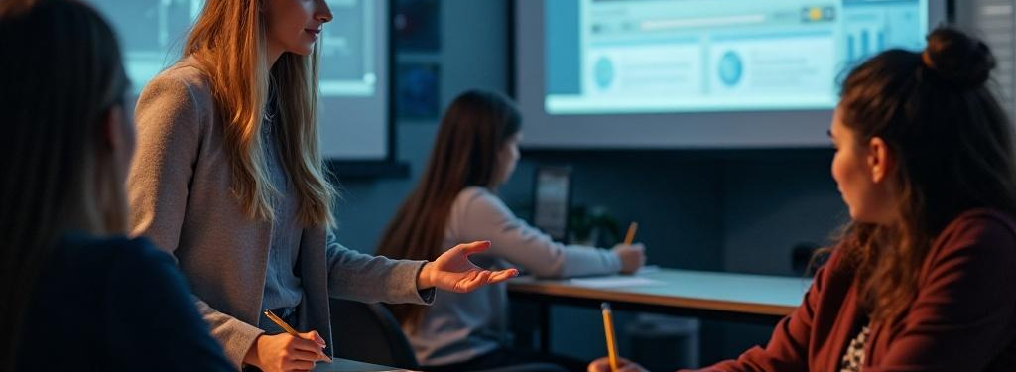
Improved Learning
Using pictures, sounds, and hands-on activities together in multimedia makes it easier for people to remember things. Studies show that when we learn through different ways at the same time, we understand better and remember it for a longer time.

Slide 11
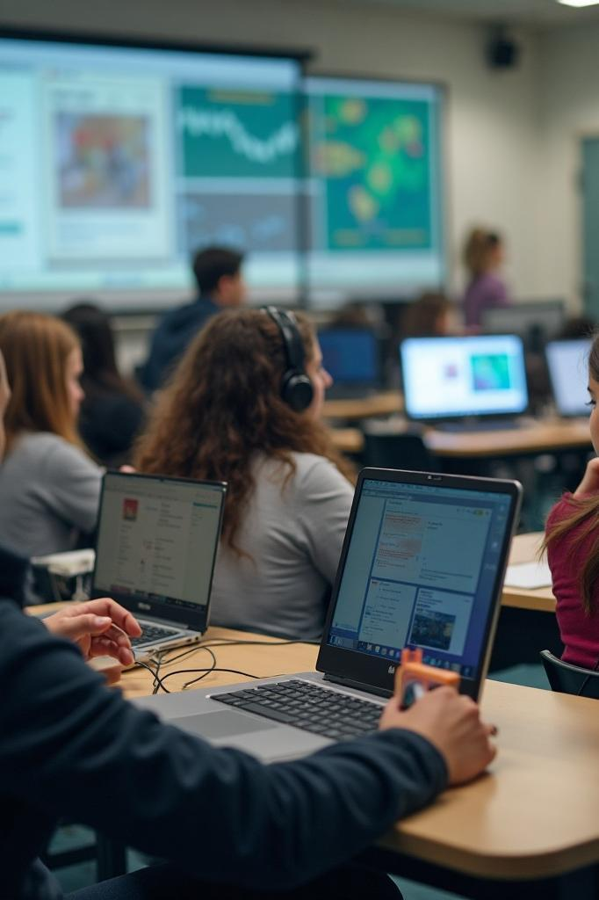
Diverse Learning Styles
Multimedia works for different ways people learn. Some understand better with pictures, while others like to listen to explanations or try things themselves. By using all these methods, multimedia helps everyone learn better and makes sure more people can understand the information

Slide 12
03
Disadvantages

Slide 13
Disadvantages of Multimedia
Can be Distracting: Too many images, sounds, or animations can make it hard to focus on the main idea and distract from the message.
Requires Technology: To use multimedia, you need devices like computers, projectors, or internet access, which not everyone has.
Takes Time to Create: Making multimedia content (like videos or interactive lessons) can take a lot of time and effort, especially when compared to just using text.
Expensive: High-quality multimedia tools, software, or equipment can be costly, which can be a problem for schools or small businesses.
Can Overload Information: Sometimes, too much multimedia content can overload the audience with information and make it harder to remember key points.

Slide 14

Conclusions
In short, multimedia is a powerful tool that uses sounds, videos, and images to make information more engaging and easier to understand. It works well for all kinds of things—whether it's teaching, sharing ideas, or telling stories. When used effectively, multimedia can grab attention, improve memory, and fit different ways people learn.

