Slide 1
Building Deterioration Measurement with Deep Learning
Junho Lee, Hyesu Jang, Myunghwan Jeon
INDEX
- Introduction
- Objective
- Dataset
- Learning
- Expected Result

Slide 2

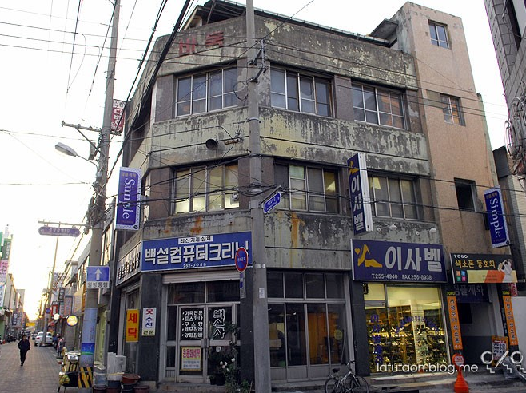
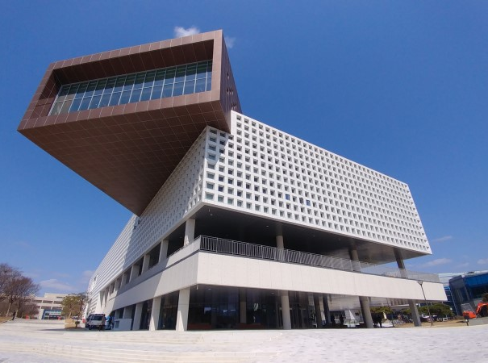
Introduction
Building Deterioration Measurement with Deep Learning
- Introduction
- Objective
- Training
- Application
- Future works
Old Building
New Building

Slide 3
Introduction
Building Deterioration Measurement with Deep Learning
- Introduction
- Objective
- Training
- Application
- Future works
Old Building
New Building
All-generation adaptive building
State of the art design
Find the reconstruction region
Durability of construction material
Design?
Properties?

Slide 4
Objective
Building Deterioration Measurement with Deep Learning
- Introduction
- Objective
- Training
- Application
- Future works
Check existing buildings that have to be replaced
It is hard to check all building with detailed examination.
We will find and sort out the candidates that have to be replaced.
Find optimum point between design & durability
With the obtained data, we could classify which building is deteriorated externally.
At the same time, real durability of the building must be considered

Slide 5
Training
- Introduction
- Objective
- Training
- Application
- Future works
Data Acquisition
Data Preprocessing
Our own data
Collect from google street view
Collect from google Image crawling
Manual dataset from KAIST
Public data
- ImageNet dataset : Synset
- Cityscape
Data Augmentation
Temporal(Daytime) change
Viewpoint change(Affine transform)
Contrast / Brightness etc.

Slide 6
Application
- Introduction
- Objective
- Training
- Application
- Future works
Maintaining the City
Estimate the durability of the structure, with simple method rather than expensive examination.
Preprocess the lists of examination to simplify the procedure.
Early determine the probability of crack from the structure view image
Designing the City
From the correspondence obtained from the research, determine the key factor behind the looking-age of the structure, which is a key factor of harmonic structure design.
Design and Build more familiar-looking city from the research above.

Slide 7

Future works
- Introduction
- Objective
- Training
- Application
- Future works

