Slide 1
Selenium
Selenium is one of the most widely used open source Web UI (User Interface) automation testing suite.It was originally developed by Jason Huggins in 2004 as an internal tool at Thought Works.
Selenium supports automation across different browsers, platforms and programming languages.
Selenium can be easily deployed on platforms such as Windows, Linux, Solaris and Macintosh.
Moreover, it supports OS (Operating System) for mobile applications like iOS, windows mobile and android.

Slide 2
Pros of Selenium
Selenium supports a variety of programming languages through the use of drivers specific to each language.
Languages supported by Selenium include C#, Java, Perl, PHP, Python and Ruby.
Currently, Selenium Web driver is most popular with Java and C#.
Selenium test scripts can be coded in any of the supported programming languages and can be run directly in most modern web browsers.
Browsers supported by Selenium include Internet Explorer, Mozilla Firefox, Google Chrome and Safari.
Selenium can be used to automate functional tests and can be integrated with automation test tools such as Maven, Jenkins, & Docker to achieve continuous testing.
It can also be integrated with tools such as TestNG, & JUnit for managing test cases and generating reports.

Slide 3
Launch Browser using Selenium Java
How Selenium webdriver communicates with Browser:
Selenium webdriver communicates with the browser via the JSON wire protocol which is a Restful service JSON. The selenium commands are passed to drivers via JSON wire protocol HTTP commands Json and then drivers communicate with browsers.
Each browser has different drivers to communicate with Selenium and browsers.
The drivers are,
Chromedriver - Chrome browser Geckodriver - Firefox browser MicrosoftWebDriver - Edge browser Opera driver - Opera browser Safari driver - Safari browser

Slide 4
To Invoke Chrome Browser
package test; import org.openqa.selenium.WebDriver; import org.openqa.selenium.chrome.ChromeDriver; import org.openqa.selenium.chrome.ChromeOptions; public class SeleniumTest { public static void main(String[] args) { ChromeOptions options = new ChromeOptions();
// Set the path of the chromedriver, in our case it is placed in root folder System.setProperty("webdriver.chrome.driver", "chromedriver.exe"); WebDriver driver = new ChromeDriver(options); driver.get("https://qafeast.com/"); driver.quit(); } }

Slide 5
Locators in Selenium webdriver
Locators are the identification of HTML elements. The Selenium web driver interacts with HTML controls in the page through the locators.
Below are the locators supported by the selenium web driver to identify the element,
By Id
By Name
By ClassName
By Tag name
By Link text
By Partial link text
By Css
By Xpath

Slide 6
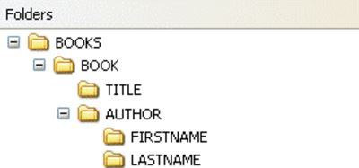
Find the Path Of The LastName

Slide 7
Best Practices to use Locators:
In the web page ID will be mostly unique, the unique element appears to be faster when selenium webdriver query the HTML document. If the ID is not available or not unique then next preference is Name then Class name, Tagname, Xpath/CSS. If there is a hyperlink with unique text then Link text or partial link text can be used.

Slide 8
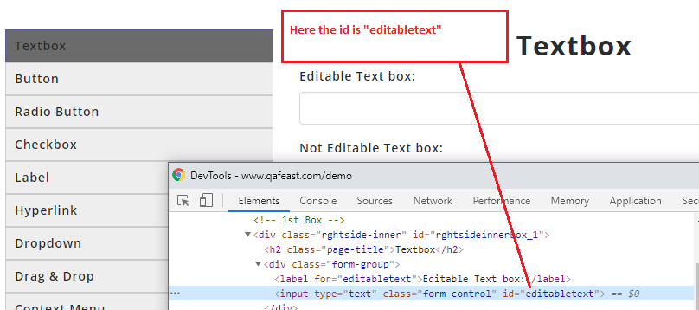

Slide 9
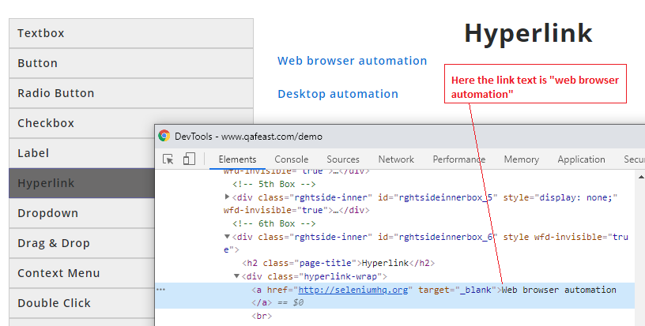

Slide 10
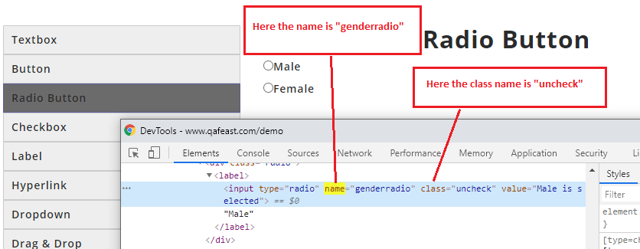

Slide 11
ClassName:
In the above picture class name "uncheck"
Tag Name:
In the above picture, the start tag input is the tag name
Link Text and Partial Link text:
In the below image the Link text is "Web browser automation" and if the text is dynamic and few texts is static then it is Partial link text

Slide 12
CSS:
CSS is Cascading Style Sheets and it is used to apply the structure and styles to the HTML controls in the webpage. To identify the CSS for the text box that appears in the above image 1
Css - #editabletext
XPath
XPath is a major element in the XSLT standard.
XPath can be used to navigate through elements and attributes in an XML document.
XPath is defined as XML path, XPath technique is to find the XML path of the locator To identify the XPath for the text box appear in the above image 1 Xpath - //input[@id='editabletext']

Slide 13
How to use Locators:
We can use the locator by,
findelement()
findelements()
driver.findElement(By.id("")) driver.findElement(By.name("")) driver.findElement(By.className("")) driver.findElement(By.linkText("")) driver.findElement(By.partialLinkText("")) driver.findElement(By.Xpath("")) driver.findElement(By.css(""))

Slide 14
How to handle text box in Selenium Java
There are different operations we can perform in the text box using the Selenium web driver.
The operations are:
Type in the text box: To type , sendKeys() method used to pass the Keyboard keys or text into editable elements (text bar, text area) without replacing the previously available content.
Editable or not: isEnabled() method used to verify if the web element is enabled or disabled within the webpage.
Get the text: getAttribute function is used to get the value
Clear: We can clear any editable field using a clear() method present in selenium, most of the time clear() will be used when the text typed.
Navigate to https://www.qafeast.com/demo, and click the Text box tab.
Press F12 on the keyboard and inspect the Text box.

Slide 15
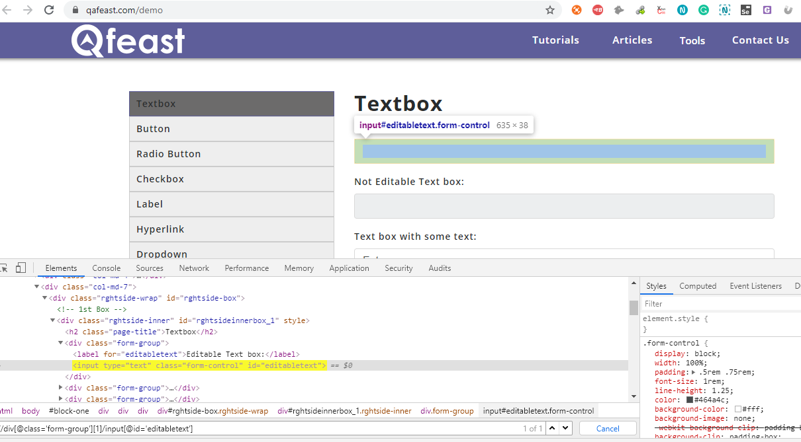

Slide 16
To type in the text box
To type the text in the text box, sendKeys() method is used.
Syntax:
driver.findElement(By.locator("<locator value> ")).sendKeys("values");
Example:
driver.findElement(By.xpath("//div[@class='form-group'][1]/input[@id='editabletext']")).sendKeys("Admin");

Slide 17
To check Editable or not:
To check whether the Text box is editable or not, the method .isEnabled() is provided.
Syntax:
driver.findElement(By.locator("<locator value>")).isEnabled()
Example:
WebElement ele = driver.findElement(By.xpath("//div[@class='form-group'][1]/input[@id='editabletext']")); if (ele.isEnabled()) { System.out.println("Text box is enabled"); } else{ System.out.println("Text box is not enabled"); }

Slide 18
Get the text: To get the text from the text box
To get the typed text in the Text box , getAttribute function is used
Syntax:
driver.findElement(By.locator("")).getAttribute("value");
Example:
WebElement typedText = driver.findElement(By.xpath("//div[@class='form-group'][1]/input[@id='editabletext']")); typedText.getAttribute("value"); System.out.println(typedText);

Slide 19
To clear the text in the text box:
To clear the Text in the text box clear() method is used.
Syntax:
driver.findElement(By.locator("")).clear();
Example:
driver.findElement(By.xpath("//div[@class='form-group'][3]/input[@id='editabletext']")).clear();

Slide 20
How to handle Button in Selenium Java
There are different operations we can perform on the button using a Selenium web driver.
The operations are:
To click
Get the color of the button
To check the button is clickable or not
Navigate to https://www.qafeast.com/demo,click the button tab.
Press F12 on the keyboard and inspect the button.

Slide 21
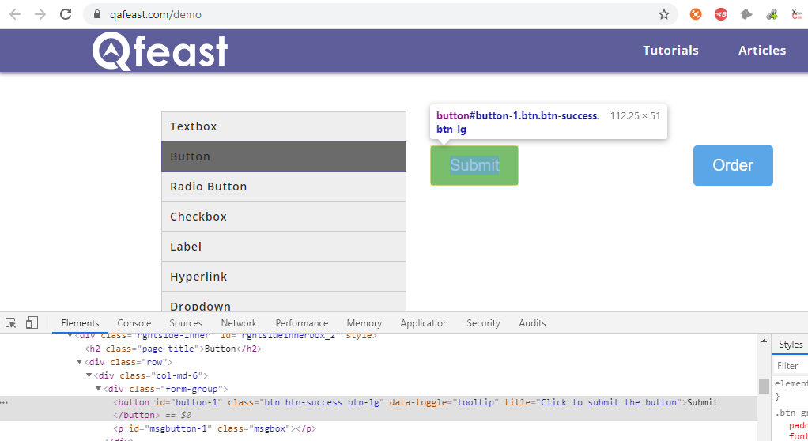

Slide 22
To click the button:
To click the button or any control on the webpage click() method is used.
Syntax:
driver.findElement(By.<locator>("<locator value>")).click();
Example:
driver.findElement(By.id("button-1")).click();

Slide 23
To get the colour of the button:
To get the colour of the button we can use getCssValue() function
Syntax
driver.findElement(By.("locator value ")).getCssValue("background-color");
Example
String buttonColor = driver.findElement(By.id("button-1")).getCssValue("background-color"); String buttonTextColor =driver.findElement(By.id("button-1")).getCssValue("color"); System.out.println(buttonColor); System.out.println(buttonTextColor);

Slide 24
To verify whether the button is clickable or not
To check whether the button is clickable or not , isEnabled() function is used.
The isEnabled() function returns a boolean value, based on the boolean value we can determine whether it is clickable or not.
Syntax:
driver.findElement(By.<locator> ("<locator value> ")).isEnabled();
Example: WebElement Button = driver.findElement(By.id("button-2")); if(Button.isEnabled()){ System.out.println("Button is enabled"); } else { System.out.println("Button is not enabled"); }

Slide 25
How to handle radio button in selenium Java
There are different operations we can perform on the radio button using selenium web driver.
Most operations are:
To select the radio button
To determine which Radio button is selected
Navigate to https://www.qafeast.com/demo, and click the radio button tab.
Press F12 on the keyboard and inspect the radio button.

Slide 26
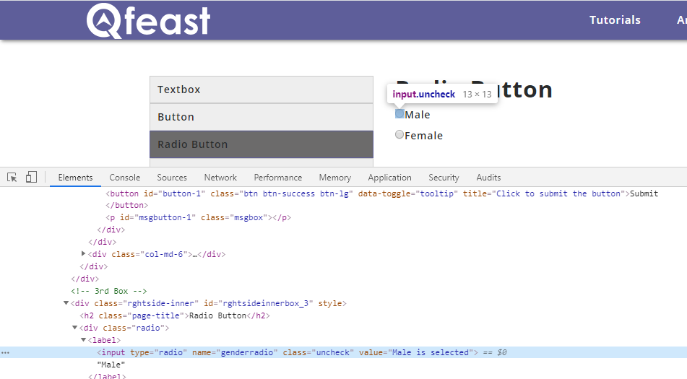

Slide 27
Select the radio button:
Selenium webdriver doesn't provide a special method to select the radio button, we can use click() method to select the radio button.
Syntax:
driver.findElement(By.<locator("<locator value")).click();
Example:
driver.findElement(By.xpath("//label[text()='Male']")).click();

Slide 28
To check which one is selected:
isSelected() function is used to know which radio button is Selected. isSelected() function return the boolean value.
Syntax:
driver.findElement(By.<locator("<locator value ")).isSelected();
Example:
boolean rdBtn = driver.findElement(By.xpath("//input[@value='Male is selected']")).isSelected(); if (rdBtn) { System.out.println("Male is selected"); } else { System.out.println("Male is not selected"); }

Slide 29
Using getAttribute() function we can determine using the checked property
String rdBt = driver.findElement(By.xpath("//input[@value='Female is selected']")).getAttribute("checked"); System.out.println(rdBt);
If the Radio button is selected then it returns true otherwise it returns false.

Slide 30
How to handle check box in Selenium Java
There are different operations we can perform on the checkbox using Selenium webdriver.
The operations are:
Check/Uncheck
Editable or not Editable
Selected or Not Selected
Navigate to https://www.qafeast.com/demo , and click the checkbox tab.
Press F12 on the keyboard and inspect the checkbox.

Slide 31
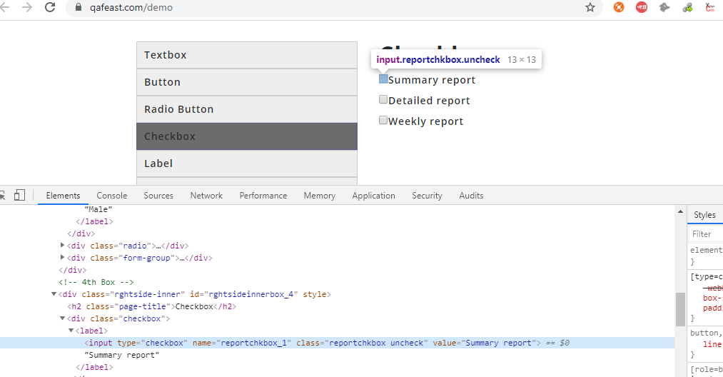

Slide 32
Check/uncheck:
Selenium webdriver doesn't provide a special method to select the check box, we can use click() method to select the radio button.
WebElement checked = driver.findElement(By.name("reportchkbox_1")); checked.click();
Editable or not:
Chechbox may not be editable sometimes, to determine whether it is editable or not we can use isEnabled() function
WebElement checked = driver.findElement(By.name("reportchkbox_1")); boolean isSelected = checked.isEnabled(); if (isSelected) {
System.out.println("Check box is Enabled and Editable");
}else{
System.out.println("Check box is not Enabled and Editable"); }

Slide 33
Selected or not selected :-
To verify which check box is checked, we can use isSelected() function
WebElement checked = driver.findElement(By.name("reportchkbox_1")); boolean isSelected = checked.isSelected(); if (isSelected) { System.out.println("Check box is selected"); }else{ System.out.println("Check box is not selected"); }
Using getAttribute() function we can determine using checked property, if the checkbox is checked then it returns true or null if it is not checked
String rdBt = driver.findElement(By.name("reportchkbox_1")).getAttribute("checked");
System.out.println(rdBt );

Slide 34
How to handle drop down in selenium Java
There are different operations we can perform on the dropdown using a selenium web driver.
The main operations are:
Select the dropdown value
Deselect the dropdown
Get the options in the dropdown
Dropdown is Editable or not
Navigate to https://www.qafeast.com/demo,click the dropdown tab.
Press F12 in the keyboard and inspect dropdown.

Slide 35
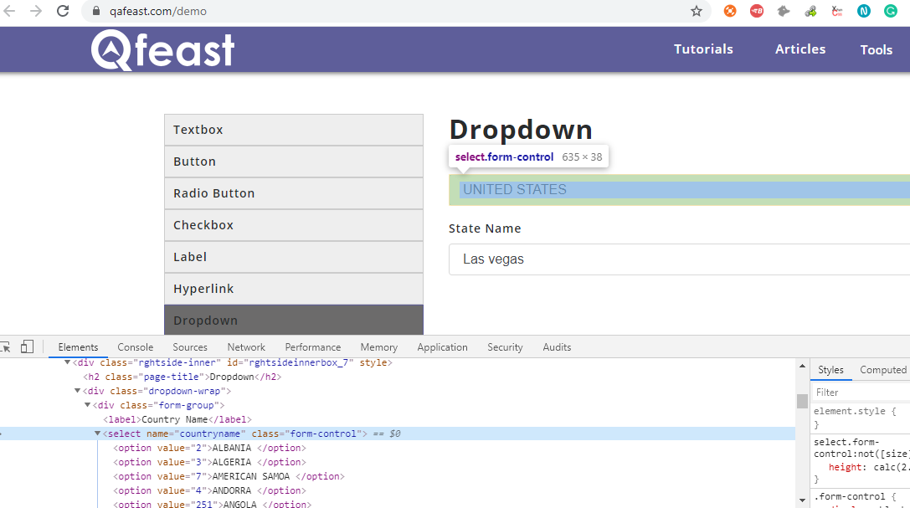

Slide 36
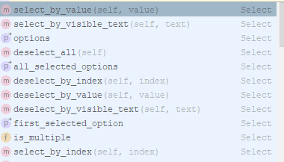
Selenium webdriver provides a select class to do the various actions in the dropdown. The actions are to select the dropdown value, deselect the selected option, and get the first option.

Slide 37
Select the dropdown value:
Selenium webdriver provides a Select class to select the dropdown value based on the Index, by value, and by visible Text. And the dropdown in the HTML page should have Select Tag otherwise we cannot use Select class
Syntax:
Select drpCountries = new Select(driver.findElement(By.<locator(""))); drpCountries.selectByVisibleText("");</locator
Example:
Select drpCountries = new Select(driver.findElement(By.name("countryname"))); drpCountry.selectByVisibleText("ALBANIA "); drpCountry.selectByIndex(0); drpCountry.selectByValue("2");

Slide 38
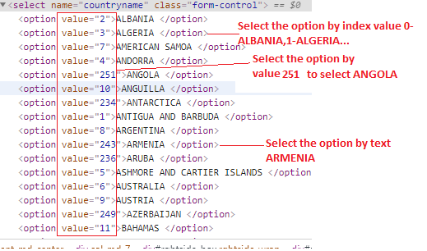

Slide 39
Deselect the dropdown:
We can deselect the selected option, only when the dropdown is multi select that is when if not then selecting deselect function will throw an error "You may only deselect options of a multi-select" There are different methods to deselect the select options. deselectall,deselectbyvisibletext,deselectbyvalue,deselectbyindex
Syntax:
Select drpCountries = new Select(driver.findElement(By.); drpCountries.deselectByValue("");
Example :
Select drpCountries = new Select(driver.findElement(By.name("countryname"))); drpCountries.deselectByValue("");

Slide 40
Get the options in the dropdown:
We may need to verify the options available in the drop-down are the expected ones, to get the options available in the dropdown getOptions() function is used, it will return the list of options.
Example:
Select dropDown = new Select(driver.findElement(By.name("countryname"))); List elementCount = dropDown.getOptions(); int itemSize = elementCount.size(); System.out.println(elementCount.size()); for(int i = 0; i < itemSize ; i++){ System.out.println(dropDown.getOptions().get(i).getText()); }
Editable or not:
To verify the dropdown is editable or not isEnabled() is used, it will return the boolean value to determine.
Example:
WebElement drop= driver.findElement(By.name("countryname")); if(drop.isEnabled()){ System.out.println("drop down menu is editable"); }else{ System.out.println("drop down menu is not editable"); }

Slide 41
How to switch over window in Selenium Java
Switch to the window: Like Iframe, selenium webdriver handles the newly opened window from the current session of the web application. To do action in a newly opened window the selenium webdriver needs to switch over the window.
getWindowHandles - helps in getting the handles of all the windows opened, window()- helps in switching between the windows
Navigate to https://www.qafeast.com/demo, and click the window tab.
Click the hyperlink "Click here" to view the new window
Switch to window:
String parentHandle = driver.getWindowHandle(); // get the current window handle for (String winHandle : driver.getWindowHandles()) { driver.switchTo().window(winHandle); // switch focus of WebDriver to the next found window handle (that's your newly opened window) // Print the new window url System.out.println(driver.getCurrentUrl()); } // Close the current window that is newly opened window in focus. driver.close(); // Switch to Parent window driver.switchTo().window(parentHandle); // print the parent window url System.out.println(driver.getCurrentUrl());
Close the newly opened window when done
driver.close(); //
Switch back to the original window
driver.switchTo().window(parentHandle); // switch back to the original window

Slide 42
How to automate file upload in Selenium Java
Upload: Uploading files in WebDriver is done by using the send_keys() method when the type is "file", entering the path to the file will be sufficient to be uploaded.
Navigate to https://www.qafeast.com/demo,click the upload and download tab.
Press F12 in the keyboard and inspect Choose File button

Slide 43
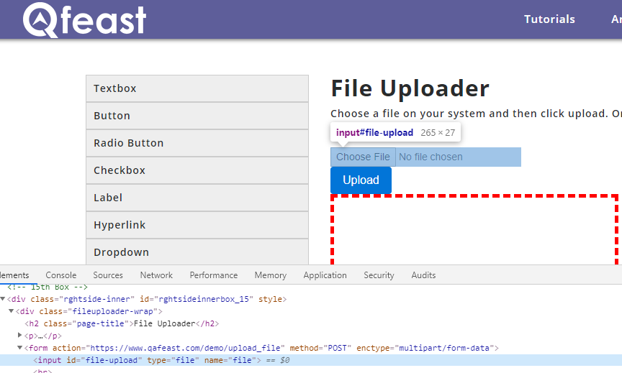

Slide 44
Using send keys:
WebElement uploadFile = driver.findElement(By.id("file-upload")); // change the path of the file uploadFile.sendKeys("D:\\user\\sample\\simple test.txt"); driver.findElement(By.id("file-submit")).click();// click the "UploadFile" button
Keyboard event using robot keys:
Click the upload button through the script and once the pop-up is opened we can simulate the keyboard event to upload the file
StringSelection strSel = new StringSelection("C:\\SeleniumResume.doc");//Store the location of the file in clipboard Toolkit.getDefaultToolkit().getSystemClipboard().setContents(strSel, null); Robot robot = new Robot();//Create an object for robot class robot.keyPress(KeyEvent.VK_CONTROL);//Control key in the keyboard robot.keyPress(KeyEvent.VK_V); robot.keyRelease(KeyEvent.VK_CONTROL); Thread.sleep(3000); robot.keyPress(KeyEvent.VK_ENTER); robot.keyRelease(KeyEvent.VK_ENTER);

Slide 45
Action class in Selenium Java
Action class in Selenium webdriver is used to handle the keyboard and mouse events.
On the web page, apart from typing, there are different actions needed to perform through the keyboard such as pressing combinations of the keys and there are different actions using mouse, drag and drop, right-click, double click, click and hold, etc..
In order to handle keyboard and mouse actions selenium webdriver provides an Action class.

Slide 46
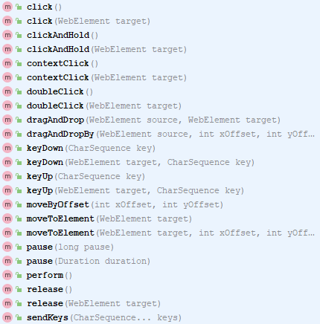
The available methods in the class

Slide 47
To hover the element :
Syntax :
Actions act = new Actions(driver); act.moveToElement("webelement").build().perform();
Example:
Go to https://www.qafeast.com/demo, click Hyperlink Tab,
Actions act = new Actions(driver); act.moveToElement(driver.findElement(By.xpath("//a[text()='Web browser automation']"))).build().perform();

Slide 48
To Right click
Syntax:
Actions act = new Actions(driver); act.moveToElement("webelement").contextClick().build().perform();
Example:
Go to https://www.qafeast.com/demo, click Hyperlink Tab,
Actions act = new Actions(driver); act.moveToElement(driver.findElement(By.id("hot-spot"))).contextClick().build().perform();

Slide 49
To Double Click:
Syntax:
Actions act = new Actions(driver); act.doubleClick("webelement").build().perform();
Example:
Go to https://www.qafeast.com/demo, click Context Menu Tab,
Actions act = new Actions(driver); act.doubleClick(driver.findElement(By.xpath("//div[@class='doubleclick-wrap']/p"))).build().perform()

Slide 50
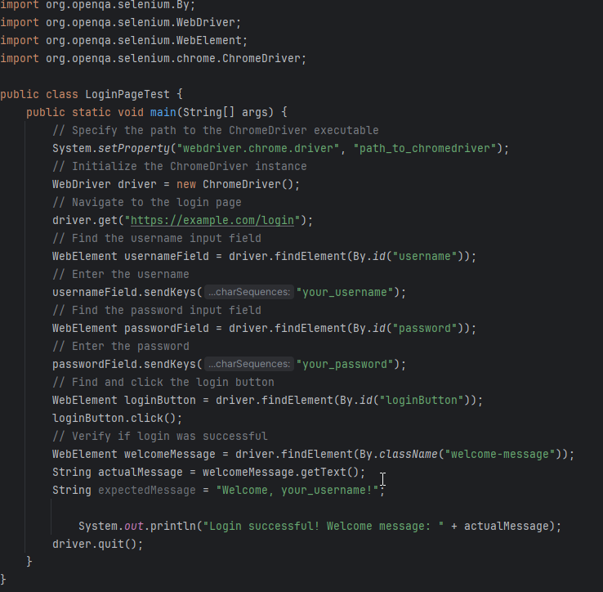

Slide 51
Explanation:
Setting Up WebDriver: We specify the path to the ChromeDriver executable using System.setProperty() method. This executable is necessary to interact with the Chrome browser.
Initializing WebDriver: An instance of the WebDriver (ChromeDriver) is created.
Navigating to the Login Page: We use get() method to navigate to the login page of the website.
Finding Username Field: We find the username input field using its ID (username) using findElement() method and assign it to usernameField.
Entering Username: We use sendKeys() method to enter the username into the username input field.
Finding Password Field: Similarly, we find the password input field using its ID (password) and assign it to passwordField.
Entering Password: We use sendKeys() method to enter the password into the password input field.
Clicking the Login Button: We find the login button using its ID (loginButton) and assign it to loginButton, then use click() method to click on it.
Verifying Login: After clicking the login button, we find the welcome message element using its class name (welcome-message). We get the text of the welcome message using getText() method and compare it with the expected welcome message.
Closing the Browser: Finally, we use quit() method to close the browser and end the WebDriver session.

Slide 52
Setting the JAVA_HOME Variable in Windows
https://confluence.atlassian.com/doc/setting-the-java_home-variable-in-windows-8895.html
https://www.softwaretestinghelp.com/download-install-and-setup-appium/

