Slide 1
TestNG
TestNG is a testing framework for Java that is commonly used with Selenium and Appium for automated testing of web and mobile applications, respectively.
It provides various features and annotations that make it easy to write and manage test cases, generate reports, and handle test execution.

Slide 2
TestNG provides several annotations that help in organizing and controlling the execution flow of test methods. Here's a list of commonly used TestNG annotations along with their simple explanations:
@Test:
Indicates that a method is a test method.
TestNG will execute methods annotated with @Test.
@BeforeSuite:
Executed before all tests in the suite.
Use it to set up any global configurations required for the entire test suite.
@AfterSuite:
Executed after all tests in the suite.
Use it to perform cleanup or teardown operations that apply to the entire suite.
@BeforeTest:
Executed before any test method belonging to the current <test> tag in the testng.xml file.
Typically used to set up configurations that apply to a specific test.
@AfterTest:
Executed after all test methods belonging to the current <test> tag in the testng.xml file have run.
Use it for cleanup or teardown operations specific to a test.

Slide 3
@BeforeClass:
Executed once before the first test method in the current class.
Use it for setting up preconditions that apply to all test methods in the class.
@AfterClass:
Executed once after all the test methods in the current class have been run.
Use it for cleanup or teardown operations that apply to all test methods in the class.
@BeforeMethod:
Executed before each test method.
Typically used to set up initial conditions required for each test method.
@AfterMethod:
Executed after each test method.
Use it for cleanup or teardown operations specific to each test method.

Slide 4
@DataProvider:
Supplies data to test methods.
Allows parameterizing tests with different data sets.
@Parameters:
Supplies parameters to test methods.
Used to pass parameters defined in the testng.xml file to test methods.
@Listeners:
Attaches listener classes to the test class.
Allows custom behavior or actions to be performed before or after test execution.
@Ignore:
Marks a test method or class to be ignored during test execution.
TestNG will skip the annotated methods or classes.

Slide 5
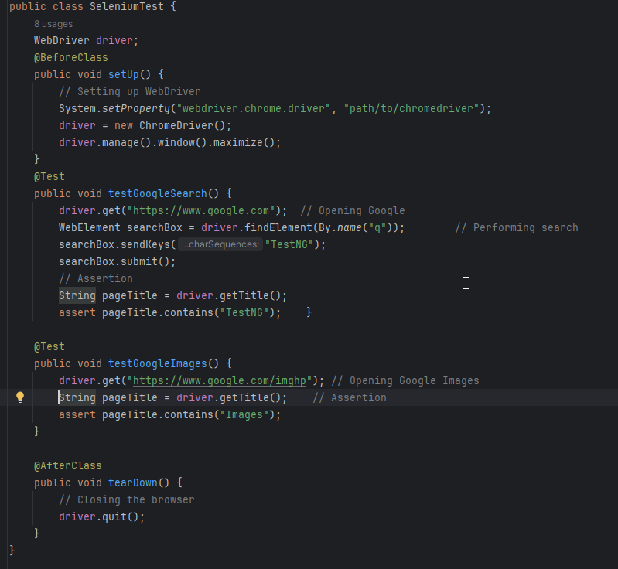

Slide 6
In this example:
@BeforeClass: The annotated method setUp() is executed before any of the test methods in the class are run. It initializes the WebDriver and maximizes the browser window.
@Test: The annotated methods represent individual test cases. In this example, we have two test methods: testGoogleSearch() and testGoogleImages().
@AfterClass: The annotated method tearDown() is executed after all the test methods in the class have been run. It closes the browser instance.

Slide 7
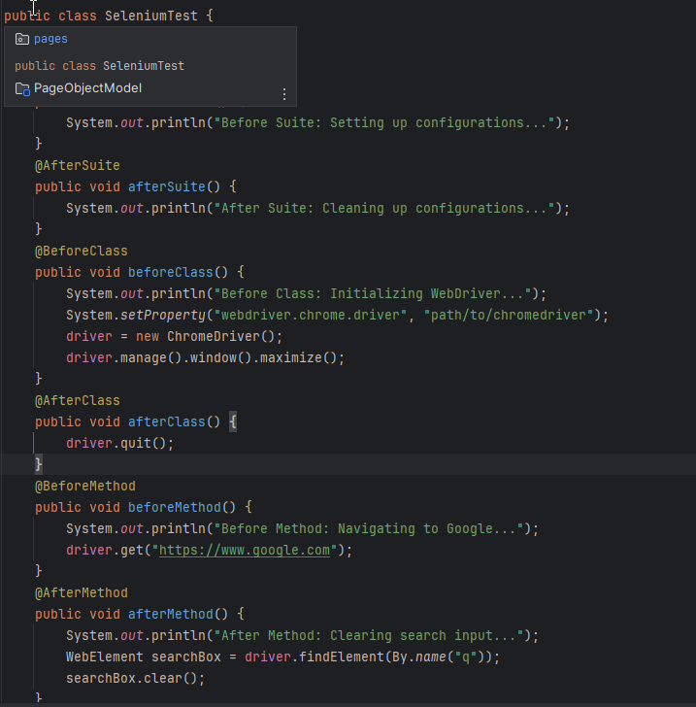

Slide 8
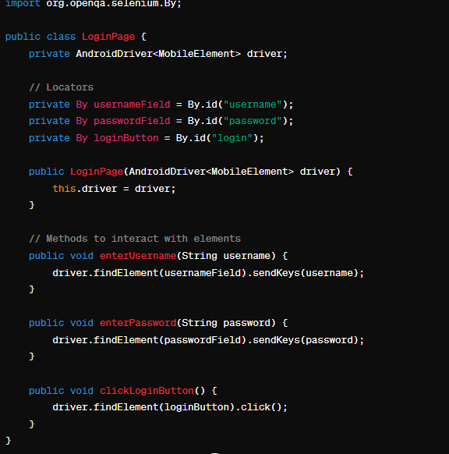

Slide 9
POM - Main Class – Common Class

Slide 10
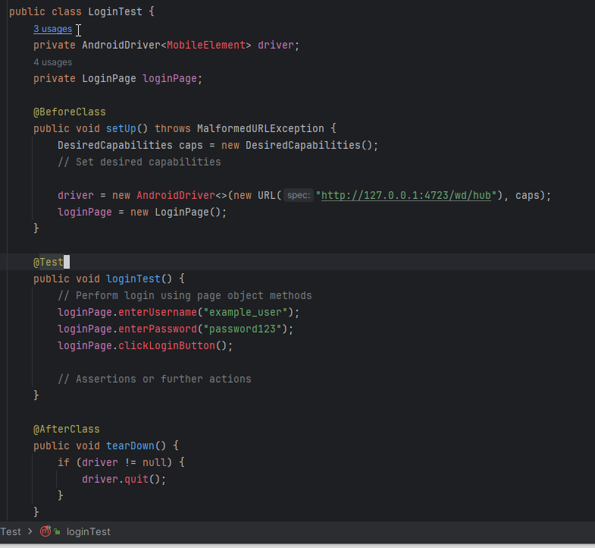
Test Class -POM

Slide 11
In this example:
LoginPage class represents the login page of the application. It encapsulates the locators and methods to interact with elements on the login page.
LoginTest class is the test class where you write your test cases. It initializes the WebDriver and the LoginPage object and performs login using the methods defined in the LoginPage class.
By using the Page Object Model, your test code becomes cleaner, more readable, and easier to maintain, as changes to the UI only require updates to the corresponding Page Object classes.

Slide 12
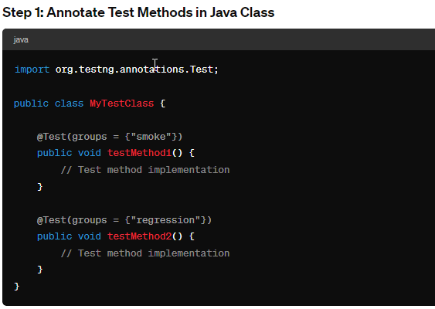
XML

Slide 13
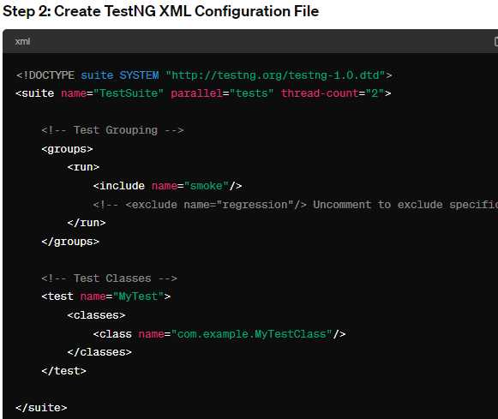

Slide 14
Explanation:
In the Java class MyTestClass, each test method is annotated with @Test along with the specified groups. This annotation marks a method as a test method.
In the TestNG XML file, the <groups> section specifies which test groups to include or exclude using the <run> tag.
The <test> element in the XML file defines the test suite, and it includes the classes that contain the test methods.
TestNG automatically identifies and runs the test methods based on the annotations and configurations provided in the XML file.

Slide 15
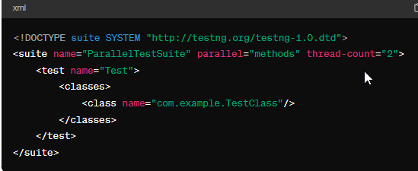
Parallel Execution

Slide 16
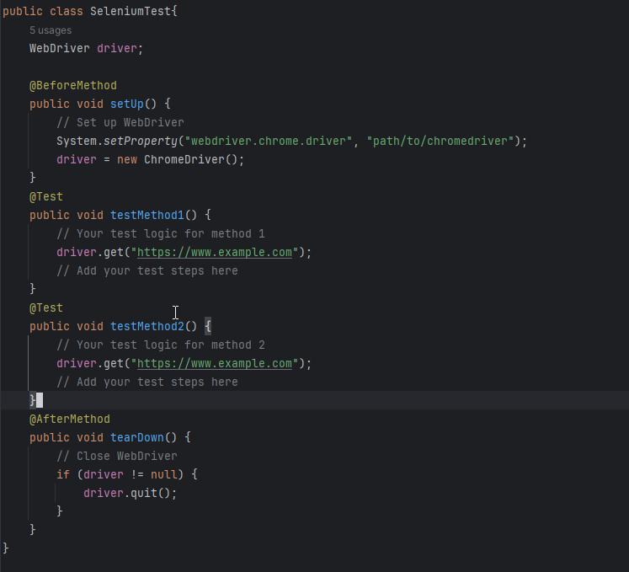
TestNG will execute testMethod1() and testMethod2() in parallel using two separate threads. You can adjust the thread-count attribute in the suite tag in the XML file to increase or decrease the number of threads depending on your requirements.

