Slide 1


Department of Biomedical Engineering Faculty of Engineering
University of Lagos, Nigeria
DEVELOPING AN AI-BASED MODEL FOR MALIGNANT BRAIN TUMOUR DETECTION
By
Joy O. Iwunor
MSc. | 199099012
SUPERVISOR:
Dr. O.A Adeleye
University of Lagos, Akoka, Lagos

Slide 2


TABLE OF CONTENT
Introduction
Significance of Study
Methodology
Aim and Objective
Scope of Study
Results
Statement of Problem
Literature Review
Conclusion
1
University of Lagos, Akoka, Lagos.

Slide 3

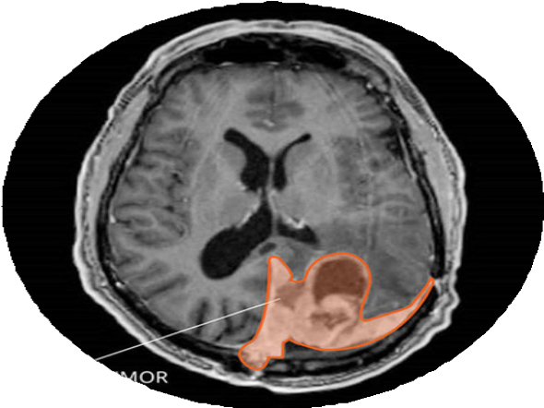
INTRODUCTION
Brain tumours are a severe medical condition that can have life-threatening consequences if left undetected and untreated.
To address this challenge, researchers have explored the use of deep learning and machine learning techniques for the
automated detection and classification of brain tumours.
University of Lagos, Akoka, Lagos.
2

Slide 4


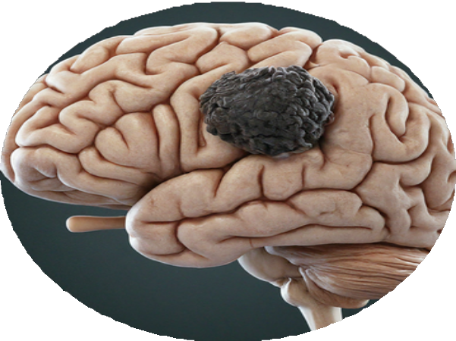
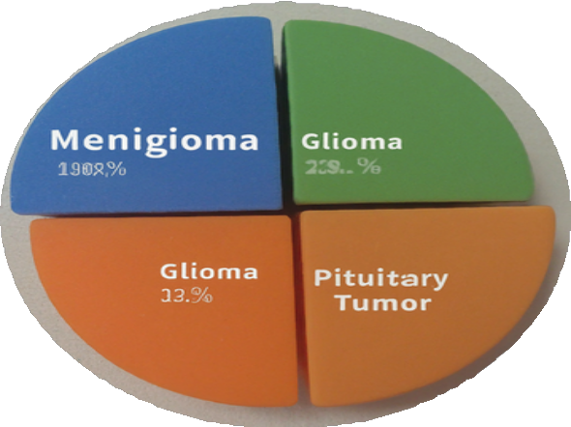
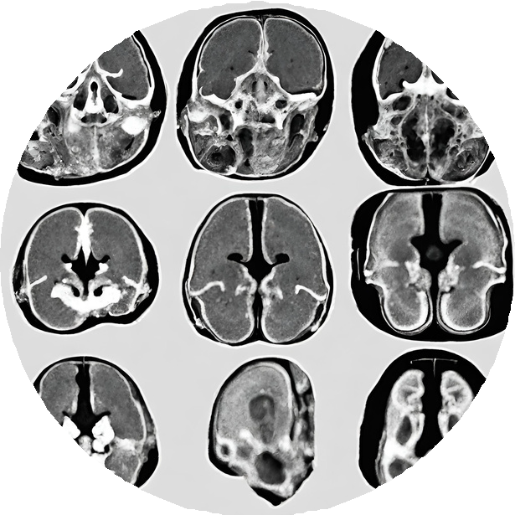
INTRODUCTION CONT...
Fig 1: (a) the brain tumor. (b) tumor types.
(c) MRI Scan of a brain tumor
3
University of Lagos, Akoka, Lagos.

Slide 5


AIM
To develop and evaluate a hybrid deep learning approach to accurately identify malignant brain tumours from MRI scans.
University of Lagos, Akoka, Lagos.

Slide 6

OBJECTIVES
To prepare MRI scan datasets for analysis.
To develop a hybrid CNN-Random Forest model for tumour classification.
To evaluate the hybrid model's performance on a testing dataset.
To assess the hybrid model's performance and optimise hyperparameters.
To deploy the optimised hybrid model for malignant brain tumour classification
University of Lagos, Akoka, Lagos.

Slide 7

STATEMENT OF PROBLEM
University of Lagos, Akoka, Lagos.
Diagnostic errors are a critical concern in brain tumour diagnosis. Previous research shows that diagnostic errors affect patient safety and outcomes, in addition to delaying treatment.
First Problem
Diagnostic errors arising from inter-observer variability in scan interpretations.
Second Problem
Delay of diagnostic processes.

Slide 8

SIGNIFICANCE OF STUDY
This study addresses the challenge of inconsistent diagnoses inherent in traditional methods employed by radiologists. Recent research has highlighted this variability, demonstrating the potential for AI to improve diagnostic consistency and precision. This, in turn, leads to the development of more effective and personalised treatment plans.
University of Lagos, Akoka, Lagos.

Slide 9

SCOPE OF STUDY
The scope of this project includes but not limited are: Patient data collection and processing
Predictive Model development Implementation and testing of the model
University of Lagos, Akoka, Lagos.

Slide 10
LITERATURE REVIEW CONT...
S/N | Title of Paper | Objective | Methods & Alternatives | Results & Contribution | Gaps
Patel et al. (2020) | Brain Tumor Detection Using Pretrained CNNs | Explore pretrained CNN architectures for detection. | Pretrained CNNs (ResNet, VGG), compared with SVM. | Pretrained CNNs yielded better performance. | Requires larger datasets for generalization .
Wang et al. (2018) | Random Forest-Based Brain Tumor Diagnosis | Use Random Forest for accurate tumor diagnosis. | Random Forest, compared with CNN. | Random Forest showed higher reliability and interpretabili ty. | Limited generalization to diverse populations.
Gupta and Singh (2019) | Deep Neural Networks for Glioma | Grade gliomas using deep neural | Deep neural networks, compared with RF, | Effective glioma grading using deep neural | Needs better interpretabilit y for clinical
University of Lagos, Akoka, Lagos.
9

Slide 11
LITERATURE REVIEW CONT...
S/N Title of Paper Objective
Methods & Alternatives
Results & Contribution
Gaps
Detect
brain tumors at early stages with machine learning.
Machine
learning models: CNN, RF;
alternative logistic regression.
Improved early detection with machine learning models.
Brown et al. (2021)
Machine Learning for Early Brain Tumor Detection
Dataset imbalance, potential overfitting.
University of Lagos, Akoka, Lagos.
Hybrid Models for
Improved Brain Tumor Detection
Utilize
hybrid models to enhance detection accuracy.
Hybrid
model: CNN + Random Forest; alternative decision trees.
Hybrid model
outperformed single methods.
Zhao et al. (2020)
Requires more clinical validation.
3D
CNNs for Brain Tumor Segmentation
Segment tumors using 3D CNN
models.
3D
CNN achieved better segmentation accuracy.
Kumar et al. (2019)
3D
CNN, alternative 2D CNN.
Challenges
in training 3D CNN models.
Miller and Zhang (2021)
CNN
and Random Forest Hybrid for Tumor Classification
Improve classification with a CNN- Random Forest hybrid.
Hybrid
CNN + RF;
alternatives SVM, logistic regression.
Hybrid model improved classification performance.
Limited interpretability of CNN-Random
Forest hybrid. 10

Slide 12
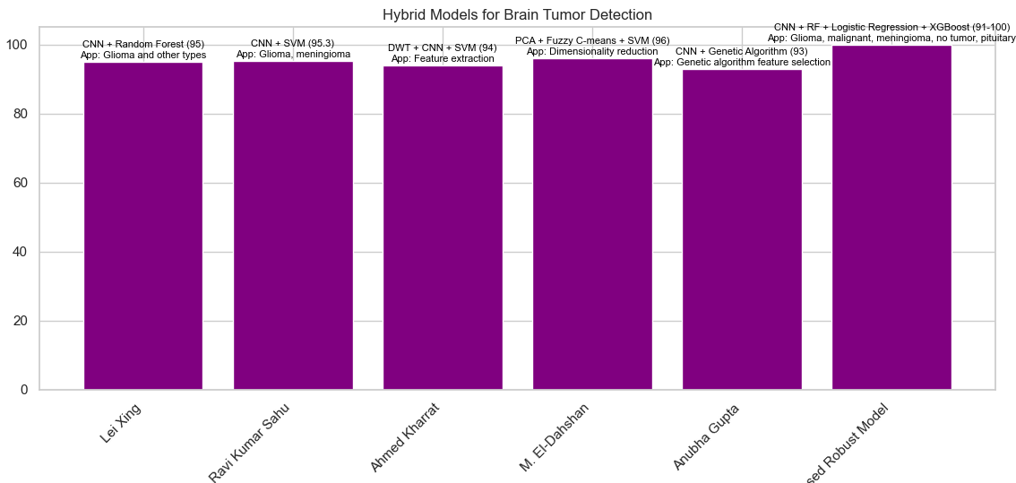
LITERATURE REVIEW CONT...
University of Lagos, Akoka, Lagos.
11

Slide 13
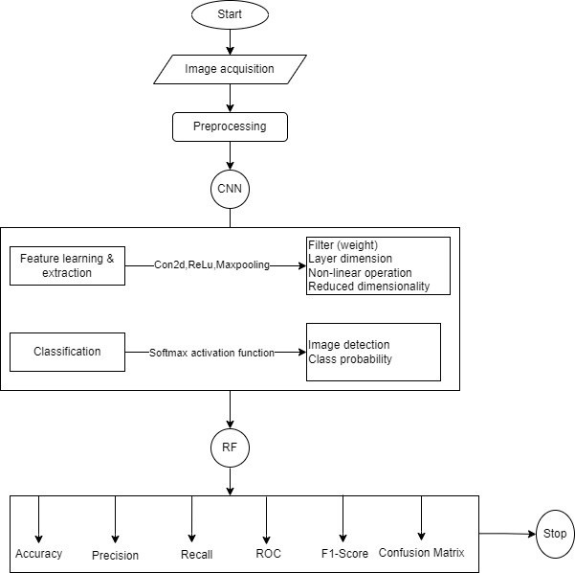
METHODOLOGY
Flowchart
University of Lagos, Akoka, Lagos.
Quantitative Method
Collection of data Data preprocessing
Exploratory data analysis (EDA)
Model development - training and validation Model testing and evaluation

Slide 14
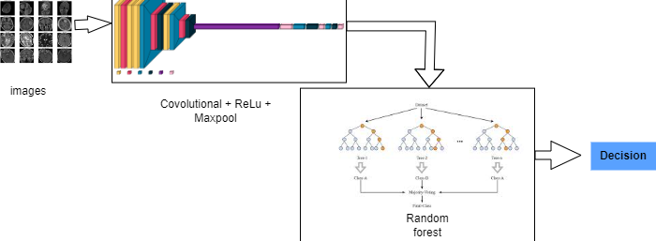
METHODOLOGY
University of Lagos, Akoka, Lagos.
Model architecture

Slide 15
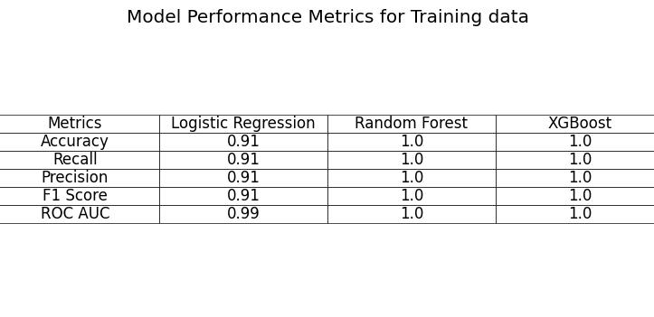
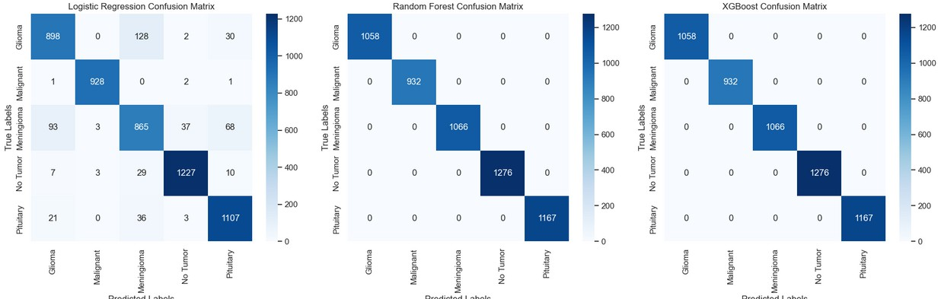
RESULTS
Model Performance
University of Lagos, Akoka, Lagos.
Confusion Metrics
14

Slide 16
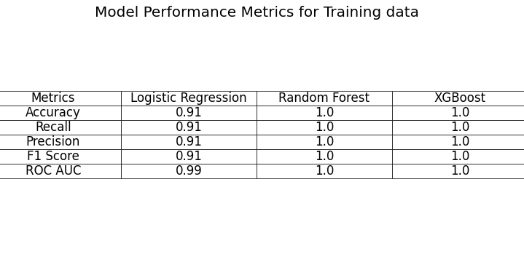
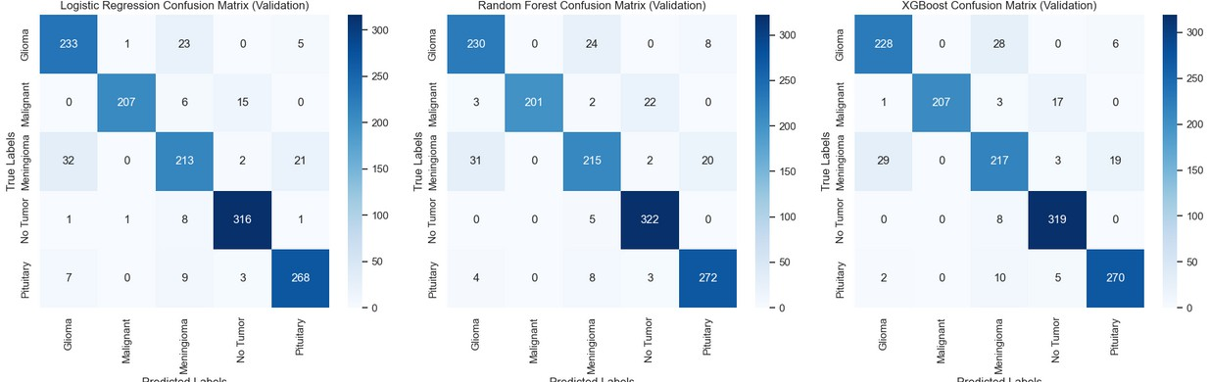
RESULTS
Model Performance
University of Lagos, Akoka, Lagos.
Confusion Metrics
15

Slide 17
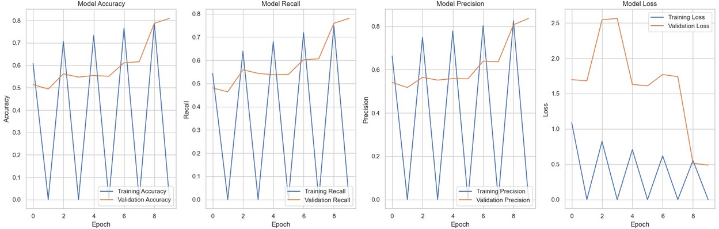
RESULTS
Model Performance with Epoch
University of Lagos, Akoka, Lagos.
16

Slide 18
CONCLUSION
perform exceptionally well for our classification task, with minimal
The results demonstrate that all three models
University of Lagos, Akoka, Lagos.
overfitting despite the high performance. While Random Forest and XGBoost showed perfect training scores, their validation metrics remained strong but realistically lower, suggesting appropriate model generalization. Logistic Regression's consistent performance between training and validation (0.91 to 0.90) indicates it might be the most stable choice, despite being the simplest model. The high ROC AUC scores across all models (>0.98) demonstrate their robust discriminative capabilities.
17

Slide 19
REFERENCE
Brown, T., et al. (2019). The impact of delayed diagnosis on brain tumor treatment outcomes. Journal of Neuro-Oncology, 143(2), 241-248.
Khan, A., et al. (2020). Inter-observer variability in brain tumor segmentation: A systematic review. Journal of Neuroimaging, 30(1), 12-23.
Li, X., Deng, Z., Wang, J., Zhang, Y., & Yang, L. (2024). Brain tumor classification with pre-trained convolutional neural networks. Scientific Reports, 14, 10723.
University of Lagos, Akoka, Lagos.
18

Slide 20
THANK YOU
University of Lagos, Akoka, Lagos.

