Slide 1
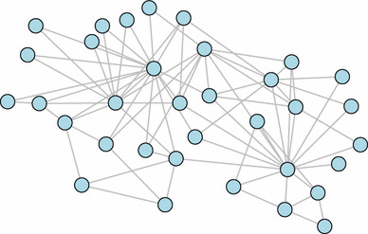
Connections

Slide 2
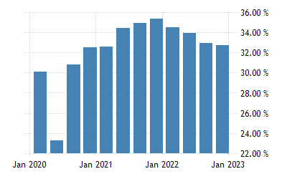
Problem
South Africa has the highest unemployment rate in the world

Slide 3
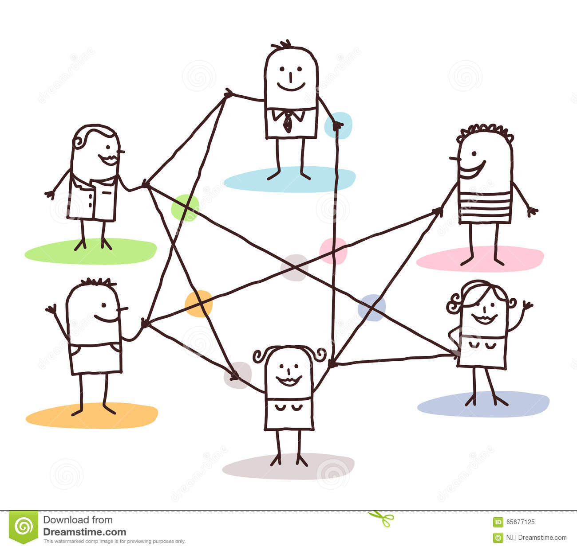
Connections

Slide 4
Solution
Connections * Connections is a system that allows People looking for Jobs to connect to companies who are hiring
- the system eliminates having to know someone to get a job and it will play a significant role in retuding unemployement.

Slide 5
How it works
makes use of Graph ADT to store nodes that represent Companies, JobSeekers and Jobs posted by Companies.
When a JobSeeker registers search methods are used to get the Jobs that match the JobSeekers criteria and edges/relationships are created between jobseekers and jobs

Slide 6
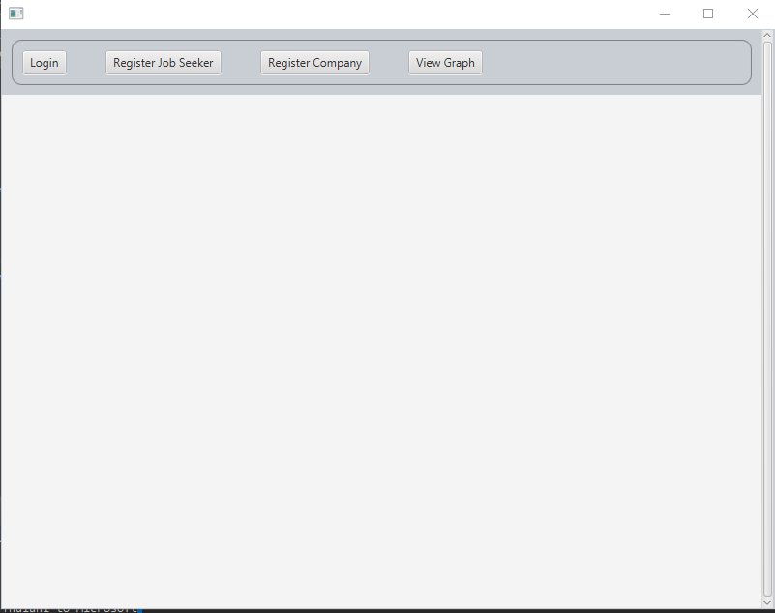
System
Login - Registered Users can login
Register Job Seeker - Users can register to look for jobs
Company Register - Companies register to post jobs

Slide 7
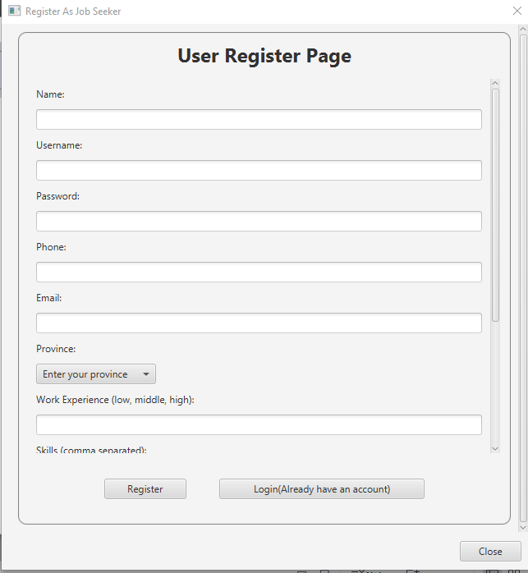
JobSeeker Register
User will enter their information and will be able to login

Slide 8
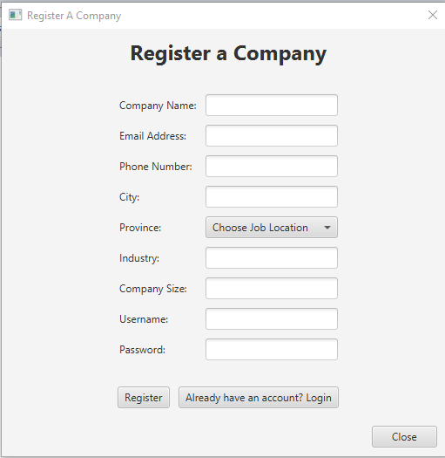
Company Register
Company Registers and to the platform and is then able to post jobs

Slide 9
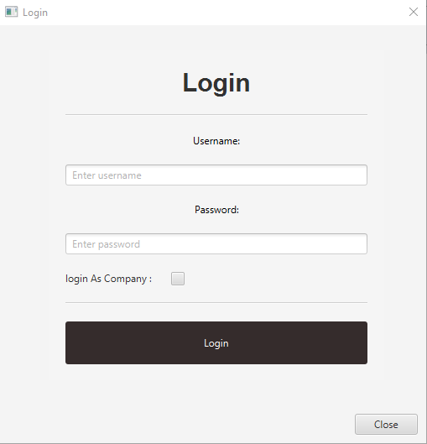
Login Page
User can login as JobSeeker which is the default and Companies the check the box to specify that they are logging in as a company

Slide 10
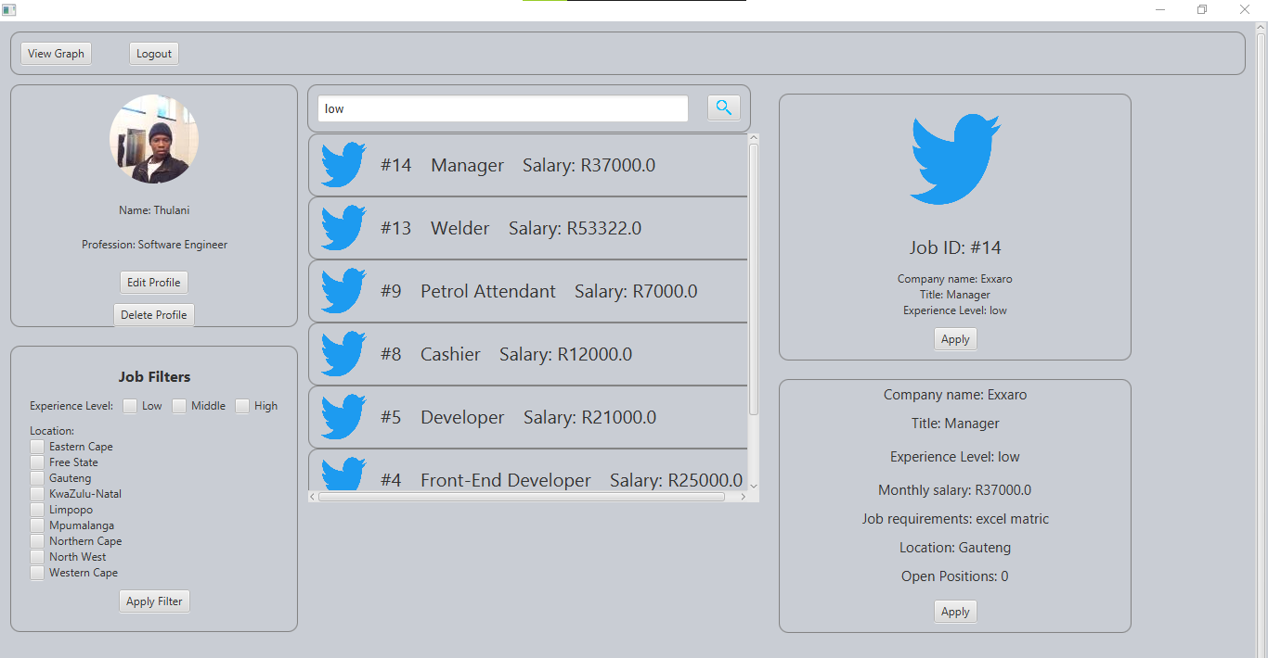
JobSeeker Home Page
by defaulf users see jobs that are related to their skills
User can search for job by typing on the search bar or use a filter
Users can delete and edit their profiles
Job details are shown when user clicks on the job they want.
User can then apply for job they want by clicking apply button

Slide 11
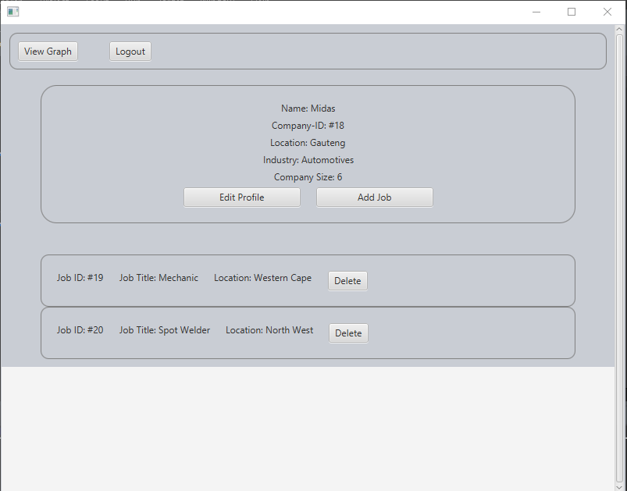
Company Home Page
A company can edit their profile
A company can add jobs
See posted jobs
delete a job they posted

Slide 12
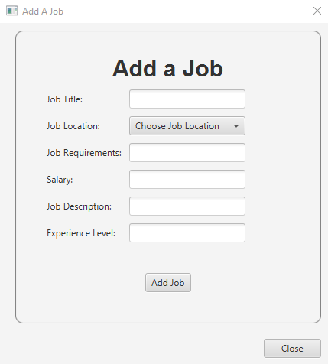
Add Job Page
Company can enter job details and Post Job
Job will be posted to the platform and JobSeeker will see it

Slide 13
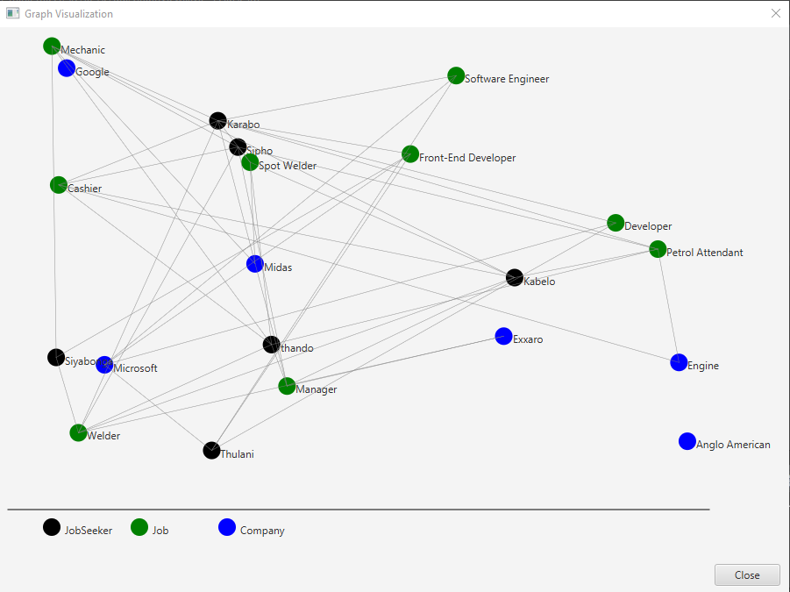
Finally
View Graph button - Visual representantion of the graph nodes and edges as they happen.
Graph-view is updated each time a JobSeeker,Job or company is added and when Jobseeker applies for a job from a company

