Slide 1

Pixes

Slide 2
Why we need this
With the boom of social media platforms like Instagram
the need for image editing has been at its highest.
Pixes helps fill the gap for all types of users who wish to have their images look a particular way

Slide 3
Introducing Pixes
Pixes is a picture editing platform which enables user to edit a picture the have in their gallery.
-Pixes comes packed with features that would usually be available to proffessionals only.
Our Package
Crop
Dilate
Rotate
Gray Scale
Canny
Erosion
Fast
ORB

Slide 4
Special Features
Identify Faces And Count Them
Stylization
Detail Enhancing
Edge Preserving Filter
Pixes can be used to can to help AI systems analayze images, its can be used to help AI systems recorgnize humans in a an image, can also be used to count the number of people in an image.

Slide 5
Methodology
Java - Basic Functional programming
JavaFx - Graphical User Interface
OpenCv Library - Open source Library for photo and video editing

Slide 6
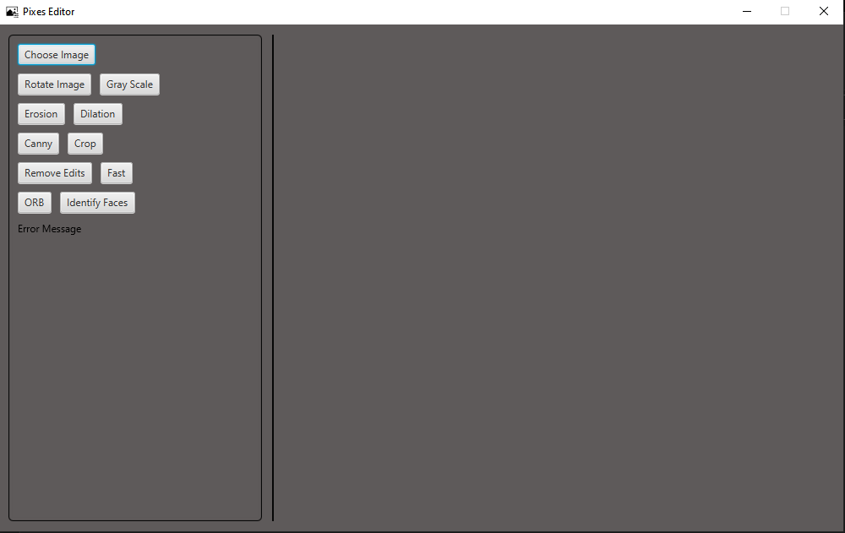
User Interface

Slide 7
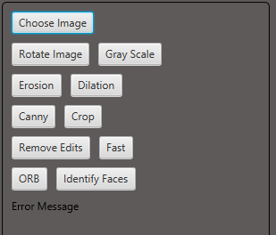
Controls
Choose Image Image Lets you choose any image you would like from the computer
Remove Edits lets you
remove any edits you made
to the picture
Identify Faces is a special feature
identifies faces in your image and
counts them

Slide 8
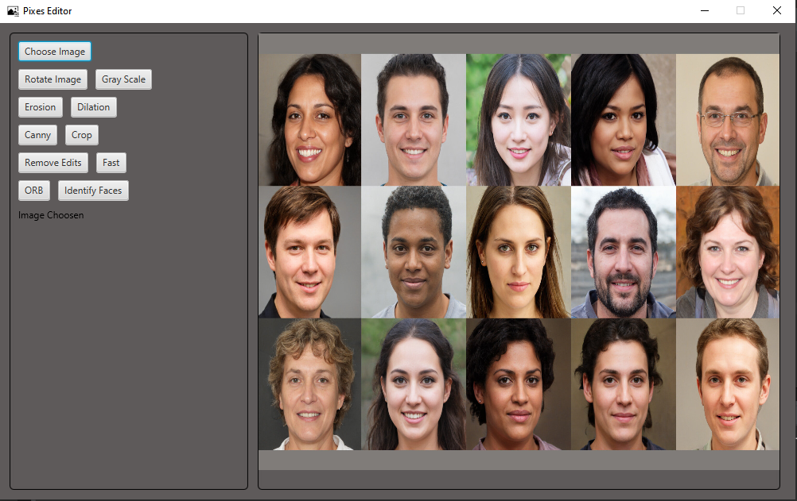
Choosing Image

Slide 9
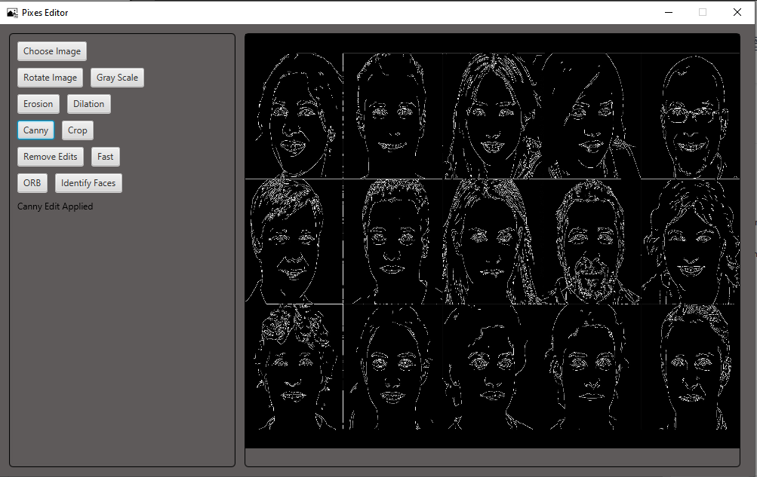
Editing
Editing Effect Applied

Slide 10
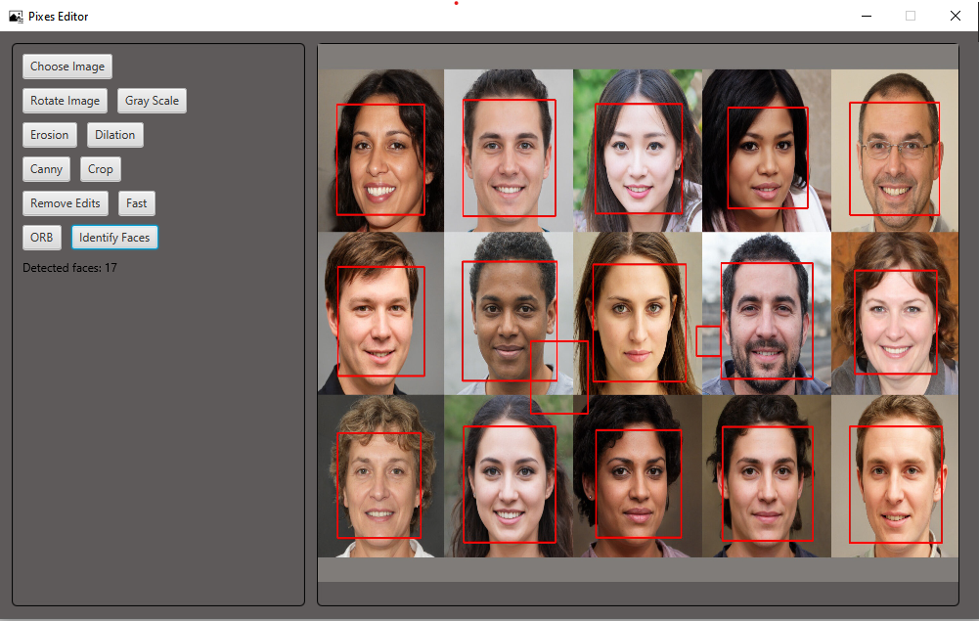
Faces Identification
Number of faces detected

Slide 11

Removing Edits
Edits Removed

