Slide 1
Detecting Diabetes
By: Michael Zelaya

Slide 2
About my dataset:
Objective: To predict the onset of diabetes on diagnostic measures.
All patients are females at least 21 years old and of Pima Indian heritage.
There are 768 rows (patients) and nine columns for specific medical measurements. Variables:
Pregnancies- the number of times the patient was pregnant.
Glucose- Plasma glucose concentration measurement
Blood Pressure - Diastolic blood pressure (mm Hg)
Skin Thickness – Triceps skin fold thickness (mm)
Insulin – 2-Hour serum insulin (mu U/ml)
BMI- body mass index (weight in kg/(height in m))²
Diabetes pedigree function- measures patients age and family history.
Age- age (years)
Outcome: Binary variable (0 = does not and 1 = does have diabetes)

Slide 3
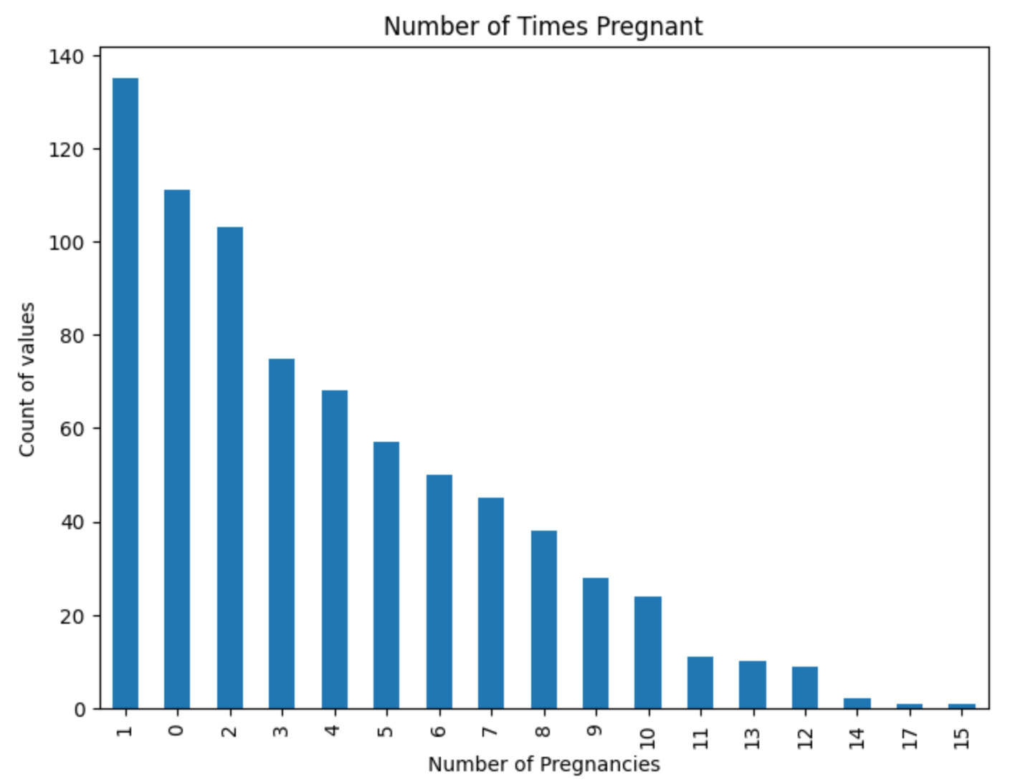
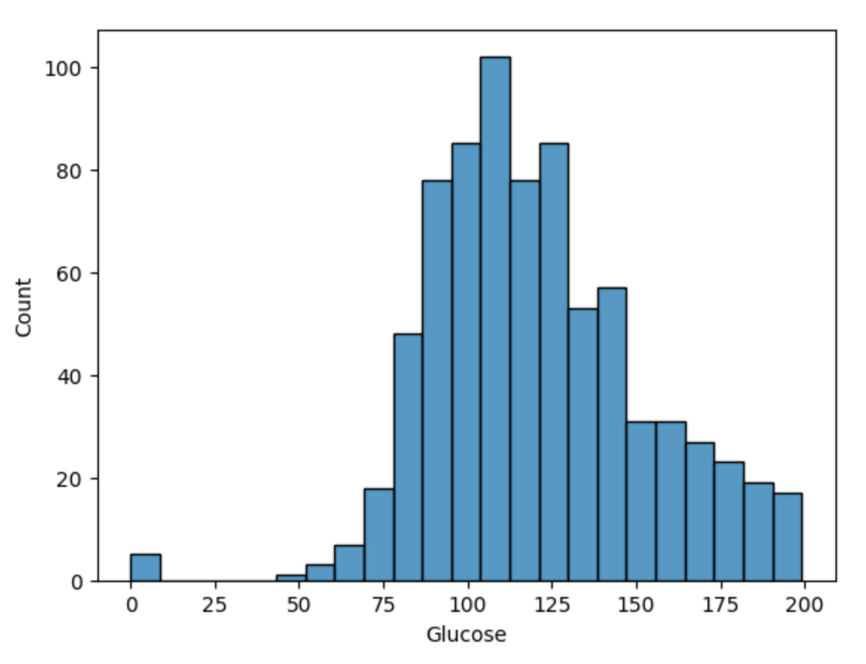
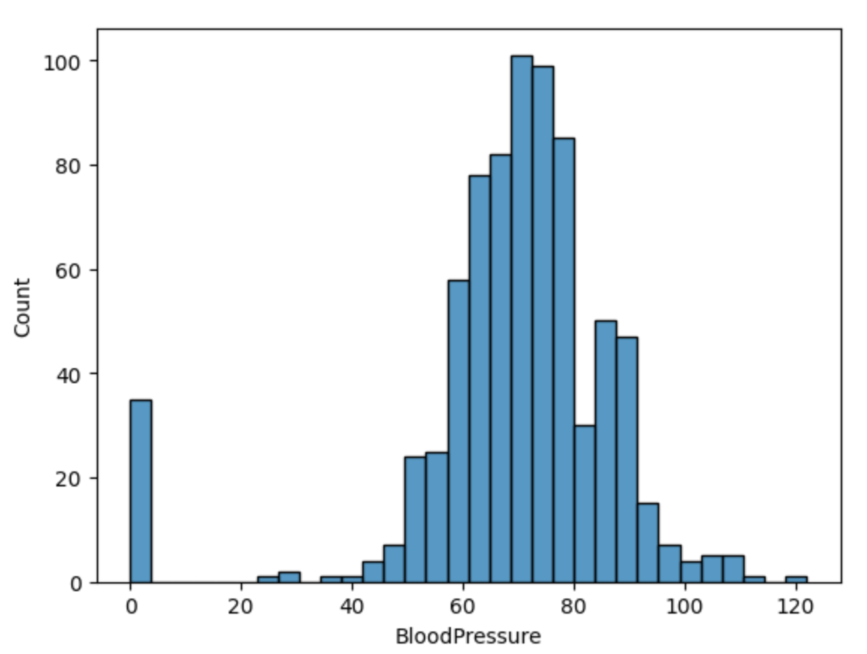
Explanatory Data Analysis (EDA)

Slide 4
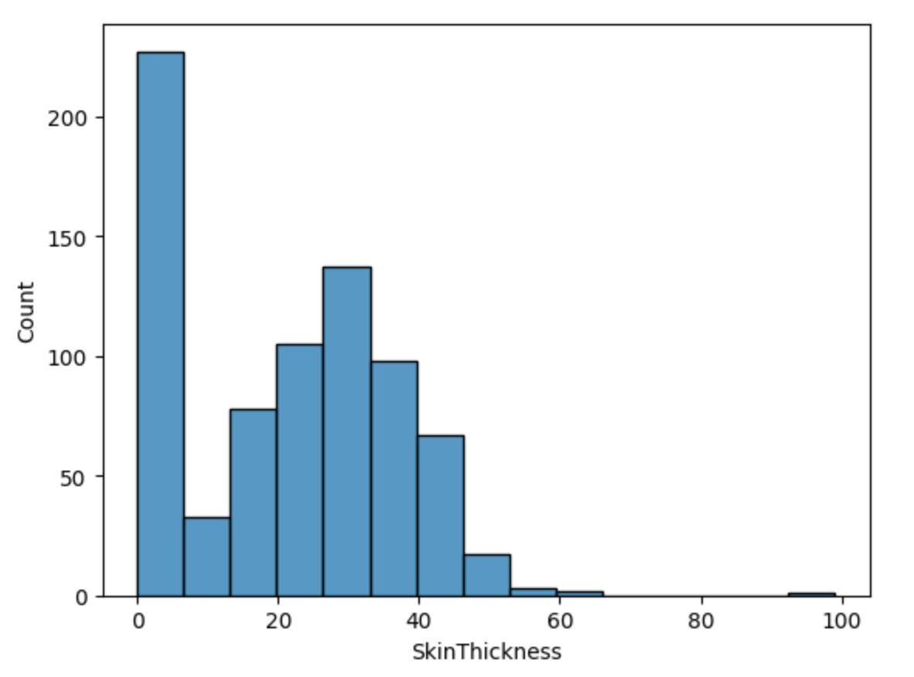
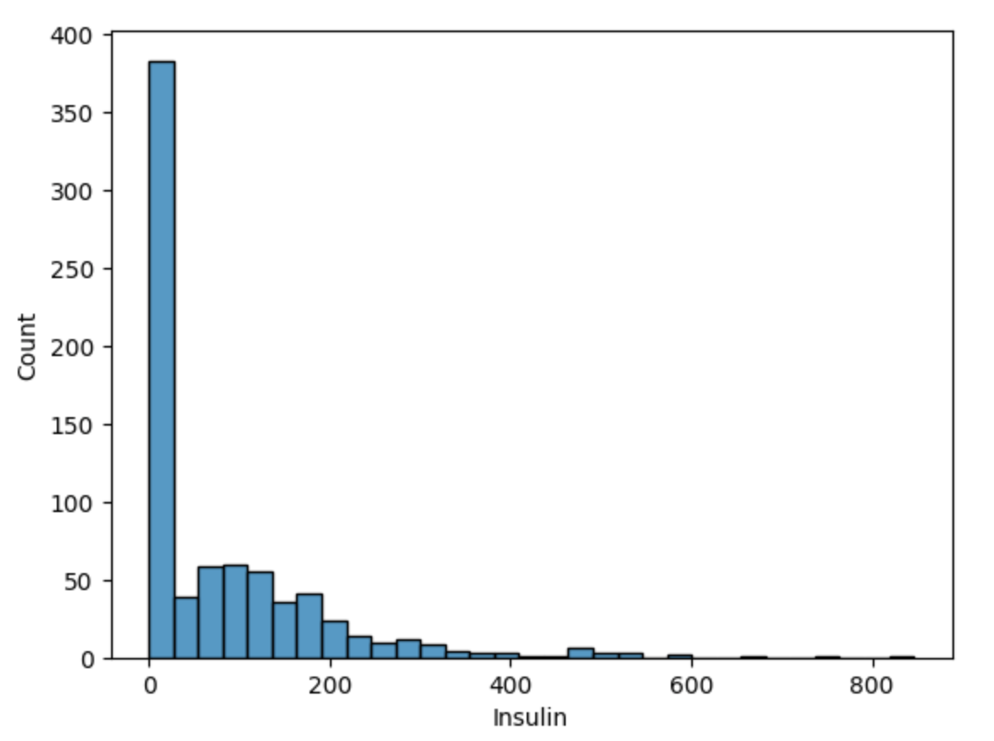
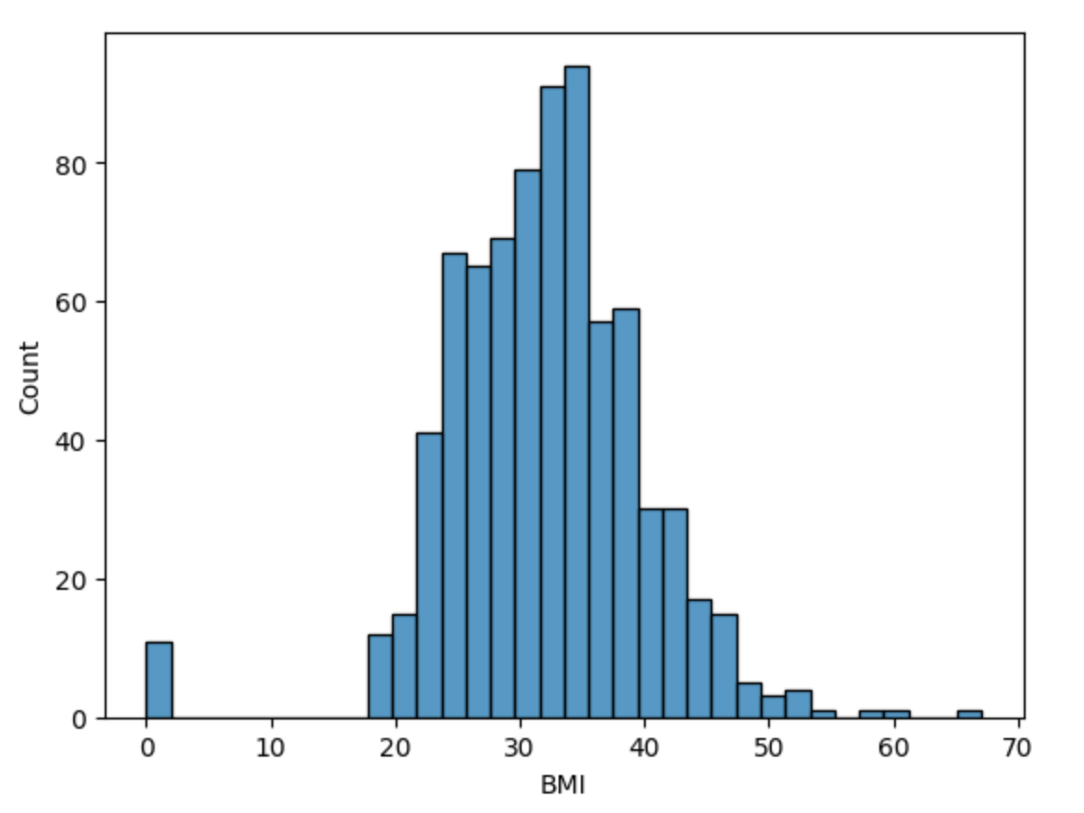
Explanatory Data Analysis (EDA)

Slide 5
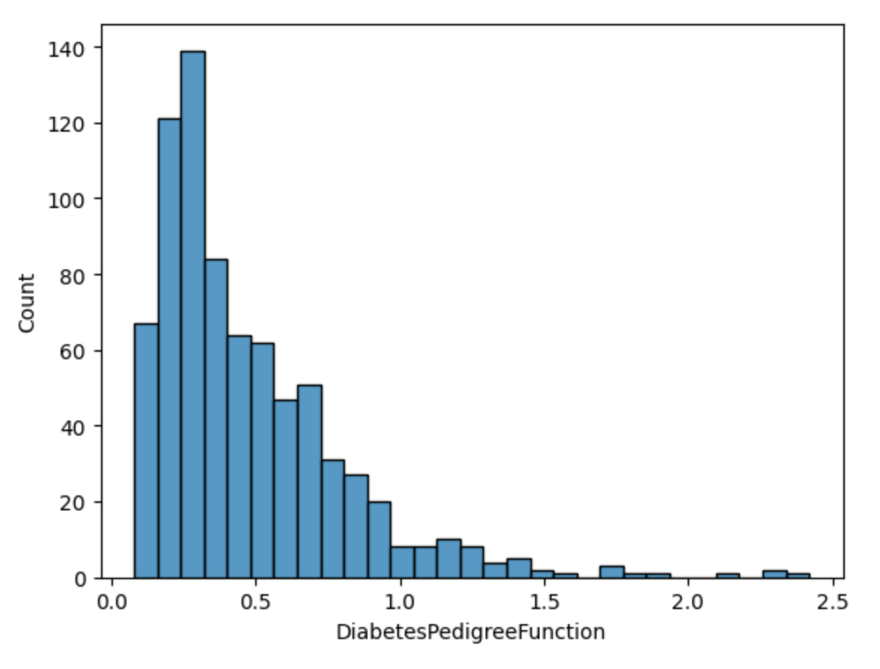
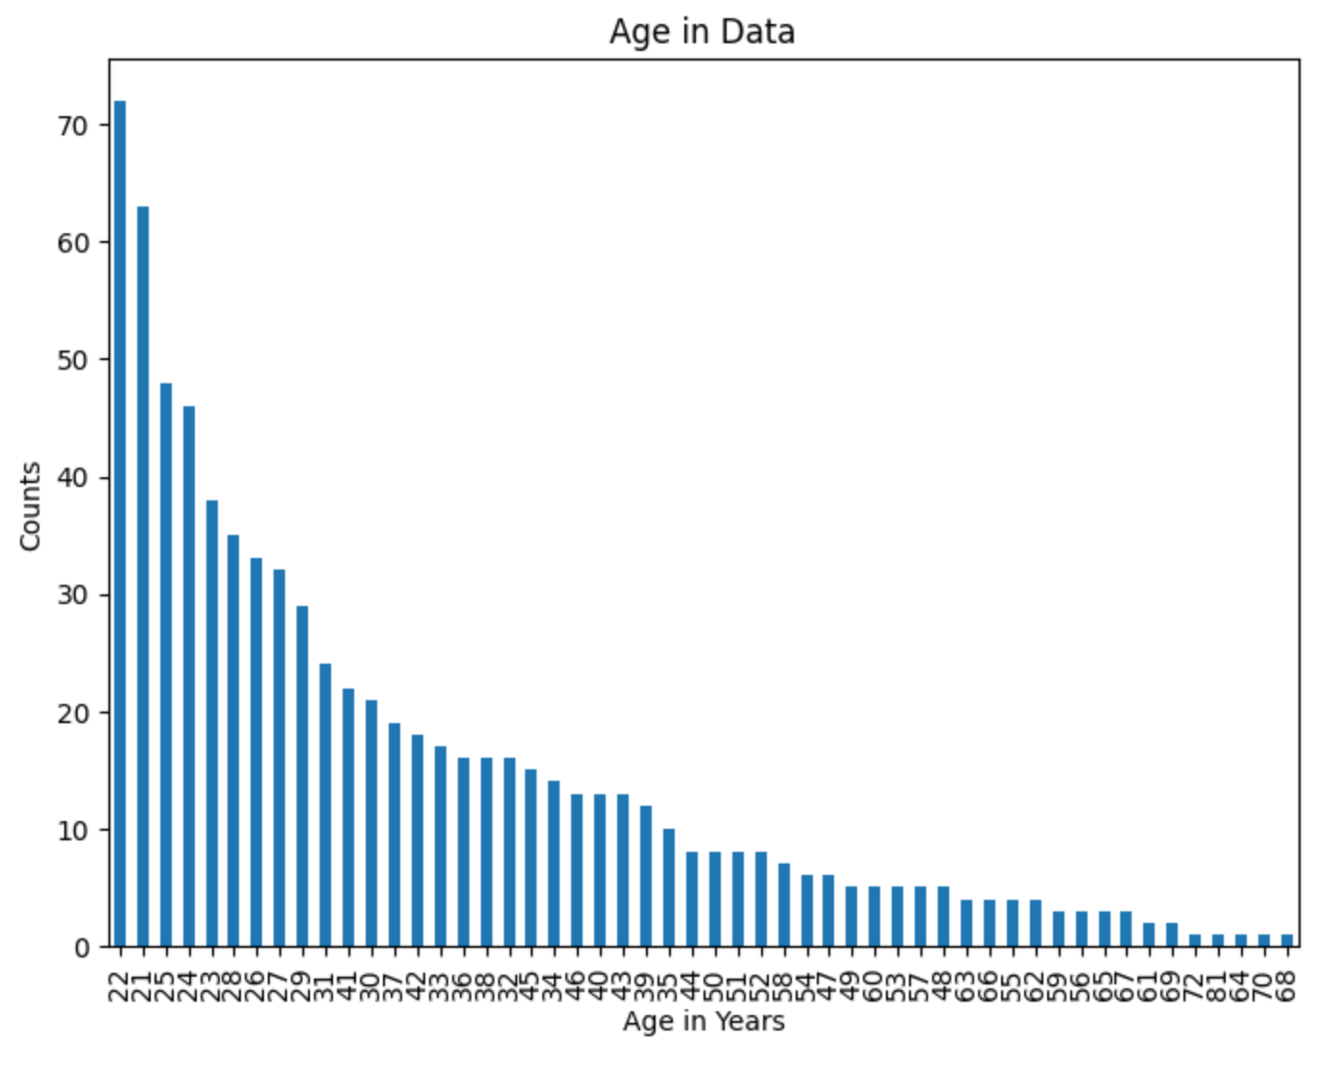
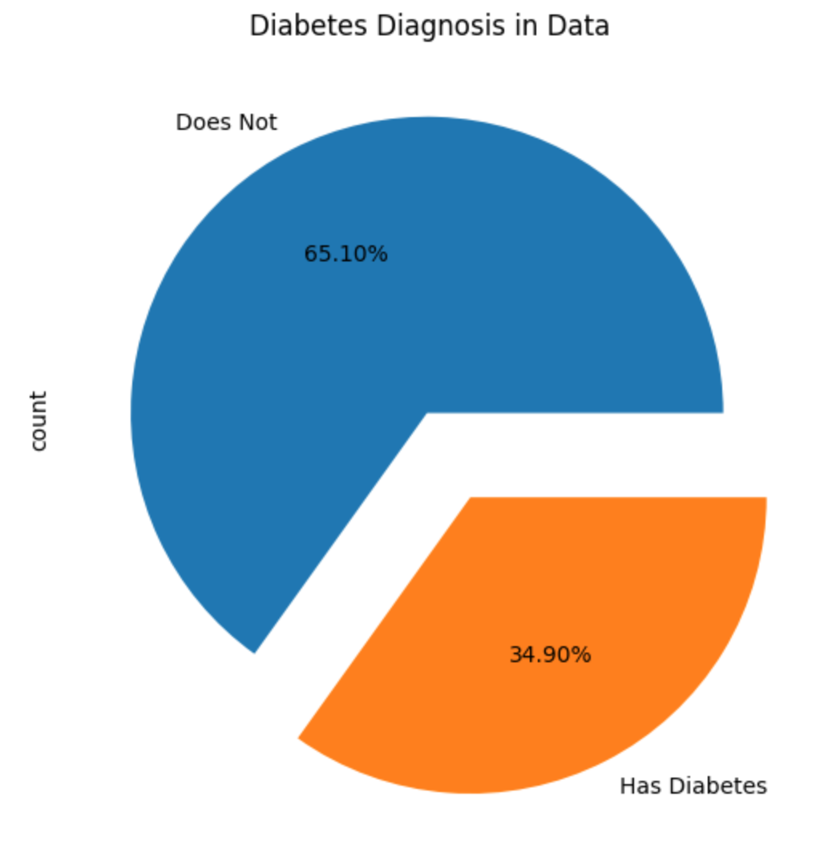
Explanatory Data Analysis (EDA)

Slide 6
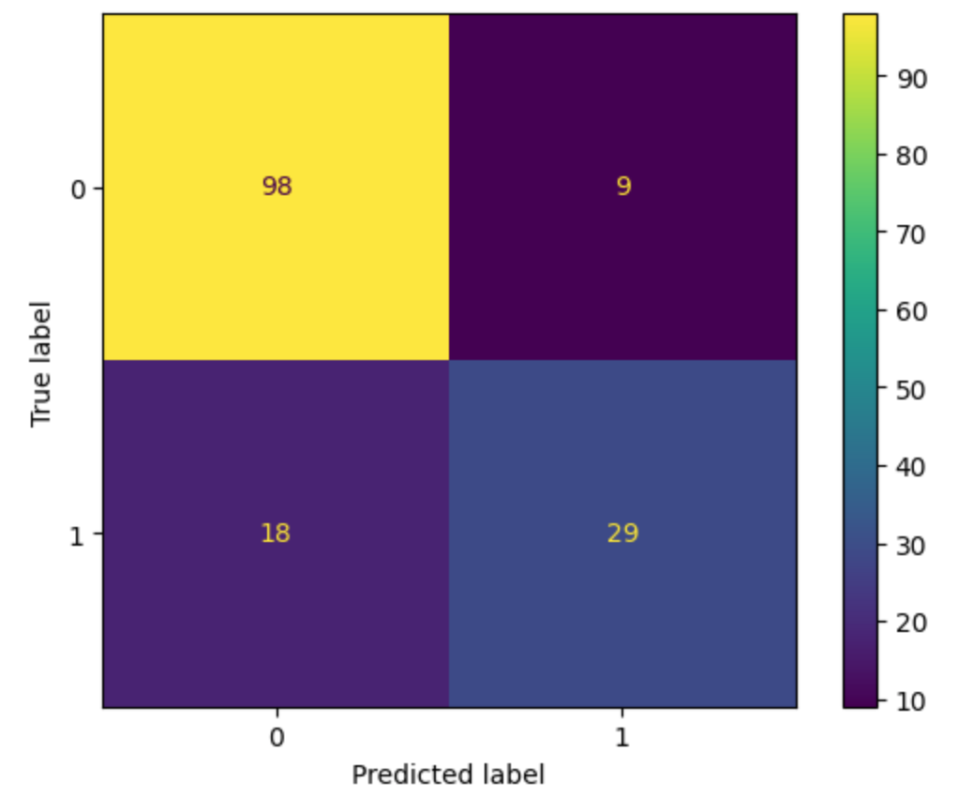
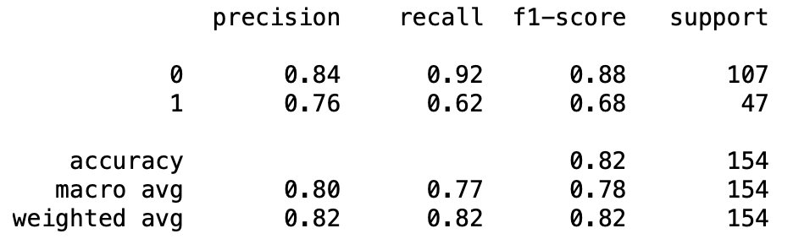
Logistic Regression
Experiment 1: 80/20/20 split for train, validate, and test.

Slide 7
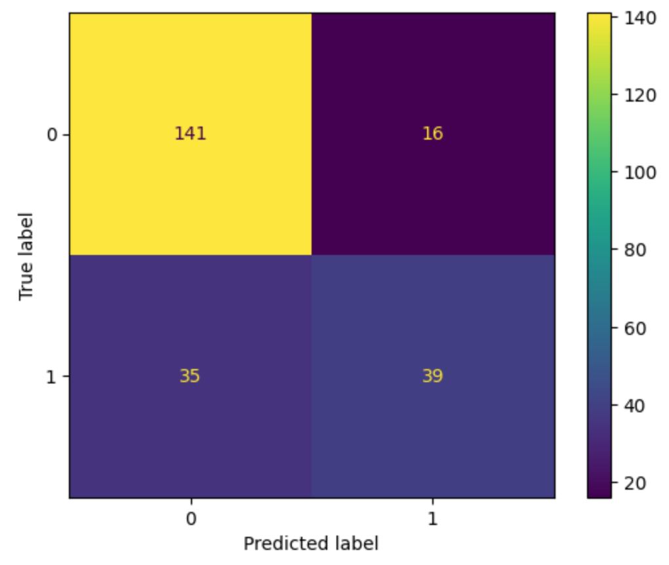
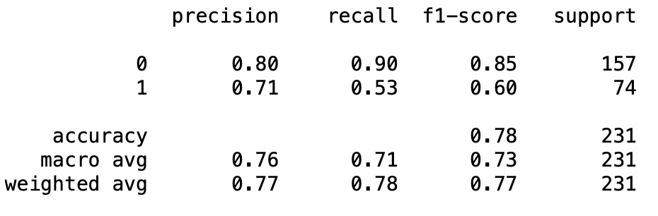
Logistic Regression
Experiment 2: 70/15/15 split for train, validate, and test.

Slide 8

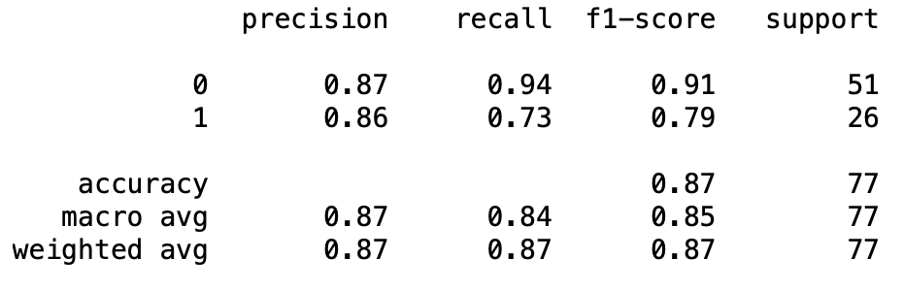
Logistic Regression
Experiment 3: 90/5/5 split for train, validate, and test.

Slide 9

Conclusion

