Slide 1
Manacher’s Algorithm
By: Conroy Lee, Ivan Zheng, and Zihan Mei

Slide 2
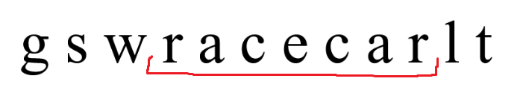
Longest Palindromic Substring
Given an input string, our goal is find the longest palindromic substring within that string.

Slide 3
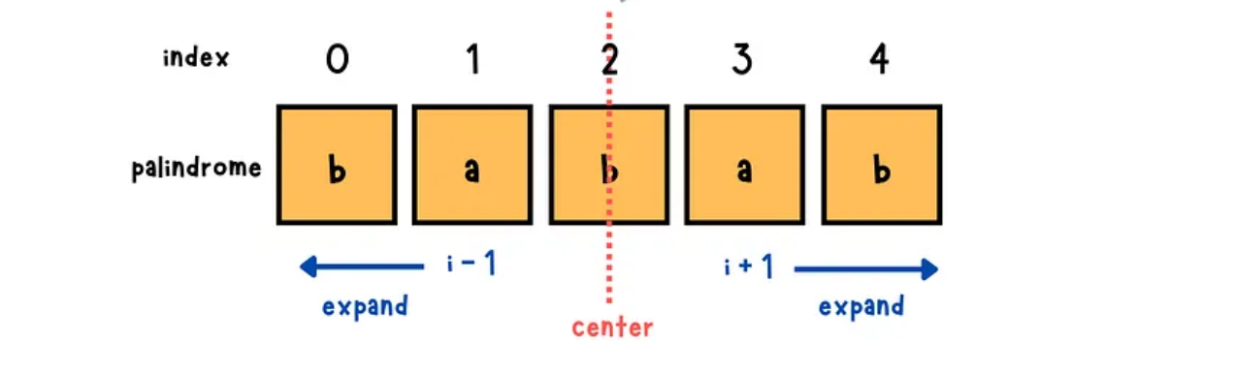
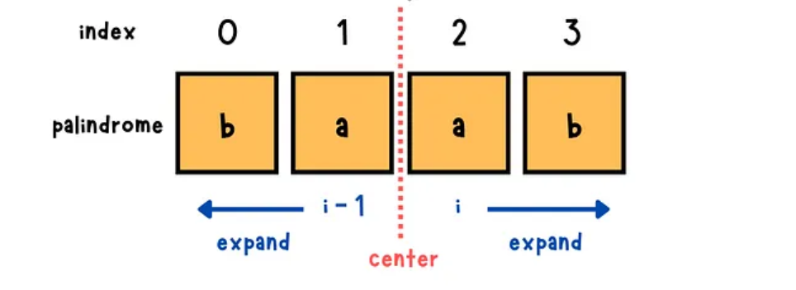
Longest Palindromic Substring: Brute Force
Iterate through each character. Try to expand the palindrome if char at left pointer matches char at right pointer.
Odd-length palindromes
Even-length palindromes

Slide 4
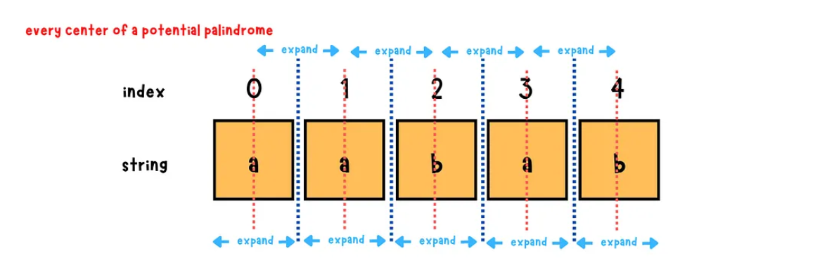
Brute Force Time Complexity
O(n^2) since we are iterating through each character, and for each character, we could potentially expand to ends of string.

Slide 5
Manacher’s Algorithm
Invented by Glenn Manacher in 1975
Computes longest palindrome in linear time
Exploits the idea that there are palindromes within palindromes

Slide 6
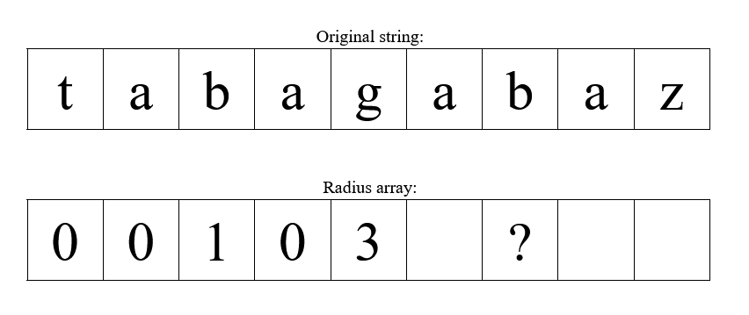

Manacher’s Algorithm: Key Idea
We know that the palindrome radius at index 2 is 1 and the palindrome radius at index 4 is 3. With that info, we can determine the radius at index 6.

Slide 7
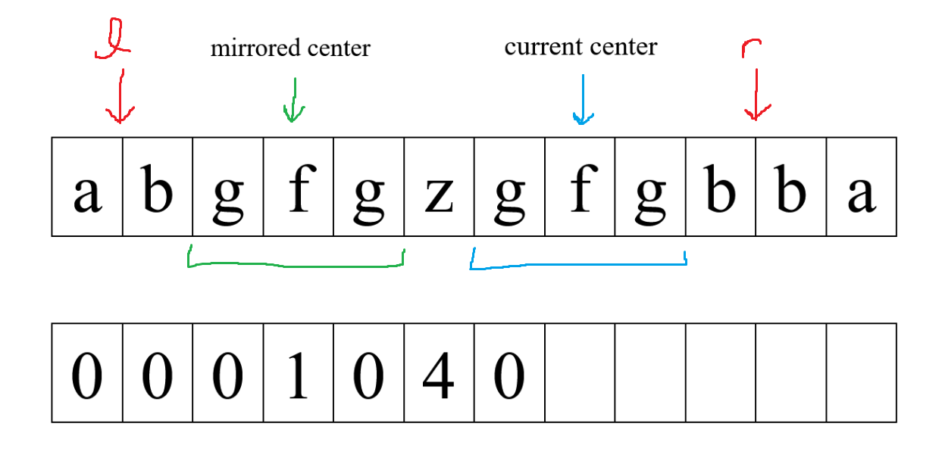
Case 1
Palindrome at current center fits within the bounds. Current center radius = mirrored center index

Slide 8
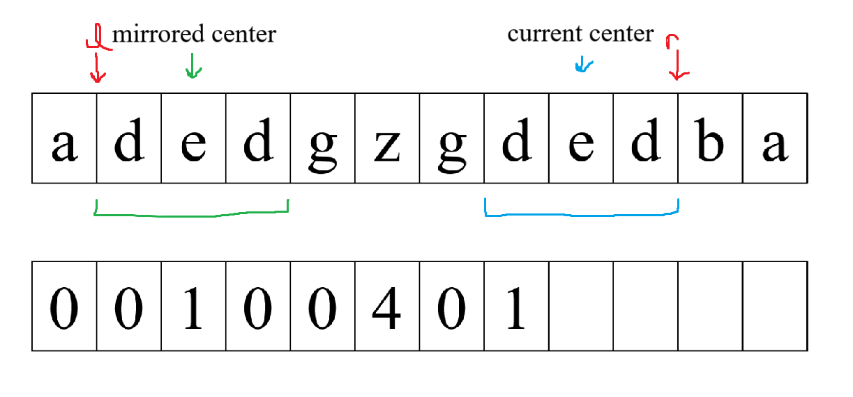
Case 2
Palindrome at current center touches the bounds. Current center radius >= mirrored center index

Slide 9
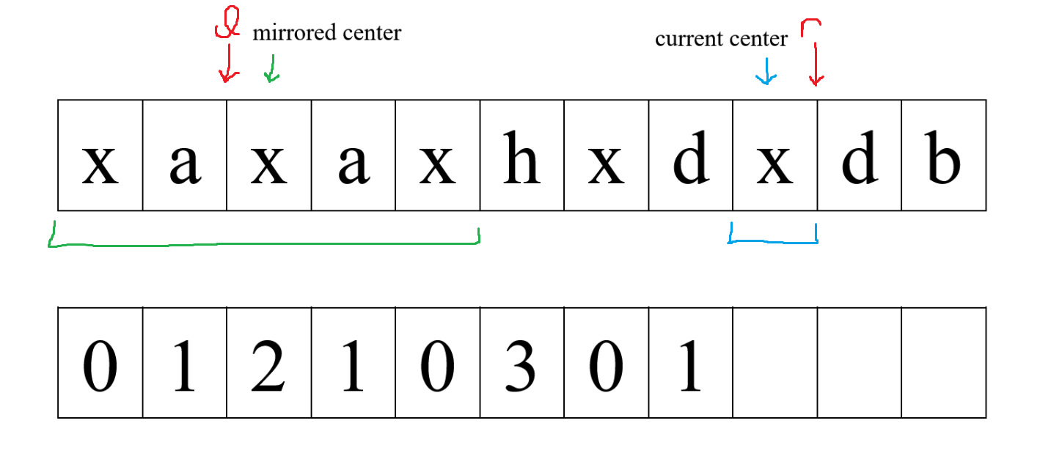
Case 3
Palindrome at current center goes past the bounds. Current center reduced to fit within bounds
a

Slide 10

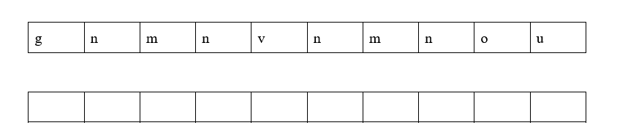
Example
center = 0 r = 0
cur_index = 0 l = 0
center =

Slide 11
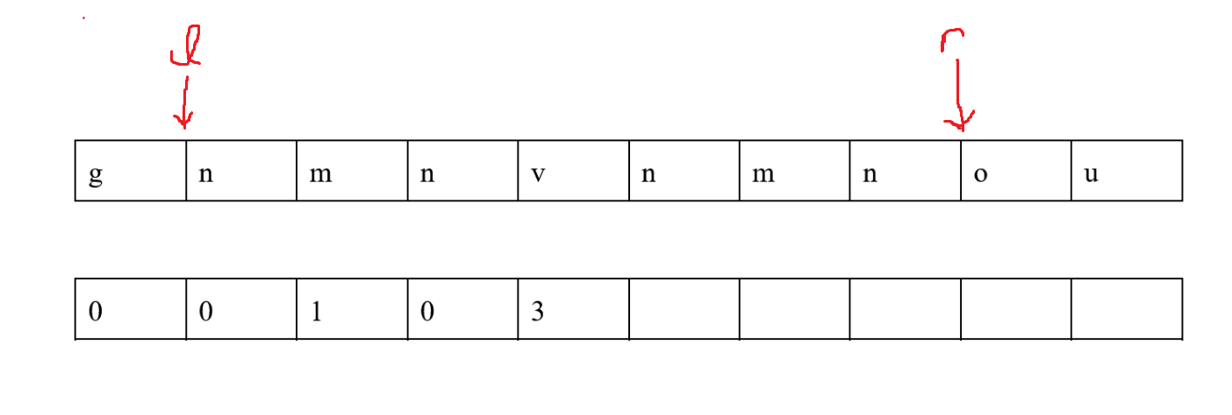
Halfway

Slide 12
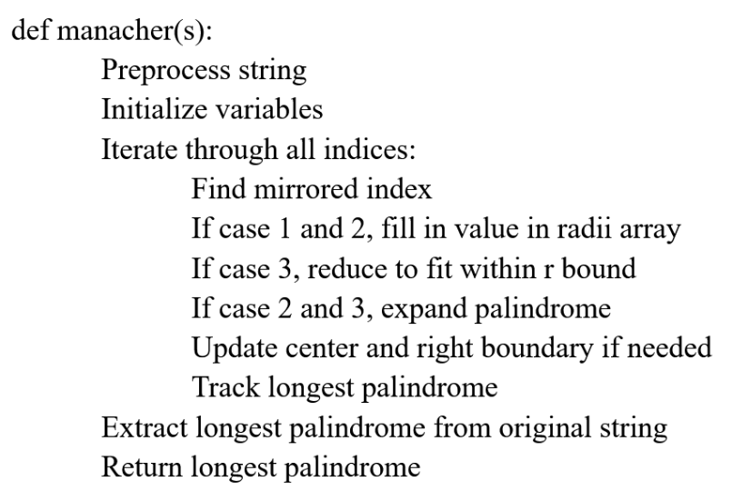
Pseudocode

Slide 13
What About Even Length Palindromes?
Preprocess array by putting a dummy character (#) in-between all characters
zskukkukop = #z#s#k#u#k#k#u#k#o#p#

Slide 14


Complexity Discussion
Time complexity: O(n) -> right pointer always moves right, never decreases
Space complexity: O(n)

Slide 15
References
https://yuminlee2.medium.com/manachers-algorithm-longest-palindromic-substring-cc97fa615f8b
https://cp-algorithms.com/string/manacher.html
https://www.hackerearth.com/practice/algorithms/string-algorithm/manachars-algorithm/tutorial/

