Slide 1
Manacher’s Algorithm
By: Conroy Lee, Ivan Zheng, and Zihan Mei

Slide 2
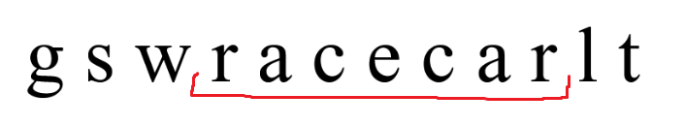
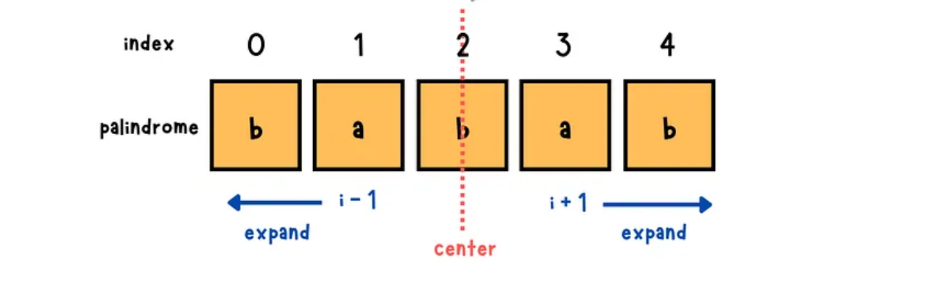
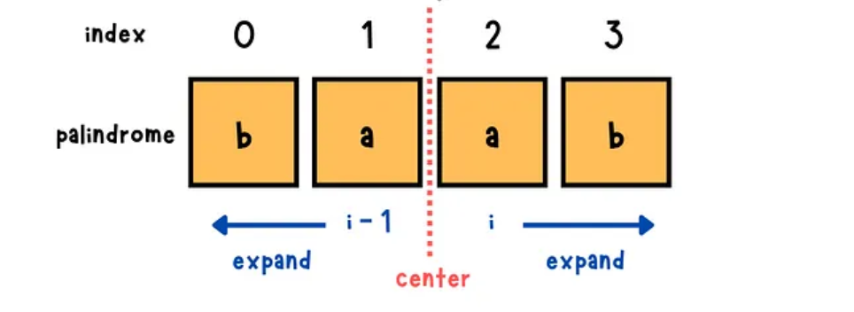
Longest Palindromic Substring: Brute Force
Odd-length palindromes
Even-length palindromes

Slide 3
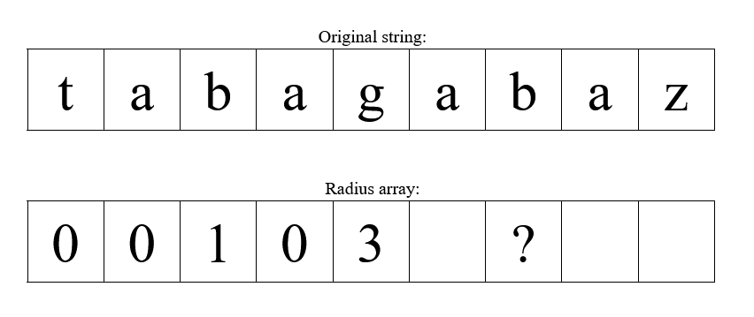
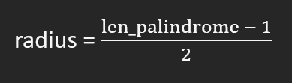
Manacher’s Algorithm: Key Idea
We know that the palindrome radius at index 2 is 1 and the palindrome radius at index 4 is 3. With that info, we can determine the radius at index 6.

Slide 4
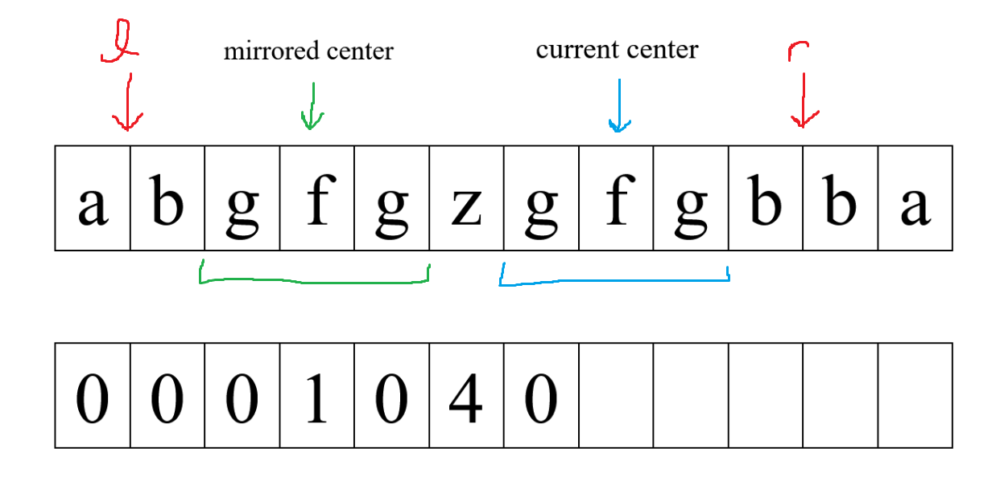
Case 1
Palindrome at current center fits within the bounds. Current center radius = mirrored center index

Slide 5
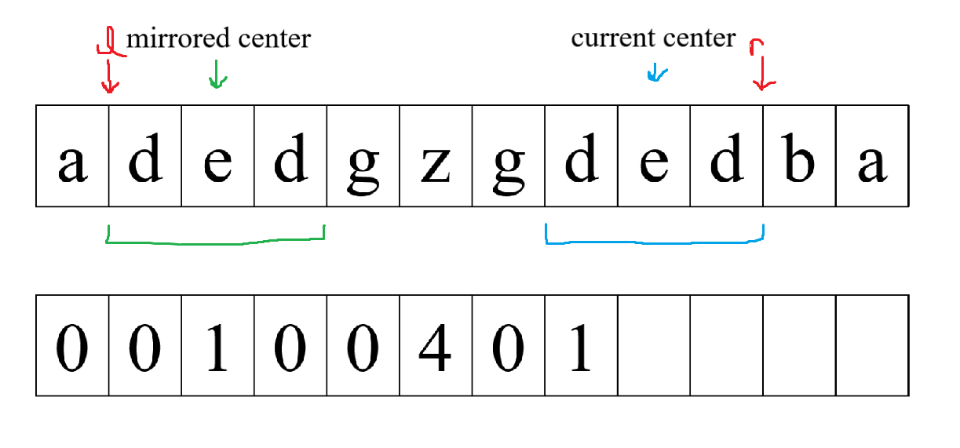
Case 2
Palindrome at current center touches the bounds. Current center radius >= mirrored center index, then expand
g

Slide 6
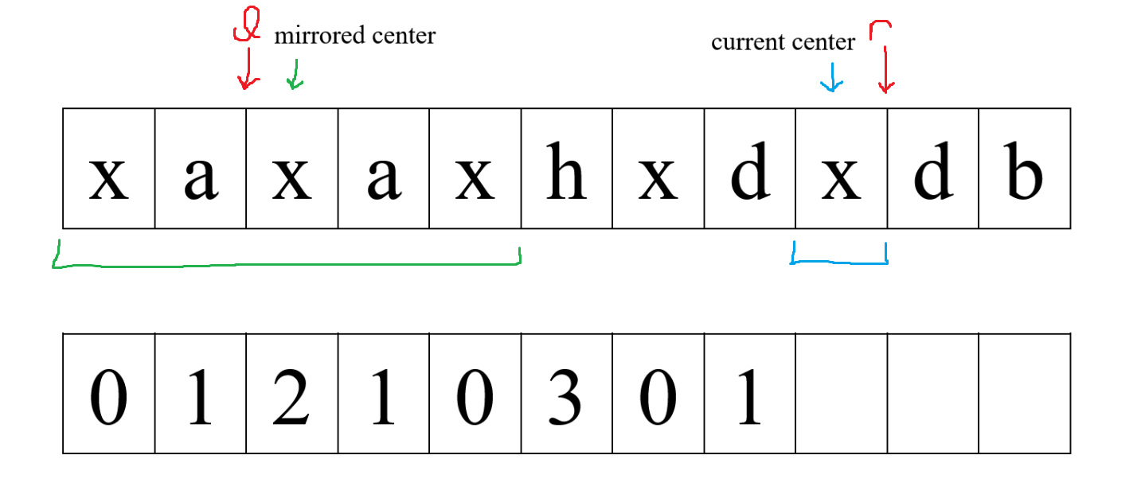
Case 3
Palindrome at current center goes past the bounds. Current center reduced to fit within bounds, then expand
a

Slide 7
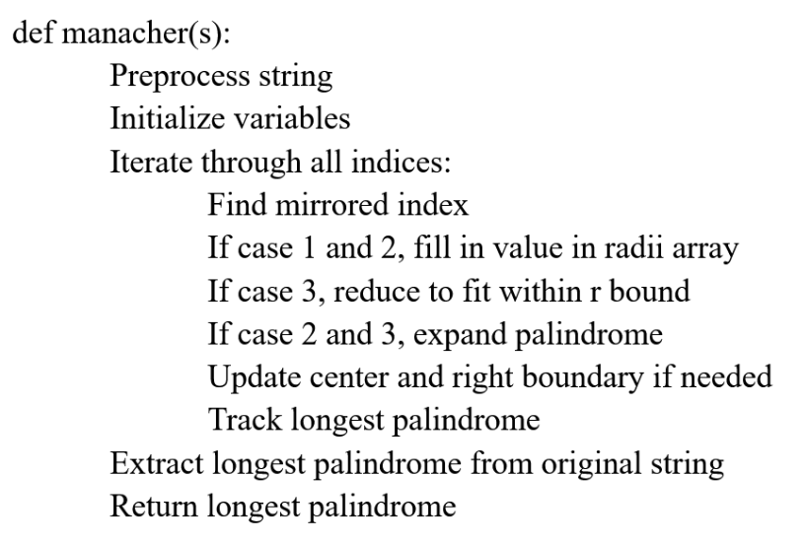

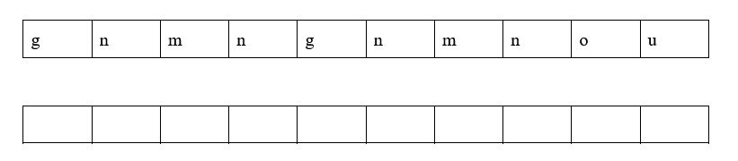
Example
center = 0 r = 0
cur_index = 0
c
c
c
c
r
r
r
r
0
0
2
0
3
0
1
0

Slide 8

Even Length Palindromes + Complexity
Preprocess array by putting a dummy character (#) in-between all characters
zskukkukop = #z#s#k#u#k#k#u#k#o#p#
Time complexity: O(n) -> right pointer always moves right, never decreases
Space complexity: O(n)

