Slide 1

SMart Emergency Monitoring system
Thimna Gogwana – 222213973
Mpilonhle Zimela Mzimela – 230197833
Jamie-Lee France – 230837484
Elzane Frans – 230651658
Asisipho Mlahlwa - 221338462

Slide 2

Introduction
Transforming Safety Through IoT
Key Benefits
Real-time threat detection
The Internet of Things revolution enables unprecedented integration of safety systems, creating intelligent environments that proactively protect occupants and assets.
Automated emergency response
Remote monitoring capabilities
Our solution addresses access control through motion and sound detection.

Slide 3

Project Vision & Goals
Our Vision
To enhance safety and efficiency in modern living and working spaces through IoT.
Project Goals
Improve emergency detection and response in smart spaces.
Provide a low-cost, scalable, and reliable multi-sensor solution.
Explore automation and remote monitoring for smarter environments.
Ultimate Aim
A comprehensive system that contributes to the vision of truly Smart Access and Smart Spaces.

Slide 4




Project Innovations
Multi-Sensor Integration for Accuracy
Cost-Effective Solution
Combines data from multiple sensors to confirm threats and reduce false alarms.
Provide scalable, low-cost safety infrastructure that delivers enterprise-grade protection for any space
Smart Automation & Response
Automatically triggers alarms (buzzer, LEDs) and can be extended to activate countermeasures (sprinklers, fans, locks).
Practical Real-World Application
Designed for dormitories, offices, and homes to protect against theft, fire, and water damage.

Slide 5
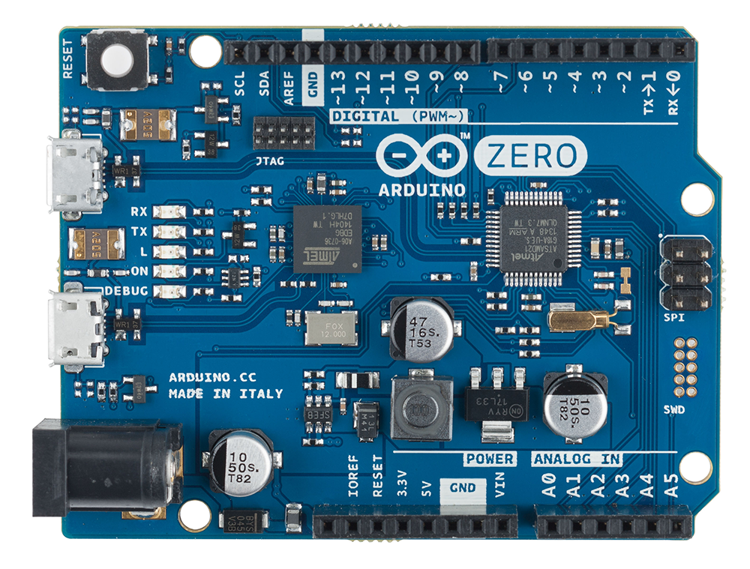
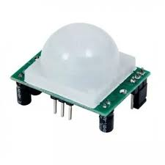
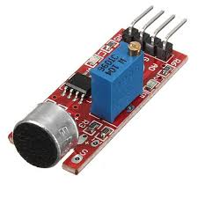
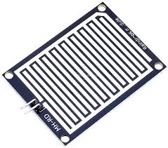
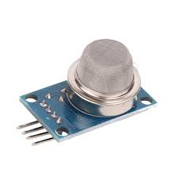
Our Sensor Suite
PIR Motion Sensor
Detects human movement through infrared radiation changes, providing reliable intrusion detection with minimal false positives from pets or environmental factors
Sound Sensor
Measures acoustic signatures to identify breaking glass, forced entry, or unusual disturbances, complementing motion detection for verification
Raindrop Sensor
Monitors moisture accumulation to detect water entry through windows or roof leaks, preventing costly property damage
Gas Sensor
Identifies fire hazards through light and heat signature analysis, enabling early fire detection before smoke alarms activate

Slide 6
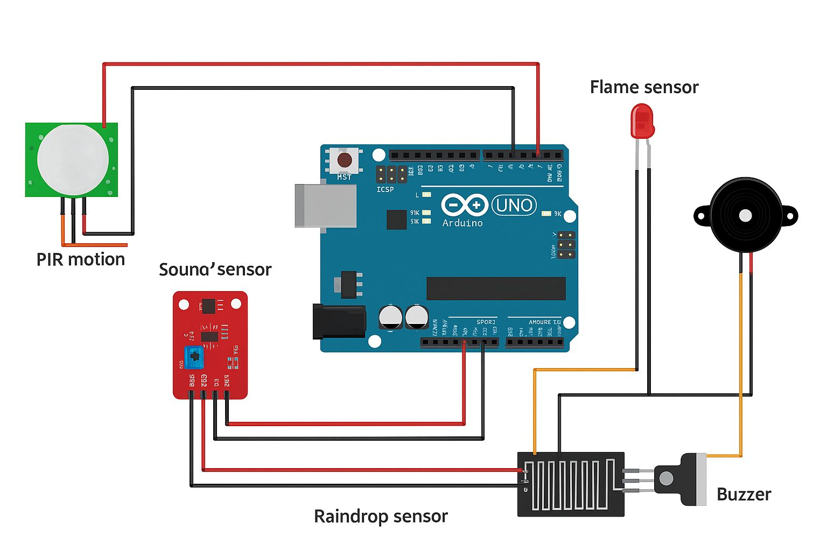
System Architecture
How it works
01
Inputs (Sensors)
PIR, Sound, Gas, Raindrop Sensors
02
Central Processing (Brain)
Arduino UNO - Processes data and executes logic.
03
Outputs (Alerts & Actions)
Buzzer - Audible Alarm
LEDs - Visual Status (Red/Green)
LCD Display - Real-time Status

Slide 7

Technical Implementation
Hardware Architecture
Detection Logic
Arduino UNO - Central processing unit
Four specialized sensors - Comprehensive monitoring
LED indicators - Visual status display
LCD screen - Real-time information
Buzzer system - Audible alerts
if (PIR detects motion) OR
(Sound > threshold) OR
(Flame detected) OR
(Raindrop detected) {
Activate buzzer;
Turn on red LED;
Display ALERT on LCD;
Send notification;
} else {
Green LED ON;
Display SAFE on LCD;
}
Programming Language: C++ optimized for Arduino platform with real-time processing capabilities

Slide 8

Future Improvements
Phase 1: Cloud Integration
Enable remote monitoring, data logging, and smartphone notifications for real-time alerts anywhere
Phase 2: Advanced Sensors
Add gas detection, temperature monitoring, and magnetic door/window sensors for complete coverage
Phase 3: AI Analytics
Implement machine learning for pattern recognition, predictive maintenance, and intelligent false alarm reduction
Phase 4: Enterprise Scale
Support multiple buildings with centralized monitoring, automated emergency services contact, and integration with existing security infrastructure

