Slide 2
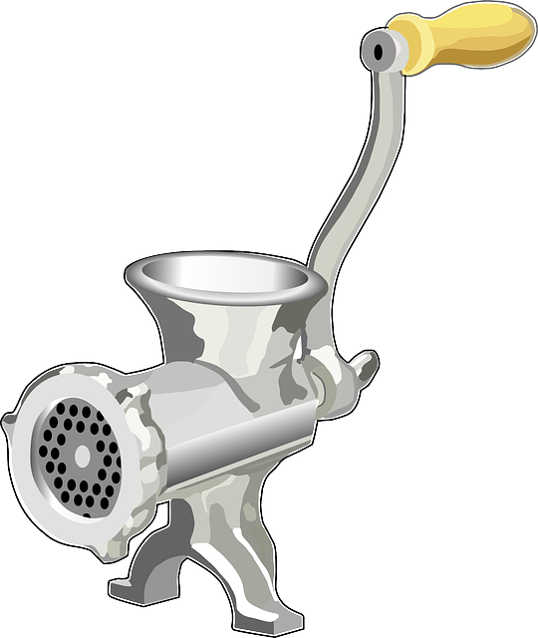


How To Make Sausages

Slide 3
How To Make Compilers?
language
compiler

Slide 4
This Talk
A new approach to the problem of calculating compilers from high-level semantics;
Only requires simple techniques, and all the calculations have been formalised in Coq;
Scales to exceptions, state, variable binding, loops, non-determinism, interrupts, etc.

Slide 5
Arithmetic Expressions
Syntax:
data Expr = Val Int | Add Expr Expr
Semantics:
eval :: Expr → Int
eval (Val n) = n
eval (Add x y) = eval x + eval y

Slide 6


Example
1 + (2 + 3)
Add (Val 1) (Add (Val 2) (Val 3))
6

Slide 7
Step 1 – Stacks
Make the manipulation of arguments explicit by transforming the semantics to use a stack.
Aim: define a new semantics
eval_{S} :: Expr → Stack → Stack
such that
Stack = [Int]
eval_{S} e s = eval e : s

Slide 8
Case for addition:
eval_{S} (Add x y) s
=
eval (Add x y) : s
add (n:m:s) = m+n : s
=
(eval x + eval y) : s
=
add (eval y : eval x : s)
=
add (eval y : eval_{S} x s)
=
add (eval_{S} y (eval_{S} x s))

Slide 9
New semantics:
eval_{S} :: Expr → Stack → Stack
eval_{S} (Val n) s = push n s
eval_{S} (Add x y) s = add (eval_{S} y (eval_{S} x s))
Stack operations:
push n s = n : s
add (n:m:s) = m+n : s

Slide 10
Step 2 – Continuations
Make the flow of control explicit by transforming the semantics into continuation-passing style.
Definition:
A continuation is a function that is applied to the result of another computation.

Slide 11
Aim: define a new semantics
eval_{C} :: Expr → Cont → Cont
Cont = Stack → Stack
such that
eval_{C} e c s = c (eval_{S} e s)

Slide 12
New semantics:
eval_{C} :: Expr → Cont → Cont
eval_{C} (Val n) c s = c (push n s)
eval_{C} (Add x y) c s = eval_{C} x (eval_{C} y (c . add)) s
Previous semantics:
eval_{S} :: Expr → Stack → Stack
eval_{S} e = eval_{C} e (λs → s)

Slide 13
Step 3 - Defunctionalise
Make the semantics first-order again by applying the technique of defunctionalisation.
Basic idea:
Represent the continuations that we actually need using a datatype.

Slide 14
New semantics:
comp’ :: Expr → Code → Code
comp’ (Val n) c = PUSH n c
comp’ (Add x y) c = comp’ x (comp’ y (ADD c))
comp :: Expr → Code
comp e = comp’ e HALT
A compiler for arithmetic expressions!

Slide 15

Example
1 + (2 + 3)
PUSH 1
PUSH 2
PUSH 3
ADD
ADD
HALT

Slide 16
New datatype and its interpretation:
data Code = PUSH Int Code | ADD Code | HALT
exec :: Code → Stack → Stack
exec (PUSH n c) s = exec c (n:s)
exec (ADD c) (n:m:s) = exec c (m+n : s)
exec HALT s = s
A virtual machine for arithmetic expressions!

Slide 17
Example
1 + (2 + 3)
Code
Stack
PUSH 1
PUSH 2
PUSH 3
ADD
ADD
HALT

Slide 18
Example
1 + (2 + 3)
Code
Stack
PUSH 2
PUSH 3
ADD
ADD
HALT
1

Slide 19
Example
1 + (2 + 3)
Code
Stack
PUSH 3
ADD
ADD
HALT
2
1

Slide 20
Example
1 + (2 + 3)
Code
Stack
ADD
ADD
HALT
3
2
1

Slide 21
Example
1 + (2 + 3)
Code
Stack
ADD
HALT
5
1

Slide 22
Example
1 + (2 + 3)
Code
Stack
HALT
6

Slide 23
Example
1 + (2 + 3)
Code
Stack
6

Slide 24
Reflection
We now have a three step process for calculating a compiler from a high-level semantics:
1 - Add a stack
2 - Add a continuation
3 - Remove the continuations
Can the steps be combined?
(see paper)

Slide 25
Summary
Purely calculational approach to developing compilers that are correct by construction;
Only requires simple techniques, and scales to a wide variety of language features;
More sophisticated languages also introduce the idea of using partial specifications.

Slide 26
Further Work
Register-based machines;
Real source/target languages;
Mechanical assistance;
EPSRC application.

