Slide 1
MapReduce
Marziyeh Mousavi
Introduction to datascience
Fall 2024

Slide 2
MapReduce
MapReduce is a programming model for performing parallel processing on large datasets. Although it is a powerful technique, its basics are relatively simple.

Slide 3
Why MapReduce
As mentioned earlier, the primary benefit of MapReduce is that it allows us to distribute computations by moving the processing to the data. Imagine we want to word-count across billions of documents. Our original (non-MapReduce) approach requires the machine doing the processing to have access to every document. This means that the documents all need to either live on that machine or else be transferred to it during processing. More important, it means that the machine can process only one document at a time

Slide 4
Different Phases of MapReduce:
Mapping
Shuffling and Sorting
Reducing
Combining

Slide 5
Different Phases of MapReduce-Mapping
It is the first phase of MapReduce programming. Mapping Phase accepts key-value pairs as input as (k, v), where the key represents the Key address of each record and the value represents the entire record content.​The output of the Mapping phase will also be in the key-value format (k’, v’).

Slide 6
Different Phases of MapReduce-Shuffling and Sorting
The output of various mapping parts (k’, v’), then goes into Shuffling and Sorting phase.​ All the same values are deleted, and different values are grouped together based on same keys.​ The output of the Shuffling and Sorting phase will be key-value pairs again as key and array of values (k, v[ ]).

Slide 7
Different Phases of MapReduce-Reducing
The output of the Shuffling and Sorting phase (k, v[]) will be the input of the Reducer phase.​ In this phase reducer function’s logic is executed and all the values are Collected against their corresponding keys. ​Reducer stabilize outputs of various mappers and computes the final output

Slide 8
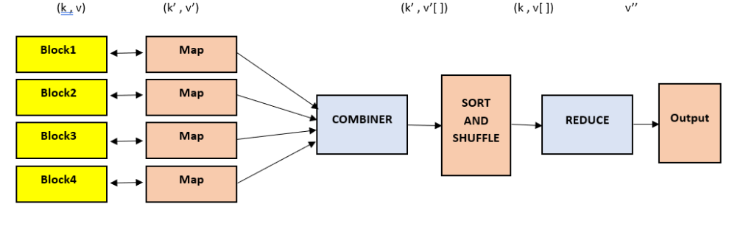
Different Phases of MapReduce-Combining
It is an optional phase in the MapReduce phases .​ The combiner phase is used to optimize the performance of MapReduce phases. This phase makes the Shuffling and Sorting phase work even quicker by enabling additional performance features in MapReduce phases.

Slide 9
Example-Movie
Suppose this is our dataset:
We want to know the rating of a movie based on this dataset
User_ID | Movie_ID | Rating | Timestamp
196 | 242 | 3 | 881250949
186 | 302 | 3 | 891717742
196 | 377 | 1 | 878887116
244 | 51 | 2 | 880606923
166 | 346 | 1 | 886397596
186 | 474 | 4 | 884182806
186 | 265 | 2 | 881171488

Slide 10
Example-Movie
Step 1 – First we have to map the values , it is happen in 1st phase of Map Reduce model.
196:242 ; 186:302 ; 196:377 ; 244:51 ; 166:346 ; 186:274 ; 186:265

Slide 11
Example-Movie
Step 2 – After Mapping we have to shuffle and sort the values.
166:346 ; 186:302,274,265 ; 196:242,377 ; 244:51

Slide 12
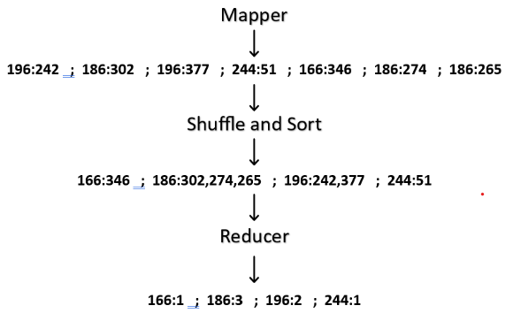
Example-Movie
Step 3 – After completion of step1 and step2 we have to reduce each key’s values.
Now, put all values together

Slide 13
Example-A Word Count
We have a text file which contents are as follows:
Dear, Bear, River, Car, Car, River, Deer, Car and Bear
Now, suppose, we have to perform a word count on the sample.txt using MapReduce. So, we will be finding unique words and the number of occurrences of those unique words.

Slide 14
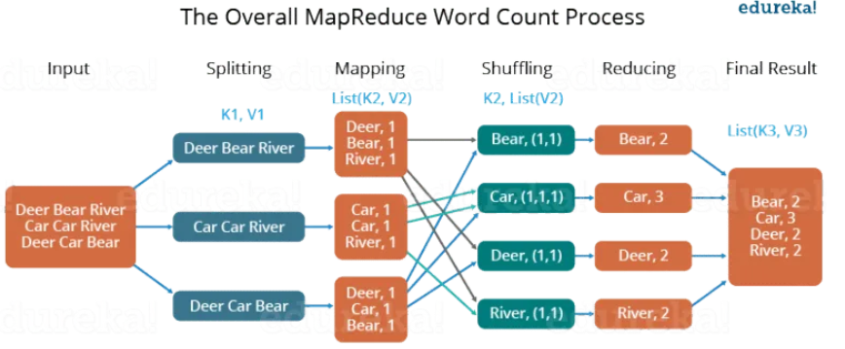
Example-A Word Count

Slide 15
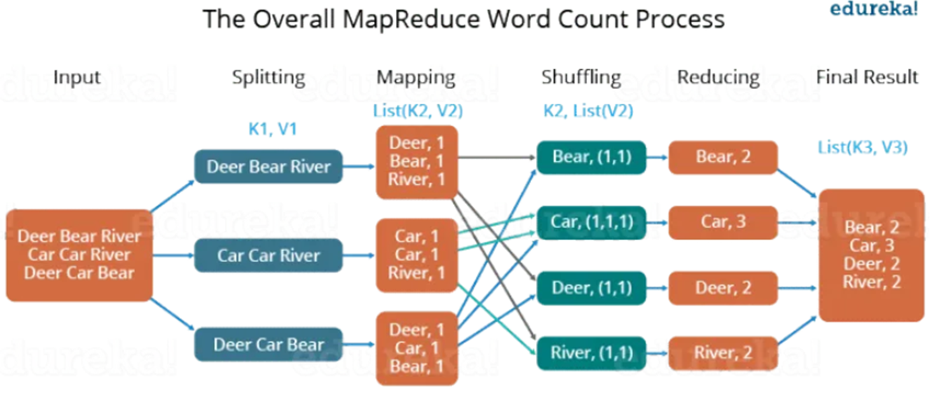
Example-A Word Count
First, we divide the input into three splits as shown in the figure. This will distribute the work among all the map nodes.

Slide 16

Example-A Word Count
Then, we tokenize the words in each of the mappers and give a hardcoded value (1) to each of the tokens or words. The rationale behind giving a hardcoded value equal to 1 is that every word, in itself, will occur once.

Slide 17
Example-A Word Count
Now, a list of key-value pair will be created where the key is nothing but the individual words and value is one. So, for the first line (Dear Bear River) we have 3 key-value pairs — Dear, 1; Bear, 1; River, 1. The mapping process remains the same on all the nodes.

Slide 18
Example-A Word Count
After the mapper phase, a partition process takes place where sorting and shuffling happen so that all the tuples with the same key are sent to the corresponding reducer.

Slide 19
Example-A Word Count
So, after the sorting and shuffling phase, each reducer will have a unique key and a list of values corresponding to that very key. For example, Bear, [1,1]; Car, [1,1,1].., etc.

Slide 20
Example-A Word Count
Now, each Reducer counts the values which are present in that list of values. As shown in the figure, reducer gets a list of values which is [1,1] for the key Bear. Then, it counts the number of ones in the very list and gives the final output as — Bear, 2.

Slide 21


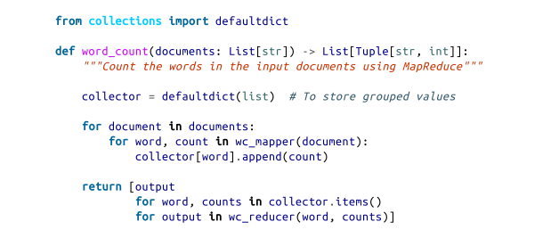
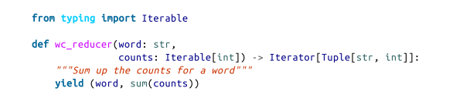
Implementation in python
1
3
2

Slide 22
Advantages of MapReduce
Parallel Processing
Data Locality

Slide 23
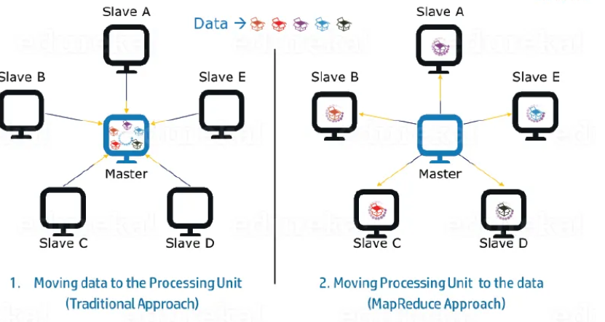
Advantages of MapReduce-Parallel Processing
In MapReduce, we are dividing the job among multiple nodes and each node works with a part of the job simultaneously. So, MapReduce is based on Divide and Conquer paradigm which helps us to process the data using different machines. As the data is processed by multiple machines instead of a single machine in parallel, the time taken to process the data gets reduced by a tremendous amount as shown in the figure below (2).

Slide 24
Advantages of MapReduce-Data Locality
Instead of moving data to the processing unit, we are moving the processing unit to the data in the MapReduce Framework. In the traditional system, we used to bring data to the processing unit and process it. But, as the data grew and became very huge, bringing this huge amount of data to the processing unit posed the following issues:

Slide 25
Advantages of MapReduce-Data Locality
Moving huge data to processing is costly and deteriorates the network performance.
Processing takes time as the data is processed by a single unit which becomes the bottleneck.
Master node can get over-burdened and may fail.

Slide 26
Advantages of MapReduce-Data Locality
Now, MapReduce allows us to overcome the above issues by bringing the processing unit to the data. So, as you can see in the image that the data is distributed among multiple nodes where each node processes the part of the data residing on it. This allows us to have the following advantages:

Slide 27
Advantages of MapReduce-Data
It is very cost effective to move the processing unit to the data.
The processing time is reduced as all the nodes are working with their part of the data in parallel.
Every node gets a part of the data to process and therefore, there is no chance of a node getting overburdened.

Slide 28
Hadoop
Apache Hadoop is an open source framework that is used to efficiently store and process large datasets ranging in size from gigabytes to petabytes of data. Instead of using one large computer to store and process the data, Hadoop allows clustering multiple computers to analyze massive datasets in parallel more quickly.

Slide 29
Hadoop
It is quite expensive to build bigger servers with heavy configurations that handle large scale processing, but as an alternative, you can tie together many commodity computers with single-CPU, as a single functional distributed system and practically, the clustered machines can read the dataset in parallel and provide a much higher throughput. Moreover, it is cheaper than one high-end server. So this is the first motivational factor behind using Hadoop that it runs across clustered and low-cost machine

Slide 30
Hadoop
Hadoop runs code across a cluster of computers. This process includes the following core tasks that Hadoop performs −
Data is initially divided into directories and files. Files are divided into uniform sized blocks of 128M and 64M (preferably 128M).
These files are then distributed across various cluster nodes for further processing.

Slide 31
Hadoop
HDFS, being on top of the local file system, supervises the processing.
Blocks are replicated for handling hardware failure.
Checking that the code was executed successfully.
Performing the sort that takes place between the map and reduce stages.
Sending the sorted data to a certain computer.
Writing the debugging logs for each job.

Slide 32
Spark
Apache Spark is a general-purpose distributed computing solution for processing huge datasets. It was created at the University of California, Berkeley, and has since become one of the industry’s most prominent large data processing frameworks. Spark is intended to deal with a wide range of data sources, such as Hadoop Distributed File System (HDFS), Apache Cassandra, Apache HBase, and Amazon S3.

Slide 33
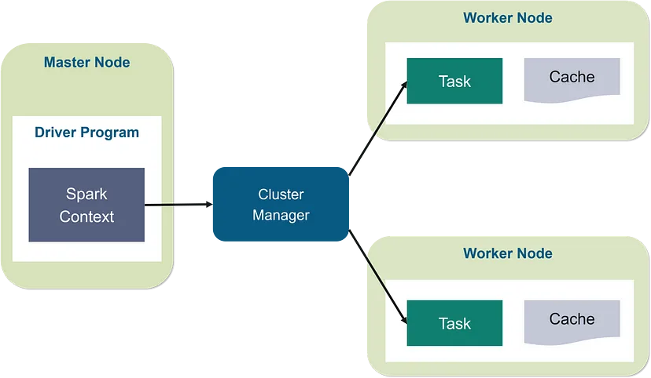
Spark
The master node in Spark’s master-worker architecture is in charge of managing and directing the whole Spark cluster. It distributes resources to various applications and splits data across worker nodes. The master node also manages the fault tolerance mechanism and keeps track of the state of the worker nodes.

Slide 34
Spark
Worker nodes, on the other hand, are in charge of carrying out the tasks delegated to them by the master node. Each worker node has its own set of resources, including as CPU, memory, and storage, and can handle one or more tasks at the same time. When the master node assigns a task to a worker node, it also provides the relevant data to that node for processing.

Slide 35
Spark
The cluster manager supervises the allocation of resources to the various applications operating on the cluster and communicates with the master node and worker nodes.

