Slide 1
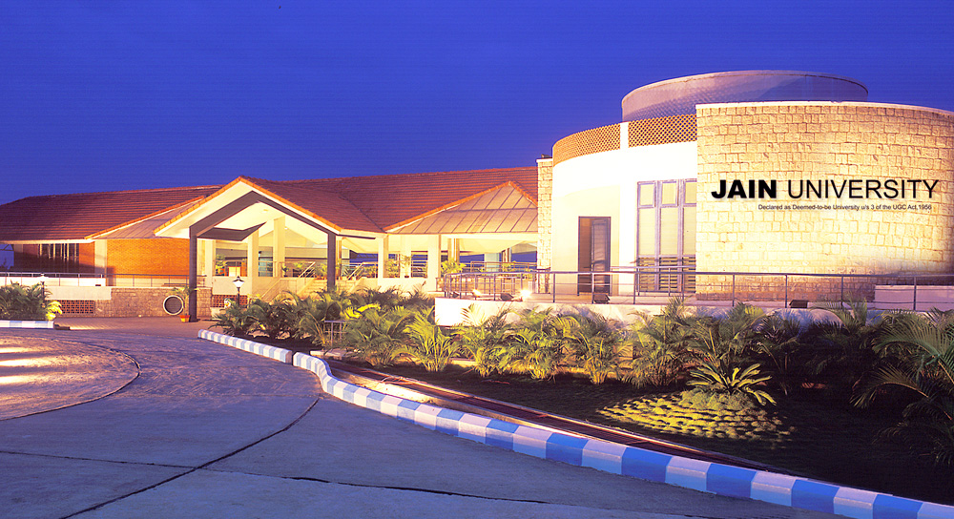

Slide 2
Title of Project
SubAud
Submitted By:
Adithya N Aditya Rajesh Gurusudhanva Mohammad Fawaaz Patel Nived PV 22BTRCO006 22BTRCO007 22BTRCO019 22BTRCO028 22BTRCO30
CSE-BFSI/IOT CSE-BFSI/IOT CSE-BFSI/IOT CSE-BFSI/IOT CSE-BFSI/IOT
Under the guidance of
Dr.Rachit Garg
CSE IOT,
School of Computer Science

Slide 3
Table of Contents
Problem Statement
Introduction
Literature Survey
Existing System

Slide 4
Problem Statement
Language Barrier
A difficulty for people communicating because they speak different languages.

Slide 5
Introduction
What is SubAud?
Subtitle generating website in required native languages.

Slide 6
Literature Survey
Tensor2Tensor for Neural Machine Translation
Abstract:
Tensor2Tensor is a library for deep learning models that is well-suited for neural machine translation. Development began focused on neural machine translation and so Tensor2Tensor includes many of the most successful NMT models and standard datasets.
Author | Year | Advantages | Problems
Ashish Vaswani1 , Samy Bengio | 2019 | T2T-specific abstractions, researchers can train models on CPU, GPU (single or multiple), and TPU, locally and in the cloud, usually with no or minimal device-specific code or configuration. | Dataset. The problem will be getting the data.The problem will arise with creating a dataset from scratch which will become a slightest problem for T2T.

Slide 7
The Multilingual TEDx Corpus for Speech Recognition and Translation
Abstract:
TEDx has released a Multilingual TEDx corpus, a collection of audio recordings from 8 source languages, designed to support speech recognition (ASR) and speech translation research. The corpus, available with open-sourced code, allows for extension to new talks and languages, improving translation performance for low-resource language pairs.
Author | Year | Advantages | Problems
Matt Post, Marco Turchi, Matthew Wiesner | 2021 | Multilingual corpus provides as with collection of audio library. | Tedx corpus provides audio for only major languages like English, French, German etc..

Slide 8
Spoken Neural Translation System for Spoken Language System:
Abstract:
This abstract explores the synergy between encode-decode and attention mechanisms in Natural Language Understanding (NLU). The encode-decode framework, inspired by sequence-to-sequence models, forms the foundation for many NLU systems. Additionally, attention mechanisms, particularly self-attention and multi-head attention, enhance NLU by capturing contextual information and improving long-range dependencies. These combined techniques have revolutionized NLU, leading to state-of-the-art performance in tasks like machine translation, text summarization, and chatbot development. Their ongoing role in advancing NLU is pivotal for improving language understanding and generation
Author | Year | Advantages | Problems
CHRISTOPHER NOLAN,HU TANG WANG | 2015 | NMT systems are able to produce more accurate and fluent translations, especially for complex and challenging text. | NMT systems are still under development, and they are not perfect. They can sometimes make mistakes, especially when translating complex or challenging text.

Slide 9
Recurrent Neural Networks: An Embedded Computing Perspective
Abstract:
Recurrent Neural Networks (RNNs) are a class of machine learning algorithms used for applications with time-series and sequential data. Recently, there has been a strong interest in executing RNNs on embedded devices. However, difficulties have arisen because RNN requires high computational capability and a large memory space. In this paper, we review existing implementations of RNN models on embedded platforms and discuss the methods adopted to overcome the limitations of embedded systems. We will define the objectives of mapping RNN algorithms on embedded platforms and the challenges facing their realization. Then, we explain the components of RNN models from an implementation perspective. We also discuss the optimizations applied to RNNs to run efficiently on embedded platforms. Finally, we compare the defined objectives with the implementations and highlight some open research questions and aspects currently not addressed for embedded RNNs. Overall, applying algorithmic optimizations to RNN models and decreasing the memory access overhead is vital to obtain high efficiency. To further increase the implementation efficiency, we point up the more promising optimizations that could be applied in future research. Additionally, this article observes that high performance has been targeted by many implementations, while flexibility has, as yet, been attempted less often. Thus, the article provides some guidelines for RNN hardware designers to support flexibility in a better manner.

Slide 10
Author | Year | Advantages | Problems
NESMA M. REZK TOMAS NORDSTRÖM 1,MADHURAPURNAPRAJNA 2, 3,ANDZAINUL-ABDIN | 2017 | Recurrent Neural Networks(RNNs) are a class of Neural Net works (NNs) dealing with applications that have sequential data inputs or outputs. It mainly uses patterns and sequences and decodes it using machine translation. | Requires high computational capability and large memory.

Slide 11
Automatic Caption Generator:
Abstract:
The last ten years have been the witnesses of the emergence of any kind of video content. In the same time, certain individuals are deaf and occasionally cannot understand the meanings of such videos because there is not any text transcription available. Hence, it becomes important to make videos available to people who have these problems and even more to remove the gaps of native languages among them. This can be best done by providing subtitles of a video. However, downloading subtitles of any video from the internet is a tedious process. So, to generate subtitles automatically through the software itself and without the use of internet is the main concept of this paper. The objective of this paper is to provide an overview of generating subtitle on offline basis using CMUSPHINX4 java API. This system will first extract the audio, then recognize the extracted audio with CMUSPHINX4 java API. Later this system writes the recognized text to the text file with timestamp and saves it with .srt extension. Then, this .srt file can be opened in a media player to view the subtitles along with video.

Slide 12
Author | Year | Advantages | Problems
Neel Patel1, Hemil Pansuria1, Jay Patel1, Bhavik Darji1, Prashant Sahatiya2 | 2015 | CMUSphinx-4 is open-source software, which means it's free to use and can be customized according to your needs and it can work offline, which means it doesn't require a constant internet connection.

Slide 13
Existing system
Similar website are already in existence like google translate, Microsoft translate, systran etc.
Similarly, there are no dedicated website for subtitle generation for native languages of India.

Slide 14
THANK YOU

