Slide 1
Vision Transformer Acceleration under Graph Processing Perspective

Slide 2
Background and Motivation

Slide 3
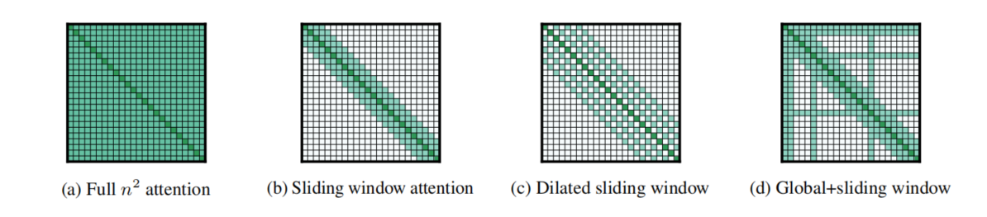
Acceleration in hardware and software methods
In traditional transformer structure, acceleration methods are classified into hardware and software techniques
longformer
Acceleration methods like longformer focus on local attention compared to global attention, which lessen the computation significantly. However, they concentrate little on other factors like memory access efficiency.
In Q*K and S*V(S = softmax(QK)), the whole vector/matrix is loaded, including those sparse positions, which actually are no longer useful in later computation

Slide 4
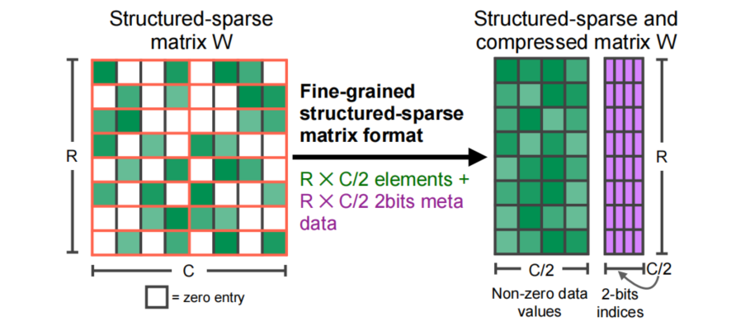
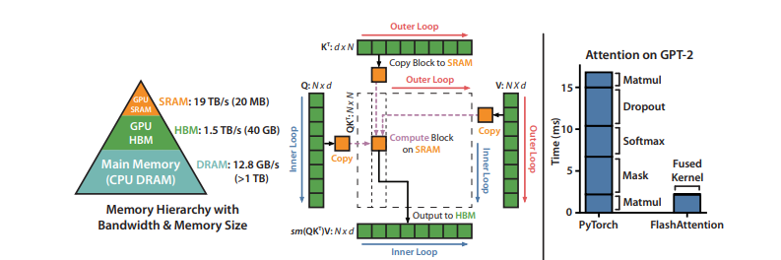
Acceleration in hardware and software methods
n-m sparsity
flash attention
In n-m sparsity and flash attention acceleration models, the acceleration mainly effectes hardware layer, solve the memory access problem to some extent. But optimization is available in software layer.

Slide 5
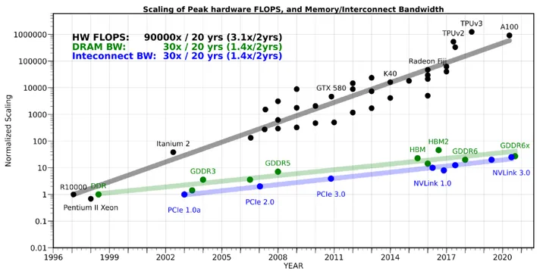
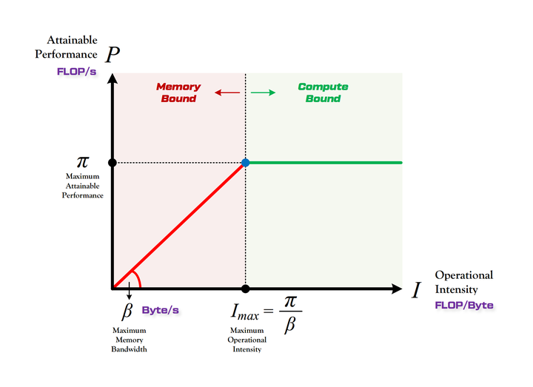
Memory Bound
If we don’t consider the optimization from GPU, here is some analysis：
V100 GPU: I_max = 15.56
vision transformer: I = 7.98
longformer: lessen the pi value, but the β value almost unchang。
Problem 1: It seems that software and hardware acceleration is splited in traditional NLP transformer.
How about vision transformer?

Slide 6
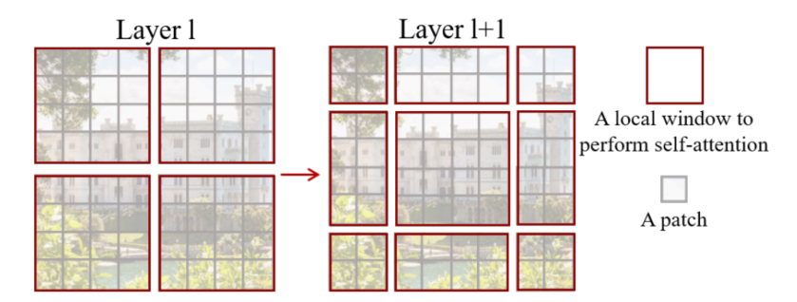
Vision Transformer(ViT)
In vision transformer, the structure of image provide some different properties, and the acceleration methods is slightly different due to the property of 2d image.
- regular structure.
- 2d structure provide more information, but also become more complex.
- token locality changes from 1d to 2d(top/down/left/right).
- different positional encoding(1d -> 2d in some ViT models)
2d structure brings more information.
Problem 2: How do we use it？
For example, swin transformer：2d local attention
swin transformer

Slide 7
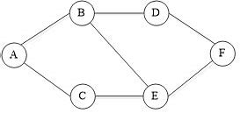
Graph is a structure with complex information
- locality
- can be treated as n-dimension topo information, thus providing rich information
- ...
Let’s thinking the ralations: Graph, Image and Transformer.

Slide 8
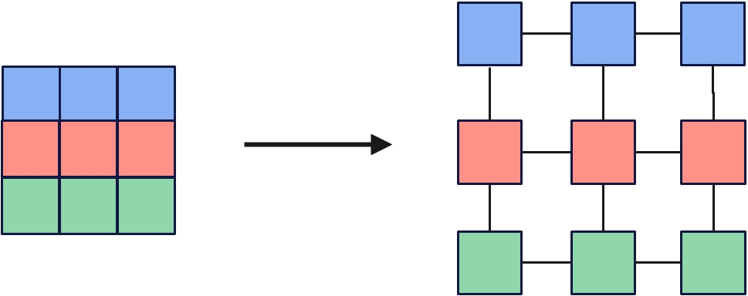
Graph and Transformer
- transformer(attention) is a special expression of gnn (message passing)
- transformer performs a global message passing operation, it means the 'graph'
constructed by transformer is a complete graph; while message passing perform localy (only share message with its 1-hop neighbours) --> is there any compromise method? --> most of local attention methods
- transformer and graph both has permutation invariance. So that's why transformer need the position coding as extra information.
Graph and Image(Img2Graph)
Many algorithms to perform img2graph!

Slide 9
If we build the information into graphs, the bfs&dfs correspond to local&global attention
bfs可以在图中采样出一个局部序列，而dfs可以在图中采样出一个全局范围的序列。有点类似于node2vec，在Img2Graph的操作后进行兼顾bfs和dfs的采样，使attention以局部学习为主，同时进行全局的学习。减少计算量，同时保证能学习到全局信息。

Slide 10
Contributions

Slide 11
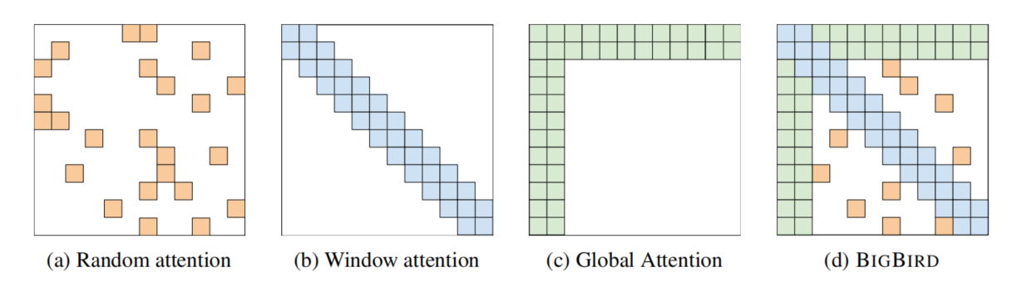
longformer
bigbird
discuss the sliding window attention and global attention, introduce methods to lessen the computation while keep the precision(inference/train)
Problem 1 is left to be solved!

Slide 12
use hardware view to lessen computation/memory access cost
n-m sparsity
Problem 1 is left to be solved!
flash attention

Slide 13
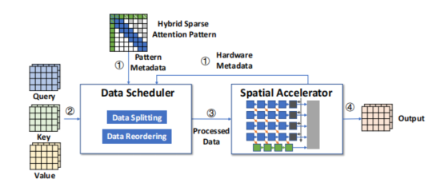
SALO: An Efficient Spatial Accelerator Enabling Hybrid Sparse
Attention Mechanisms for Long Sequences
In SALO, a hardware acceleration method is proposed to supplement window attention.
It seems that Problem 1 is solved?
The only drawback: limitation in sparsity pattern

Slide 14
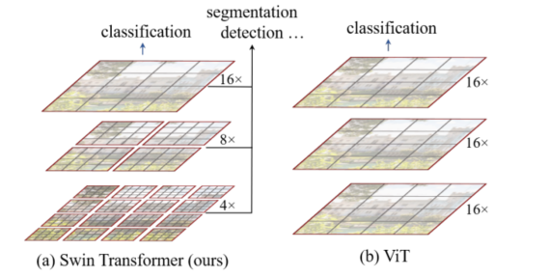
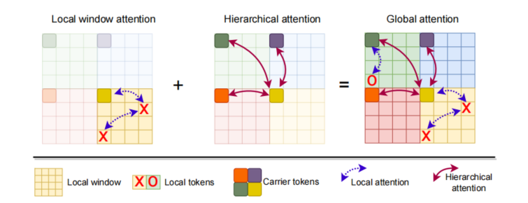
swin transformer
fastervit(with cuda acceleration)
In vision transformer, swin trasformer and fastervit decrease the computation in vision transformer, images are splited hierarchically, using the locality of images.
Problem 1 is still here without corresponding accelerators

Slide 15
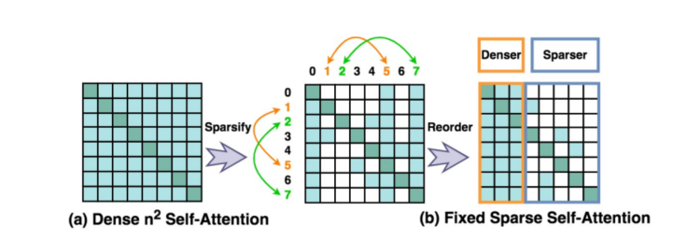
VitCOD
VitCOD work in both software and hardware perspective
- ‘one-fit-all’ in vision transformer: using fixed sparse mask in transformer layer won’t decrease the final precision extremely.
- decrease the computation and lower the memory access cost at the same time -- using differentiated sparsity.
Actually can’t handle the Problem 2 gracefully(mentioned later).

Slide 16
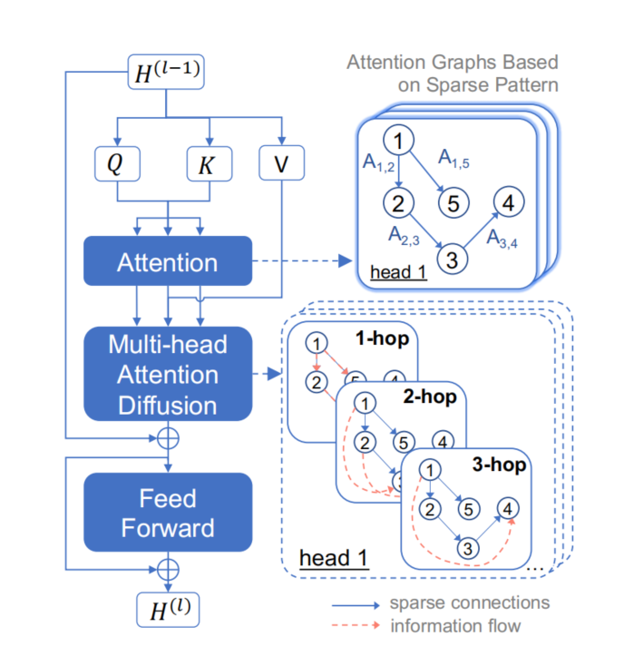
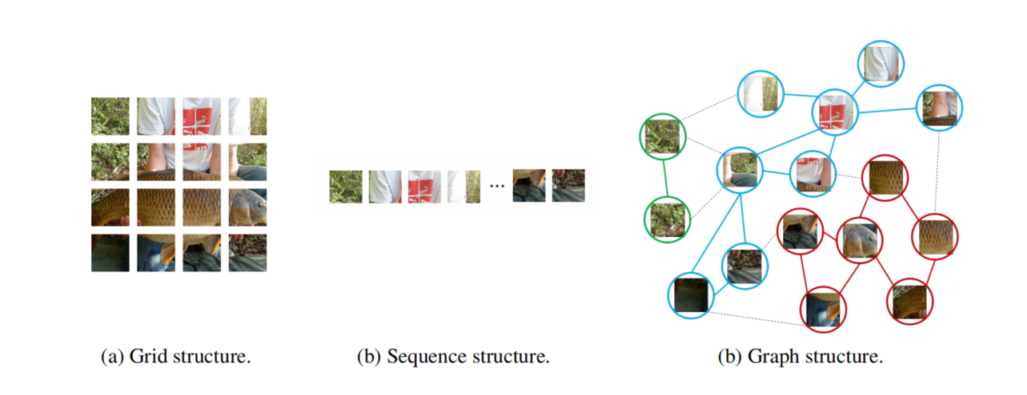
Diffuser
VisionGNN
Inspires: maybe graph structure can be used in visoin transformer:
- handle the 2d image information(solve Problem 2)
- design accelerators is a must

Slide 17
Problems & Methods

Slide 18
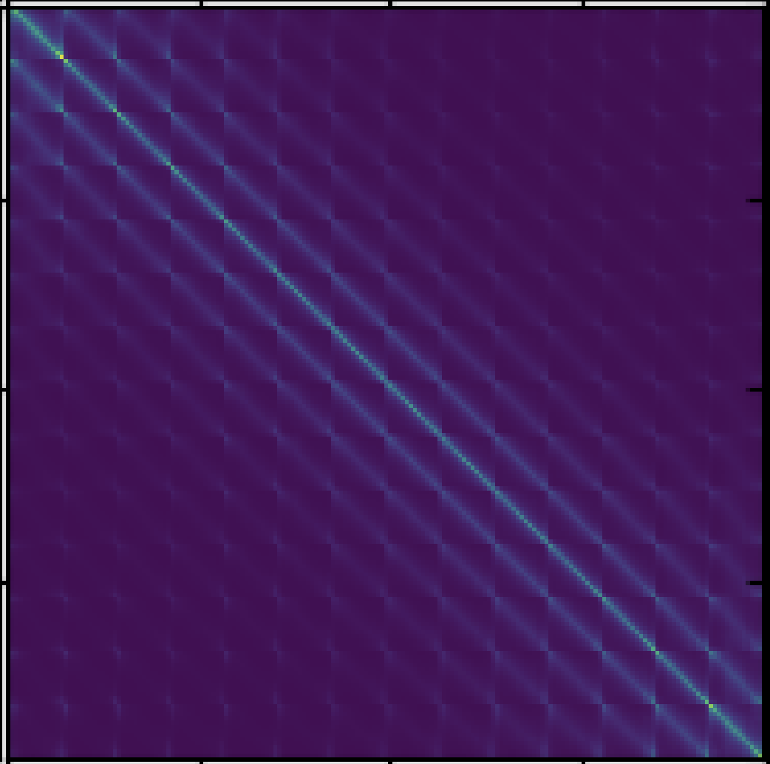
rethink a phynomenon vision transformer:
Maybe not so suitable for VitCod!

Slide 19
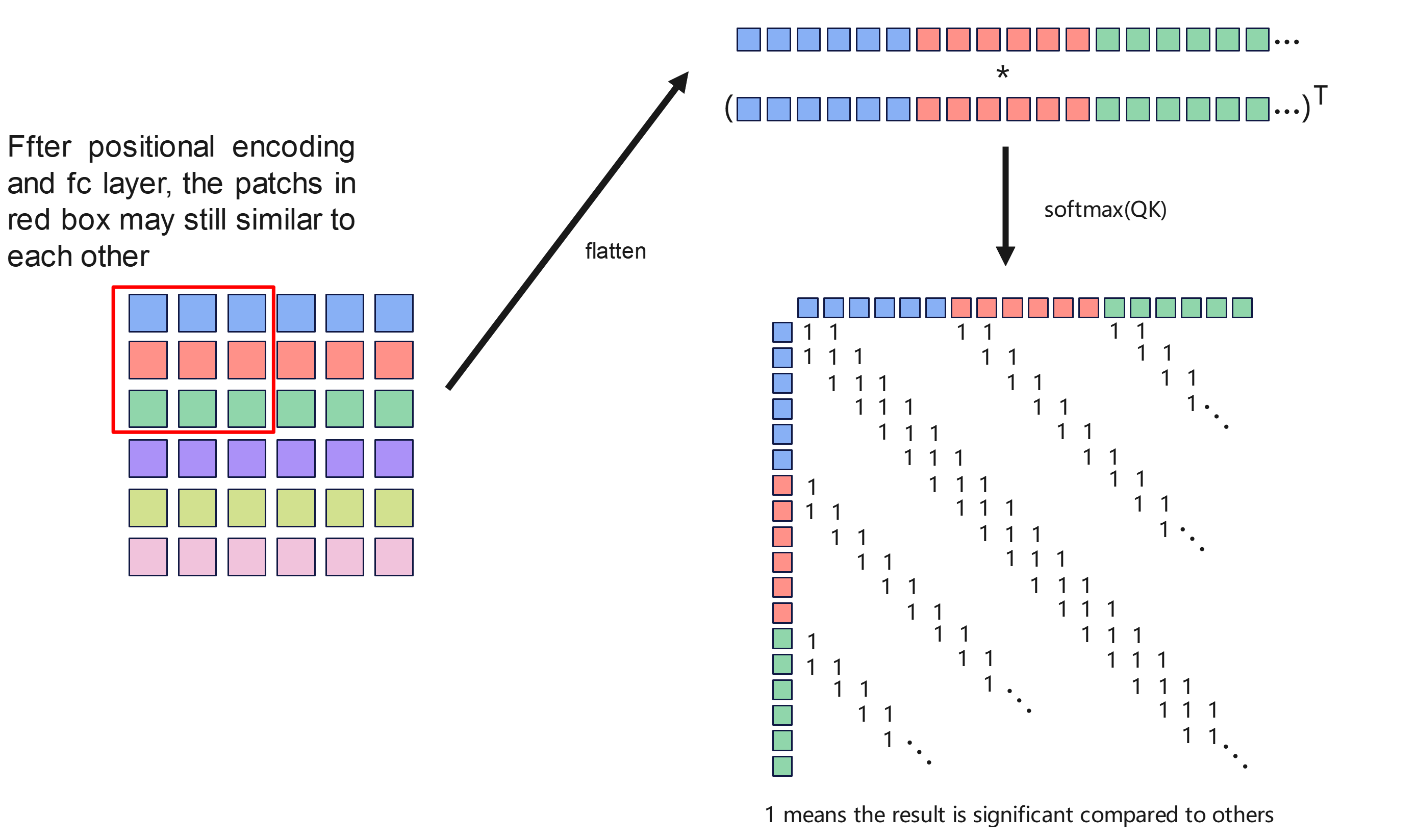
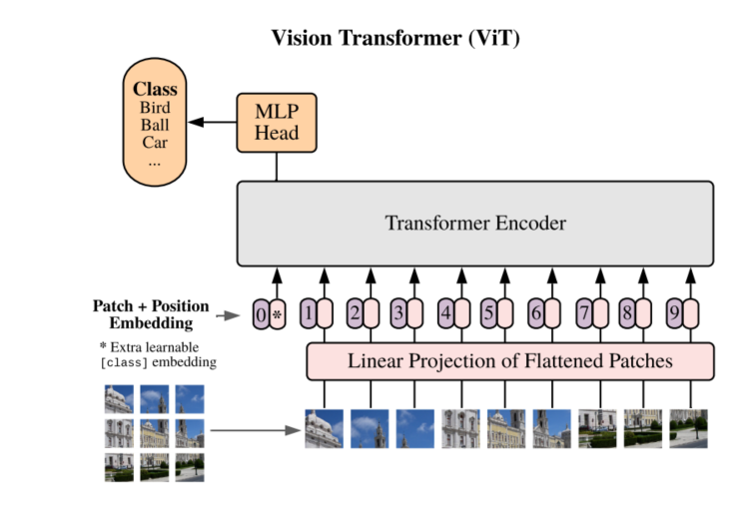
Rethink the process of vision transformer

Slide 20
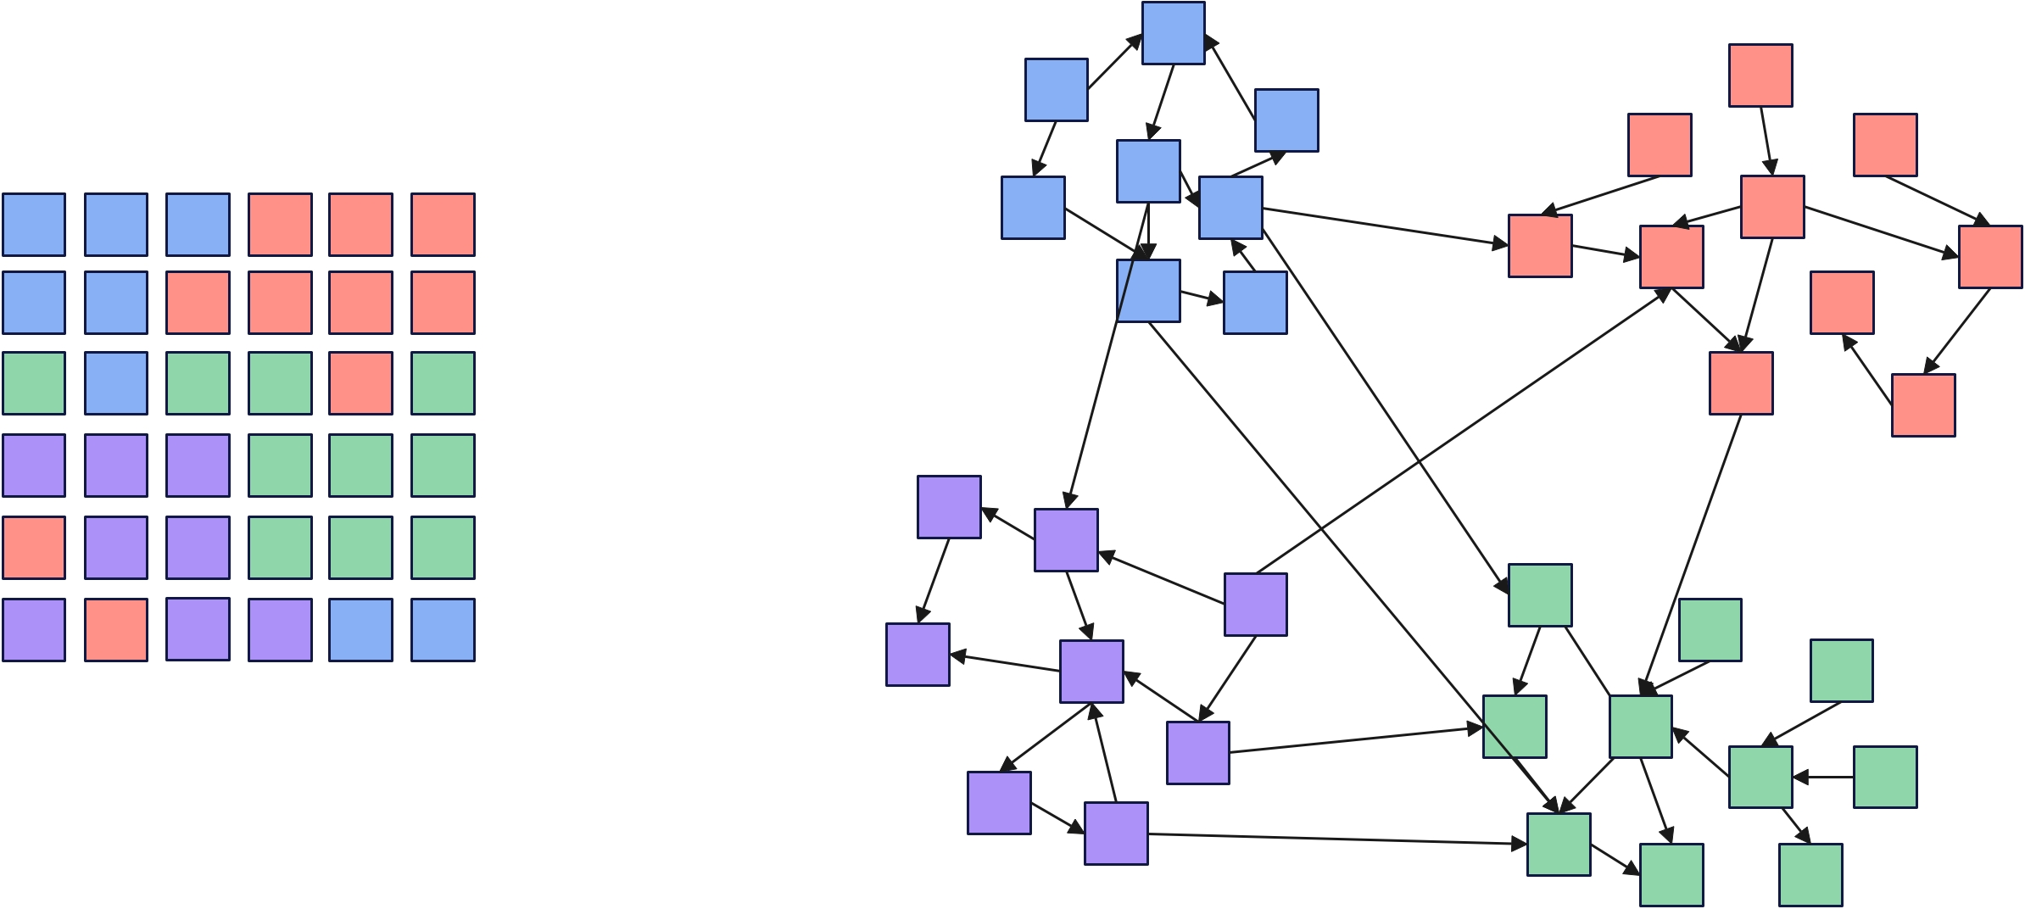
Image2Graph
Here, patches with same color represent similar patches after embedding

Slide 21
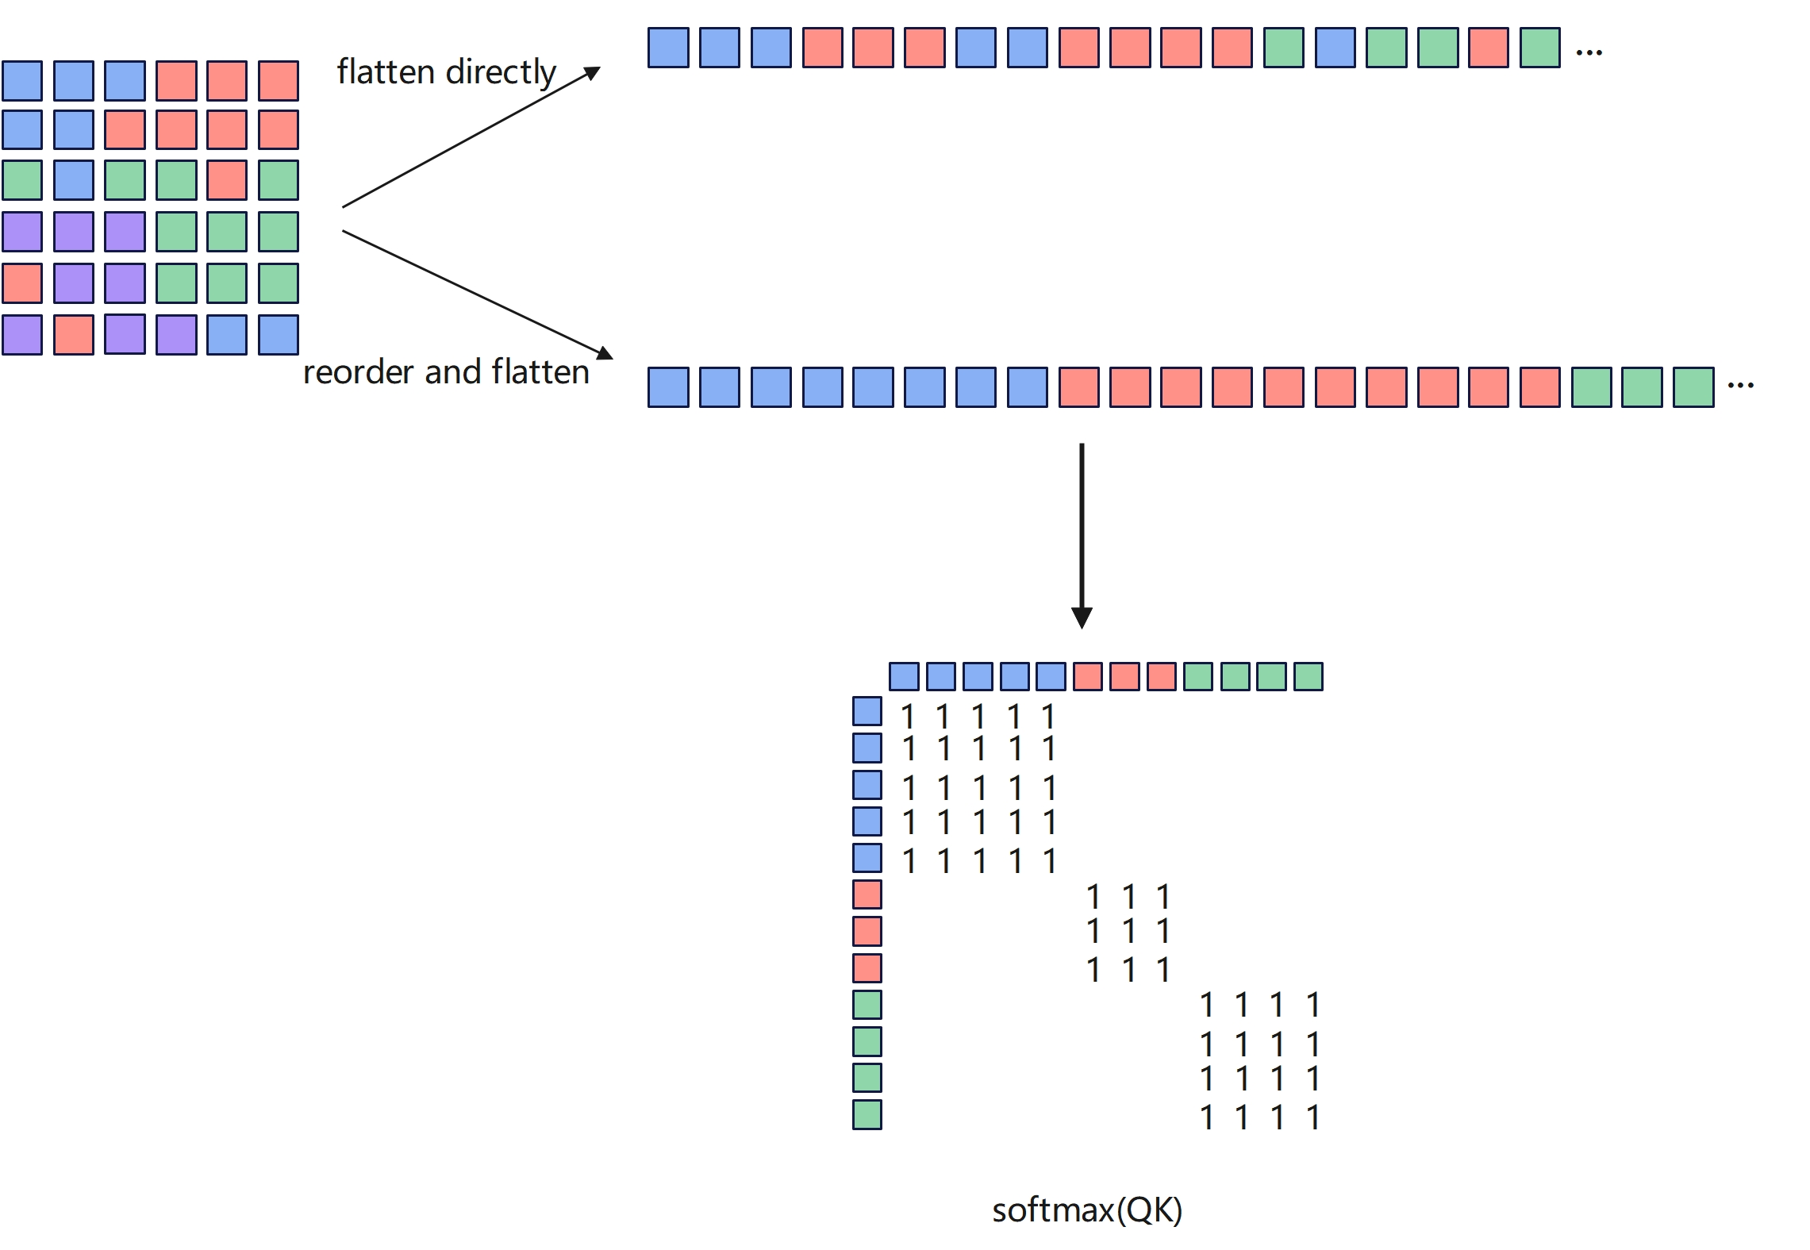
Reorder Operation

Slide 22
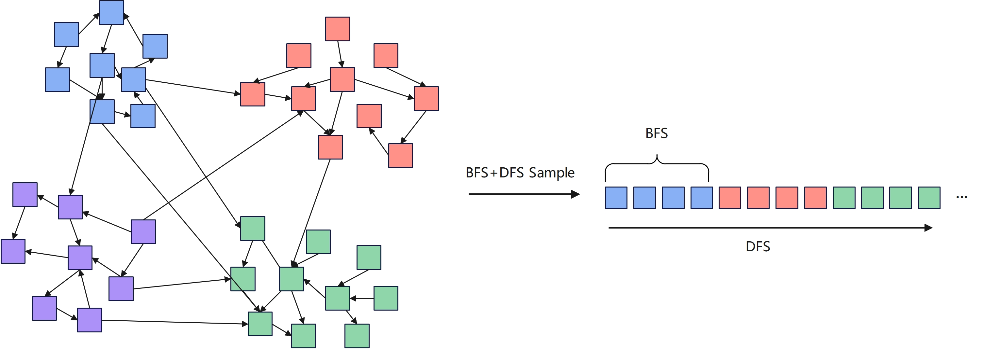
Sample Operation

Slide 23
Some experiments

Slide 24
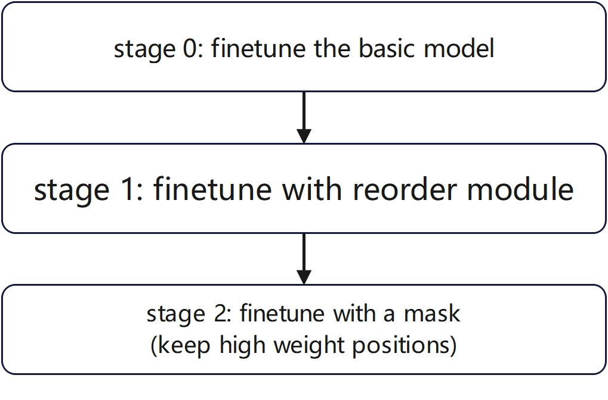
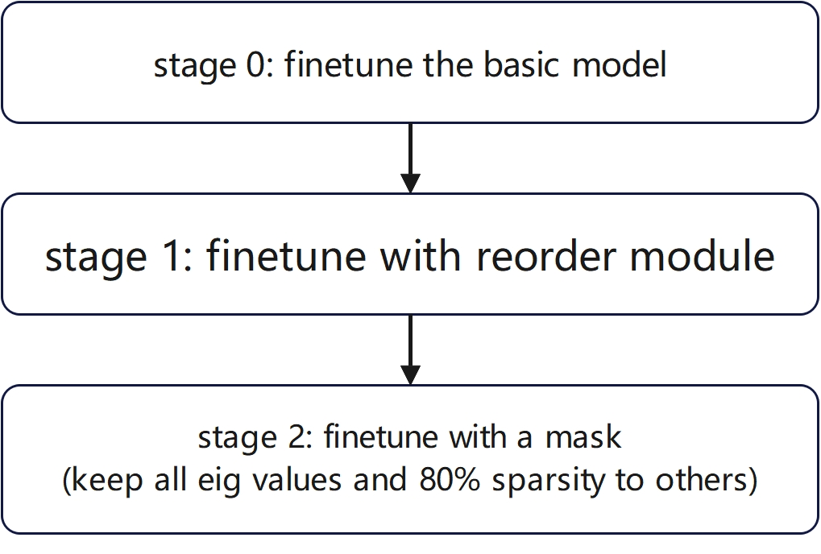
Graph and Reorder Operation:
A three stage workflow 1
A three stage workflow 2
Sparsity | 50% | 70% | 90% | workflow2
Precision | 81.1% | 80.5% | 79.6% | 80.1%
Next Direction: consider differentiated quantization

