Slide 1

Implementation and evaluation of the reinforcement learning methods Self-Play and League Training in the MicroRTS environment
Presentation for the bachelor thesis
Niklas Glaser
Heinrich-Heine-Universitaet Duesseldorf
April 2026
1 / 23

Slide 2
Overview
1
Motivation
2
Approach
3
Experiments
4
Results
5
Discussion
6
Conclusion
2 / 23

Slide 3
Goals and Research Question
Base Agent
combination of Behavioral Cloning (BC) and Proximal Policy Optimization (PPO)
strong baseline, but weaknesses against several opponents
Goal
improve the Base Agent with League Training (LT)
training against a more diverse set of opponents
focus on robustness and generalization
Research Question
How much does LT with PPO improve robustness and generalization of the BC/PPO-pretrained agent?
How strongly does this depend on the diversity of initial agents and BC experts?
3 / 23

Slide 4
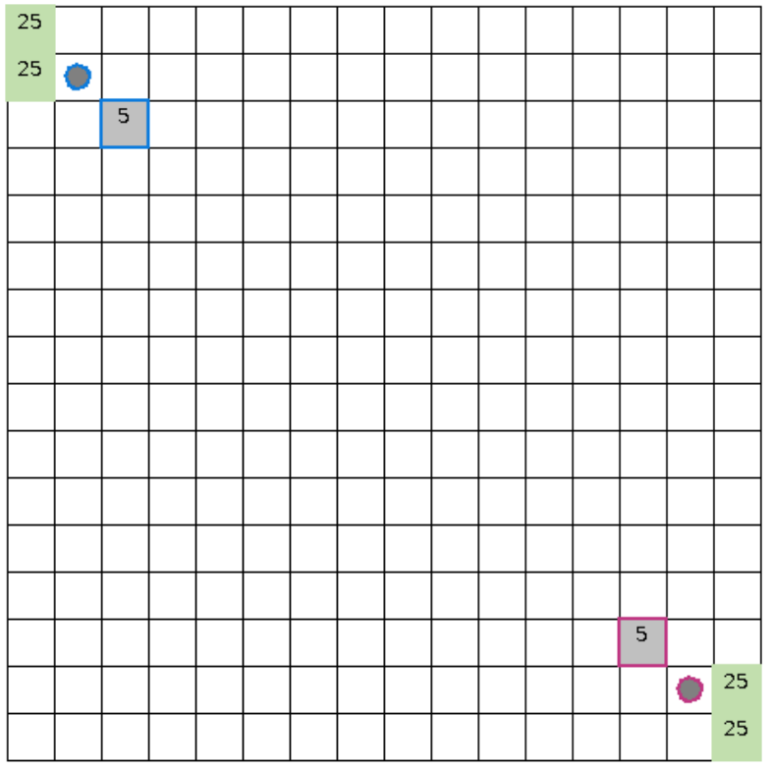
Setting
MicroRTS
simplified RTS environment for RL research
still contains resource management, unit production and combat
supports controlled and repeatable experiments
Main RL challenges
large combinatorial action space
simultaneous decisions
delayed and sparse rewards
robustness against diverse opponents
Click the play area to start the embedded MicroRTS example video.
4 / 23

Slide 5
Training Pipeline
BC -> BC-FT -> PPO -> LT -> PPO fine-tuning
BC / BC-FT: imitate strong scripted opponents to obtain a competent initial policy
PPO: refine the policy through exploration
LT: train against a population of evolving opponents instead of only bots or pure self-play
Fine-tuning: fix remaining weaknesses after LT, especially against WorkerRushAI
5 / 23

Slide 6
From SP to LT
SP
train against the current version of the agent; simple, but prone to overfitting or cyclical strategies
FSP
train against a set of past policies; reduces forgetting, but opponent choice is still crude
PFSP
sample opponents based on current win rates; focuses on informative and non-trivial matchups
LT
add role-based agents: Main Agent, Historical Agents, Main Exploiters and League Exploiters
Why LT?
LT does not only preserve diversity through historical snapshots, it also creates diversity through exploiters that actively search for weaknesses of the current policy.
6 / 23

Slide 7
League Training Design
Main Agent: primary policy
Historical Agents: frozen snapshots for stability
Main Exploiters: exploit weaknesses of historical Main Agents
League Exploiters: search for broader league weaknesses
Key idea
LT turns robustness against diverse opponents into part of the optimization target.
7 / 23

Slide 8
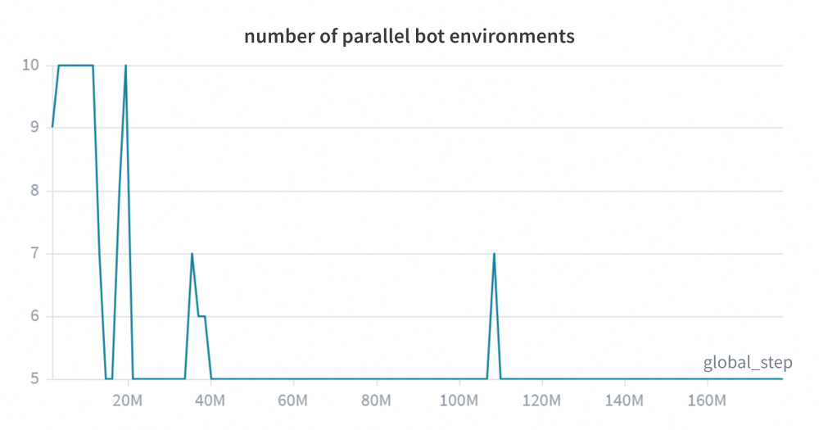
Bot Environments
additional dynamic bot environments (CoacAI and Mayari)
scripted bots: CoacAI, Mayari, WorkerRushAI, PassiveAI, LightRushAI, RandomAI and RandomBiasedAI
MCTS based bots: Rojo, MixedBot, Izanagi, Tiamat, Droplet, GuidedRojoA3N and NaiveMCTS
8 / 23

Slide 9
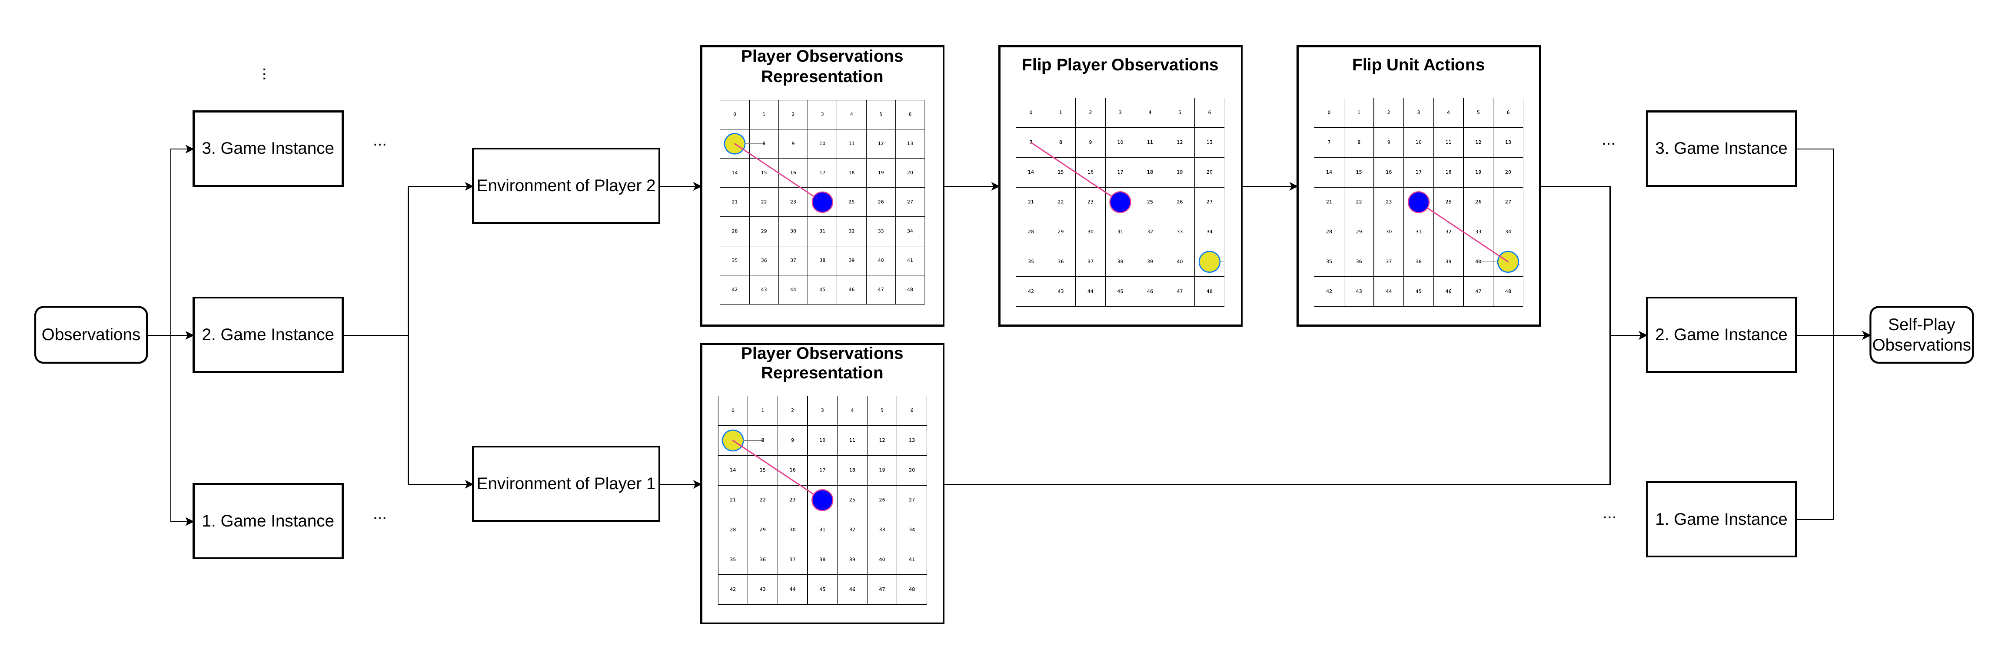
Observation Adjustment for SP
Player 2 observations are transformed so SP remains compatible with a Base Agent only trained as Player 1.
9 / 23

Slide 10
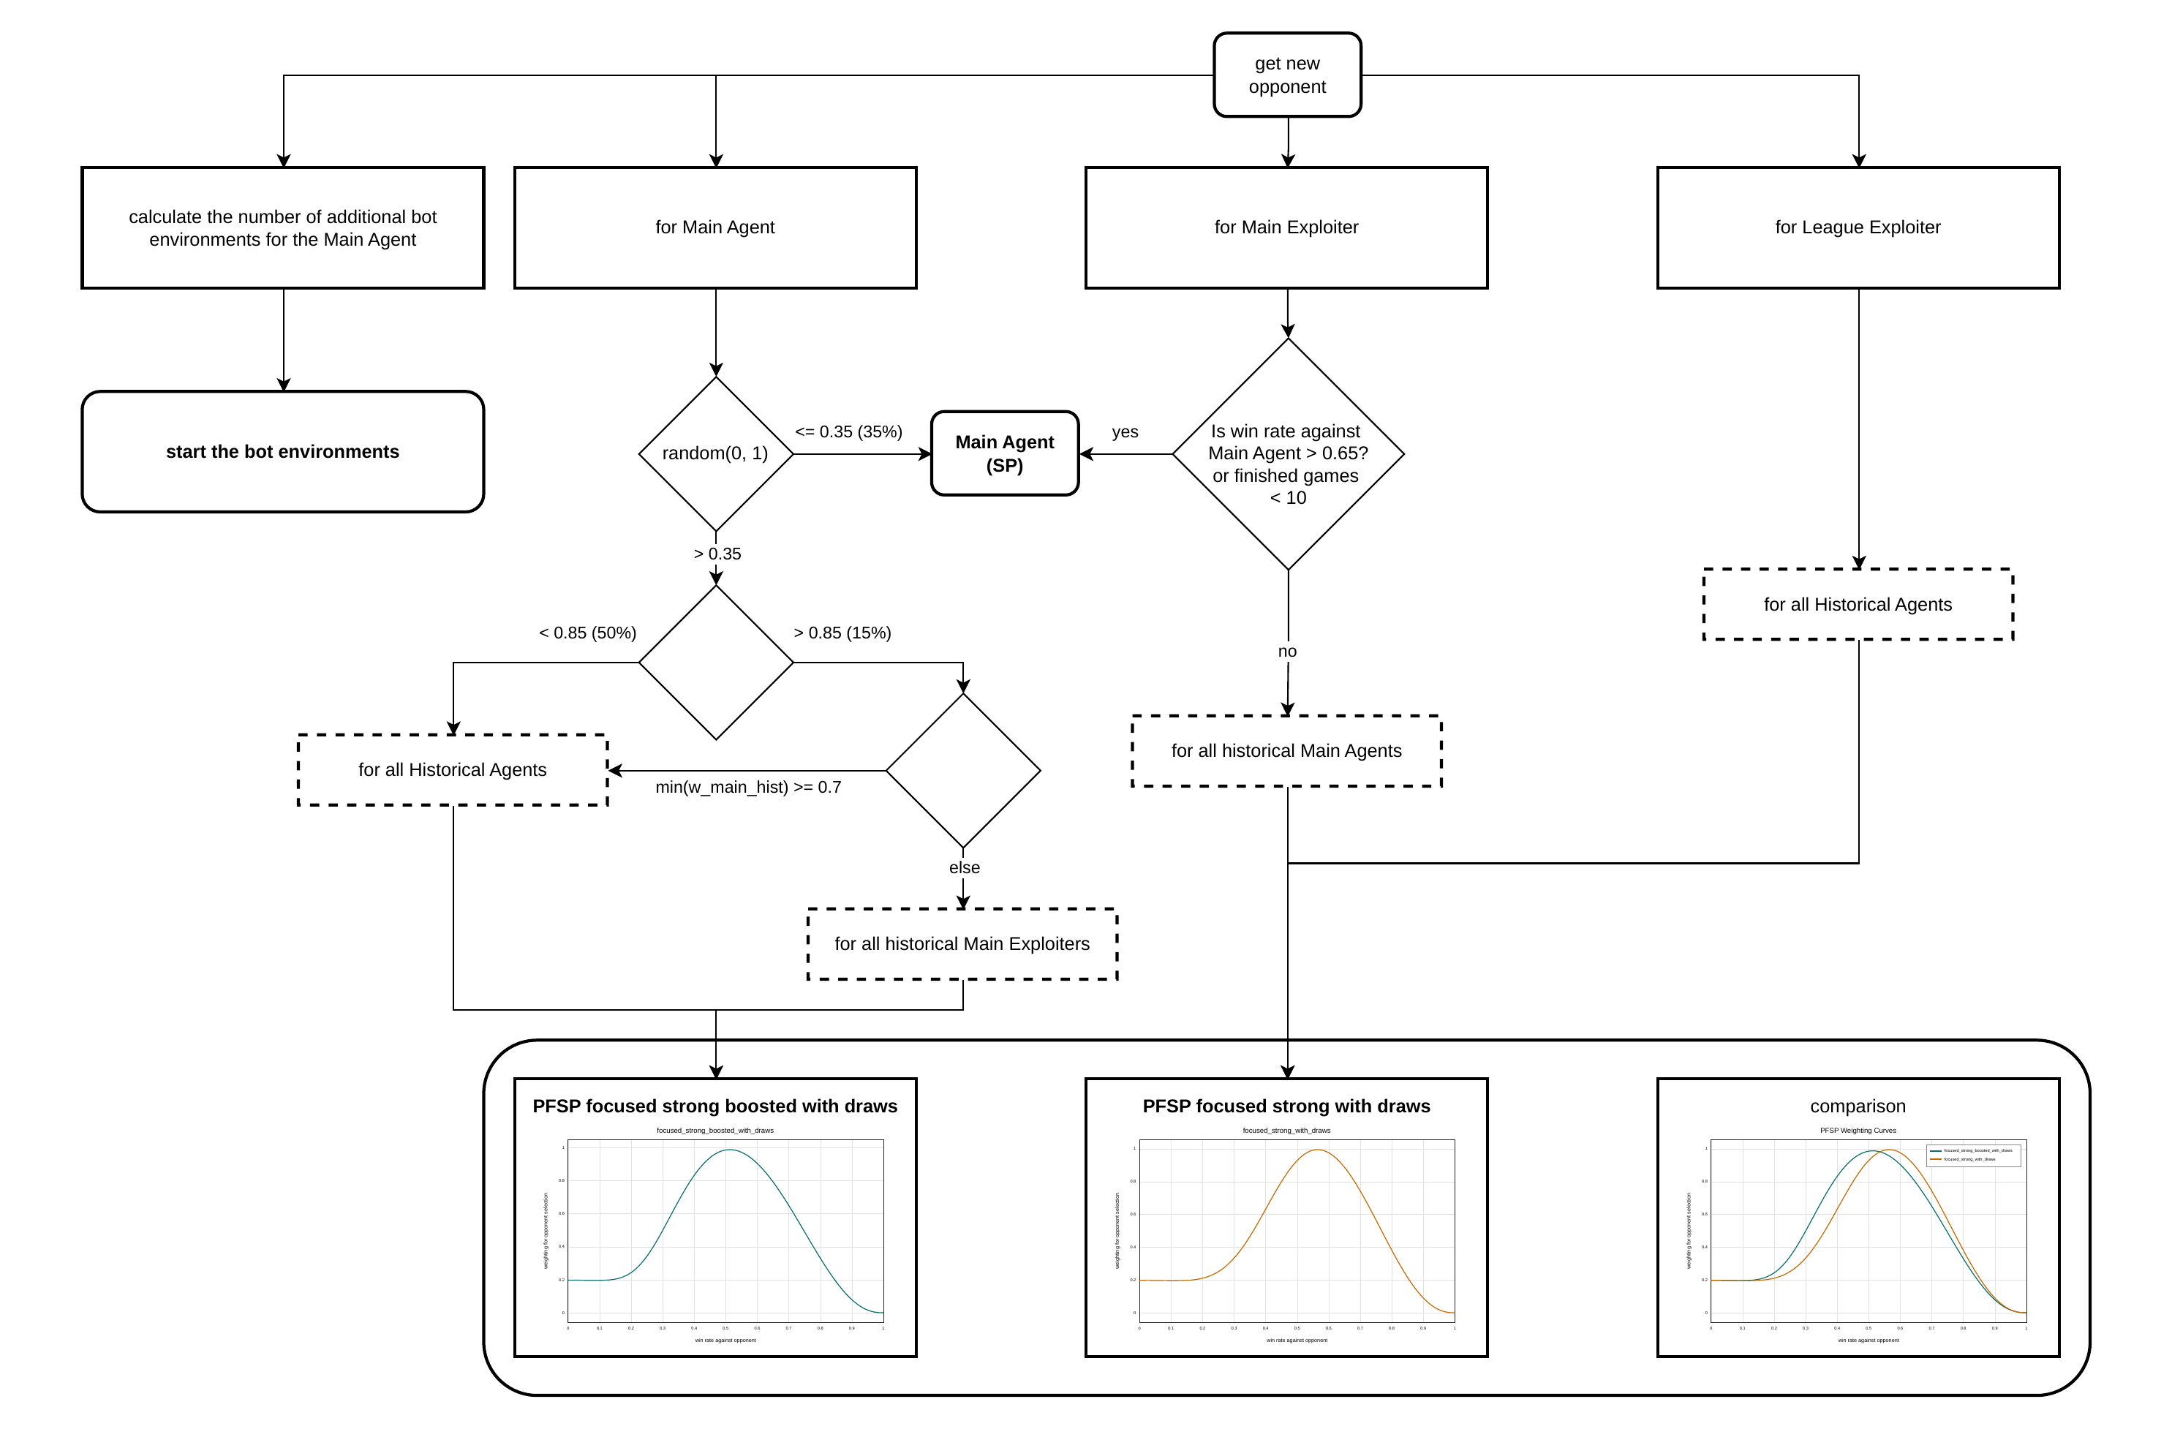
LT Matchmaking
Matchmaking and opponent sampling in the LT setup.
10 / 23

Slide 11
Other Implementation Changes
delta score
annealed entropy coefficient
new initial agents
11 / 23

Slide 12
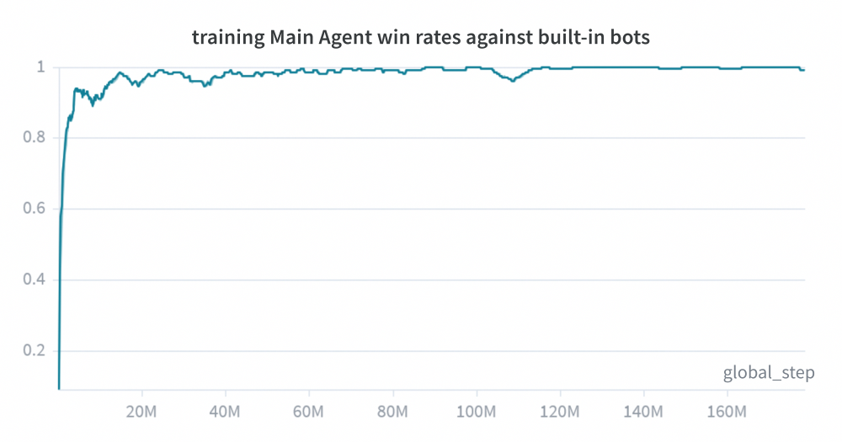
Experiment Setup
map: basesWorkers16x16A
LT setup: 1 Main Agent, 4 Main Exploiters, 1 League Exploiter
25 environments per learning agent
5 to 10 additional dynamic bot environments
approximately 130 million LT steps
training time: about 100 hours
maximum setup size: 160 parallel environments
evaluations over at least 100 games against 12 opponents after LT and after fine-tuning
12 / 23

Slide 13
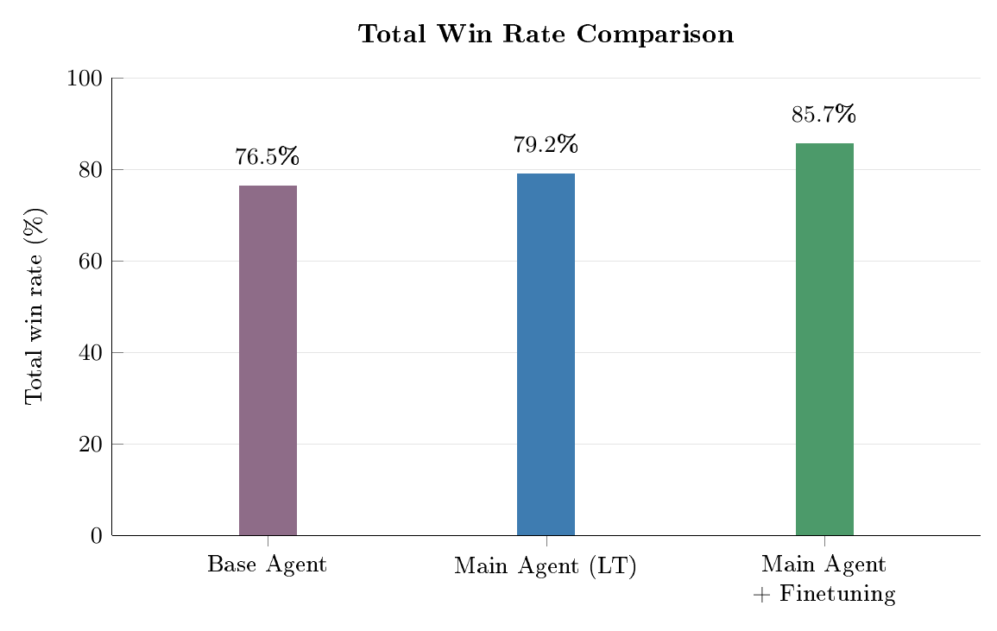
Main Quantitative Result
overall loss rate drops from 7.7% to 2.2%
13 / 23

Slide 14
Evaluation Results
Opponent
Main Agent without new initial agents
Base Agent
Main Agent (LT)
Main Agent + Fine-tuning
bots used in training
CoacAI
100.0
96.0
100.0
100.0
Mayari
100.0
67.3
100.0
100.0
Built-in bots
WorkerRushAI
31.0
100.0
35.0
99.5
PassiveAI
100.0
99.7
100.0
100.0
LightRushAI
100.0
98.0
100.0
100.0
RandomAI
100.0
99.0
100.0
100.0
RandomBiasedAI
91.0
79.0
97.0
97.5
Other bots
Rojo
100.0
81.0
100.0
100.0
MixedBot
45.0
43.3
57.0
60.5
Izanagi
68.0
71.7
70.0
72.5
Tiamat
94.0
93.0
99.0
99.0
Droplet
45.0
67.7
62.0
75.5
GuidedRojoA3N
64.0
74.7
87.0
88.5
NaiveMCTS
0.0
0.7
2.0
6.5
overall
74.1
76.5
79.2
85.7
14 / 23

Slide 15
Evaluation Results
Opponent
Main Agent without new initial agents
Base Agent
Main Agent (LT)
Main Agent + Fine-tuning
bots used in training
CoacAI
0.0
2.0
0.0
0.0
Mayari
0.0
27.3
0.0
0.0
Built-in bots
WorkerRushAI
63.0
0.0
55.0
0.5
PassiveAI
0.0
0.0
0.0
0.0
LightRushAI
0.0
2.0
0.0
0.0
RandomAI
0.0
0.0
0.0
0.0
RandomBiasedAI
0.0
0.0
0.0
0.0
Other bots
Rojo
0.0
5.3
0.0
0.0
MixedBot
33.0
34.3
20.0
13.5
Izanagi
15.0
16.3
7.0
6.0
Tiamat
6.0
7.0
1.0
0.5
Droplet
22.0
9.0
22.0
10.5
GuidedRojoA3N
0.0
1.7
0.0
0.0
NaiveMCTS
0.0
2.7
0.0
0.0
overall
9.9
7.7
7.5
2.2
15 / 23

Slide 16
Interpretation of the Results
hypothesis:
LT turns robustness against diverse opponents into part of the optimization target
LT helps to find a better local optimum that is then further improved by fine-tuning, while pure PPO often gets stuck in not as generalized local optima.
16 / 23

Slide 17

Player 1 Priority
Observation
MicroRTS gives player 1 action priority, so a potential concern is that self-play style training could accidentally favor player-1-specific behavior.
Result from the thesis
In one self-match evaluation of the same agent over 200 games, player 1 achieved 38% wins, 28% draws and player 2 achieved 34% wins.
minimal effect on evaluations
alternating the learning side to prevent the agent from exploiting player-1-specific priority
17 / 23

Slide 18
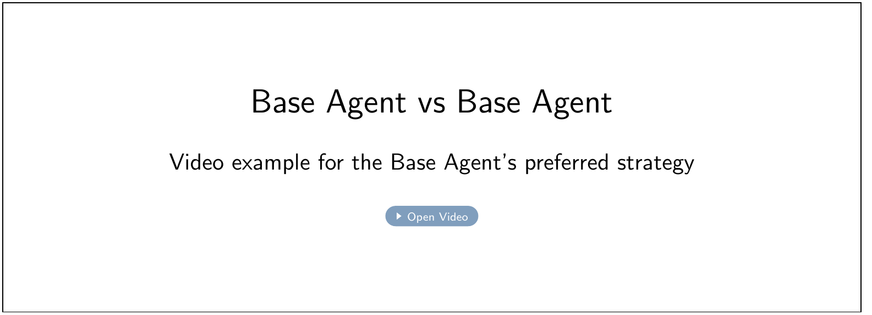
Main Limitation: Diversity
18 / 23

Slide 19
Main Limitation: Diversity
Exploiters initialized from similar policies tend to discover similar weaknesses.
Some strategically different exploits are hard to reach because they require first unlearning the Base Agent's preferred behavior.
New initial agents with focuses on different unit types to improve exploiter diversity and Main Agent generalization.
Hypothesis: LT therefore depends strongly on the diversity already present at initialization
19 / 23

Slide 20
Scope and Remaining Limitations
evaluation is limited to one map: basesWorkers16x16A
the setting uses full observability and no fog of war
high computational cost
exploiter diversity
Takeaway
The method works, but the strength of the final result depends strongly on the diversity and cost of the training setup.
20 / 23

Slide 21
Future Work
train on multiple maps and with fog of war
improve the diversity and strength of initial agents
reduce computational cost of MicroRTS training
investigate stronger diversity mechanisms for exploiters
21 / 23

Slide 22
Conclusion
Conclusion
LT with PPO improves the robustness and generalization of the MicroRTS Base Agent. Additional PPO fine-tuning improves the final agent even further.
Key takeaway
The effectiveness of LT depends strongly on exploiter diversity, which in turn depends on the diversity of the initial agents and BC experts.
LT improves most matchups and the overall performance
fine-tuning further improves the final agent
diversity of initial agents is the critical practical factor
22 / 23

Slide 23
Thank you
Questions?
23 / 23

