Slide 1
Quiz
Q1. Why might I not want to perform slice-timing correction?
Q2. What spatial registrations do we apply in fMRI preprocessing? (3 total)
Notes:
Q1. We might not want to do this if we have a low TR. If the TR is low, then the slice timing differences will also be small – to the extent that they wont have a meaningful influence on the modeling.
Therefore we may decide that it isnt worth doing the interpolation and introducing errors when slice timing errors are not that big in the first place.
Q2.
1. One would be the registration of all functional volumes to the middle functional volume (motion correction)
2. Another would be the registration of the functional image to the subjects high resolution structural image.
3. Another would be the registration (and normalisation) of the structural image and the tstandard brain (e.g. MNI brain).
By combining 2 and 3, we take the functional data into standard space – which we could also consider another registration.

Slide 2
Quiz
Q3. What temporal transormations might we apply to fMRI data?
Q4. What is the point in spatial smoothing?
Notes:
Q3. This could include slice-timing correction, high pass temporal filtering and low pass temporal filtering.
Q4. This serves two purposes:
It enhances the influence of what is probably signal (clusters of activation can blur into one another) and reduces the influence of what is probably noise (isolated voxels do not have neighbouring activations to blur into them).
It can increase the extent of activations, increasing the chances of overlapping activations between subjects.
Both of these functions increase the signal to noise ratio and statistical power (our ability to detect effects).

Slide 3
Quiz
In my design matrix (X) I have a regressor that codes the presence of bodies, scenes and text (and an intercept). We end up with the followng betas after fitting.
Q3. What hypothesis does the contrast [1, 0, 0, 0] evaluate?
Q4. What is the dot product of β and the contrast vector?
β
Voxel no
Β Bodies β Scenes β Text β Intercept
10 3 2 1
8 2 1 3
7 4 4 9
β
10 3 2 1
8 2 1 3
7 4 4 9
C
1 0 0 0
Notes:
Q3. This would allow us to evaluate the hypothesis β (bodies) == 0. Re-phrased, in english this would be “Bodies have no influence (β(bodies) ==0) on the signal (y)”
Q4. This gives us the first column x 1 and the remaining columns x 0. If we sum this, we just get the first column.

Slide 4
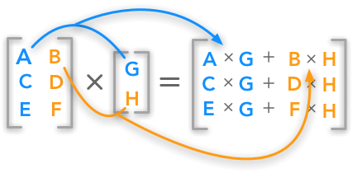
Quiz
Q5. What linear prediction has this model made?
X
10 3
8 2
7 4
β
2 1
Notes:
Q5. To get Yhat (our prediction), we multiply each column of X (our design matrix) by its corresponding beta and take the sum (i.e. a dot product). This gives us: [23, 18, 18]

Slide 5
Quiz
Q6. Now we know the predictions (23, 18, 18), what is the SSE of the model?
Y
25 16 16
Notes:
Errors are -2, 2, 2
Squared errors are 4, 4 , 4
Sum of squared errors: 12

