Slide 1
EDA on ABC news Dataset
By:-
Harish Natarajan
Dereck Jos
Omkar Mahadik
Guided by:
Prof. Manivannan

Slide 2
Table Of Content
Table Of Content
Introduction
Project Objective
UML Diagram
Package Diagram
Sequence Diagram
Existing vs Proposed system
Future Plans

Slide 3
Introduction
Exploratory data analysis (EDA) is an approach using descriptive statistics and graphical tools to better understand data.
It is used mainly to maximize insight into a dataset, detect outliers and anomalies, and test underlying assumptions.
EDA is an important step in data mining as it is the first step to model building.

Slide 4
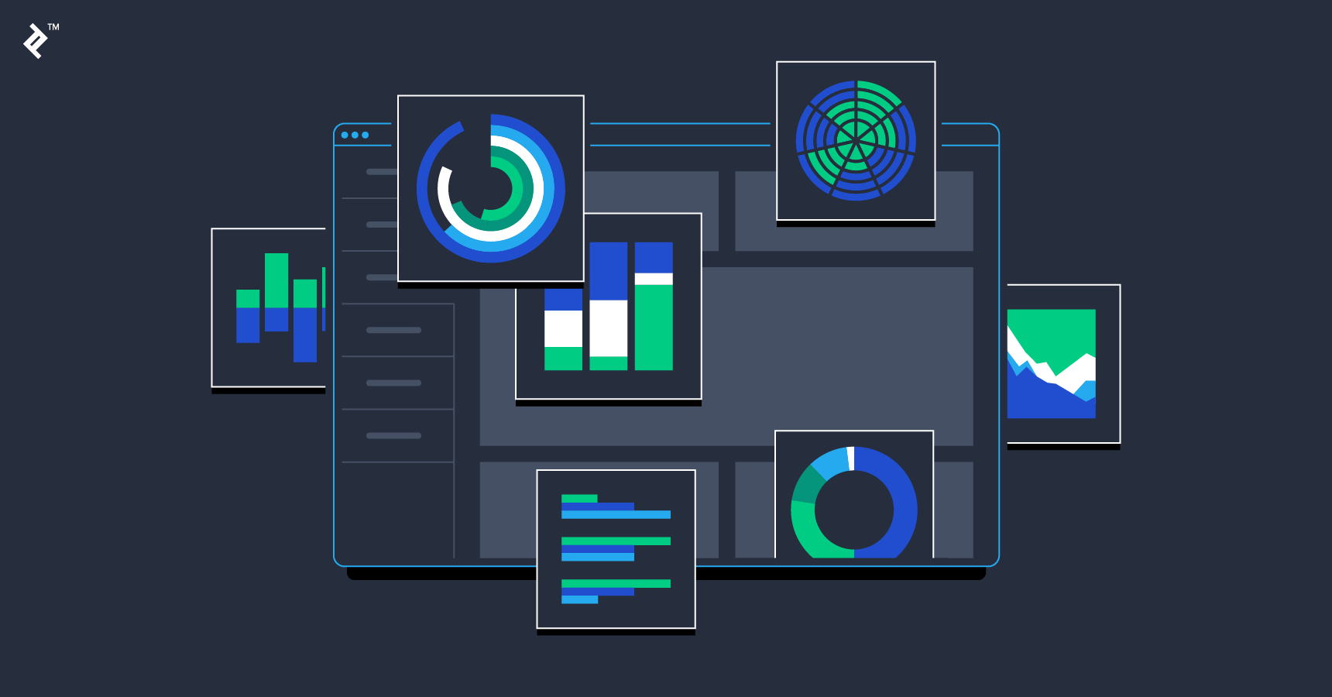
Project objective
The project aims to provide a visual analytics of news dataset by means of stop words and non-stop words plot, Topic modelling (i.e. classifying which news belongs to which topic) , Word-cloud (i.e. visualizing the most frequent words), Also Unsupervised Sentiment analysis models such as Affin Lexicon, Vader Lexicon and Textblob which uses word-list method to calculate the polarity and the sentiment of the given news headline as well as the text taken from user.

Slide 5
WHAT IS UML?
A UML diagram shows the unified visual presentation of the UML (Unified Modeling Language) system intending to let developers or business owners understand, analyze, and undertake the structure and behaviors of their system. So far, the UML diagram has become one of the most common business process modeling tools, which is also highly significant to the development of object-oriented software.

Slide 6
APPLICATION OF UML:
UML diagramming has many benefits for both software developers and businessman, and the most key advantages are:
Complex applications need collaboration and planning from multiple teams and hence require a clear and concise way to communicate amongst them.
Improve Productivity - By using the UML diagram, everyone in the team is on the same page and lots of time are saved down the line.
Businessmen do not understand code. So UML becomes essential to communicate with non programmers essential requirements, functionalities and processes of the system.

Slide 7
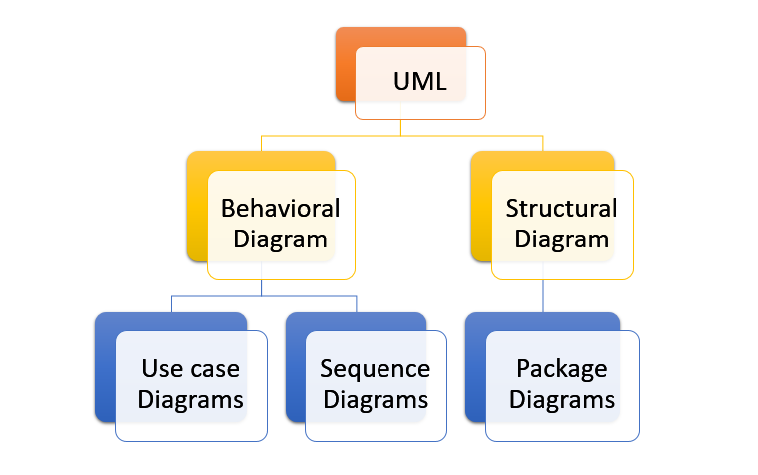
Types of UML used:

Slide 8
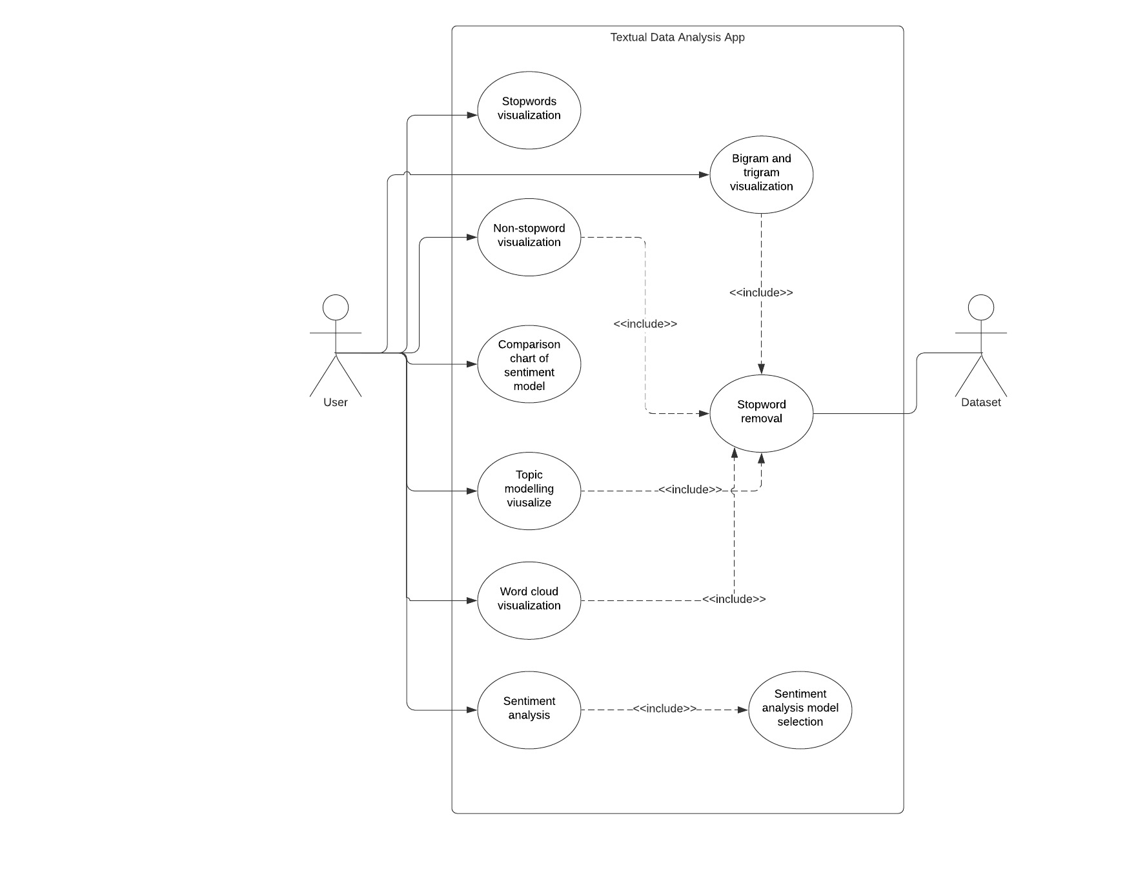
USE CASE DIAGRAM
The use case diagram alongside shows two actors ‘user’ and ‘dataset’ interacting with the system. The user has option to perform following activities:
Stop-word visualization
Non stop-word visualization
Bigram plot
Word cloud visualization
Topic modelling plot
Sentiment Analysis

Slide 9
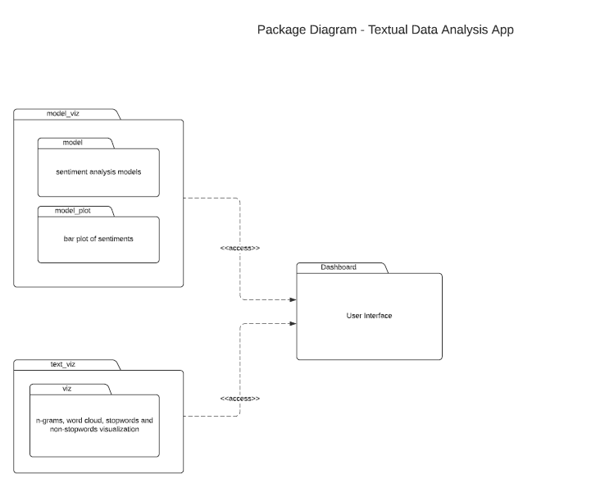
PACKAGE
DIAGRAM
Package diagram is UML structure diagram which shows structure of the designed system at the level of packages. The package diagram alongside shows two packages ‘model_viz’ and ‘text_viz’. Module ‘model_viz’ is responsible for sentiment analysis and ‘text_viz’ is responsible for text analytics. The ‘Dashboard’ package access the content of both packages to display plots to user

Slide 10
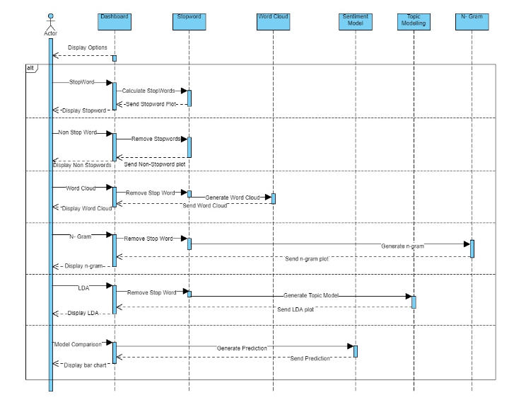
Sequence Diagram

Slide 11
Existing vs Proposed System
Existing | Proposed
In this system all components such as sentiment analysis, Data visualization ,Topic Modelling work individually | This is a unified system consisting of components such as sentiment analysis, Data visualization ,Topic Modelling
Single model is used for predicting sentiment | Three different model are used for predicting the sentiment
User is restricted to a single model | User is not restricted to a single model
There is no comparison between lexicon models | There is comparison between three lexicon model

Slide 12
Future Plans
Currently we are using static dataset ( i.e. csv file in local machine) in future we will integrate with Twitter , Facebook and Redit API.
Currently we are not making use of database/firebase. So in future we would make dynamic dashboard using above components.
Currently our web app is not supporting multi-lingual data. In future we will integrate with cloud for supporting this feature.
Currently this system is web-app , in future we would convert it into android app.

Slide 13


